Slide 1
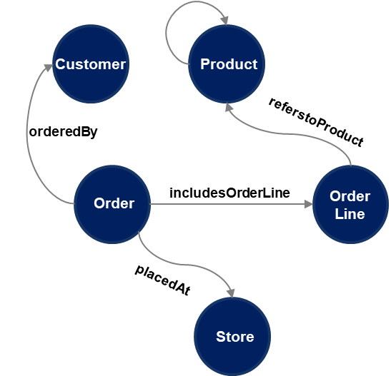
Demo - Accelerate New Value
Insights From Interconnected Entities
📌 Help in increasing sales and drive customer experience - e.g. Provide personalized recommendations to a customer that will improve their experience
🧩 Question:
Which products were the most influential in driving co-purchases at the Uppsala store, and how should we promote or bundle them?

Slide 2
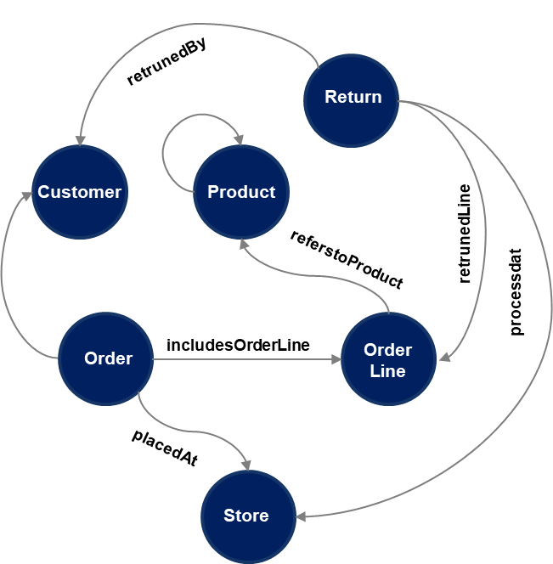
Demo - Insights from disjointed data
Insights from disjointed data
📌 Bringing together disjointed data like orders, returns, and customer profiles to uncover behaviors that are otherwise hidden
🧩 Question:
Which customers are returning items most frequently relative to their purchase? Show customers’ behaviour in terms of total orders, total returns, and their return rate.

Slide 3
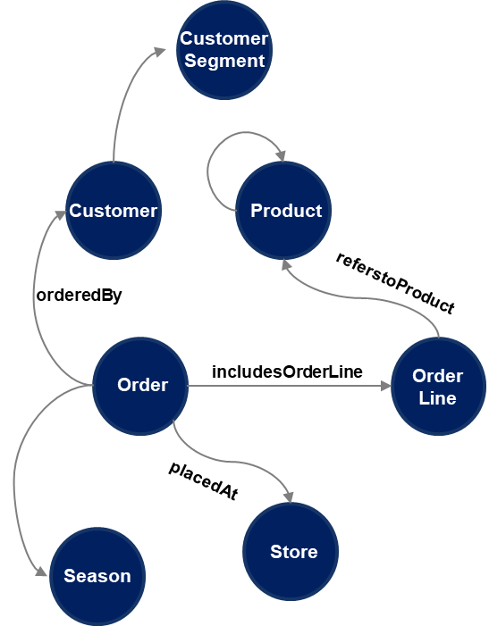
Demo - Unearth trends or warnings
Insights that are not explicit
📌 Spotting emerging trends or early warning signs — insights that are not explicit but are critical to strategic outcomes.
🧩 Question:
Are my high-value customers purchasing less frequently by comparing the number of orders they placed across the Summer and Autumn seasons?

Slide 4
Demo - Operational Questions
📌 Quick answers to everyday business questions that help store or category managers make decisions based on historical data.
🧩 Question:
Which products in each category had the highest sales in March 2023 at the Store Stockholm?

