Slide 1

Introduction to Version Control System(VCS)
Faizul b. Hadiman

Slide 2





Git and Github?
Git (cranky old man) – VCS tools
Created by Linus Torvald to do version control on Linux kernel
Github – Online repository

Slide 3
Why git + github?
Team collaboration
Rollback changes
Proper documentation + code management
Handle large project

Slide 4
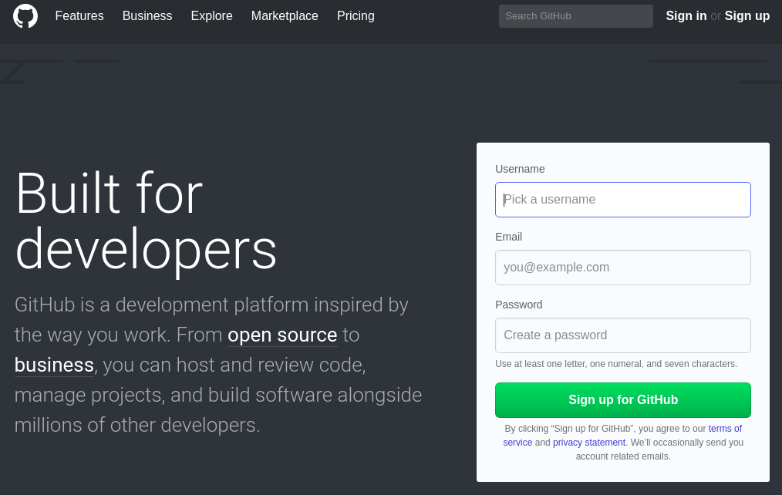
Create github account
Go to github.com

Slide 5
Install git
Mac - http://git-scm.com/download/mac
Windows - http://git-scm.com/download/win
Linux – Ubuntu/Debian → sudo apt install git
      Gentoo → sudo emerge --ask git
      Fedora/RedHat → sudo dnf install git

Slide 6
Github vs Bitbucket
Github – free open source/public repo
Bitbucket – free private repo
Gitlab - ???????????????

Slide 7
Code, Commit, Push! Git command Example
Cd to project directory
git init
git add .
git commit -m "commit message"
git remote add origin https://github.com/{profile/repo_name}
git push -u origin master

Slide 8
Git clone
Git clone <url/to/repo>
https://github.com/HackMyCampusUCTS/gitintro

Slide 9

Thank you
github.com/fyezool
github.com/InnovateUCTS

