Slide 1
Op System for Embedded App
Unit 2: Virtualization

Slide 2
Content
Intro
Process
Process API
CPU Virtualization
Limited Direct Execution
Scheduling
Memory Virtualization

Slide 3
Intro
Originally a computer performs one task
Input
Run
Output
An operator will wait for the task to complete and load the next task
Operate the System
Operating System will replace the manual operator
Improvements made to
run multiple processes
better use all the resources
Save programs and data between runs
Virtualization
Make each process believe it has all the resources

Slide 4
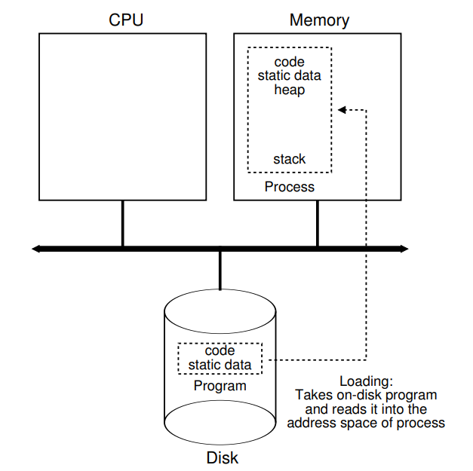
Process/Task
Process = running program
Problem: running multiple programs
Time sharing of CPU
Process
Memory
Address space
Registers:
program counter (instruction pointer)
Stack pointer
Stack frame pointer
Open files, IO’s
To switch between processes: save state, register context, process list for each state
struct task_struct
https://github.com/torvalds/linux/blob/master/include/linux/sched.h

Slide 5
Process/Task API
State
Running / Ready / Blocked
Init / Final
Create (fork / exec)
Load code + static data
Create stack + initiate
Allocate heap
Create file descriptors and mark open file structure: IN/OUT/ERR
Destroy (kill, exit)
Wait (wait)
Control
Suspend
Resume
sudo apt-get install manpages-dev

Slide 6
Limited Direct Execution
Share CPU
time sharing
Virtual CPU
Direct Execution -> run fast
Run natively on the CPU
Restricted Operations: User Mode vs Kernel Mode
System Call/API:
Trap / return from trap
System Call Number
Trap IRQ
table at boot time (high privilege)
Locations/addresses saved in HW
Switch Between Processes
Cooperative – wait for syscall, can use “yield” like calls
Non-Cooperative – OS in control, use timer IRQ

Slide 7


Scheduling
FIFO
SJF: Shorter Job First
STCF: Shorter Job to Completion First
RR: Round Robin
Time slice
Timer IRQ every X ms
MLFQ: Multi Level Feedback Queue
RR on many diff priority queues
R1. P(A) > P(B) => A runs
R2. P(A) = P(B) => RR
R3. start all tasks at highest priority level
R4. if I/O before time slice => keep same priority
Starvation / Gamming (fix: after some time drop priority anyway)
R5. after some time move all jobs to highest priority
A
B
C
C
A
B

Slide 8
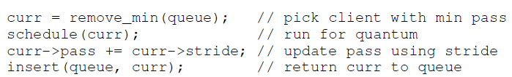
Scheduling – Proportional Share/Fair Share
Different metric: guarantee a percentage
Lottery (simple)
Tickets
"currency" per user
temporary transfer
temporary inflation
Stride scheduling
UserStride = N/#UserTickets

Slide 9
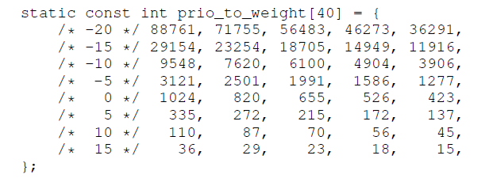


Scheduling – Proportional Share/Fair Share
CFS: Completely Fair Scheduler
CPU time evenly divided
Performance vs fairness (sched_latency, min_granularity)
Time slice = max(sched_latency/#processes, min_granularity)
Per process vruntime
Pick the process with the lowest vruntime
Niceness/weight
Binary tree based on vruntime

