Slide 1
DAVI ASSIGNMENT CA2 Singapore’s Land Public Transport
Cai Ruizhe DAAA/1b/01

Slide 2
TABLE OF CONTENT
Objectives
DATA Processing
01
02
Data analysis
Conclusions
03
04
Objective and Approach
Data cleansing into useful data points
Data visualization using seaborn and plotly
Insights and Recommendations

Slide 3
Objective
Project overview
01
"Singapore has created a best-in-class public transport system, which is accessible, efficient, convenient, sustainable, and at the same time affordable” - The 2018 report by consulting firm McKinsey titled “Elements of Success: Urban Transportation Systems of 24 Global Cities”
In this analysis, I will focus more on the accessibility to Singapore Public Bus System. With the following 2 objectives to be achieved:
To assess Singapore public bus system accessibility on country level
To compare the difference in the accessibility of the bus system between old towns and new towns

Slide 4
2.1 Data sources
Data processing
02
Total 5 datasets being used for this analysis (including the given one)
Dataset 1:
Master Plan 2019 Subzone Boundary (No Sea)
(https://data.gov.sg/dataset/master-plan-2019-subzone-boundary-no-sea)
Dataset 2:
Annual Age Distribution of Buses
(https://datamall.lta.gov.sg/content/datamall/en/static-data.html)
Dataset 3:
Singapore Housing Dataset
(The dataset from CA1 im not sure where you got it from)
Dataset 4:
Bus Arrival
(https://datamall.lta.gov.sg/content/datamall/en/dynamic-data.html)

Slide 5
DATA processing
02
Data Cleansing into useful data points

Slide 6
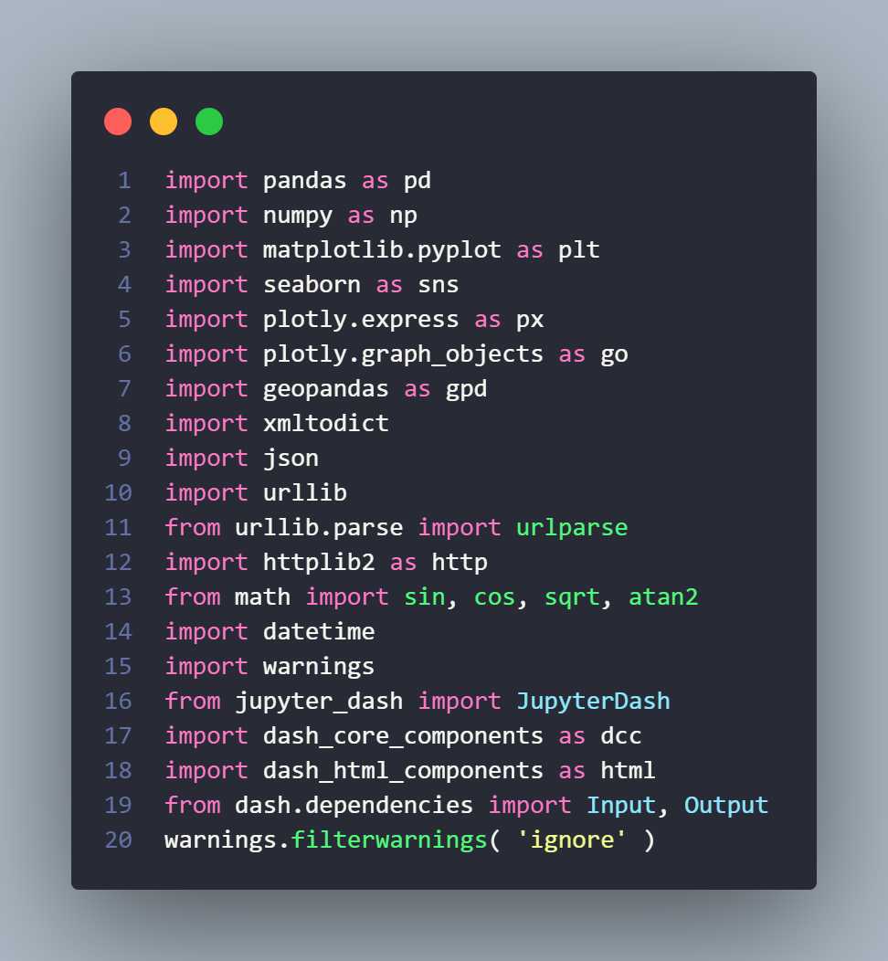

2.2 Cleansing process
Data processing
02
For the cleansing and analysis, following modules are used:

Slide 7

2.2 Cleansing process – Dataset 1
Data processing
02
For the first dataset
(GeoJSON subzone file)
Data was in usable condition so no cleansing was done
For wrangling, convert the xml elements into dict using xmltodict.parse so it is usable. This dataset was used as a region indicator to distinguish towns

Slide 8
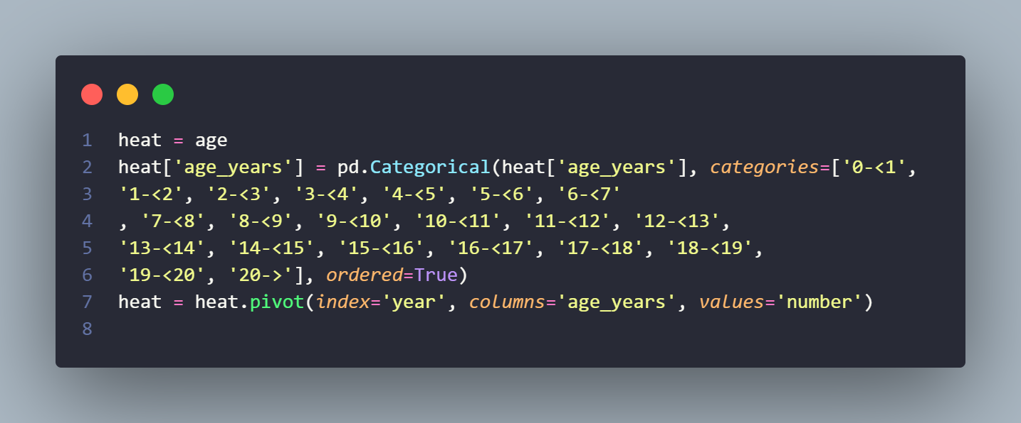
2.2 Cleansing process – Dataset 2
Data processing
02
For the second dataset
(Bus Capacity)
Data was in usable condition so no cleansing was done
Categorical() and pivot() pandas function was used to convert column into suitable format for plotting a heatmap

Slide 9
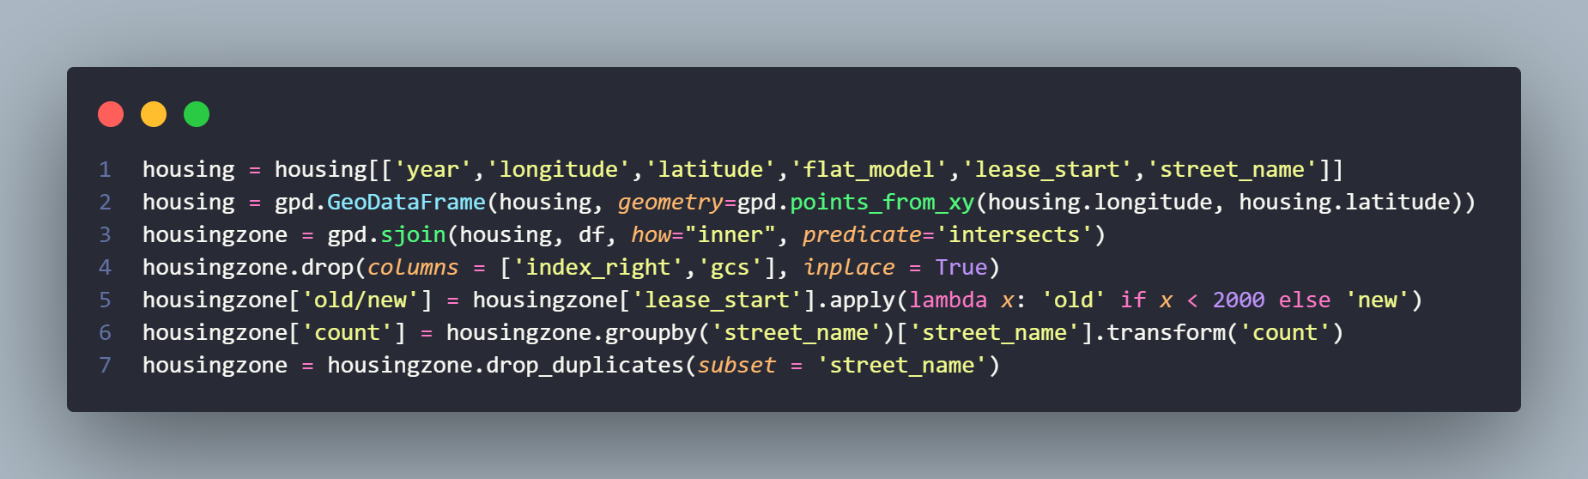
2.2 Cleansing process – Dataset 3
Data processing
02
For the third dataset
(Singapore Housing Dataset)
Dropped unused columns, converted Dataframe to a GeoDataFrame, sjoin with dataset with Town polygons to define Town.
Count And Split HDBS into neighbourhoods based on streetname, summarize units per neighbourhood into column “count”
Drop Duplicated Columns

Slide 10
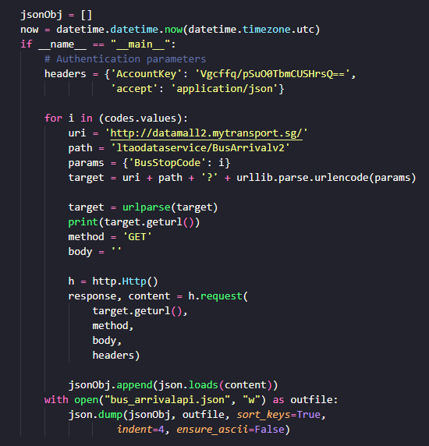
2.2 Cleansing process – Dataset 4
Data processing
02
For the fourth dataset
(Dynamic Bus Arrival Times)
Use HTTP and urllib library to send a GET request to API and get bus arrival timings, store data into a JSON file

Slide 11

2.2 Cleansing process – Dataset 4 (ii)
Data processing
02
For the fourth dataset
(Dynamic Bus Arrival Times)
Read JSON file into a dataframe and remove the first row of the dataframe Create an empty list called to store the arrival times, Use nested loop to get the estimated arrival times for each bus and store in list. Append the list into the another list Use another nested loop to convert the string representation of the arrival time into a seconds and calculate the time taken for arrival(with time taken before I send the requests)
Convert difference in timings into minute format

Slide 12
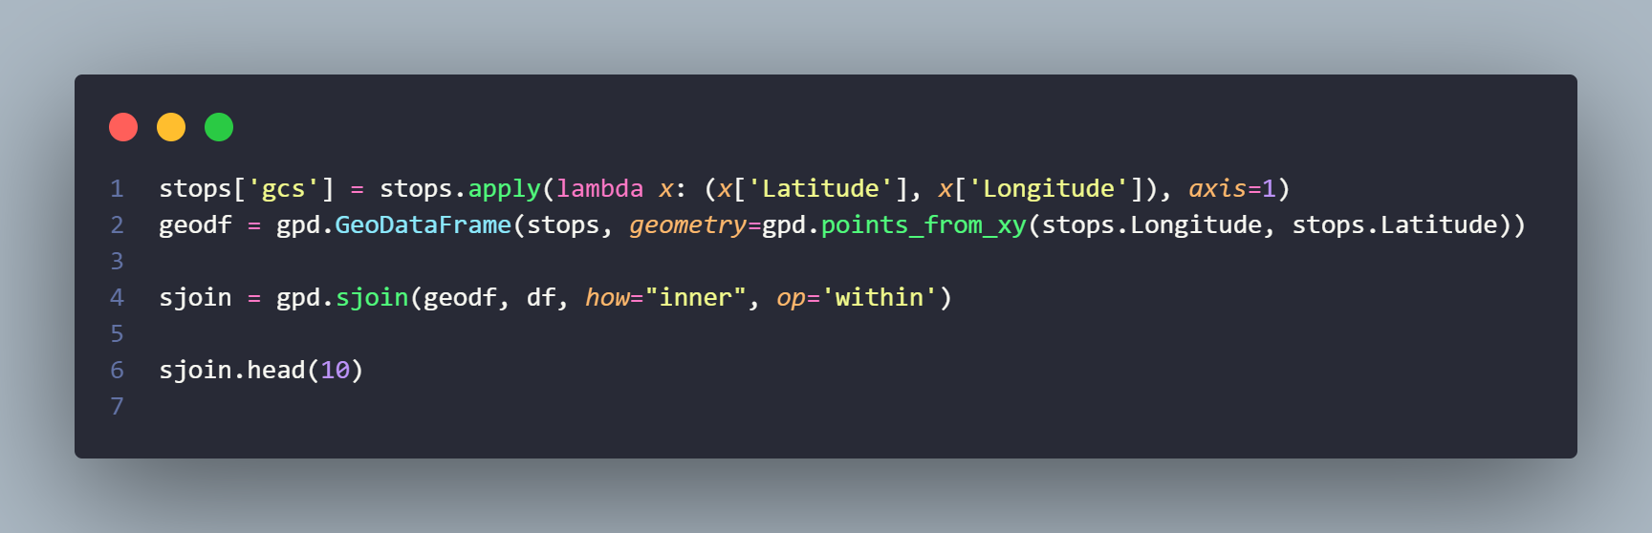
2.2 Cleansing process – Dataset 5(stops)
Data processing
02
For the fifth dataset
(Bus dataset that was given)
Use sjoin for stops data with Town region dataframe to define ‘Description’ column which represents town

Slide 13

2.2 Cleansing process – Dataset 5 (routes)
Data processing
02
For the fifth dataset
(Bus dataset that was given)
Replace – with NAN so dropna will drop routes for bus services with missing First bus and Last bus (Night buses)

Slide 14
2.2 Cleansing process – Dataset 5 (services)
Data processing
02
For the fifth dataset
(Bus dataset that was given)
Didn’t use this dataset

Slide 15
DATA analysis
03
Derive insights based on processed data

Slide 16
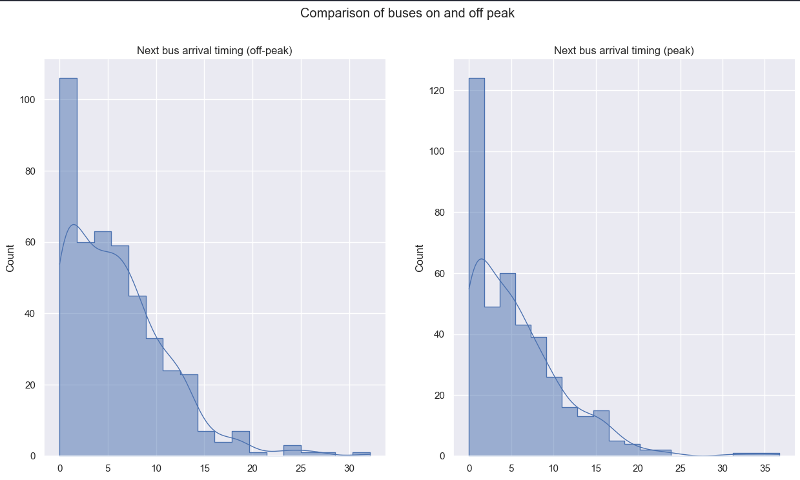
Singapore PUBLIC BUS ACCESSIBILITY ANALYSIS – Country level
Data analysis
03
Singapore Bus Frequency analysis
A metric to measure public bus accessibility is “Bus frequency”, which indicates the waiting time for the next bus.
The government and public transport operators in Singapore are able to provide frequent and reliable bus services, with waiting times of less than 10 minutes on most bus routes during peak hours and off peak hours with peak hours having majority of the buses arriving in less than 5 minutes. As shown in the charts, which was measured at 5:34 pm 7/2/2023 for peak and 10:44 7/2/2023 for offpeak.
This makes public transport a more attractive and convenient option for passengers and results in improved public bus accessibility.

Slide 17
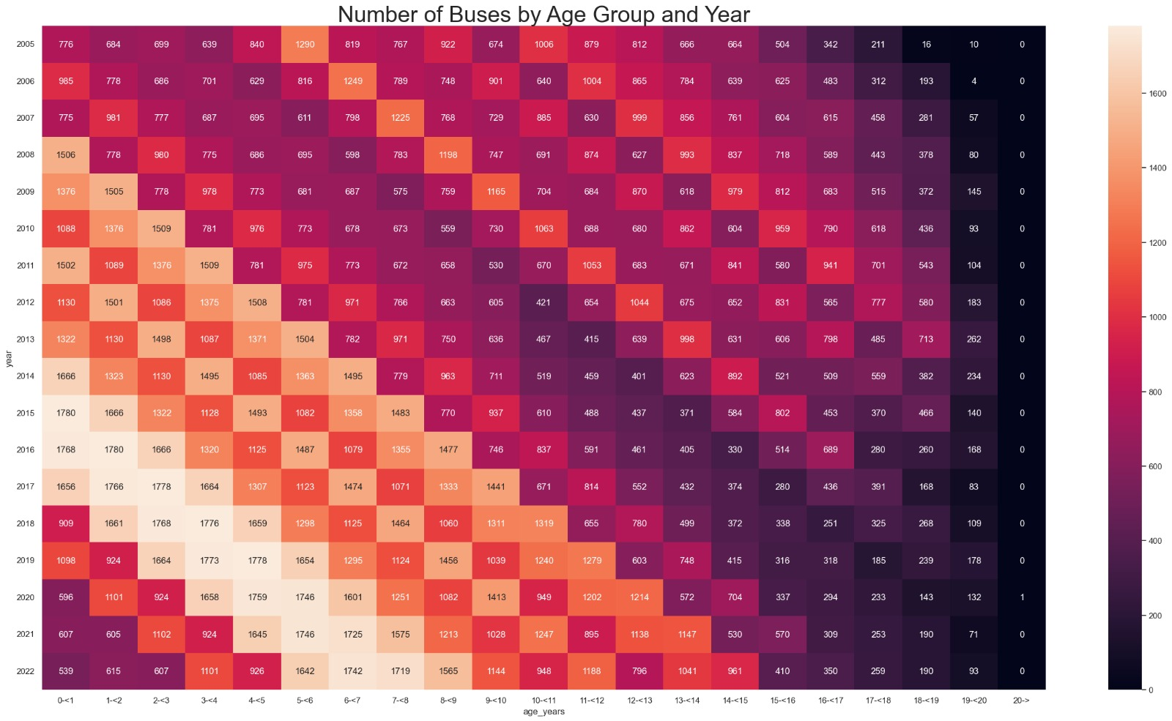
Singapore PUBLIC BUS ACCESSIBILITY ANALYSIS – Country level
Data analysis
03
Singapore Bus age analysis
Another metric to measure public transport accessibility is “Transport Quality”. Older buses may be less reliable and less equipped with modern amenities such as air conditioning, making bus travel less attractive to passengers. Additionally, older buses may require more frequent maintenance and repairs, leading to disruptions in bus services and longer wait times for passengers.
As shown in the chart, Singapore government invested in alot of new buses in 2014 and 2015, however that was more than 5 years ago and the buses now are of course older, less reliable and would be of lower quality. So I believe that the government should start investing in new buses

Slide 18
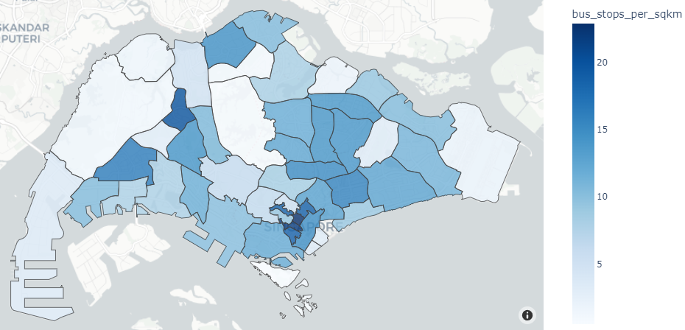
Singapore PUBLIC BUS ACCESSIBILITY ANALYSIS – Country level
Data analysis
03
Singapore Bus Stop Density analysis
Another one of the metrics to measure public bus accessibility is “Bus stop density”, which measures the number of bus stops per unit area and indicates availability of bus stops near a location.
As shown in the map, different areas of Singapore have differing numbers of bus stops, with darker regions having more bus stops.
The Singapore Public transport system has a far reach and every region of Singapore is accessible by bus.
However why do you think The number of bus stops differ for certain regions?

Slide 19
Objective 2
To compare the difference in the accessibility of the bus system between old towns and new towns

Slide 20
Singapore PUBLIC BUS ACCESSIBILITY ANALYSIS – town level
Data analysis
03
Singapore Bus Stop Density analysis
As seen from this graph from the previous Objective, there is a wide range of distribution for the bus_stops_per_sqkm in different Towns in Singapore.
That led me to think about all the possible causes for this situation, and I came up with the hypothesis.
Hypothesis:
The accessibility of the bus system in each Town is different based on the age of the town.
So in order to procede with this test, I picked out two towns one considered relatively newer which would be Punggol and one considered relatively older which would be Bishan.

Slide 21
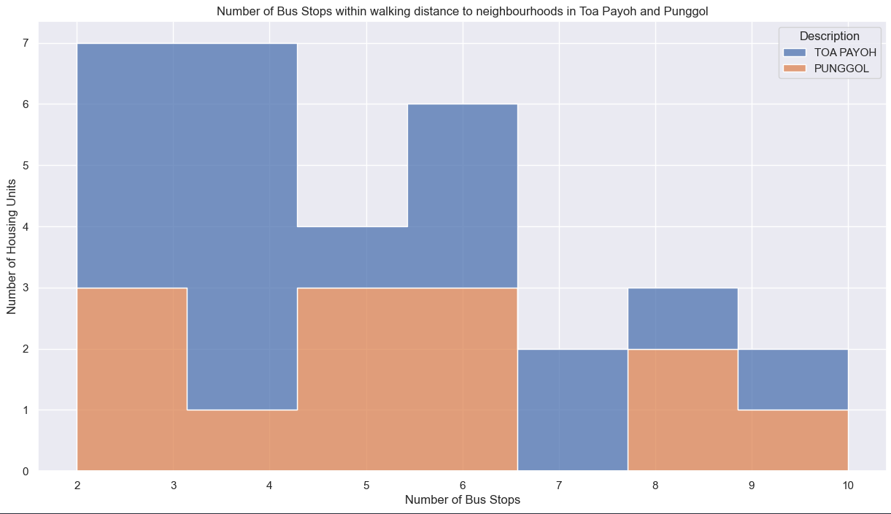
Singapore PUBLIC BUS ACCESSIBILITY ANALYSIS – TOWn level
Data analysis
03
So firstly let us take a look at how practical the bus systems in these regions are.
This histogram shows the distribution of bus stops that I consider “accessible” (within 300m) to the neighbourhoods in each Town
As you can see Neighbourhoods in Toa payoh tend to have more Bus Stops that can be accessed within 300m.
However this does not mean much as just because there are more bus stop that are accessible, doesn’t mean that the system in that town is necessarily more useful

Slide 22
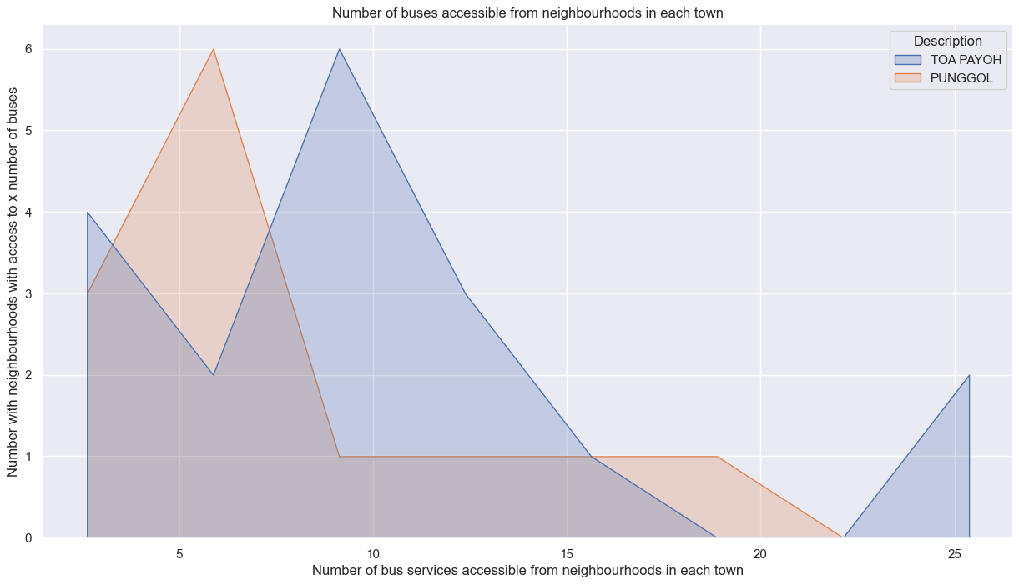
Singapore PUBLIC BUS ACCESSIBILITY ANALYSIS – TOWn level
Data analysis
03
To gain a deeper level of understanding, we will be looking into the amount of bus services that are accessible instead.
As seen from this graph, there are generally more bus stops that have access to more bus services available to Toa Payoh residents. There is even a neighbourhood which has access to more than 20 bus services, which I would assume means that the bus interchange is within close reach
Therefore it can be said that the bus system in Toa Payoh, the older town is more practical as it is generally more flexible as there are more bus stops and services to choose from.

Slide 23
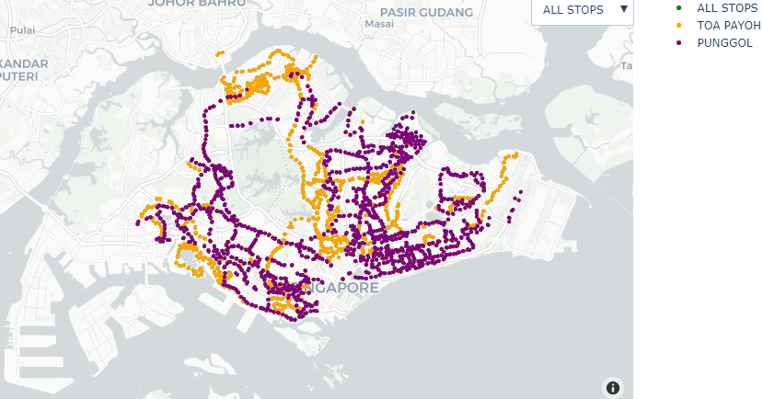
Singapore PUBLIC BUS ACCESSIBILITY ANALYSIS – TOWn level
Data analysis
03
This is a map of the areas that can be accessed through Buses in the respective towns.
Due to Singapore being a small country and having a well developed public transport system, majority of the island can be accessed by buses accessible to residents living in each town, however clearly there are some flaws such as buses from punggol do not have as wide a reach as buses from toa payoh, and as punggol has fewer bus services available although most places are accessible, efficiency might be an issue as if your destination is across the entire island, it is likely that the bus will take a huge detour before reaching your destination.

Slide 24
Singapore PUBLIC BUS ACCESSIBILITY ANALYSIS – TOWn level
Data analysis
03
Based on the data visualizations and analysis performed, it can be concluded that the accessibility of the bus system in each town is different based on the age of the town.
For example, the older town of Toa Payoh has a more densely populated bus stop network compared to the newer town of Punggol. This suggests that the accessibility of the bus system in Toa Payoh is higher compared to Punggol, likely due to the older age of the town, the public transport system in that area was likely able to develop along with the development of overall Singapore’s public transport system where as in the newer town, Punggol many bus services were likely introduced just to accommodate for the residents of the new town making it more sloppy in a sense.
In conclusion, the data visualizations and analysis performed provide evidence that supports the hypothesis that the accessibility of the bus system in each town is different based on the age of the town.

Slide 25
Conclusion
04
Insights and Recommendations

Slide 26
Issues/solutions – objective 1
MENU
ANALYSIS
CONTACT
Conclusion
Although Singapore’s Public transport system can be said to be of high quality, nothing in this world is perfect so clearly there are some flaws, this includes the age of the buses in recent years.
As the years go on, buses will clearly age and it is important to pay regular attention to this so as to uphold the high quality of the public transport system.
As stated in the analysis before, the buses in Singapore are getting older, and majority of them are over 6 years of age. As buses usually have a life expectancy of 15-20 years, It will be a good idea to introduce new buses to the public transport system within the next few years

Slide 27

Issues/solutions – objective 2
MENU
ANALYSIS
CONTACT
Conclusion
As stated in the hypothesis testing scenario’s conclusion previously, the bus system in newer towns have relatively lower accessibility compared to older towns.
So my recommendation for this is for the government to develop more new bus services when accommodating for these new towns so that these can be even more “connected” to the areas in Singapore.
This is extremely important for newer towns as in recent times many of the new towns being developed are In the extreme ends of Singapore (with the exception of Tengah), meaning that the existing bus system in those areas will have less accessibility

Slide 28
references
https://www.sciencedirect.com/science/article/pii/S1877705816000412?ref=cra_js_challenge&fr=RR-1
https://www.hdb.gov.sg/cs/infoweb/about-us/history/hdb-towns-your-home/punggol
https://www.hdb.gov.sg/cs/infoweb/about-us/history/hdb-towns-your-home/toa-payoh
Datasets
https://datamall.lta.gov.sg/content/datamall/en/dynamic-data.html
https://datamall.lta.gov.sg/content/datamall/en/static-data.html
https://data.gov.sg/dataset/master-plan-2019-subzone-boundary-no-sea

