Slide 1
Design Relationship between Classes

Slide 2
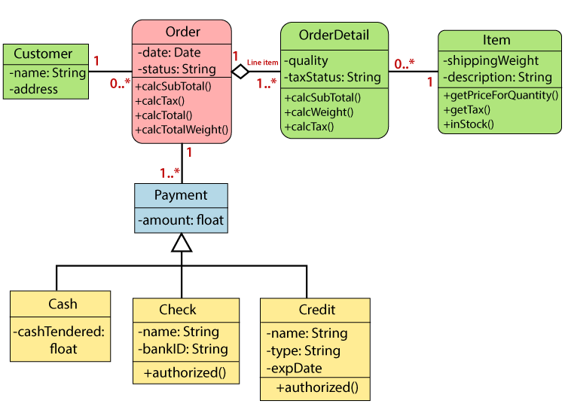
Relationships
To represent real-world interactions between different entities or objects, we need to have links (define relationships) among objects. By defining these relationships, we can create more accurate, efficient, and maintainable software designs.

Slide 3
Types of Relationships
There are several types of relationships that can exist between classes or objects. Here are the most common ones:
Inheritance: This is a "is-a" relationship between a base class (the parent) and a derived class (the child). The derived class inherits all the public and protected members of the base class. For example, a "Dog" class could be a derived class of a more general "Animal" base class.
To show inheritance in a class diagram, a solid line from the child class to the parent class is drawn using an unfilled arrowhead.
Person
is-a
Student

Slide 4
Types of Relationships
Association: To address how objects can communicate with each other, we need to have links or association between them which allow them to communicate. This form of association between classes can be:
one to one: where one object of a class has a link to one other object of a class
one to many: where one object of a class has links with many objects of a particular class
many to many: where many objects of one class have links with many objects of a particular class.
1
A one-to-one association
1
1
A one-to-many association
*
*
A many-to-many association
*

Slide 5
Direction of message passing
Associations are generally assumed to be bi-directional. i.e. a message can pass in both directions between objects. Association represents a “uses-a" relationship.
For instance, a "Driver" class might use a "Car" class.
To show association in a class diagram, a solid line between the two classes is drawn. Both classes see each other (a driver uses a car and a car is used by a driver)
What type of association the classes Driver and Car has?
Uses-a
Driver
Car

Slide 6
Direction of message passing
Associations can be also unidirectional. i.e. a message can pass from one class to another as shown in the example bellow.
To show direct association in a class diagram, a solid line from the user class to the used class is drawn using a filled arrowhead
What type of association the classes Switch and Light bulb has?
controls
Switch
Light bulb

Slide 7
Association in applications
The following example shows a more realistic diagram
Teaches
Lecturer
*
Module
*
Teaches to
Teaches to
Takes place in
*
Contract
Classroom
The Association in a timetable example

Slide 8
Types of Relationships
Aggregation: This is a specialized form of association where a class is composed partially of another class.
The commonly used term for aggregation relationship is a "has-a" (containment). This type of relationship refers to the formation of a particular class as a result of one class being aggregated as a collection.
The lifetime of the 'part' (the object being referred to) is not managed by the 'whole' (the object doing the referring).

Slide 9
Aggregation example
For example, a “Library" object might have it's representation defined by a “Book" object. A library object is a collection of books object. However, the “Book" objects can exist independently of the “Library".
To show aggregation relationship in a class diagram, use a directional line connecting the two classes, with an unfilled diamond shape adjacent to the container class and the directional arrow to the contained class.
Book
Library
Has-a

Slide 10
Types of Relationships
Composition: Is very similar to the aggregation relationship where the 'whole' manages the lifetime of the 'part’.
The 'part' cannot exist independently of the 'whole'. For instance, a “Patient" class owns the “MedicalFile" class. Here, the “MedicalFile" class cannot exist without the “Patient".
To show a composition relationship in a class diagram, use a directional line connecting the two classes, with a filled diamond shape adjacent to the container class and the directional arrow to the contained class.
MedicalFile
Patient
Composed of

Slide 11
Example of Relationships
For example, a Seller sells Clock objects that can be thought of being composed entirely of the following parts; Hand, Face, and Accessories. A Clock has a Battery part.
Seller
sells
Clock
Has-a
Battery
Composed of
Hand
Face
Accessories

