Slide 1

Agile Threat Models: Oxymoron?
Brook S.E. Schoenfield
Author, passionate security architect, curious questioner

Slide 2
Everybody’s talking about threat models
What does “threat model” mean?
Why is “threat modelling” even important?
Can’t we just automate our security tests?

Slide 3
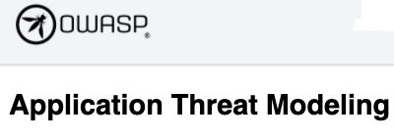
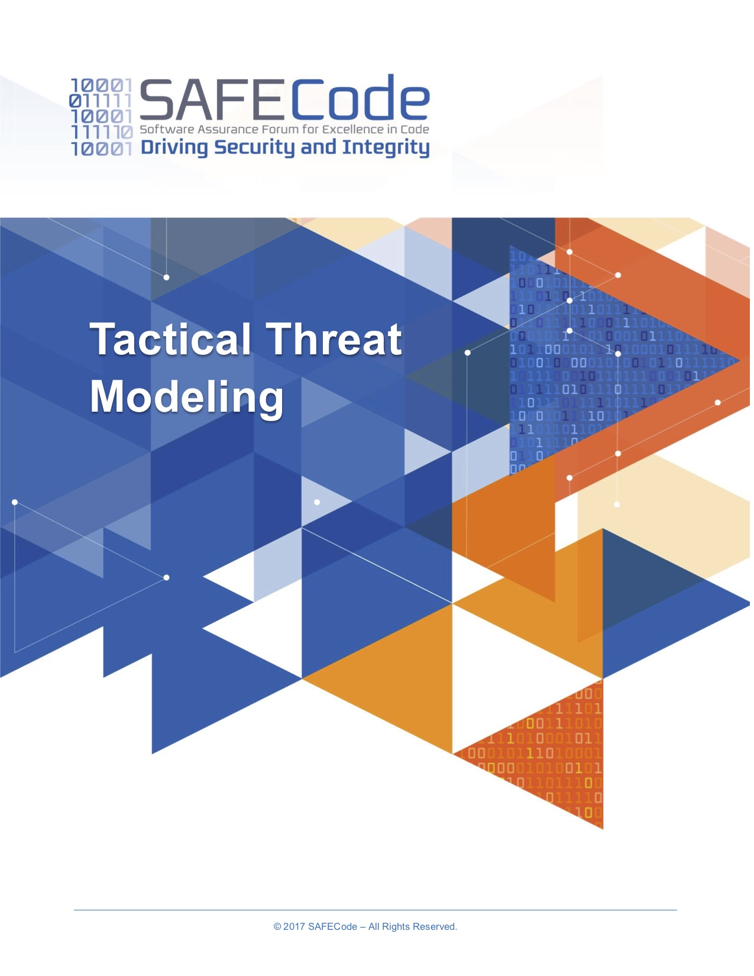
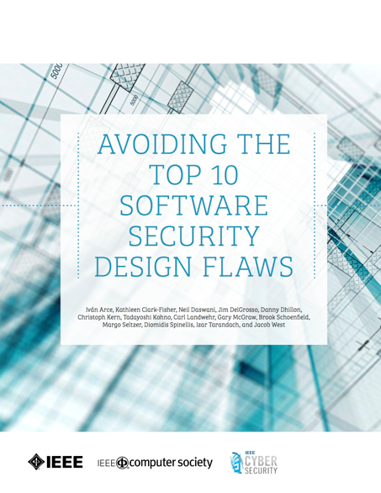
“Threat modeling is analyzing representations of a system to highlight concerns about security and privacy characteristics.”

Slide 4

Adam Shostack Asks:
What are we working on?
What can go wrong?
What are we going to do about it?
Did we do a good enough job?

Slide 5

Threat Model Analysis In a Nutshell
Apply known, successful attacks
To points on a system that attackers might reach
Gauge the potential (negative) impacts
Rate the risk for each attack scenario
To identify appropriate defenses
(Sometimes, support the implementation of the defenses)
Notes:
This presupposes that we have sufficient knowledge of the correct collection of attacks for systems of the type under analysis.
Further, threat modeling presupposes that the analyst has a broader enough understanding of security defenses to apply the right ones to prevent, slow down, or at least, alert about an attack
I like science fiction occasionally, especially when it’s written around some bits of science – a great way to explore tricky physics without attending a lecture that I probably won’t understand. But when it comes to threat modeling, the moment attack scenarios range into science fiction, start including techniques or technologies that have yet to be invented, the analysis can stop. That might be a fun mental exercise, perhaps interesting conversation? But it makes for lousy, ivory tower threat models that aren’t going to build real world defenses.

Slide 6
Secure Design
Threat model contributes to design by anticipating attacks before they occur
Threat model is an aspect of design (like performance or scalability, etc.)
However implementation specifics are identified, include (iterative) threat modelling
“[Threat modeling] allows you to pinpoint design and implementation issues that require mitigation.”
-- Threat Modeling Manifesto

Slide 7

Agile Methods?

Slide 8

Central team
Parachute into project
Find as many “flaws”¹ as possible
Generate requirements
On to next TM
Pre-release governance
Consultants/employees
Not prioritized
1. Gary McGraw’s term
Anti-agile
Never effective
“Hero Threat Modeler
Threat modeling does not depend on one’s innate ability or unique mindset; everyone can and should do it.”
-- Threat Modeling Manifesto
Notes:
The central team are usually shared across multiple functions, often highly-over-resourced (so they don’t have time to integrate with each team or project)
The process is opaque because typically the central security expert meets with only the team’s technical leaders, perhaps only the lead architect. Requirements seem to emerge essentially out of nowhere, at a point in development that was convenient to the security person and the leader(s)
Balky, defensive developers
Resistant project managers
Escalations & exceptions

Slide 9
Software security cannot be imposed.
It can only be earned through the inspired and driven efforts of many people from varied roles and specialties working together toward common goals.
James Ransome & Brook S.E. Schoenfield,
Building In Security At Agile Speed, © 2020
“Varied Viewpoints
Assemble a diverse team with appropriate subject matter experts and cross-functional collaboration.”
-- Threat Modeling Manifesto

Slide 10
Context
Constraints, especially to creativity?
Is expertise available?
Has “secure software” been defined?

Slide 11

Context: SDLC How is software developed?
Assuming Agile
DevOps?
Ci/Cd?
Epics? (who/how defined?)
“Modified” agile?
Who “designs”? When?

Slide 12

“Threat modeling must align with an organization’s development practices.” -- Threat Modeling Manifesto
Integrate organically, naturally

Slide 13
Design occurs as a part of implementation?
Threat model unfolds with implementation

Slide 14

Design occurs before implementation?
Threat model is a key contributor to design

Slide 15

Threat model after design is complete?
Probably rework

Slide 16
DevOps
DevOps
Create
Interdependent infinite loops
Continuous activity
Plan
Verify
Monitor
Goals +
Feedback
Package
Configure
Release
Image © redmine.com
James Ransome & Brook S.E. Schoenfield,
Building In Security At Agile Speed, © 2020
Notes:
When you get comfortable with lots of parallelism, suddenly, there exist no blocks to any piece of the puzzle executing continuously. But, that takes a lot of coordination, essentially, shared goals and lots of feedback between the pieces as they run in parallel. This then becomes the power in DevOps, since siloed roles don’t really work: coders can’t throw code over a wall to Operations, because these two must work to each other’s benefit.
Each activity is continuous, or nearly so. But feedback isn’t linear, passing strictly from one activity to another: every activity has potential to influence any other activity. The “hub” of all this activity will be shared goals, both software requirements, and group norms of behaviour and boundaries. While at a macro level, one may think of planning as a starting point in the larger infinite loop, once started, each piece of the total activity puzzle continues, both in itself, and in communication and interchange with all the others.
For instance, packaging will have implications for future planning. Creation of the software must build monitoring hooks and dumps, but also improves through what’s being learned. There is no separation of discreet task in a waterfall sense, though Agile techniques may help manage work flow.
The above has profound implications for security. You may intuitively grasp why I’m becoming deadest against single, point-in-time security engagements? Security will be built and tested continuously, which means, like anything else being built, requires feedback and learning. Security belongs in each of these activities; none can be overlooked. A significant part of security will be designing secured structures (architecture) and secure designs that can be built in the context of the software and toolset in use at any point.

Slide 17
“Continuous refinement over a single delivery” --Threat Modeling Manifesto
Threat model iterations: refinement and review
Create
Plan
Verify
Goals +
Interaction
Monitor
“A journey of understanding over a security or privacy snapshot.”
--Threat Modeling Manifesto
James Ransome & Brook S.E. Schoenfield,
Building In Security At Agile Speed, © 2020
Threat model validation/feedback
Notes:
Threat modeling begins as the key security input into planning. Since, like other activities, planning is continuous, the threat model is repeatedly refined and reviewed. A return to the threat model has specific triggers. It’s important to understand that every change does NOT require threat modeling.
As code gets generated, learning/feedback may trigger a threat model refinement or review, because the model has to stay in sync with what is being built. Assumptions are just that and always subject to refinement or outright change. Security improves with iteration and feedback.
Some verify actions come out of the threat model. At the same time, verification proves/disproves the threat mode’s assumptions. Therefore, threat model refinement and review continues as verification unfolds for any particular set of changes
Again, each of these is ongoing and continuous, so in effect, the threat model becomes a living document subject to change.
All the while dev continues, monitoring of runtime feeds back data into the threat model improving or discarding assumptions, refining security implementations.
At its essence, this IS Agile threat modelling.

Slide 18

Threat Model Automation?
State of the tools
Amount depends on constraints and breadth
At the very least, generate TM stories
“Useful Toolkit
Support your approach with tools that allow you to increase your productivity, enhance your workflows, enable repeatability and provide measurability.”
-- Threat Modeling Manifesto

Slide 19

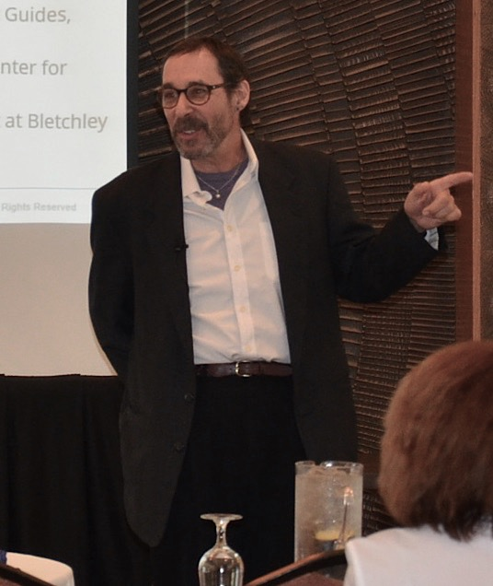
Q & A
www.brookschoenfield.com

Slide 20
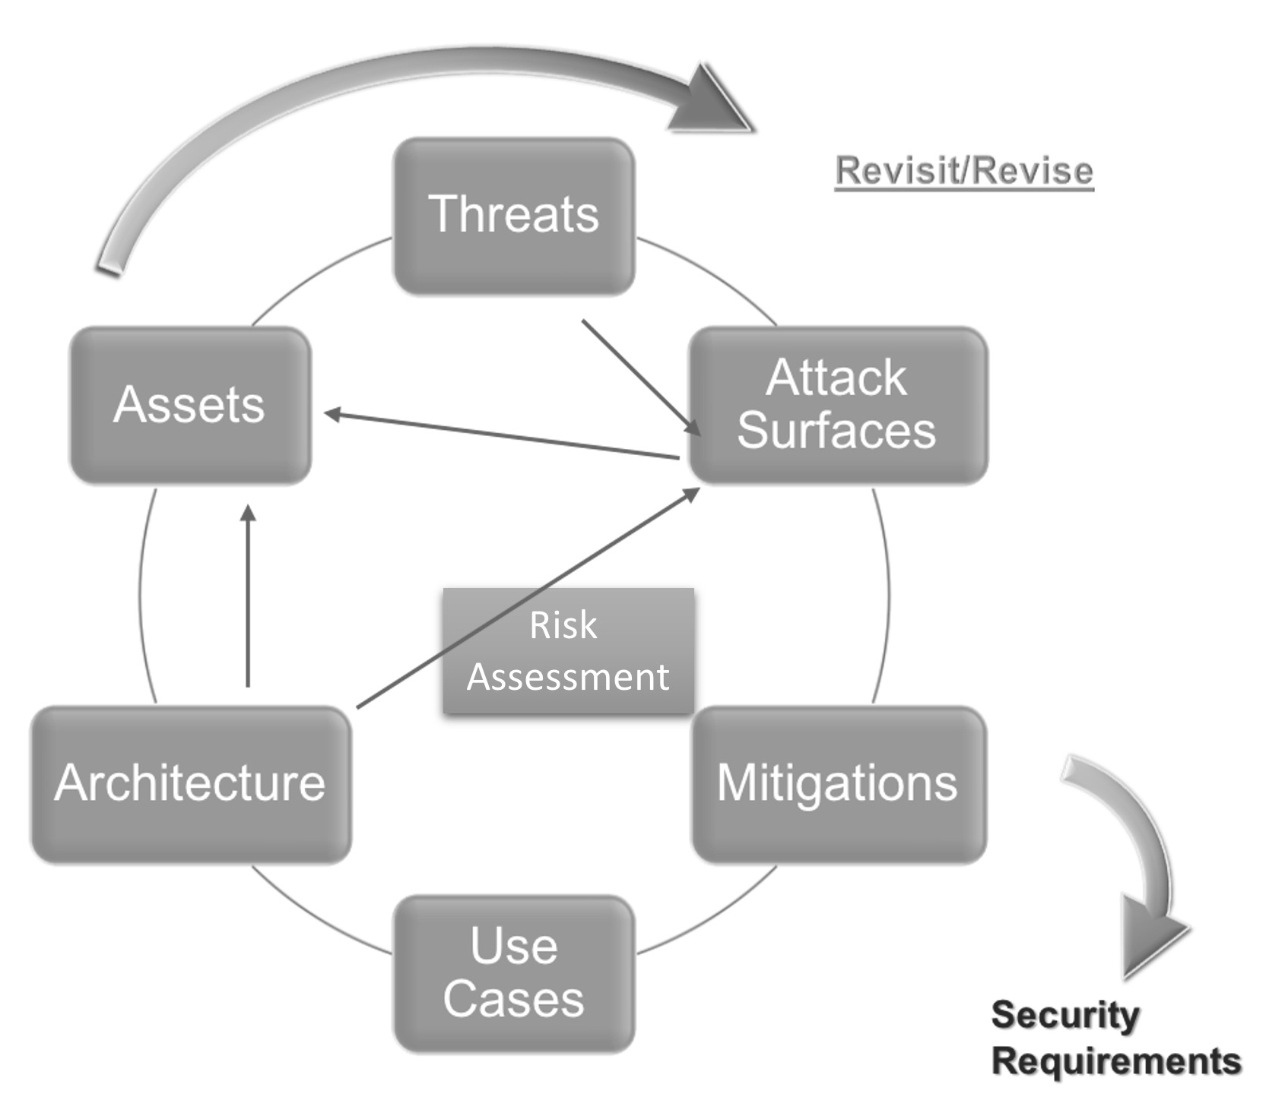
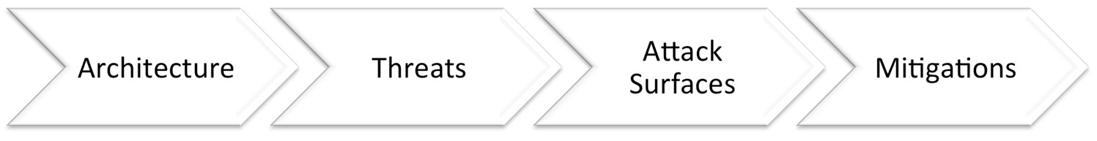
Specifics:

Slide 21
To The Dust Bin Of History
Security Architecture Review
Architecture Risk Assessment
Security Design Review
Architecture
Forum

Slide 22
KISS
Security Architecture Review
Architecture Risk Assessment
Security Design Review
It’s All Threat Modeling
Architecture
Forum

