Slide 1
C-Sharp Project Fifa
Made by: Group 1

Slide 2
Inleiding
Moscow C-Sharp
Live demo

Slide 3
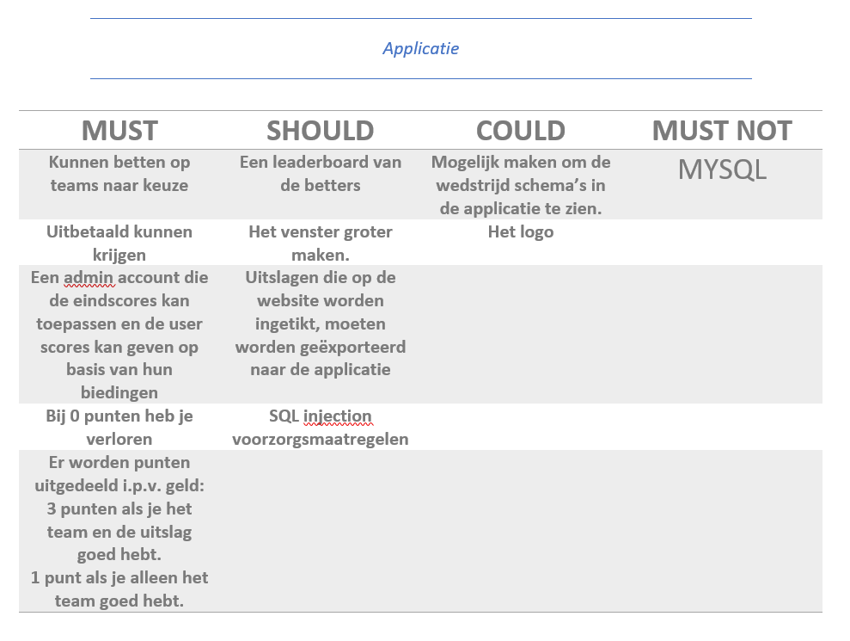
MoSCoW

