Slide 1

[TGRS 2025] SeqCSIST: Sequential Closely-Spaced Infrared Small Target Unmixing
Ximeng Zhai, Bohan Xu, Yaohong Chen, Hao Wang, Kehua Guo, Yimian Dai
arXiv: https://arxiv.org/abs/2507.09556
code: https://github.com/GrokCV/SeqCSIST
翟曦盟, Ximeng Zhai
SeqCSIST : Sequential Closely-Spaced Infrared Small Target Unmixing

Slide 2
SeqCSIST: Sequential Closely-Spaced Infrared Small Target Unmixing
1、Why Closely-Spaced Infrared Small Target Unmixing?
2、How to achieve Closely-Spaced Infrared Small Target Unmixing?
3、Specific implementation
4、Summary
翟曦盟, Ximeng Zhai
SeqCSIST : Sequential Closely-Spaced Infrared Small Target Unmixing

Slide 3
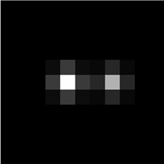
Why Closely-Spaced Infrared Small Target Unmixing?
Energy Diffusion
Energy Overlap
One Target
Two Targets
What if the target distance is smaller?
翟曦盟, Ximeng Zhai
SeqCSIST : Sequential Closely-Spaced Infrared Small Target Unmixing

Slide 4
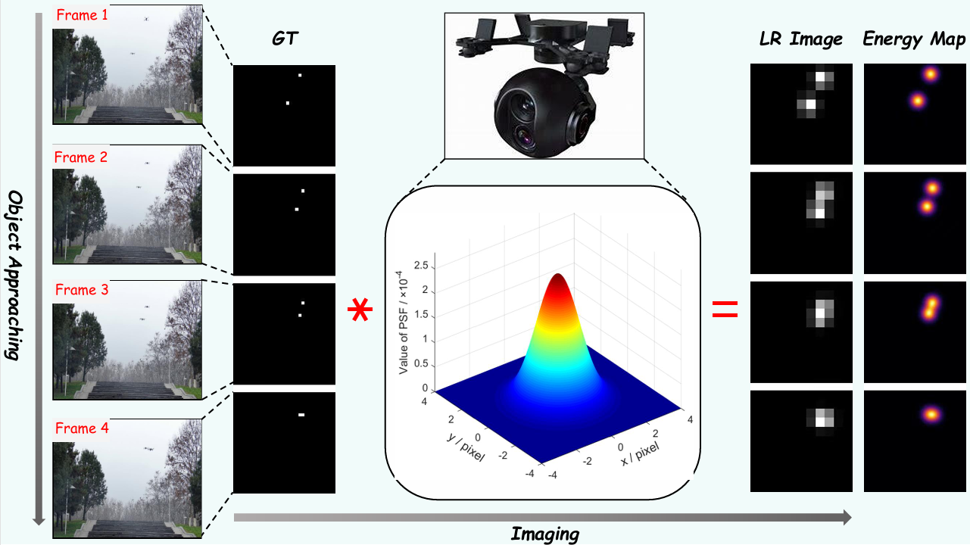
Why Closely-Spaced Infrared Small Target Unmixing?
PSF
Energy Diffusion
Energy Overlap
The limitation of infrared detector’s resolution
Difficult to distinguish and identify individual targets !
翟曦盟, Ximeng Zhai
SeqCSIST : Sequential Closely-Spaced Infrared Small Target Unmixing

Slide 5
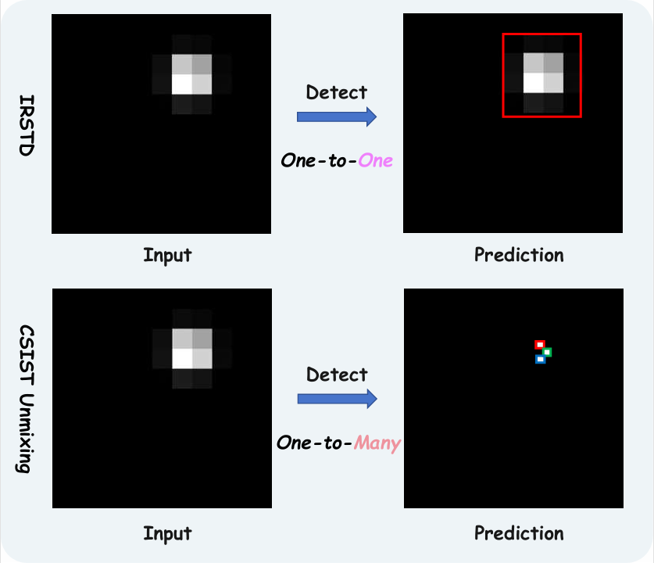
Why Closely-Spaced Infrared Small Target Unmixing?
Infrared Small Target Detection
Limited to scenes of large field-of-view but sparse targets
Assumes a one-to-one mapping between image objects and real targets
Unable to distinguish and identify individual targets !
翟曦盟, Ximeng Zhai
SeqCSIST : Sequential Closely-Spaced Infrared Small Target Unmixing

Slide 6
Why Closely-Spaced Infrared Small Target Unmixing?
Novel Task
Closely-Spaced Infrared Small Target Unmixing
Distinguishing closely packed, overlapped targets
Transforming the task from simple detection to precise sub-pixel localization
Focusing on resolving target groups that are visually indistinguishable!
翟曦盟, Ximeng Zhai
SeqCSIST : Sequential Closely-Spaced Infrared Small Target Unmixing

Slide 7
How to achieve?
IRSTD
CSIST Unmixing
Lacks task-specific priors
Generic ResNet backbones
sparsity-driven feature extraction
Complex and computation-intensive
Complex spatial-temporal fusion module
Lightweight absolute position encoding
weak spatial target awareness
Rely on optical flow method for inter-frame alignment
Multi-frame deformable alignment
Talent is limited without resources !
翟曦盟, Ximeng Zhai
SeqCSIST : Sequential Closely-Spaced Infrared Small Target Unmixing

Slide 8




















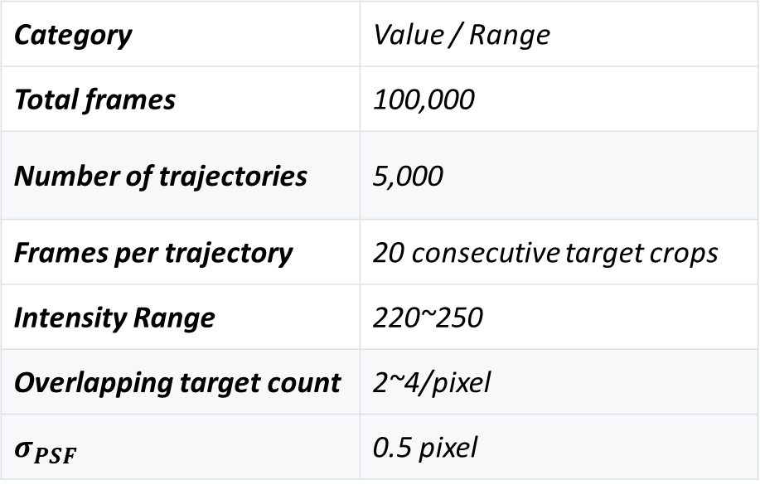
SeqCSIST Dataset
SeqCSIST generation guided by diffraction and resolution theory
subSequence-1
Inputs-1
Category | Value / Range
Total frames | 100,000
Number of trajectories | 5,000
Frames per trajectory | 20 consecutive target crops
Intensity Range | 220~250
Overlapping target count | 2~4/pixel
$$σ_{PSF}$$ | 0.5 pixel
GTs-1
subSequence-2
Inputs-2
GTs-2
翟曦盟, Ximeng Zhai
SeqCSIST : Sequential Closely-Spaced Infrared Small Target Unmixing

Slide 9
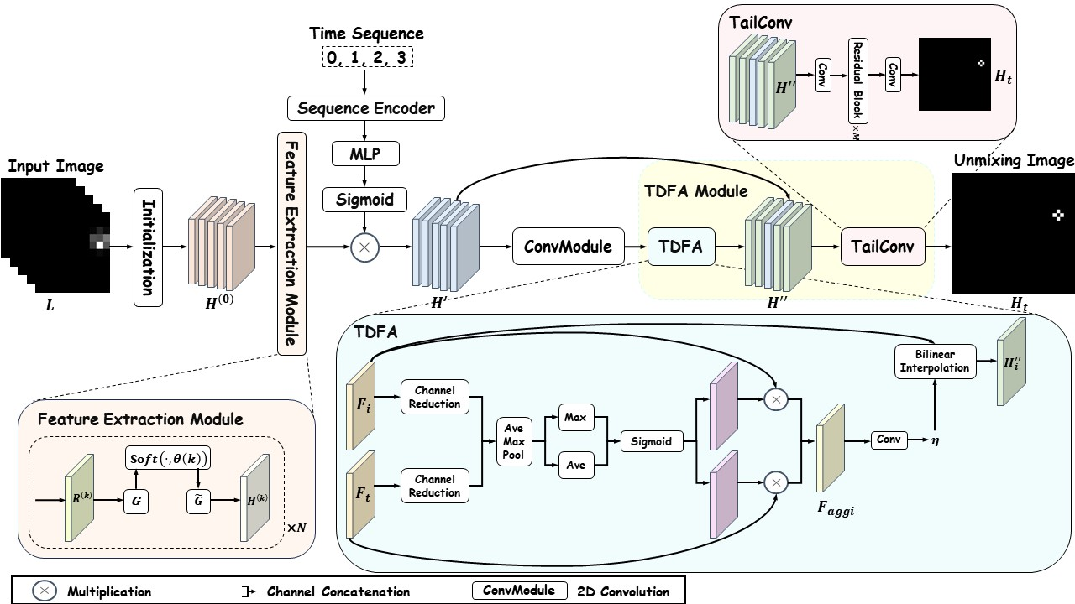
Method
DeRefNet
Position Encoder
Sparsity-driven
Feature Extraction
Implicit Alignment
翟曦盟, Ximeng Zhai
SeqCSIST : Sequential Closely-Spaced Infrared Small Target Unmixing

Slide 10
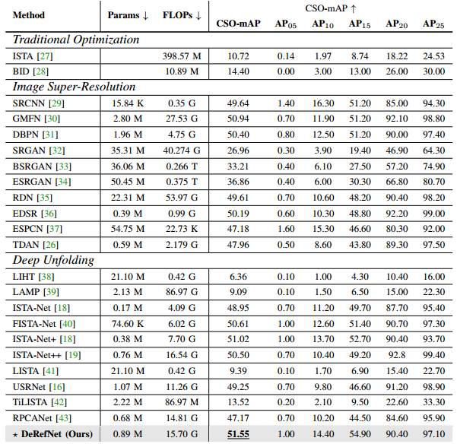
Experiment
Comparison with State-of-the-Arts
Metric : CSO-mAP
A toolkit that provides objective evaluation metrics for this special task, along with the implementation of 23 relevant methods.
翟曦盟, Ximeng Zhai
SeqCSIST : Sequential Closely-Spaced Infrared Small Target Unmixing

Slide 11
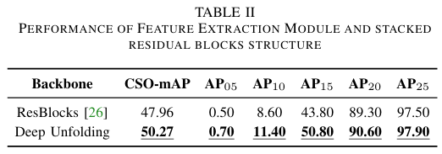
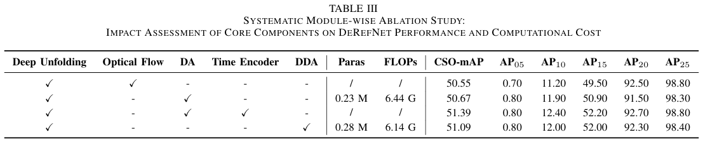
Experiment
Ablation Study
翟曦盟, Ximeng Zhai
SeqCSIST : Sequential Closely-Spaced Infrared Small Target Unmixing

Slide 12
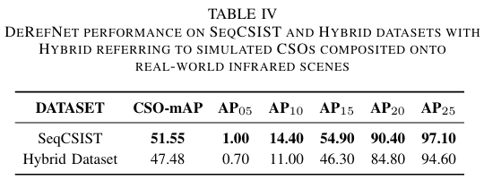
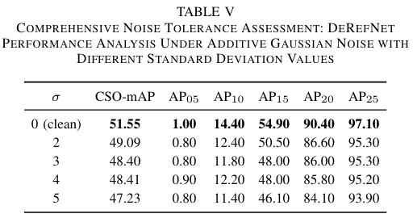
Experiment
Generalization experiment
翟曦盟, Ximeng Zhai
SeqCSIST : Sequential Closely-Spaced Infrared Small Target Unmixing

Slide 13
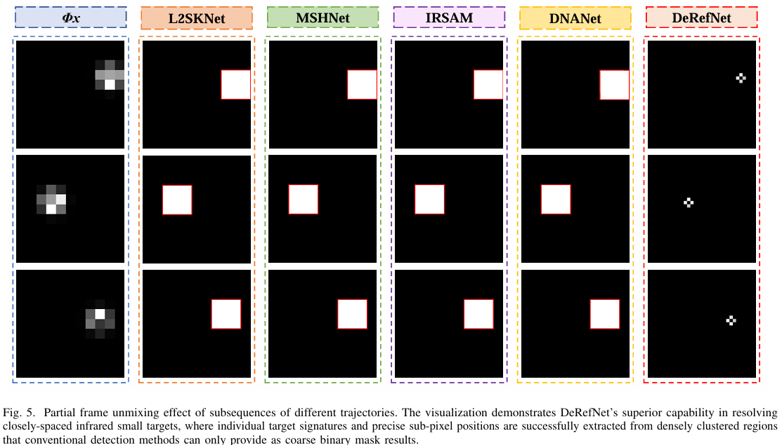
Visualization
翟曦盟, Ximeng Zhai
SeqCSIST : Sequential Closely-Spaced Infrared Small Target Unmixing

Slide 14
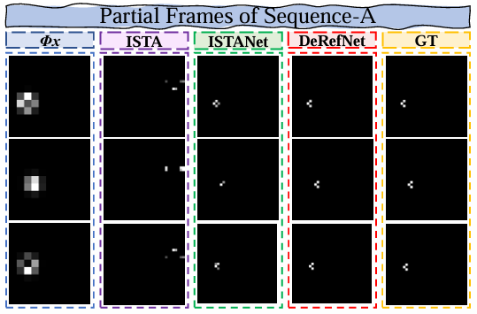
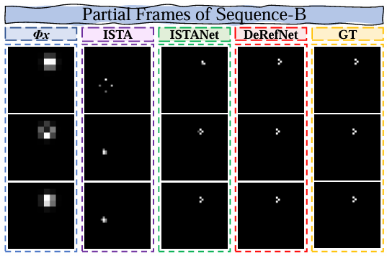
Visualization
翟曦盟, Ximeng Zhai
SeqCSIST : Sequential Closely-Spaced Infrared Small Target Unmixing

Slide 15
Summary
This work is the first endeavor to address the CSIST Unmixing task within a multi-frame paradigm.
Novel Task: We propose a novel task, Sequential CSIST Unmixing, which broadens the definition of IRSTD
Open-Source Ecosystem: We release an open-source
ecosystem for CSIST Unmixing, including the SeqCSIST
dataset and a toolkit for benchmarking
Contribution
End-to-End Framework: We propose DeRefNet, a
multi-frame model-driven deep learning architecture with temporal deformable feature alignment.
翟曦盟, Ximeng Zhai
SeqCSIST : Sequential Closely-Spaced Infrared Small Target Unmixing

Slide 16
THANK YOU!
arXiv: https://arxiv.org/abs/2507.09556
code: https://github.com/GrokCV/SeqCSIST
翟曦盟, Ximeng Zhai
SeqCSIST : Sequential Closely-Spaced Infrared Small Target Unmixing

