Slide 1

Stroke Risk Factors Analysis
Data-Driven Insights for Prevention
CREATED FOR EDUCATIONAL PURPOSES BY MICHAL FILIPEK
03.07.2025

Slide 2






Research Methodology
Data Source:
Healthcare Dataset Stroke Data (5,100 records)
Key Steps:
Data cleaning (BMI imputation, data conversion)
Statistical analysis (t-tests, chi-square)
Visualization (Seaborn/Matplotlib)
Tools Used:
Python, Pandas, Scipy, numpy, Matplotlib, Seaborn

Slide 3
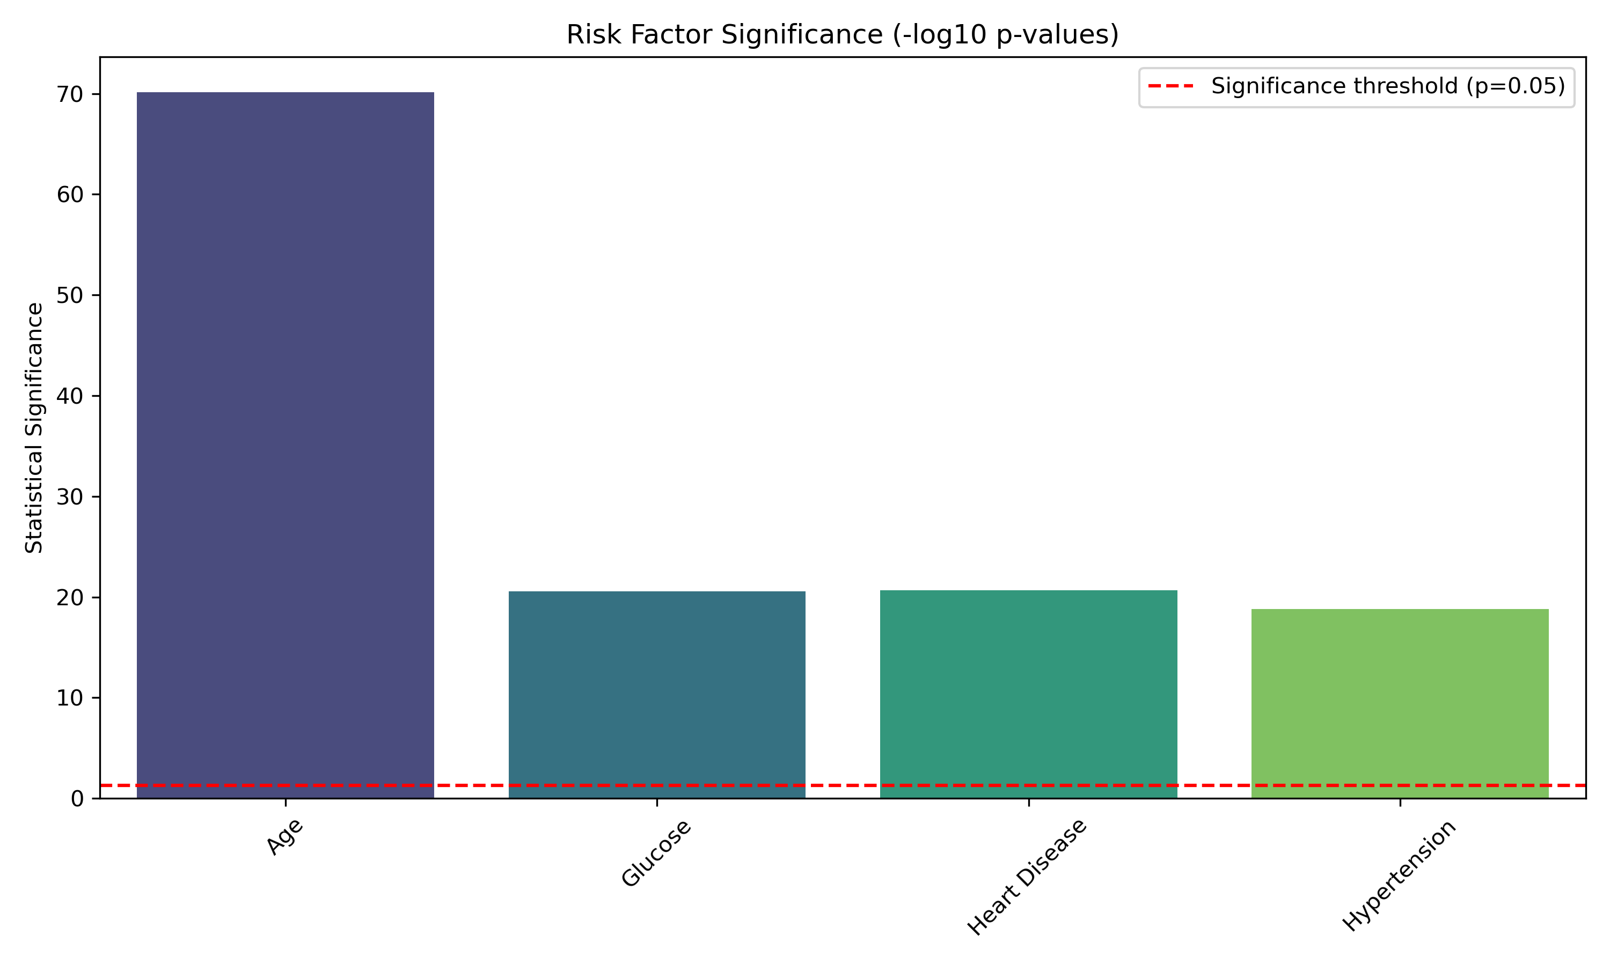
Key findings
TOP 4 RISK FACTORS:
AGE (p < 0.001)
GLUCOSE LEVELS (p < 0.001)
HYPERTENSION (OR = 2.5)
HEARTH DISSEASE (OR = 2.1)

Slide 4
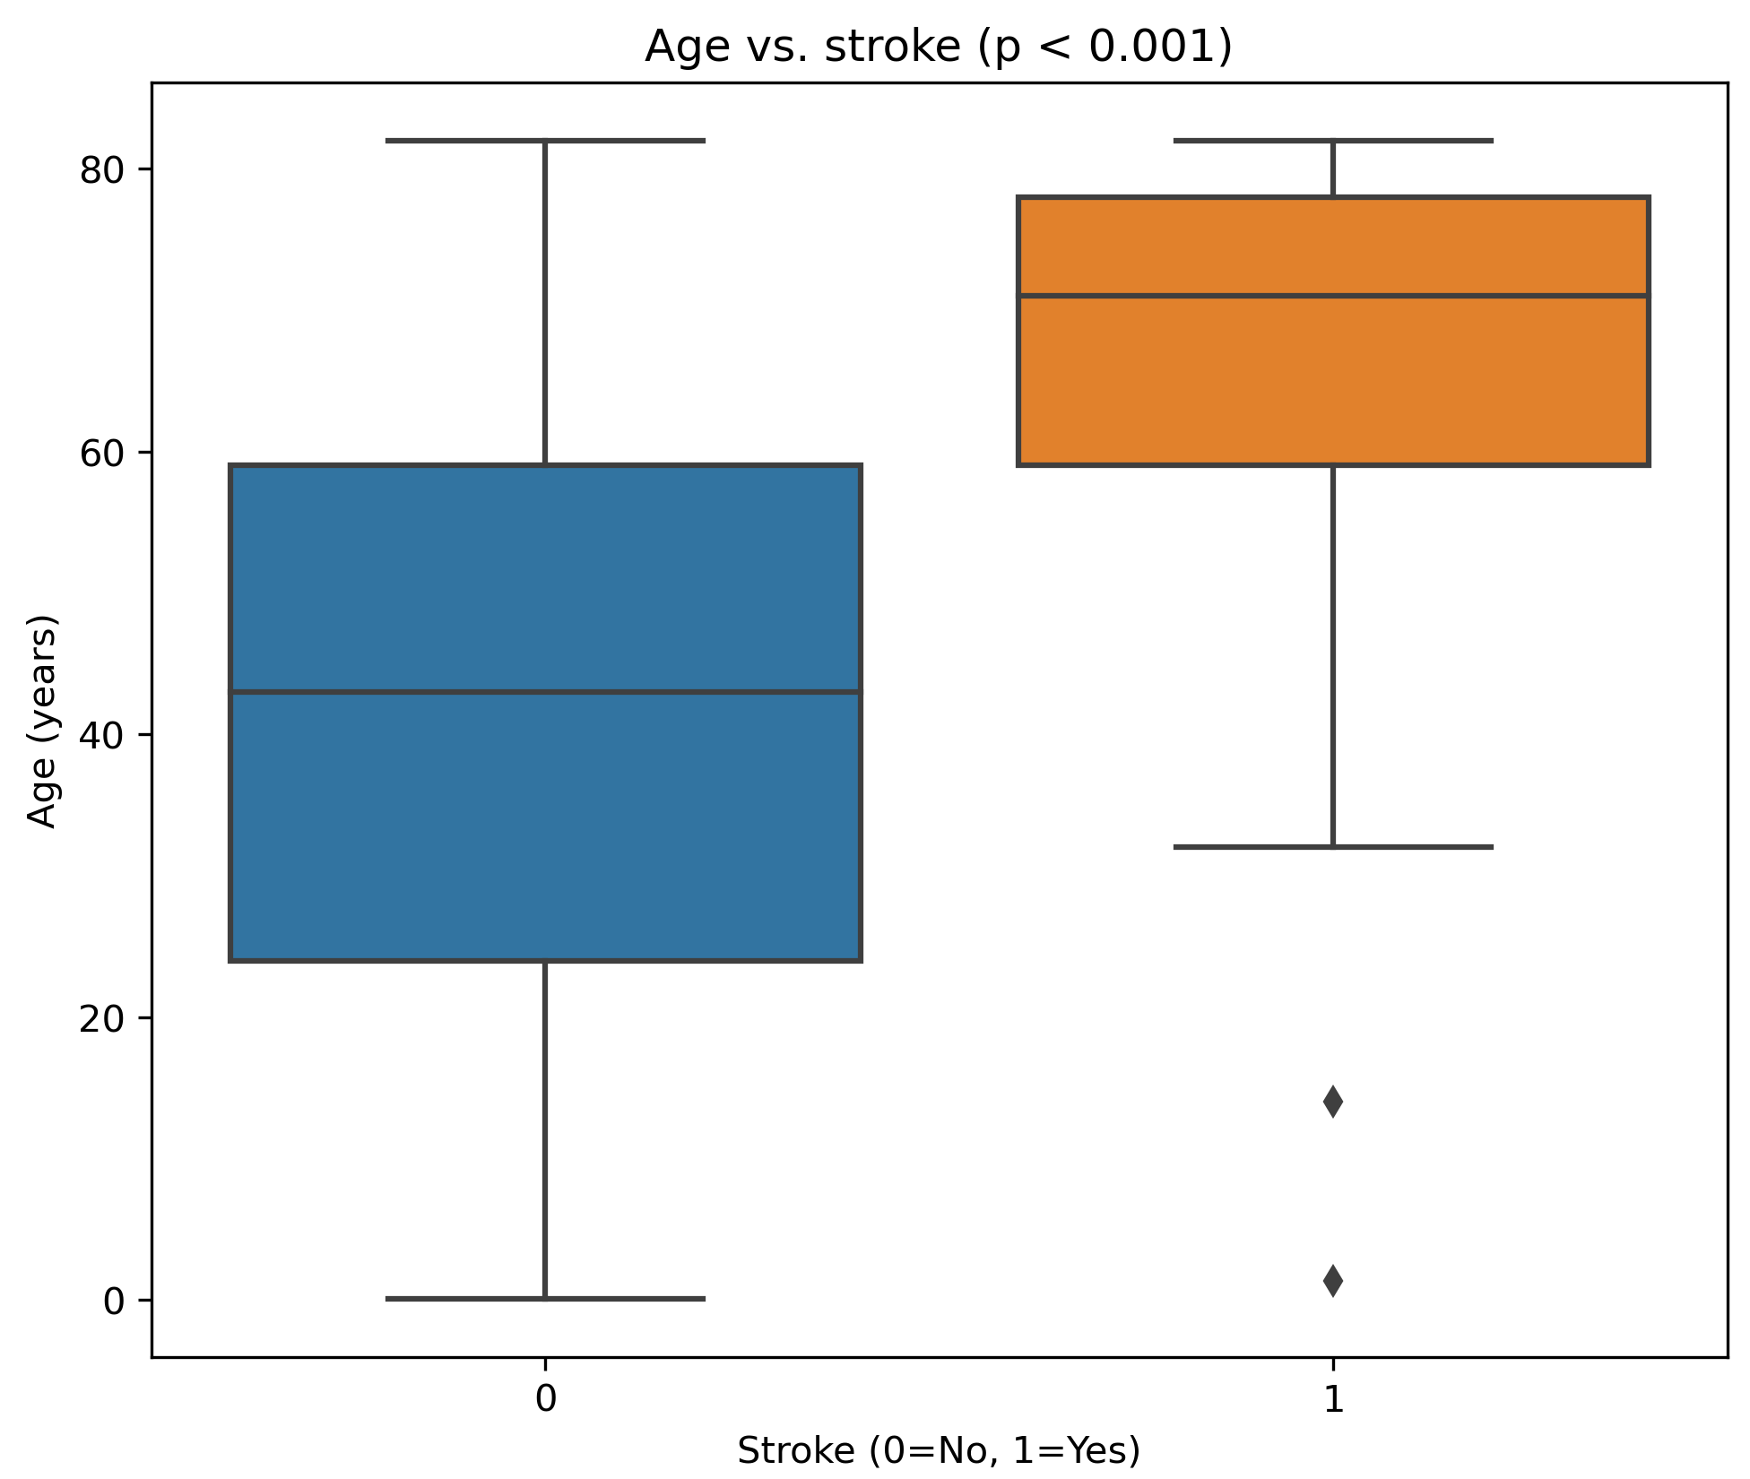
Age-vise Analysis
FINDING:
Patients with stroke were significantly older (median 71 vs 43 years)

Slide 5
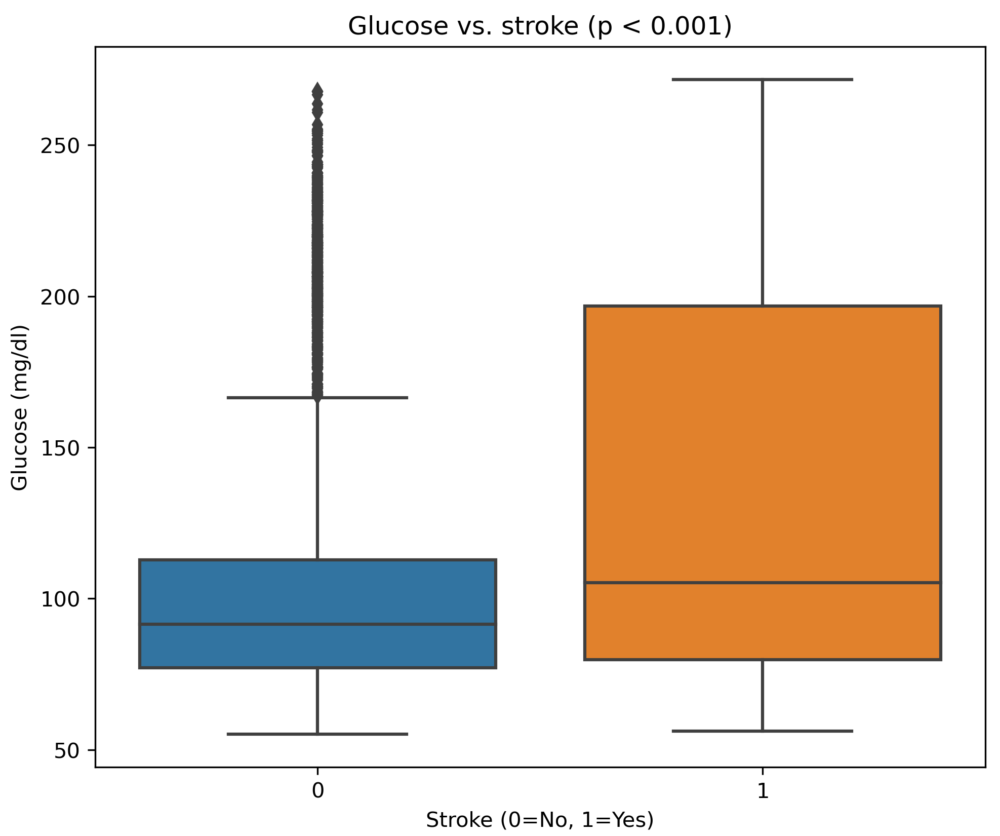
Glucose-vise Analysis
105.2 mg/dl
FINDING:
Patients with stroke had higher glucose level (median 105,2 mg/dl vs 91,5 mg/dl)

Slide 6
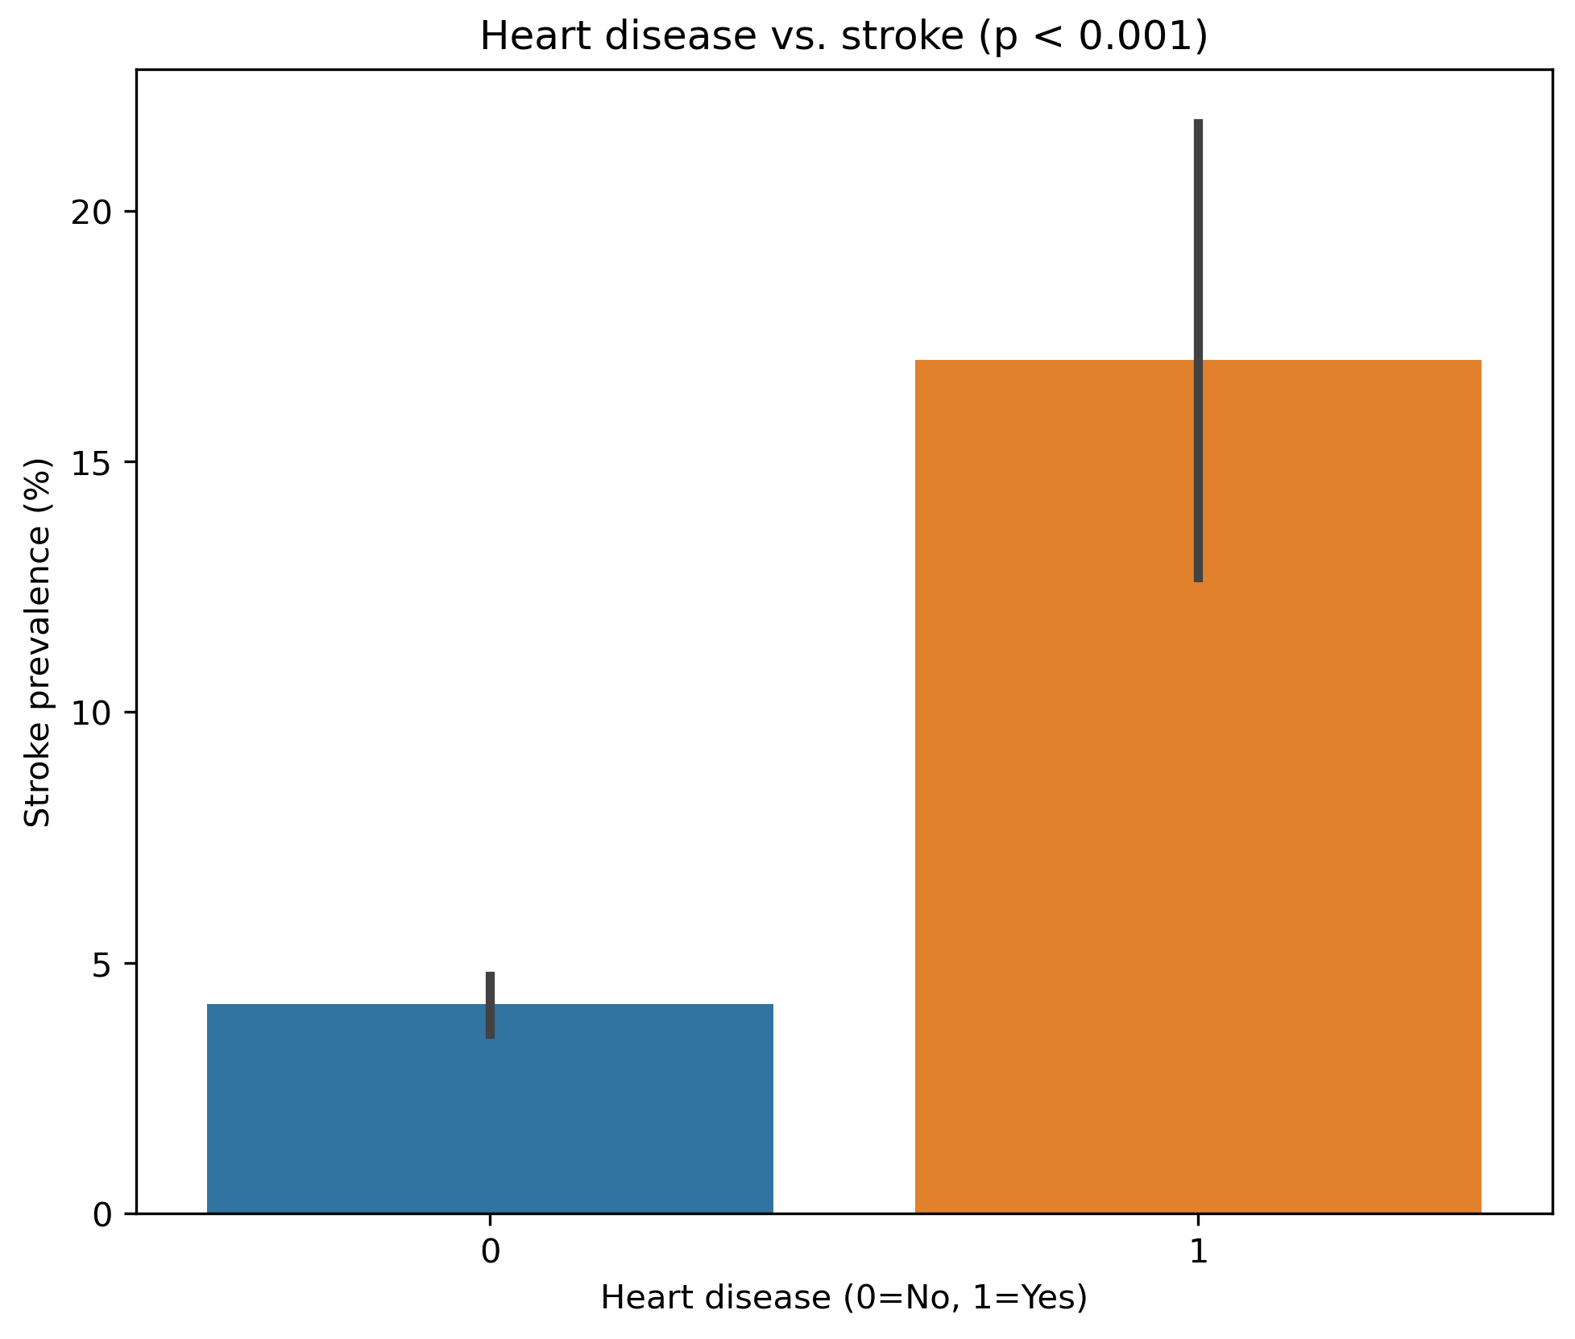
Heart dissease-vise Analysis
FINDING:
Patients with heart dissease had 4,1x more stroke occurences (17,1% with dissease and 4,2% without)

Slide 7
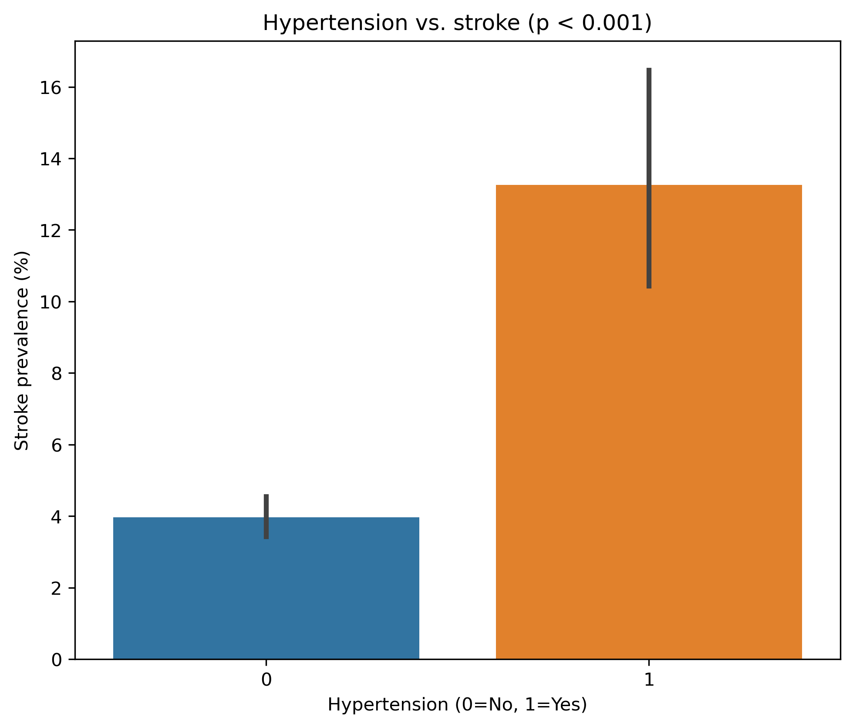
Hypertension-vise Analysis
FINDING:
Patients with hypertension had 3,3x more stroke occurences (13,3% with hypertension and 4,0% without)

Slide 8
Conclusions & Clinical Recommendations
Key Takeaways
Age is the strongest predictor
Patients >70 years have 3× higher stroke risk
Recommendation: Prioritize screening in elderly populations
Controllable risk factors matter
Hypertension (13.3% vs 4.0%, p<0.001)
Heart disease (17.0% vs 4.2%, p<0.001)
Recommendation: Aggressive BP control and cardiac monitoring
Glucose levels signal risk
Even moderately elevated levels (105 vs 92 mg/dl) increase risk
Recommendation: Annual glucose checks for patients >50

