Slide 1
Professor Assistant
Program
Automated Exam Generation from a Question Bank
Team MANIAC | Python Final Project

Slide 2
Project Overview
Goal
Help professors automatically generate exams from a pre-built question bank
Language
Python — uses only the built-in random module
Input
question_bank.txt with Q&A pairs
Output
A saved exam file with randomly selected questions

Slide 3
Team MANIAC
1
Ale Magar Ridam
2
Subedi Kushal
3
Shrestha Anish
4
Syangtan Sameer
5
MUYASSAR ARZIMATOVA

Slide 4
Program Workflow
Start
Set Count
1
4
Professor launches the program
Professor picks number of questions
Enter Name
Generate
2
5
Validates letters-only input
Randomly selects unique questions
Load Bank
Save Exam
3
6
Reads question_bank.txt Q&A pairs
Writes exam to chosen output file

Slide 5
Key Functions
read_question_bank()
Reads question_bank.txt, strips whitespace, validates even-line format, and returns a list of (question, answer) tuples. Returns None on errors.
create_exam()
Randomly selects unique questions using index tracking. Writes numbered Q&A pairs to the output file. Caps selection at available count.
main()
Controls program flow: validates professor name, loops exam creation, and displays a personalized farewell on exit.

Slide 6
Question Bank Format
Plain .txt file — one question per line, answer on the next line
Lines come in pairs: Question → Answer → Question → Answer
Blank lines are automatically skipped during processing
Odd number of lines signals an invalid file — returns None
sample question_bank.txt
Who is the father of Computer science?
Charles Babbage
What does CPU stand for?
Central Processing Unit
BIOS stands for?
Basic Input Output System
Contains 100 Q&A pairs on computer science fundamentals

Slide 7
Input Validation
Professor Name
Must contain letters only. Spaces are stripped before check. Loop repeats until valid input is given.
Question Count
If count exceeds available questions, it is automatically capped at the bank size — no crash.
File Existence
read_question_bank() catches FileNotFoundError and returns None, prompting a user-friendly error message.
File Format
Odd number of cleaned lines returns None — prevents incorrect Q&A pairing.

Slide 8
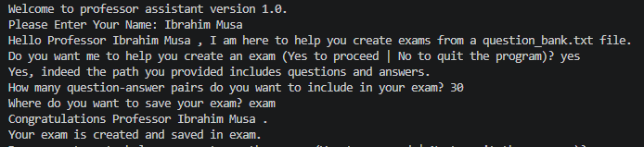
Sample Program Output

Slide 9
Challenges & Solutions
CHALLENGES
SOLUTIONS
Preventing duplicate questions
Track used indexes in a list; loop until new index found
Handling missing or malformed files
try/except FileNotFoundError + even-line format check
Capping question count safely
Cap total_questions to available_questions automatically
Keeping name input valid
Use .replace(' ','').isalpha() with a retry loop

Slide 10
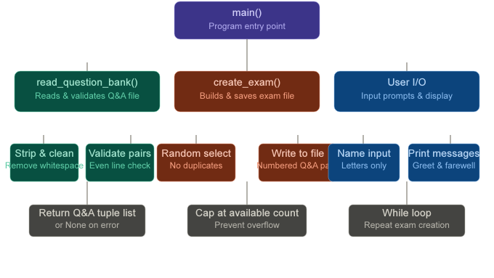

Slide 11
Conclusion
Automates exam creation — saves professors significant time
Robust error handling for missing files and bad input
Guarantees no duplicate questions per exam session
Simple, clean Python design using only the random module
Scalable: question bank can be expanded at any time
Team MANIAC — Professor Assistant v1.0

