Slide 1
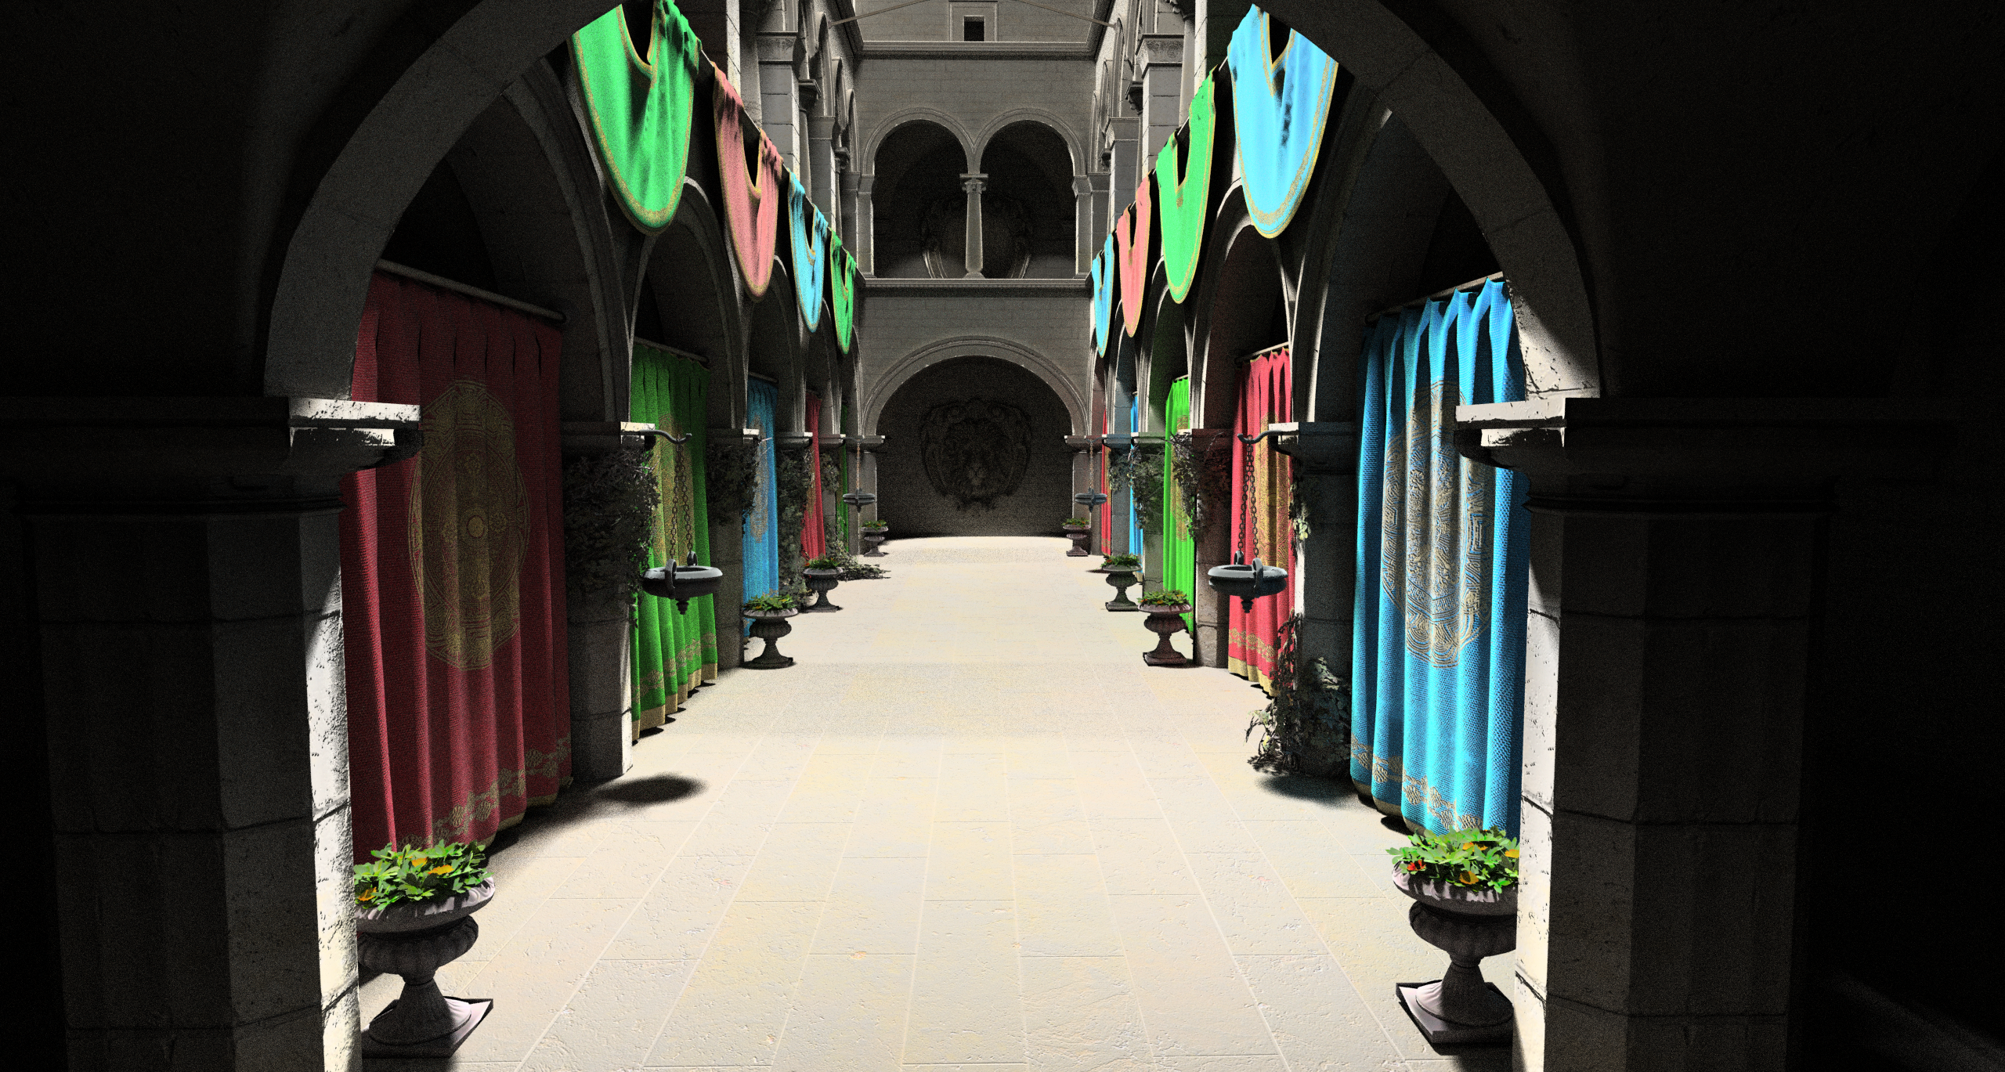
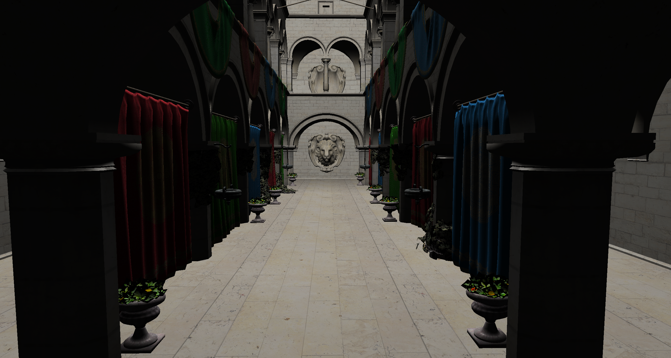
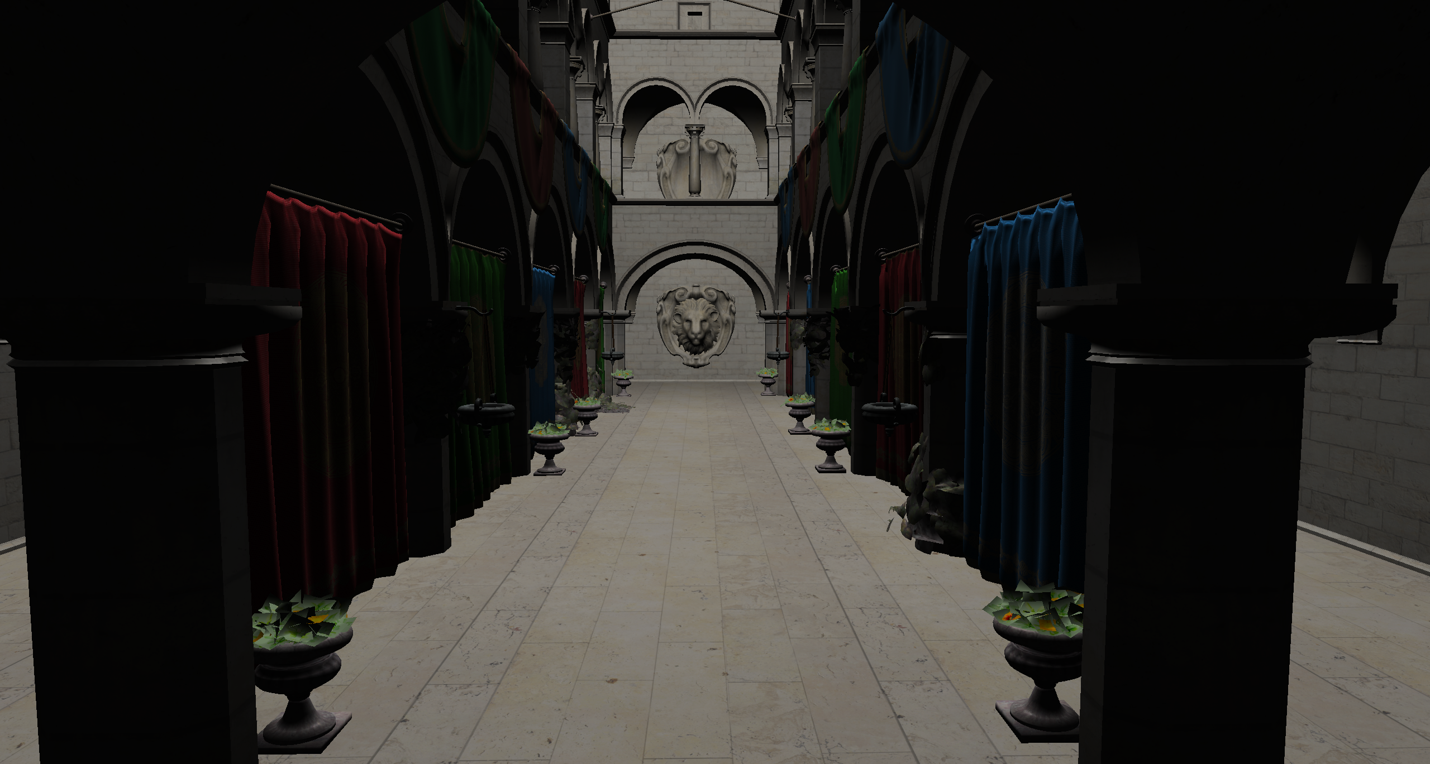
Software Rasterizer
10 FPS
Path tracer
1 FPS
GPU Deferred renderer
1424 FPS

