Slide 1
Big mountain resort
Market Study – Executive Presentation

Slide 2
1. Problem identification
Overview of problem statement

Slide 3
1 Problem Identification
1.1 Problem Statement
Big Mountain Resort wants to analyse market ticket prices to better fit resort attractions and forecast future investments in infrastructure to be able to increase the ticket price while at the same time attract more skiers and riders with the new features.
Our Criteria for success are:
Analyze market prices of similar resort attractions to predict the ideal ticket price for Big Mountain Resort; there is potential for a ticket price increase.
Create a list with changes that can cut costs without undermining the price ticket and impacting visitors.
Create different investment options that can contribute to a high-ticket price.
Our model should provide which attractions correlates better to a higher ticket price according to market data.
The main dataset (CSV file) was provided by Alesha Eisen and contains information of resorts with similar attractions than Big Mountain Resort.

Slide 4
2. Recommendation and key findings

Slide 5
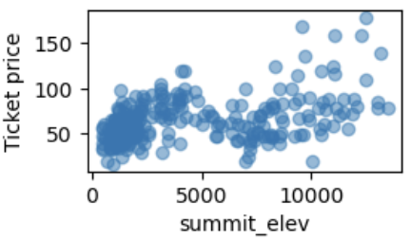
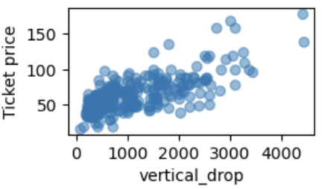
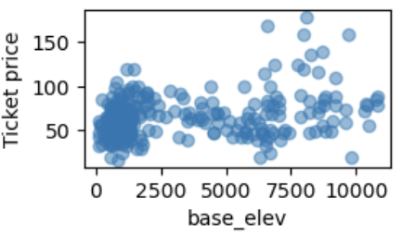
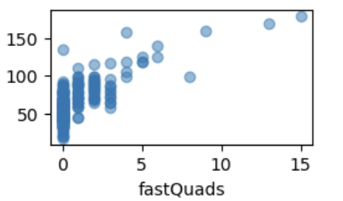
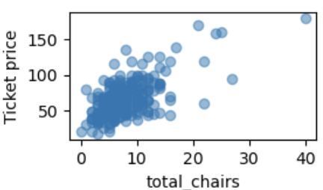
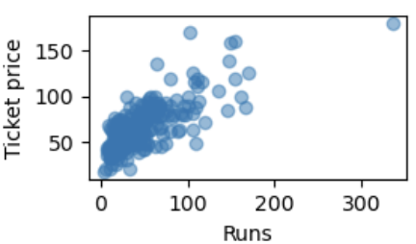
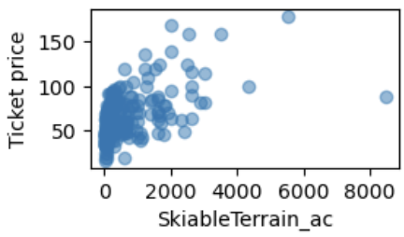
2. Recommendation and Key Findings
See below the key insights from the dataset analysis and our recommendation on which features to use to train the model:
The data contains 3 categorical features which are: Resort name, Region and state.
The data contains 22 numerical features, of which the most important are: Adult Weekend ticket price, vertical drop, summit and base elevations, quantity of runs, chairs and fastquads, and size of skiiable terrains.
Based on our initial data analysis, we found no clear relationship between state and ticket prices.
As there were not clear relationship between state and ticket price, we must analyze the resort's features further to find the best features that correlate and have a strong relationship with ticket prices.

Slide 6
3. Modeling results and analysis

Slide 7
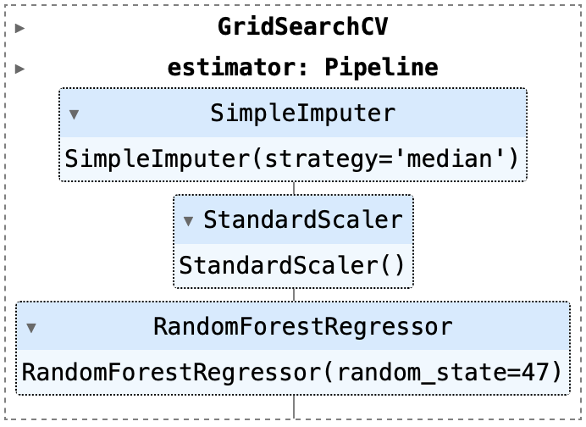
3. Modeling results and analysis
3.1 Modeling Assumptions
A good baseline is to start with the average calculation of our target feature, As the average is a common knowledge, it is a very rough indication on how each model perform. After getting the average, we explore different models and assumptions to compare which one will provide us with the most accurate prediction, meaning lower Mean Absolute Error, lower Mean Squared Error and highest R-squared.
The following were our model assumptions with the best metric results:
Model: Random Forest Regressor
Randon Forest Regressor – random_state: 47
Random Forest Regressor__n_estimators: 69
Simple imputer__strategy: Median
Standar Scaler: None

Slide 8
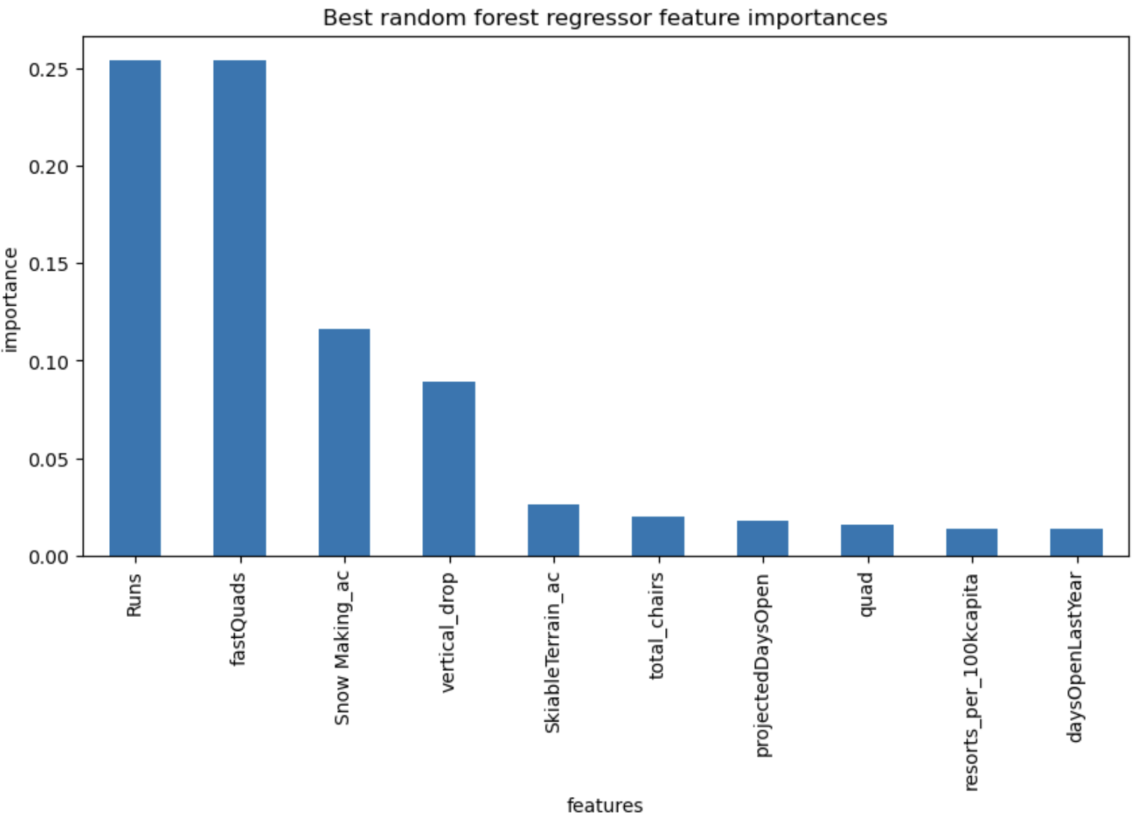
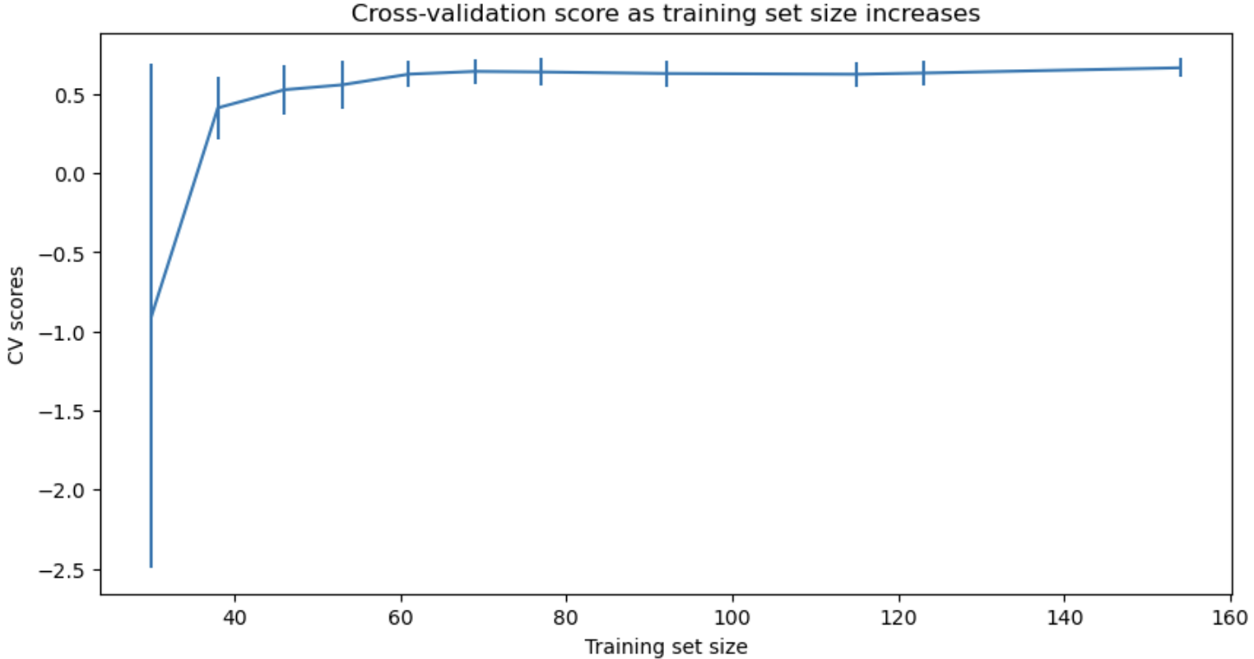
3. Modeling results and analysis
3.2 Modeling using Random Forest Regressor – Best Parameters
By running the model with the best parameters, we found the following features to be the most important on supporting a higher ticket price:
fastQuads
Runs
Snow Making_ac
vertical_drop
It has been confirmed that our dataset is large enough to train our model effectively. As the graph demonstrates, the score increases significantly from 0 to 60 and then levels off as the size of the training set increases.

Slide 9
3. Modeling results and analysis
3.3 Model Analysis
After exploring and defining the best parameters to our model, we have trained our model and result in the following metrics:
Mean Absolute Error (MAE) – Train set = 9.65
Mean Absolute Error (MAE) – Train set, standard deviation = 1.49
Mean Absolute Error (MAE) – Test set = 9.50
Cross-validation:
Best Score mean = 0.71
Best Score Standard Deviation = 0.07

Slide 10
4. Summary and conclusion

Slide 11
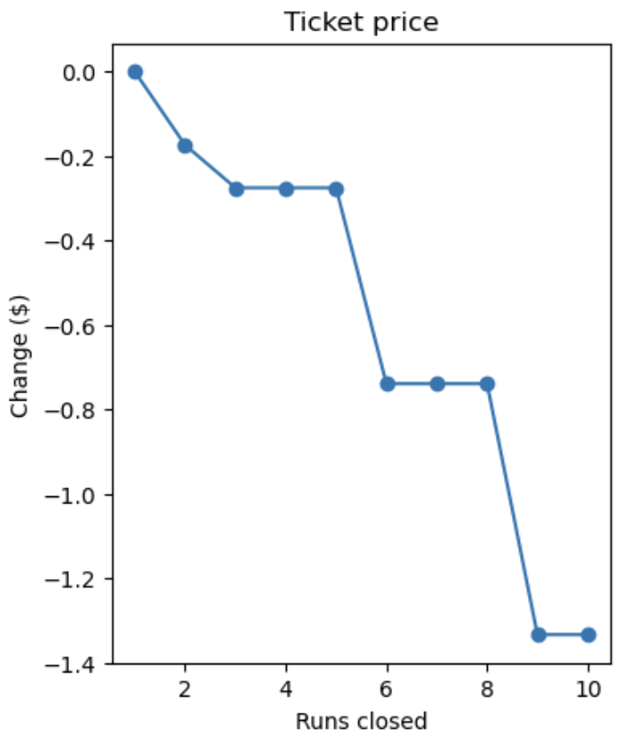
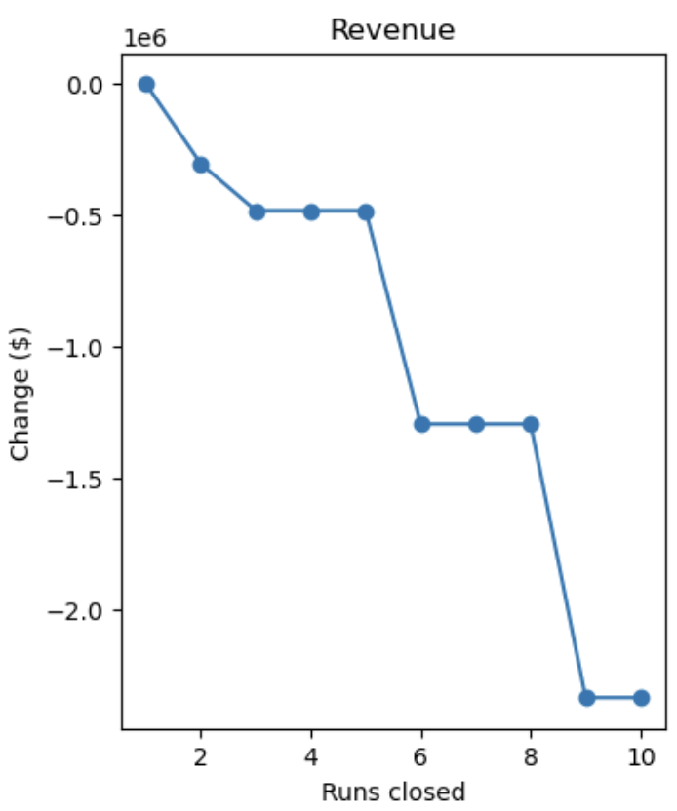
4. Summary and conclusion
4. Summary
Our model predicted that Big Mountain Resort market position is very strong in comparison with all other resorts, which resulted in a modelled price of $95.88 (compared to actual price of $81.00), even with the mean absolute error of $10.36, there is still room for price increase.
4.1 Conclusion
Our model is recommending to Big Mountain Resort executives the following:
Closing one run makes no difference. Closing 2 and 3 successively reduces support for ticket price and so revenue. If Big Mountain closes 3 runs, it seems they may as well closes 4 or 5 as there's no further loss in ticket price. Increasing the closures down to 6 or more leads to a large drop.
In the scenario where Big Mountain Resort adds an additional run with an increase of the vertical drop by 150 ft, and installing an additional chair lift, the model increases support for ticket price increase by $1.61, over the season, this could be expected to amount roughly ~2.75 MM.
In the third scenario, the resort additionally increases the snow-covered area by 2 acres, this such increase resulted in an insignificant price increase. Therefore, the model doesn’t not support for this scenario.
The 4th scenario, considers an increase on the longest run by 0.2 miles and adding 4 acres of snow making capabilities. The model shows no support on this scenario.

