Slide 1
ASP.NET Web API

Slide 2
What is ASP.NET Web API?
ASP.NET Web API is a framework for building HTTP services that reach a broad range of clients (browsers, mobile devices, desktops).
With ASP.NET Web API you can build RESTful applications on the .NET Framework.

Slide 3
REST
Representational state transfer (REST) is an architecture style for managing state information on the Internet. REST is typically used over HTTP, due to the simplicity of HTTP and its mapping to RESTful principles, however it is not tied to any specific protocol.
The formal REST constraints are as follows:
Client-Server Communication
Stateless
Cacheable
Uniform Interface

Slide 4
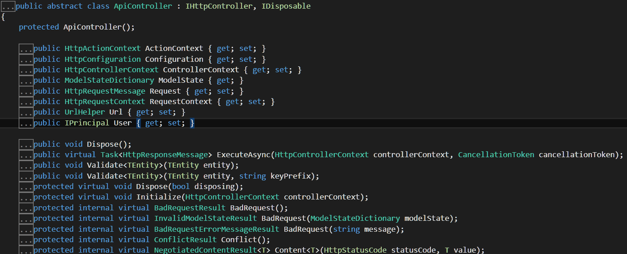
Controllers
In Web API, a controller is an object that handles HTTP requests: it takes HttpRequestMessage object, processes this object and returns a response as HttpResponseMessage object.
Web API controllers are similar to MVC controllers, but inherit the ApiController class instead of the Controller class:

Slide 5

Controllers
To have custom behavior for our controller we can directly implement IHttpController interface that has one method:
In another case inherit from ApiController that has default implementation of IHttpController interface.

Slide 6
Controllers
Controllers accept requests as HttpRequestMessage object with the folowing properties:
Content: HttpContent object (request body)
Headers: the collection of Request Headers
Method: request type (Get/Post/Put/Delete)
Properties: dictionary that contains objects, provided by host
RequestUri: requested URL resource
Version: HTTP protocol version

Slide 7
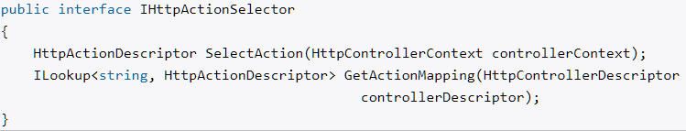

Controllers
Selection:
After getting request controller delegates responsibility to object which implement the IHttpActionSelector interface for choosing the necessary method (ApiControllerActionSelector class has its default implementation):
Method call:
After selecting method for request the object which implements the IHttpActionInvoker interface calls method of controller (ApiControllerActionInvoker class has default implementation of IHttpActionInvoker interface).
Notes:
Выбор метода для обработки запроса:
1. Сначала идет обращение к механизму рефлексии для получения у контроллера всех возможных методов.
2. Затем у всех методов-кандидатов просматриваются атрибуты маршрутизации (при их наличии). Если будут найдены методы, в атрибутах которых определены маршруты, соответствующие запросу, то все остальные методы отбрасываются.
3. Далее просматриваются данные маршрута на наличие в них значения для сегмента action (если в маршруте определен такой сегмент). Если такое значение (которое передает имя метода) имеется, выбираются все методы, которые имеют данное имя. Остальные методы отбрасываются.
4. На следующем этапе проверяется, соответствуют ли методы соглашениям о наименовании Web API RESTful. Например, согласно этим условностям метод, обрабатывающий запрос GET, должно называться или начинаться с "Get", например, "GetBooks". Все методы, которые не соответствуют типу запроса (GET, POST, PUT) и не следуют условностям об наименовании, отбрасываются
5. Если ни один метод не использует соглашения о наименовании, то ApiControllerActionSelector просматривает наличие у методов атрибутов HttpGet, HttpPost, HttpDelete и HttpPut, которые соответствуют типу запроса.
6. На финальном этапе отбрасываются все методы, которые не соответствуют маршруту по числу и типу параметров.
И по идее в конце должен остаться только один метод. Если же не остается ни одного или, наоборот, больше одного, то возникает ошибочная ситуация.

Slide 8
Action results
A Web API controller action can return any of the following:
Return type | How Web API creates the response
void | Return empty 204 (No Content)
HttpResponseMessage | Convert directly to an HTTP response message.
IHttpActionResult | Call ExecuteAsync to create an HttpResponseMessage, then convert to an HTTP response message.
Other type | Write the serialized return value into the response body; return 200 (OK).

Slide 9
Model binding
By default, Web API uses the following rules to bind parameters:
If the parameter is a "simple" type, Web API tries to get the value from the URI. Simple types include the .NET primitive types (int, bool, double, and so forth), plus TimeSpan, DateTime, Guid, decimal, and string, plus any type with a type converter that can convert from a string. (More about type converters later.)
For complex types, Web API tries to read the value from the message body, using a media-type formatter.
Web API has 5 model binders (in System.Web.Http.ModelBinding.Binders):
ArrayModelBinder
CollectionModelBinder
DictionaryModelBinder
MutableObjectModelBinder
TypeConverterModelBinder

Slide 10
Routing
There are two types of routing in Web API:
convention-based routing
attribute routing

Slide 11
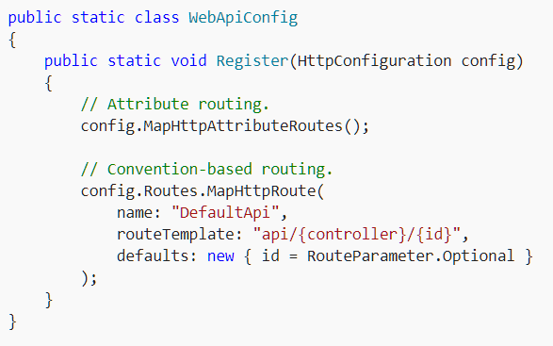
Routing
Convention-based routing: you define one or more route templates, which are basically parameterized strings. When the framework receives a request, it matches the URI against the route template. For example, the following URIs match the default route:
/api/contacts
/api/contacts/1
/api/products/gizmo1
The following URI does not match,
because it lacks the "api" segment:
/contacts/1

Slide 12
Routing
When the Web API framework receives an HTTP request, it tries to match the URI against one of the route templates in the routing table. If no route matches, the client receives a 404 error.
Once a matching route is found, Web API selects the controller and the action:
To find the controller, Web API adds "Controller" to the value of the {controller} variable.
To find the action, Web API looks at the HTTP method, and then looks for an action whose name begins with that HTTP method name. For example, with a GET request, Web API looks for an action that starts with "Get...", such as "GetContact" or "GetAllContacts". This convention applies only to GET, POST, PUT, and DELETE methods. You can enable other HTTP methods by using attributes on your controller. We'll see an example of that later.
Other placeholder variables in the route template, such as {id}, are mapped to action parameters.

Slide 13
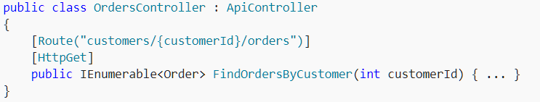
Routing
Attribute routing
To enable attribute routing, call MapHttpAttributeRoutes during configuration. This extension method is defined in the System.Web.Http.HttpConfigurationExtensions class.
Attribute routing can be combined with convention-based routing. To define convention-based routes, call the MapHttpRoute method.
The following URIs would match this template:
http://localhost/customers/1/orders
http://localhost/customers/bob/orders
http://localhost/customers/1234-5678/orders

