Slide 1



Is Java Call-by-Value OR Call-by-Reference?
Oğuzcan Biçer

Slide 2
Contents / Agenda
Introduction
Definitions
Why Java is Pass-by-Value ?
Examples

Slide 3
Introduction
This topic common misconpection about java.
Primitives are passed by value, object are passed by reference.
Java always passes arguments call by value.

Slide 4

Definitions
Call-by-Value: The value of a variable is passed to a function/method. (frequently by copying the value into a new memory region)
Call-by-Reference: The reference to that variable is passed to the function. That gives the function a way to change the contents of the variable.

Slide 5

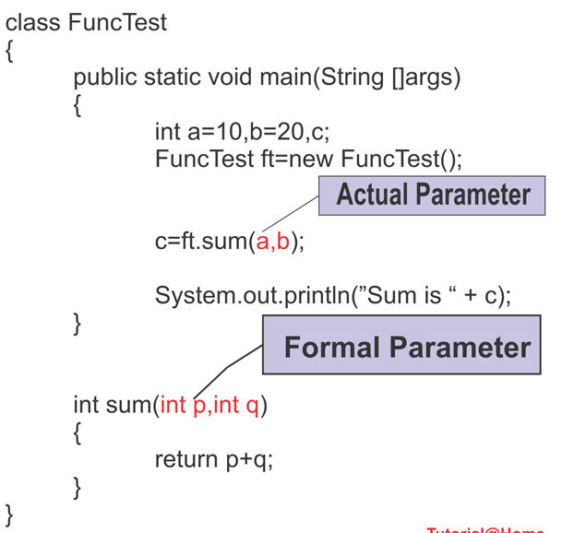

What's Actual / Formal parameter?
Actual Parameter: Subprograms pass information using parameters
Formal Parameter: The variables declared in a subprogram specification

Slide 6
Why Java is Pass-by-Value ?
In Java Language Specification Document (8.4: Method Declarations) says that:
When the method or constructor is invoked, the values of the actual argument expressions initialize newly created parameter variables, each of the declared type, before execution of the body of the method or constructor. The Identifier that appears in the FormalParameter may be used as a simple name in the body of the method or constructor to refer to the formal parameter.

Slide 7
Actual Parameter VS Formal Parameter
Variable p is a copy of variable a.
They are in different stacks.

Slide 8
Objects are not passed by reference.
Object references are passed by value.
A variable of a class type stores an address of the object, not the object itselft. The object itself is stored at the address which the variable points to.

Slide 9
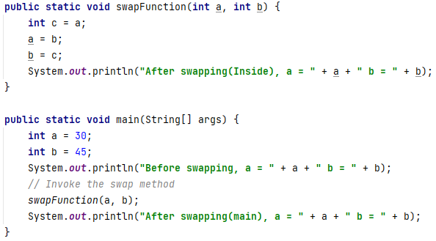

Debugging (Primitive Value)

Slide 10

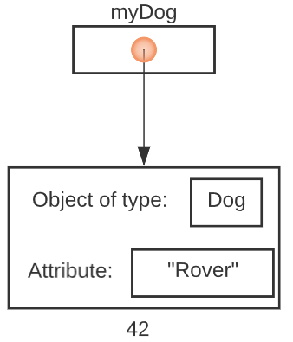
Debug(Object as value)
You’re essentially passing the address of the created Dog object to the foo method.
Suppose the Dog object resides at memory address 42. This means we pass 42 to the method.

Slide 11
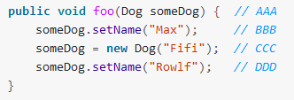
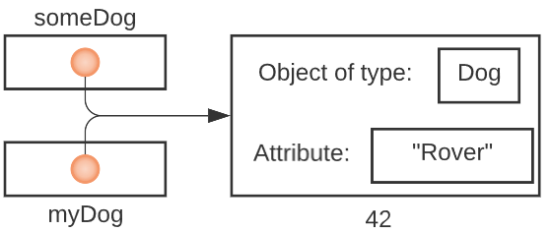
Line AAA
the parameter someDog is set to the value 42

Slide 12
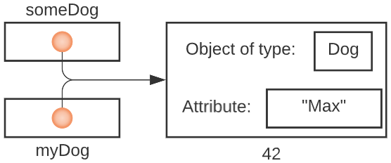
Line BBB
someDog is followed to the Dog it points to (the Dog object at address 42)
that Dog (the one at address 42) is asked to change his name to “Max”

Slide 13
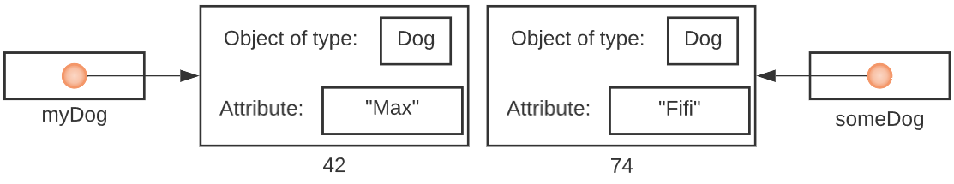
Line CCC
a new Dog is created. Let’s say he’s at address 74.
we assign the parameter someDog to that address, 74

Slide 14
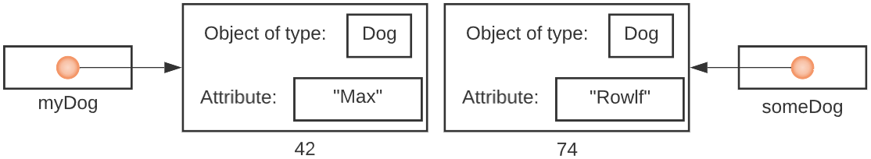
Line DDD
someDog is followed to the Dog it points to (the Dog object at address 74)
that Dog (the one at address 74) is asked to change his name to “Rowlf”

Slide 15
Did myDog change ?
myDog is a pointer, and not an actual Dog, the answer is NO. myDog still has the value 42; it’s still pointing to the original Dog.

Slide 16
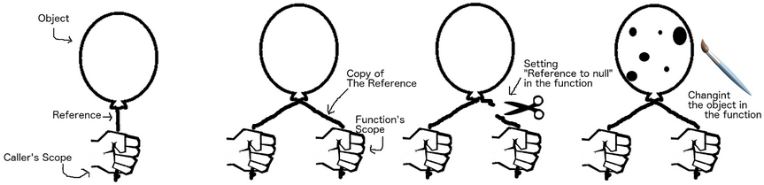
Passing Object Reference By Value

Slide 17
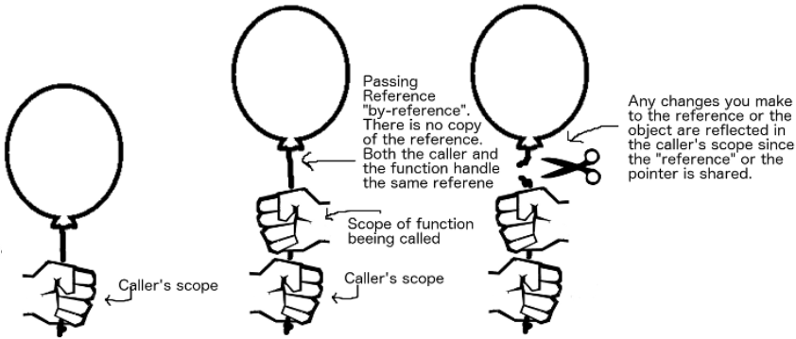
Pass-by-Reference (Not Allowed In Java)

Slide 18

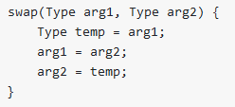
Litmus test
There’s a simple “litmus test” for whether a language supports pass-by-reference semantics:
actually switches the values of the variables var1 and var2, the language supports pass-by-reference semantics.

Slide 19
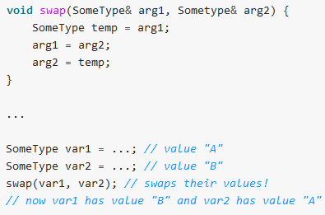
Implementation of C++ Language

Slide 20
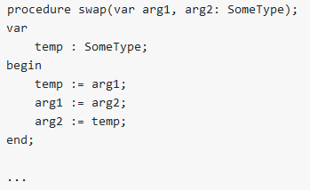
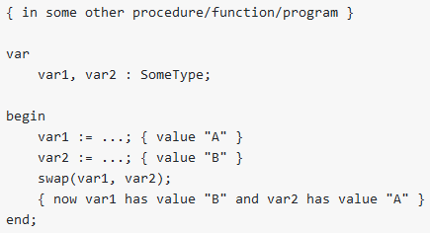
Implementation of Pascal Language

