Slide 1
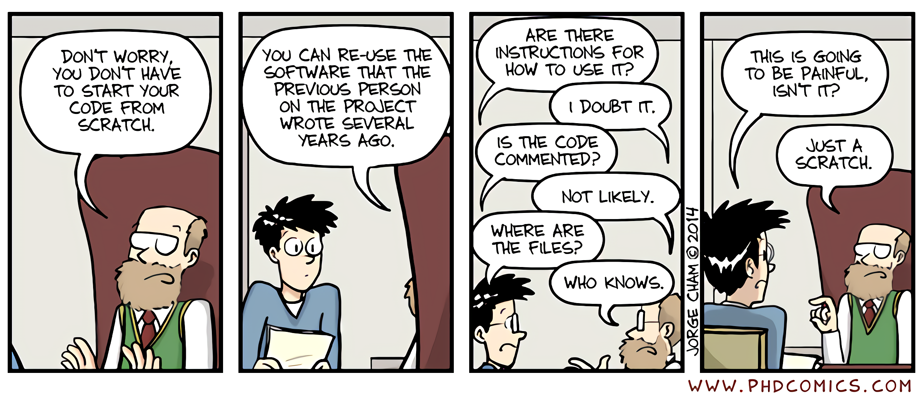
Reproducible Science

Slide 2



Why R Markdown
1. To record your bioinformatic work flow
Support multiple languages
2. To generate interactive reports of your work

Slide 3
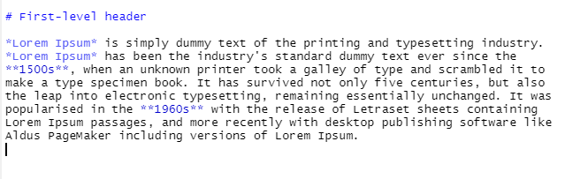
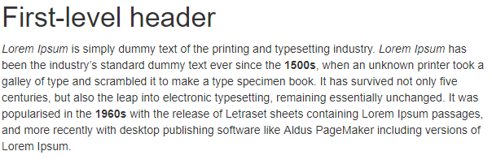
Basic Markdown
Section headers can be written after a number of pound signs, e.g.,
# First-level header
## Second-level header
After compiling
Inline text will be italic if surrounded by underscores or asterisks, e.g.,
_text_ or *text*
Bold text is produced using double asterisks (**text**).

Slide 4
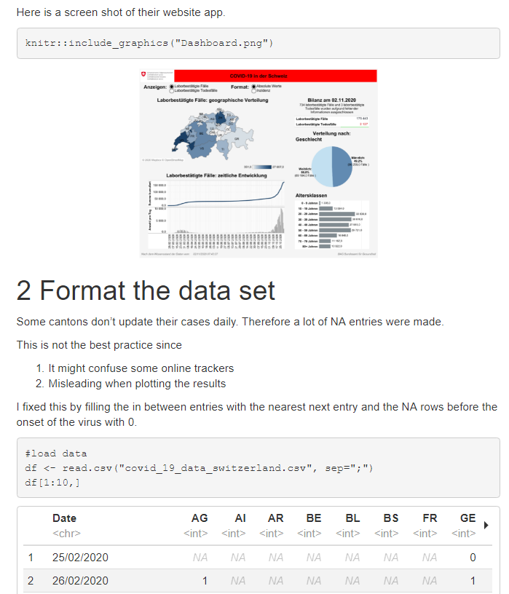
R Markdown
Code + Literate writing
More functions:
Build blogs and websites
Author books
Make html slides
Shiny Apps
There is no limit…..

Slide 5
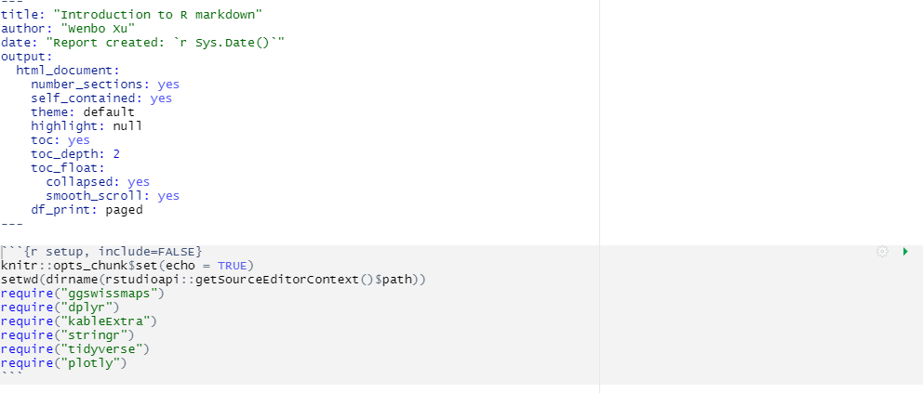
R Markdown structure
Output file
: Header
Output file parameters
Code chunk

Slide 6
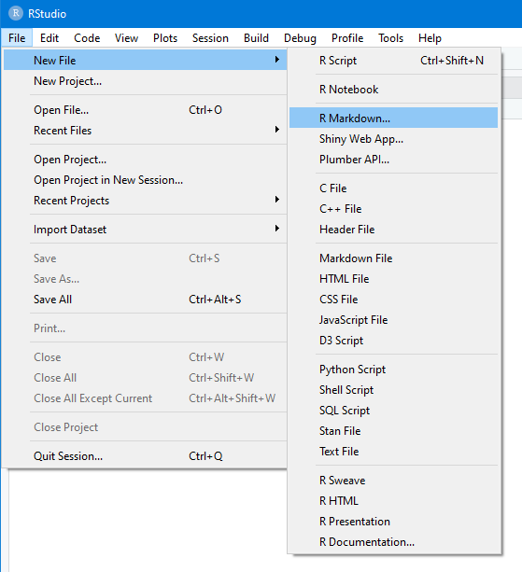
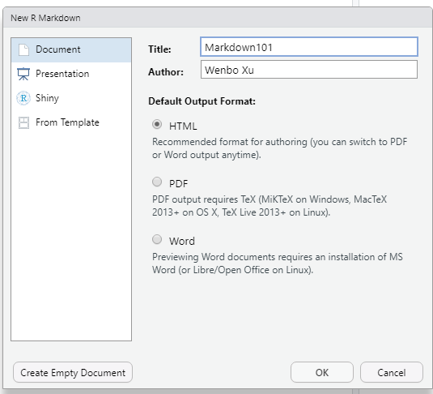
Baby steps
* You need to have LaTex or similar on your machine to compile R markdown to PDF

Slide 7
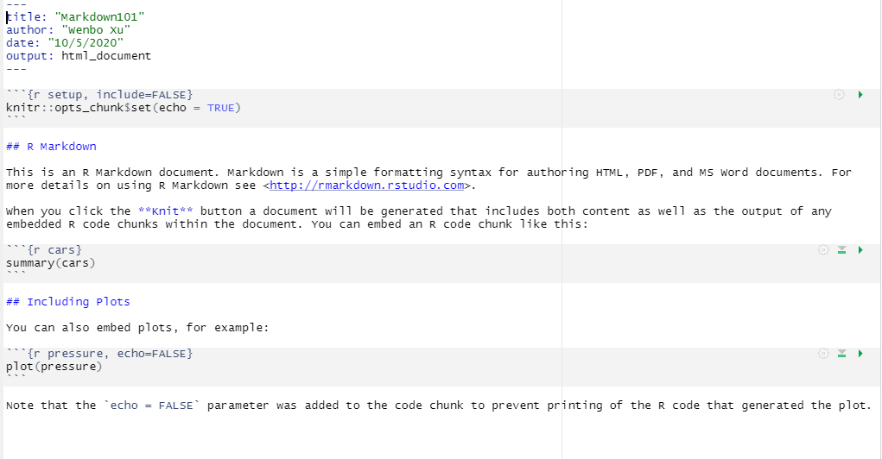
Default template
: Header
: Code
: Text
: Code
: Text
: Code
: Text

Slide 8
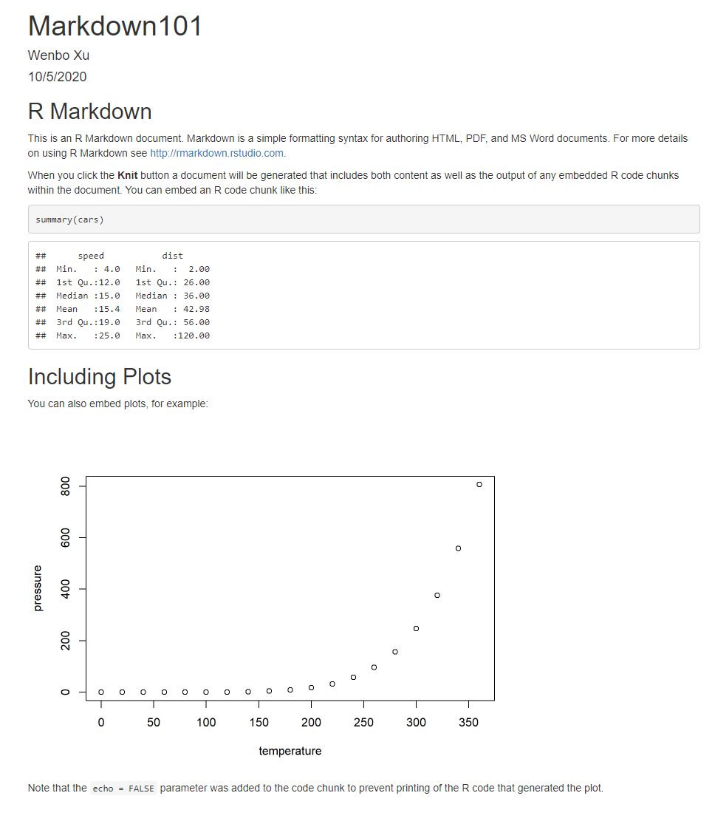



Rendered output
A single html file that can be opened with most modern Browsers

Slide 9
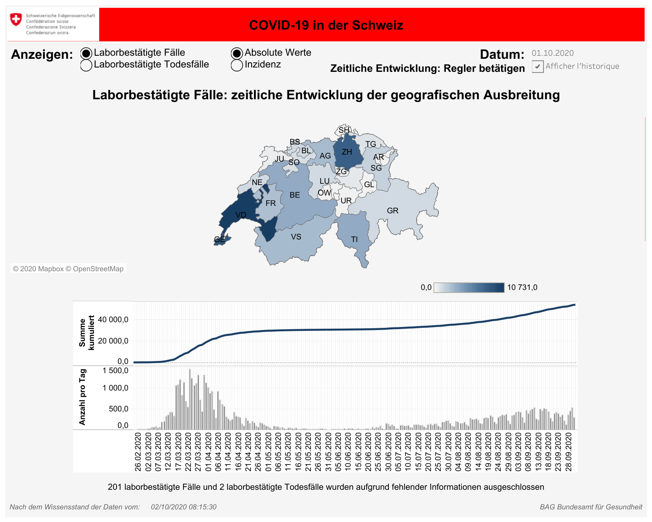
Hands On Time
Plot Covid-19 cases in Switzerland

