Slide 1

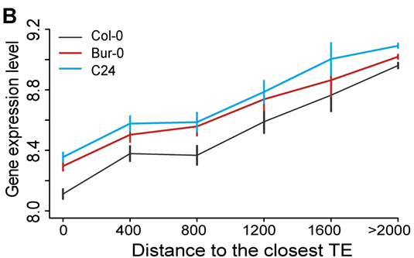
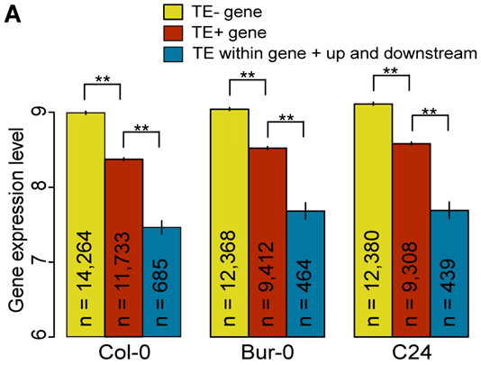
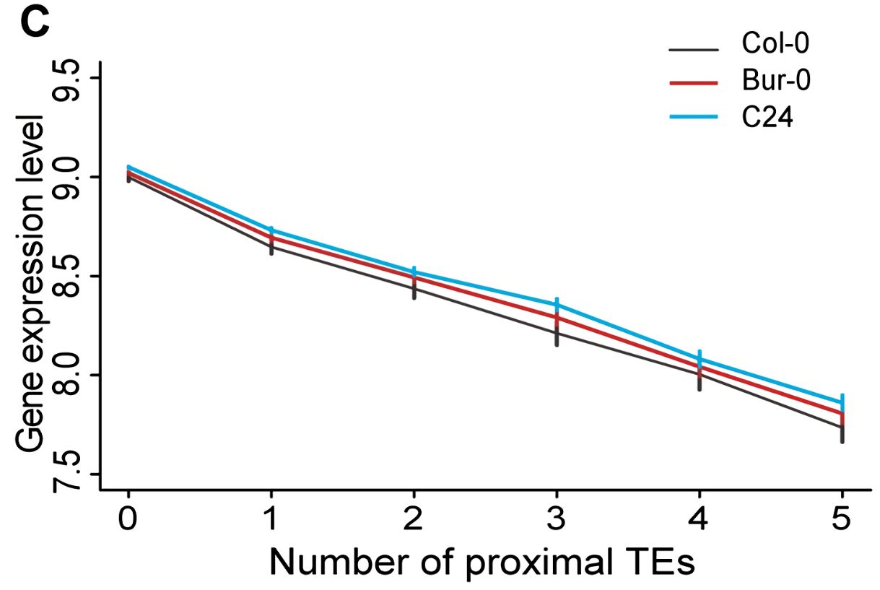
What do we know – A. thaliana
Global effects
Gene expression is suppressed by proximal TEs, especially if they are close to the gene and numerous (Hollister and Gaut, 2009, Wang et al., 2013).
https://www.eurekalert.org/multimedia/pub/web/103393_web.jpg
The average expression level of neighboring genes was positively correlated with the distance to the nearest TE
Genes with proximal TEs (< 2kb) were on average expressed at lower levels than those without proximal TEs

Slide 2
What get practiced
Rstudio, Rmarkdown, file parsing in R
Genome annotation files and how to use them
How to process NGS data

