Slide 1

Introduction to Database using SQL Server Database Platform
By: Maynard I. Capil

Slide 2
Full Name: Company / School: Reason(s):

Slide 3
Couse Outline

Slide 4


Maynard Capil, MIT, MCSA
Doctor in Information Technology – in-progress
Masters in Information Technology
Profession: SQL Server DBA / 13+ years in
I.T Industry
Bachelor of Science in Information Technology
Vocation: 3+ years as part time I.T Lecturer
Specializations:
Database Administration, Windows Server, Backend Automation, Project Management,
I.T Operations and Management, .NET Programming
Associate Degree in Software Development
Subjects Taught:
Information Management
Database Administration
Object Oriented Programming
Introduction to Programming
Software Engineering
I.T Project Management
Web Development
Technical Certifications
Microsoft Certified: Azure Database Administrator Associate
Microsoft Certified: Azure Data Engineer Associate
Microsoft Certified: Azure Administrator Associate
Microsoft Certified Solution Associate MCSA: SQL 2016 Database Administration
Scrum Foundation Professional Certificate
Cyber Security Foundation Professional Certificate - CSFPC™
Remote Work and Virtual Collaboration Professional Certificate - RWVCPC

Slide 5
Career Path
Studying databases is critical in many career paths due to several reasons:
High Demand for Data Skills
Critical for Modern Applications
Career Opportunities
Competitive Advantage

Slide 6
Career Tips for Entry Level
Build a Strong Foundation
Stay Patient and Positive

Slide 7
SQL vs RDBMS vs Tools
SQL
MS-SQL Server
Oracle
MySQL
PostgreSQL
Common Language: SQL –Structure Query Language
RDBMS: Oracle, MS-SQL, MySQL, PosgreSQL, Sybase etc.
Database Tools: SQL Server Management Studio, Oracle Developer, Toad, SQLYog, MySQL Workbench, Azure Studio etc

Slide 8
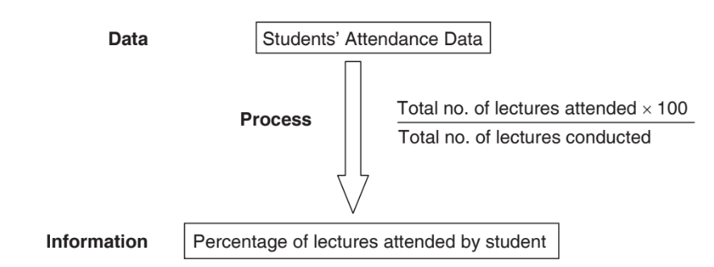
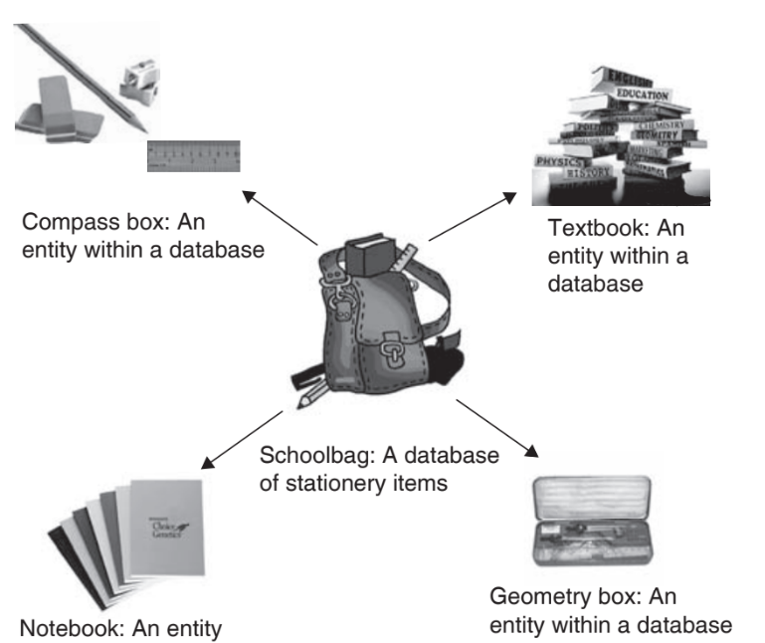
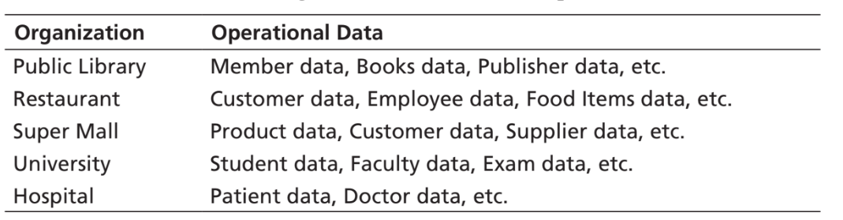
Introduction to Database
Data -> raw facts which may be numbers, values, names, dates etc
Information -> processes related to data
Relationship
Data
Process
Information
What is Database??

Slide 9
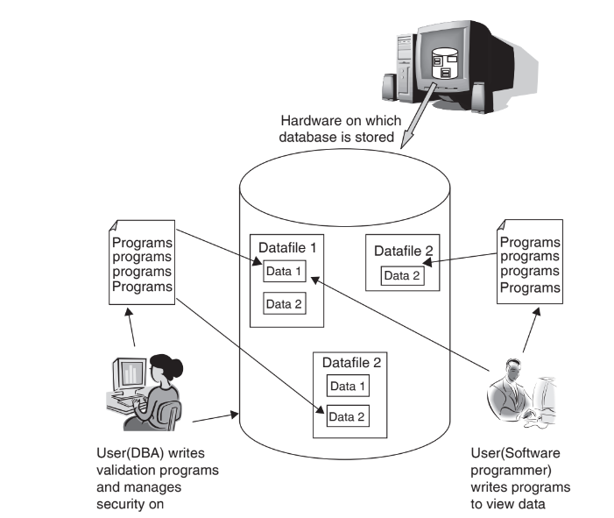
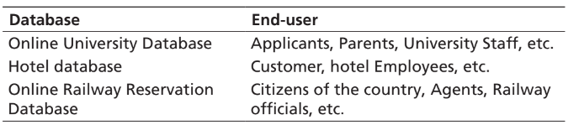
Database System Components

Slide 10

Why MS-SQL Server?
Integration with Microsoft Ecosystem
High Performance and Scalability
Security Feature
Comprehensive Tools
Cloud Ready
Support and Community
Cost-Effective Editions

Slide 11
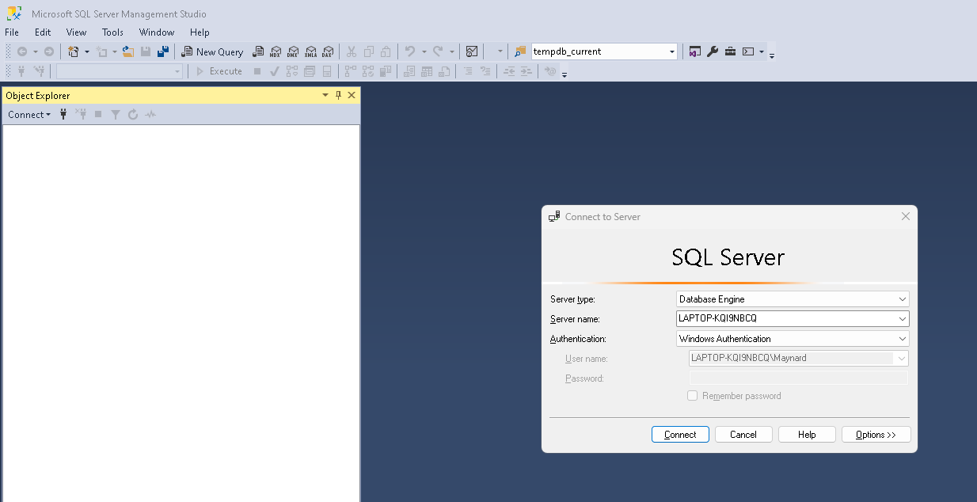
SQL Server Architecture

Slide 12
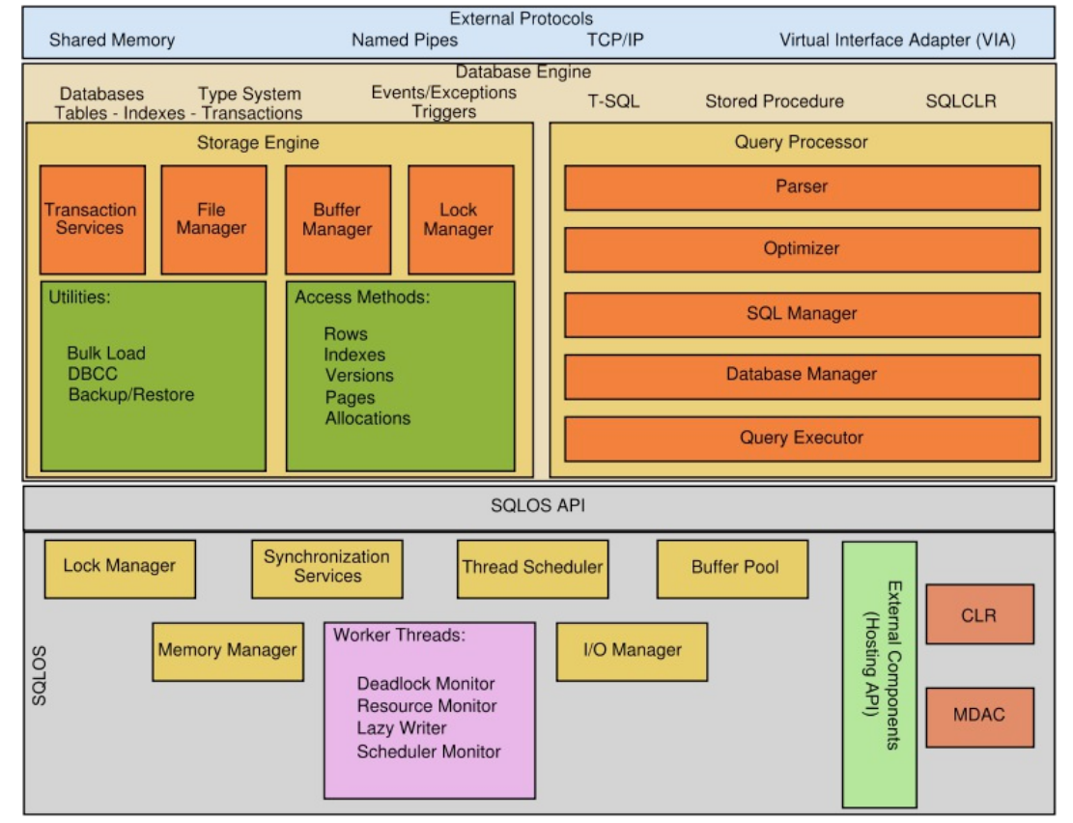
SQL Server Architecture
1
2
3

Slide 13
Database Modelling
Requirements analysis
Planning
System definition
Database Designing
Logical Model
Physical Model
Implementation
Data Loading
Normalization

Slide 14
A Sample Business Case / Problem
GG-Angkas App

Slide 15
Common Problems
Traffic Congestion in Urban Areas
Lack of Affordable Transportation Options
Slow Delivery of Goods and Services
Parking and Space Issues
Difficult in Booking Reliable Transport

Slide 16
What is GG-Angkas App?
Is a motorcycle ride-hailing and delivery service platform that involve riders, passengers, booking and payment entities.
Business Rules
Passenger Registration : passenger must be registered with their contact details (first name, lastname, phone number, email) to book a ride
Rider Registration: riders must be registered with their license information and motorcycle plate details
Booking Process: A passenger book a ride by specifying the pickup and drop-off locations Bookings have different statuses: Pending, Accepted, Completed or Cancelled
Payments: Payments are processed after ride is completed The payment method can be cash, GCASH or online payment

Slide 17
Conceptual Diagram – Visual Diagram
Establish the entities and their relationships
Passenger-Booking: A passenger can have multiple bookings, but each booking is associated with one passenger. (1:N)
Rider-Booking: A rider can fulfill many bookings, but each booking involves one rider. (1:N)
Booking – Payment: A booking can have one payment, and each payment it tied to a booking. (1:1)

Slide 18
Logical Diagram – Oracle SQL Modeler
detailed version of a Conceptual ERD. A logical ER model is developed to enrich a conceptual model by defining explicitly the columns in each entity and introducing operational and transactional entities

Slide 19
Physical Design – MSSQL Server
Process of translating a database’s logical design into actual database implementation

Slide 20
Industry Assignment
 | Governance
 | Finance
 | Education
 | Media and Entertainment
 | Food and Beverage
 | Automotive
 | Telecommunication
 | Fashion and Apparel
 | Insurance
 | Retail

Slide 21
Module 1: Task 1
Create a PowerPoint presentation based on your assigned industry, that includes:
Propose Title
Introduction (brief description of your solution)
Common Problems
Business Rules (in a bulleted format, at least 5)
Conceptual and Logical diagram and relationship of each entities
Minimum of 4 entities, maximum of 6 entities
Physical Implementation using SQL Server

