Slide 1

ConferNow – A Conference Management System
“ConferNow©" is a web based software that supports the organization of online conferences, webinars, and meetings for people all around the world.
Group 22:
IIT2020113 Meghana Pedduri
IIT2020133 Niranjani Koteshwar
IIT2020134 Shah Krishna Dineshkumar
IIT2020200 Prakhar Jalan

Slide 2

Index
Introduction
Structure and relationships
Tech used
Features of the App
Login page
Register page
Home page
Host conference
Join chat room
Attend conference
Conferencing
Q&A feature
Leave conference
End conference

Slide 3
Introduction
ConferNow is a user-friendly technology designed to help humans organise meetings in a business setting. Users can use this programme to schedule meetings using a decision-oriented technique. Users choose the date, time, and resources needed to run efficient meetings between participants. The date, time, programme schedule, speaker information, and planned activities for the meeting are all shared with anyone who are interested. It also allows users to pre-register for the conference and use the system at any time and from any location.
With the increasing number of individuals wanting to share, learn and discuss on a wide range of interesting subjects, it has become a necessity to build a platform connecting people from all corners of the globe to take part in the joy of exchanging ideas and knowledge. ConferNow is a detailed software, aimed towards organizations with frequent conference scheduling and administration needs. It will facilitate conference management for the target audience to meet the needs of modern work environments.
It supports Interpersonal Communication, Collaboration, Presentations and education.

Slide 4
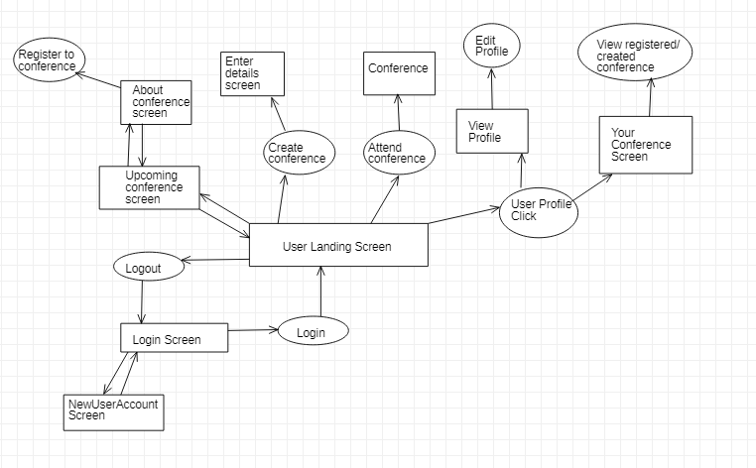
Structure and Relationships

Slide 5





Tech Used
Group video calling application using the Agora Web SDK with a Django backend.
The languages used for building the application:
Python
Django
HTML
CSS
javaScript

Slide 6
Features of the App
The following are the features of the app:
Login
Register
Dashboard
Host a conference
Register for a conference
Attend a conference
Audio/Video conferencing
Leave conference
End conference

Slide 7
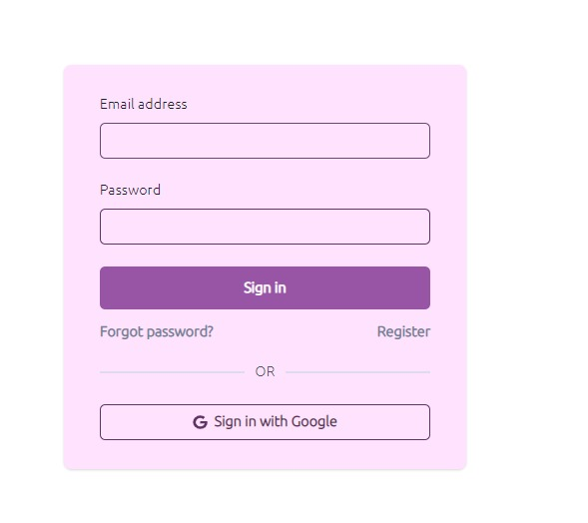
Login Page
Description:
Login via registered credentials in order to authenticate your identity.
Stimulus/Response Sequences:
If the user has an existing account, he/she will be directed to this page, where they can login using registered email and password. Click on the forgot password button, where you can reset your password in case you forgot.
Functional Requirements:
An existing account on ConferNow
Password and email

Slide 8
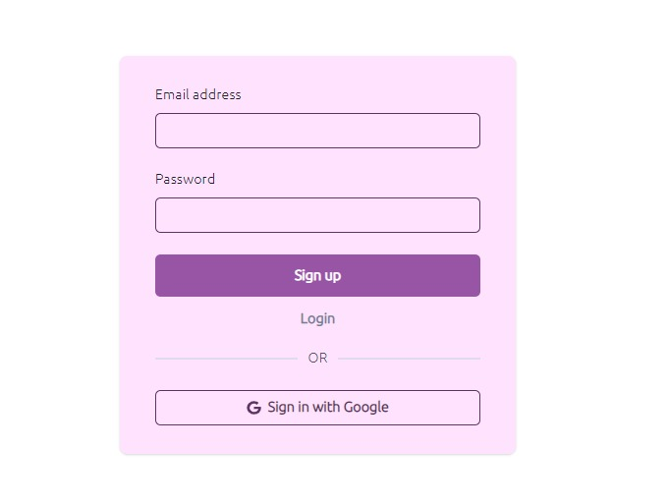
Register Page
Description:
Register page for the user. The users must be registered into the platform to have access to its features .
Stimulus/Response Sequences:
If the user doesn’t have a priorly existing account, he or she is redirected to the registration page where they must enter their .
Functional Requirements:
All mandatory details must be filled
Email verification is required

Slide 9
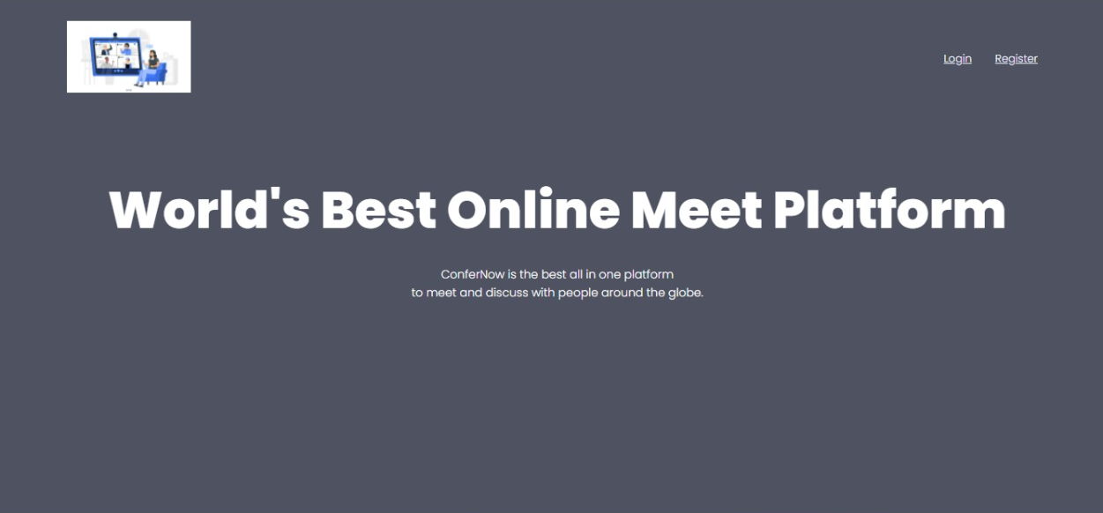
Home Page
Description:
Users can access the register and login features through this page
Stimulus/Response Sequences:
Authenticated users will be directed to this page.
You can view the login and the register button on this page.
Functional Requirements
Users should open the app

Slide 10
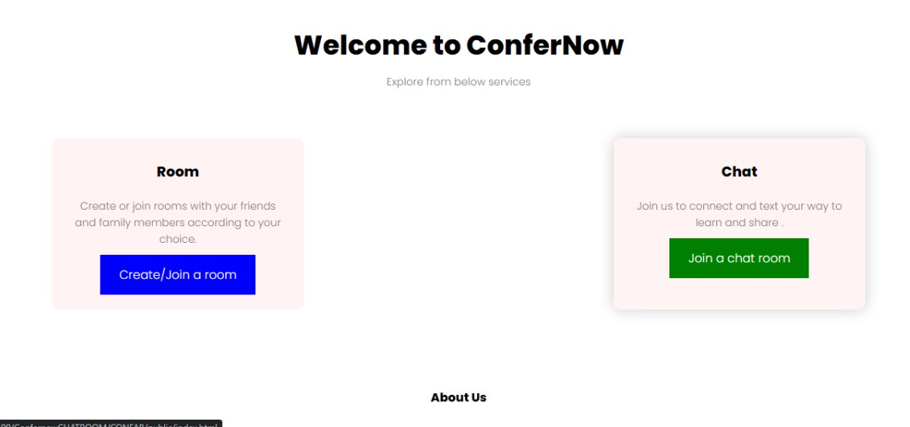
Host Conference
Description and Priority:
This is the key feature of ConferNow,
where an organization can host a conference,
and send an invitation to the desired audience.
Stimulus/Response Sequences:
The system will ask for the following inputs from the organization while they use the host feature:
Date
Time (IST)
Information about the hosting organization
Once the system receives these inputs, it will generate an invite link for the conference and the host can send this invite link to their target audience.
Functional Requirements:
When creating an event, all necessary information should be given in detail

Slide 11
Join chat room
Description and Priority:
Allows us to join a chat room
Stimulus/Response Sequences:
Click on the join a chat room button then it’ll direct you to a chat room
Functional Requirements:
When joining a chat room we should make sure that we are logged in.

Slide 12
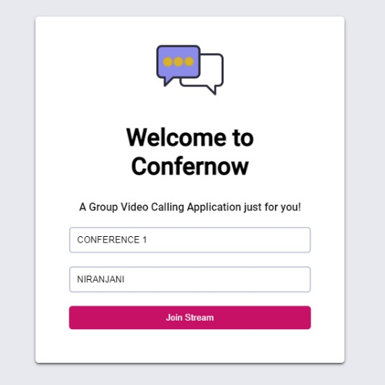
Attend Conference
Description:
The users registered into a conference can join the ongoing session
Stimulus and response:
After successful registration, the user can click on the “Join” button, which will be enabled once the conference starts. During the conference, the participants will have the access to a broad panel of options such as video chat, audio chat, a Q&A panel in the form of text chat as well as the option to present their screen.
Functional Requirements:
Already registered for the conference.
Conference has started

Slide 13
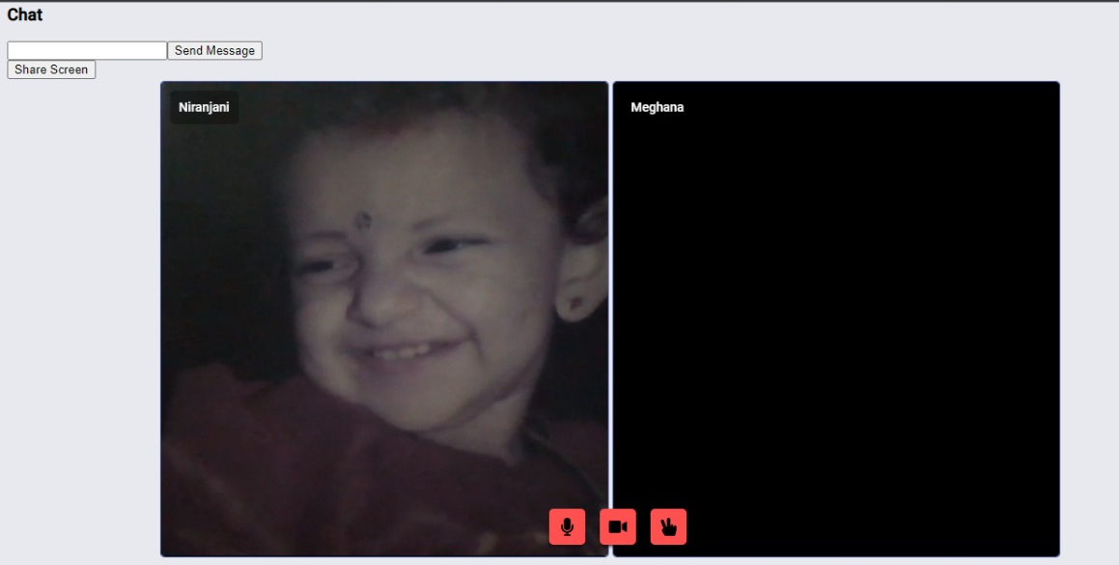
Conferencing
Description:
ConferNow also provides audio and video conferencing options during the conference, for better interaction.
Stimulus/Response:
The audio and video button, named as mute and camera respectively, enables the participants and host to turn on/off their audio or video accordingly.
Functional Requirements :
Must have a microphone and camera connected.
Must allow ConferNow to access the system’s camera and microphone.

Slide 14
Q&A Feature
Description:
During a conference, the participants can ask questions to the hosts through the Q&A option as well.
Stimulus/Response:
The Q&A panel present on the side
,on clicking will allow the participant
to type all their queries and even
their responses to the speaker that
will only be received and read by
the host.
The host can respond via panel.

Slide 15
Leave Conference
Description:
The participants can leave amidst the conference
Stimulus and response:
The end option only visible to the participant can be used to exit the ongoing session. The participant can join again using the attend feature.
Functional Requirements:
The user must have the role of a participant

Slide 16
End Conference
Description:
The host can end the conference using the end option.
Stimulus and response:
The end option only visible to the host can be used to end the session. The conference ends
Functional Requirements:
The user must have the role of a host to have this feature

Slide 17

Thank You!
Group 22

