Slide 1
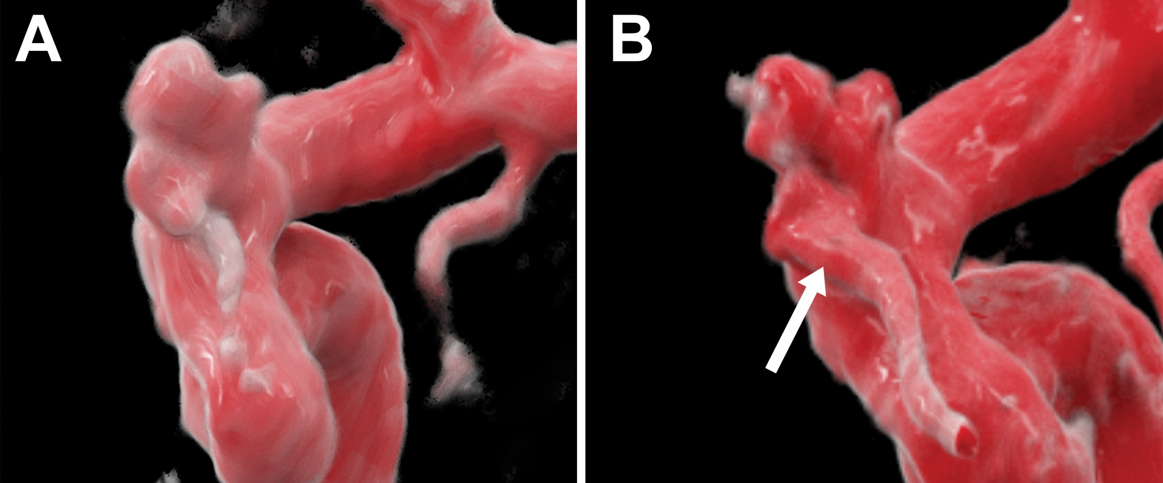
Cerebral Aneurysm Imaging at 7 T with Use of Compressed Sensing
ClarityWise / FastPath Image-Limited Review and Audit
Clinical Source Context
A 51-year-old woman with autosomal dominant polycystic kidney disease underwent screening for intracranial aneurysm.
Intracranial time-of-flight MR angiography demonstrated a superiorly projecting left ophthalmic artery aneurysm measuring 4 mm from neck to dome.
Ultra-high-resolution 7-T TOF MRA was performed to better characterize the aneurysm.
Audit Objective
Artifact-first review: describe image evidence first, then audit against source caption.
Safety posture: no image-only final diagnosis without source context and specialist review.
Figure 1. Cinematic rendering of standard 1.5-T TOF MRA compared with 7-T TOF MRA in a 51-year-old woman with ADPKD undergoing intracranial aneurysm screening. The 7-T MRA better demonstrates aneurysm sac complexity and the relationship to the ophthalmic artery origin, indicated by the arrow.
Source: Desai A, Middlebrooks EH. Cerebral Aneurysm Imaging at 7 T with Use of Compressed Sensing. Radiology. 2023;306(3):e221277. DOI: 10.1148/radiol.221277. Image/source material © Radiological Society of North America (RSNA). Used here for educational review and source-attributed analysis; permission may be required for redistribution or publication.
Educational/research audit demonstration only; not a medical diagnosis or substitute for neuroradiologist interpretation.
1

Slide 2
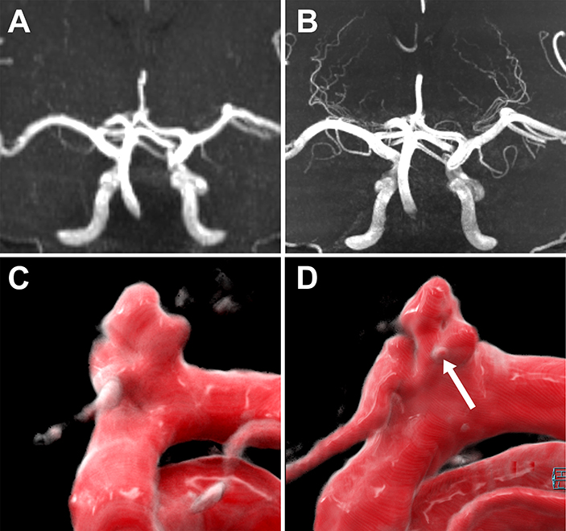
Supplemental Figure Review — 1.5-T vs 7-T TOF MRA
Higher spatial resolution and compressed sensing sharpen vascular detail and sac morphology.
ClarityWise Image-Limited Review Box
Patient context: 51-year-old woman.
Clinical context: autosomal dominant polycystic kidney disease.
Screening indication: intracranial aneurysm.
Figure type: vascular MR angiographic comparison with 3D cinematic renderings.
Visual finding before audit: vessel-associated lobulated outpouching-like abnormality near an intracranial arterial branch/junction.
Candidate interpretation before source confirmation: possible intracranial aneurysm-type vascular outpouching.
Safety constraint: no final diagnostic conclusion from figure alone without source caption, complete imaging series, measurements, and specialist review.
Figure S1. Coronal MIP images from standard clinical TOF MRA are compared with ultra-high-resolution compressed-sensing 7-T TOF MRA. Cinematic renderings compare the ophthalmic artery aneurysm from 1.5-T TOF MRA with a similar 7-T projection. The 7-T MRA better demonstrates aneurysm sac complexity and a small daughter aneurysm, indicated by the arrow.
Source: Supplemental Figure S1 from Desai A, Middlebrooks EH. Cerebral Aneurysm Imaging at 7 T with Use of Compressed Sensing. Radiology. 2023;306(3):e221277. DOI: 10.1148/radiol.221277. Image/source material © RSNA. Used here for educational review and source-attributed analysis; permission may be required for redistribution or publication.
Educational/research audit demonstration only; not a medical diagnosis or substitute for neuroradiologist interpretation.
2

Slide 3
ClarityWise Audit Against Publication Ground Truth
Image-only description matched the abnormality class while preserving diagnostic restraint.
Ground Truth from Publication
Diagnosis/finding: superiorly projecting left ophthalmic artery aneurysm.
Size: 4 mm from neck to dome.
Imaging comparison: standard 1.5-T TOF MRA versus ultra-high-resolution compressed-sensing 7-T TOF MRA.
7-T advantage: better depiction of aneurysm sac complexity, ophthalmic artery origin relationship, reduced blurring, small perforators, and small daughter aneurysm.
Audit Item | ClarityWise Image-Only Output | Publication Ground Truth | Result
Vascular imaging | Likely angiographic / 3D vascular reconstruction | TOF MRA and cinematic rendering | Pass
Intracranial vascular anatomy | Supported as candidate | Intracranial TOF MRA | Pass
Focal abnormality | Lobulated vessel-associated outpouching | Ophthalmic artery aneurysm | Pass
Aneurysm lane | Possible aneurysm-type outpouching | Confirmed aneurysm | Pass, conservative
Arrow significance | Neck/base/branch relationship candidate | Ophthalmic artery origin; daughter aneurysm in supplement | Pass, partly undercalled
7-T advantage | Better morphology/detail on higher-quality figure | 7-T shows sac complexity, small vessels, daughter aneurysm | Pass
Diagnostic restraint | No final diagnosis made from figure alone | Appropriate under prompt constraints | Pass
ClarityWise behaved appropriately: it detected the correct abnormality class while resisting premature final diagnosis.
Educational/research audit demonstration only; not a medical diagnosis or substitute for neuroradiologist interpretation.
3

Slide 4
Final Audit Synthesis
After source confirmation, the image-only review is best characterized as conservative and clinically safe.
Audit Grades
Visual detection: A−
Constraint compliance: A
Clinical safety: A
Specific diagnosis recovery: intentionally blocked
Confirmed Interpretation Context
Best audit label after source confirmation:
Left ophthalmic artery aneurysm with complex sac morphology; 7-T compressed-sensing TOF MRA better demonstrates the ophthalmic artery relationship and small daughter aneurysm compared with standard 1.5-T TOF MRA.
Why the audit passes
The image-only review correctly identified a focal vessel-associated, lobulated, aneurysm-type outpouching.
It did not overreach by assigning a named artery, lesion size, rupture status, or treatment implication before source confirmation.
The main undercall was conservative: the arrowed supplement finding was described as a focal contour/neck-region candidate rather than a small daughter aneurysm.
Patient-safe summary:
This artifact illustrates how a higher-resolution 7-T MR angiogram can reveal finer detail in a small brain-vessel aneurysm. It is educational only and does not replace specialist interpretation.
Educational/research audit demonstration only; not a medical diagnosis or substitute for neuroradiologist interpretation.
4

Slide 5
References, Source Credit, and Permissions
Source attribution is kept visible to preserve provenance.
Primary Source
Desai A, Middlebrooks EH. Cerebral Aneurysm Imaging at 7 T with Use of Compressed Sensing. Radiology. 2023;306(3):e221277. DOI: 10.1148/radiol.221277.
Source URL: https://pubs.rsna.org/doi/10.1148/radiol.221277
Rights / Permissions Note
Images and source captions are from Radiology / RSNA. Copyright retained by the Radiological Society of North America.
This artifact is source-attributed for educational review. Redistribution, publication, or commercial use may require permission through RSNA/Copyright Clearance Center.
No additional diagnostic annotations were added to the source images. Original panel labels and arrows were preserved.
Safety Footer
This artifact is for educational, research, and audit demonstration purposes only. It is not a medical diagnosis, clinical recommendation, or substitute for interpretation by a qualified neuroradiologist.
ClarityWise / FastPath Radiology Audit
Educational/research audit demonstration only; not a medical diagnosis or substitute for neuroradiologist interpretation.
5

