Slide 1
GROUNDSTRUTH
Campa DMS — System Design
Distribution Management System · High- & Low-Level Design · Target stack: Vercel + Supabase
Web-app build (no native/offline this phase) · MVP go-live 4 wks · Phase 2 6 wks
Internal engineering document · companion to the Delivery Plan & MSA

Slide 2
THE SYSTEM IN ONE SLIDE
What we’re building
Warehouse
Van load-out
Field sale
Stock deduct
Collect
Reconcile
stock in, batches, FIFO
challan, qty out
order → invoice
atomic, audited
cash/UPI recorded
stock↔sales↔cash flag
The owner sees everything on one dashboard. The reconciliation flag is the anti-leakage core — every unit that leaves the warehouse ends the day sold, returned, or flagged.
In this build
Out (later paid add-ons)
MVP: auth/RBAC, SKU master, inventory (FIFO, low-stock), van load + challan + returns, retailer onboarding, order→invoice→deduct, cash/UPI + owner dashboard
Phase 2: beat + GPS, attendance, ledger + credit, geo-PoD, discounting, WhatsApp/push alerts, daily sales report
Offline-first + auto-sync · native mobile app
Automated scheme engine (buy-X-get-Y)
Targets, expense/KM · advanced analytics
Full damaged-goods / RTV
IRN/e-invoice, e-way bill · payment-gateway money movement · multi-tenant
GroundsTruth · DMS System Design · Internal
2

Slide 3
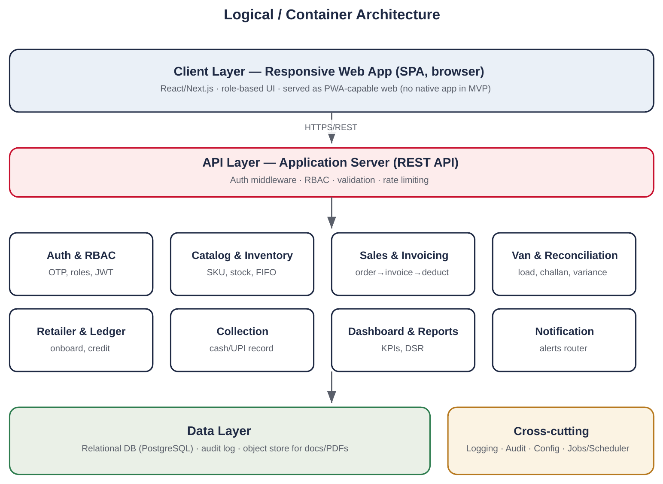
HIGH-LEVEL DESIGN
Architecture at a glance
The shape
Modular monolith. One web client, one application surface organised into cohesive modules — right-sized for one distributor and a two-person team, not premature microservices.
Four layers. Web client (Vercel) → API surface (auto-REST + RPC/Edge Functions) → service modules → Postgres as system of record.
Each module owns its tables and exposes a clean interface, so a hot module (inventory, sales) can be extracted later if the product ever serves many distributors.
Cross-cutting concerns — auth, audit, config, scheduled jobs — run across all modules.
GroundsTruth · DMS System Design · Internal
3

Slide 4
TECHNOLOGY CHOICES
The stack — aligned with BookMyMedia
We deliberately reuse the BookMyMedia stack so we move fast on familiar tools and can share components. Each choice below earns its place for this DMS.
1
Vercel
2
Supabase
3
Next.js / React
WEB HOSTING
BACKEND PLATFORM
WEB APP
Next.js app, edge-delivered, instant deploys, preview URLs for client demos. Same flow as BookMyMedia.
Postgres + Auth + Storage + RLS + Edge Functions + Cron in one. Replaces a whole custom backend.
One responsive codebase for owner laptop + field phones; PWA-installable, no native build.
4
Google Maps API
5
Resend
6
Meta WhatsApp
GEO
EMAIL
MESSAGING
GPS check-in, geo-tagged proof-of-delivery, beat mapping (Phase 2).
Daily reports, invoice email, transactional mail. Simple, developer-first.
Low-stock & payment alerts where the distributor actually reads them.
Also: Claude (LLM) as a development accelerator and optional in-app assist later. Domain + GroundsTruth accounts hold all of these; infra billed to client pass-through.
GroundsTruth · DMS System Design · Internal
4

Slide 5
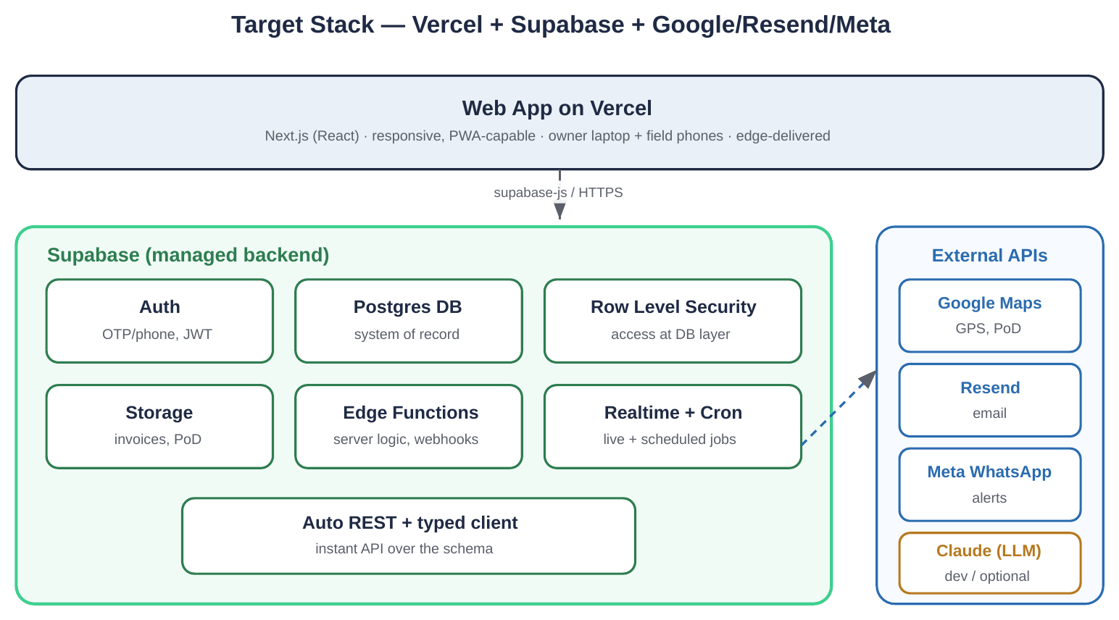
WHY THIS BACKEND
Why Supabase is the right call here
One platform, not five
Auth, Postgres, storage, realtime, scheduled jobs and an auto-generated API in a single managed service — a two-person team ships in weeks, not months.
Real Postgres
Not a document store. We get transactions (for atomic invoice+deduct), constraints (qty ≥ 0), and proper relations for ledger integrity.
Security at the database
Row Level Security enforces access on the data itself, so a driver cannot read another beat’s rows even via the raw API — stronger than app-only checks.
Cheap & predictable to run
Generous free tier, ~$25/mo Pro; the client pays infra pass-through. Self-hostable later if ever needed.
GroundsTruth · DMS System Design · Internal
5

Slide 6
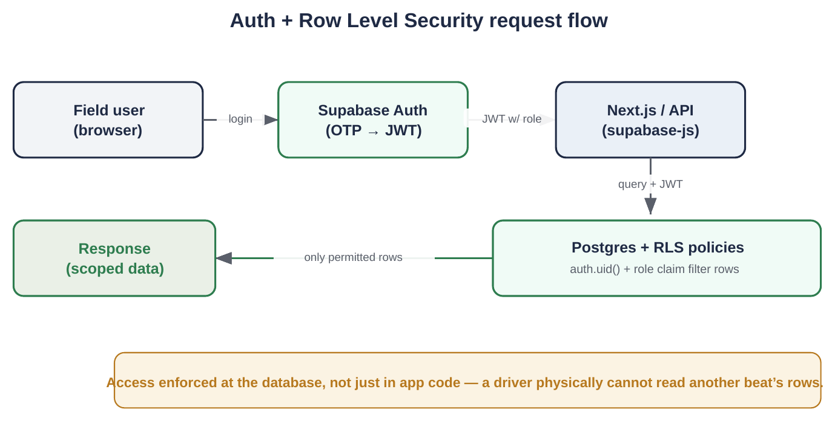
HOW A REQUEST FLOWS
Auth + Row Level Security
The access model
Login: phone OTP via Supabase Auth → JWT carrying the user’s role.
Authorise: RLS policies use auth.uid() + role claim to filter every query at the DB.
Result: owner sees all; warehouse sees stock; driver sees only their beat & cannot see margins.
Guardrail: discounts capped by an approval ceiling so a driver can’t invent them.
GroundsTruth · DMS System Design · Internal
6

Slide 7
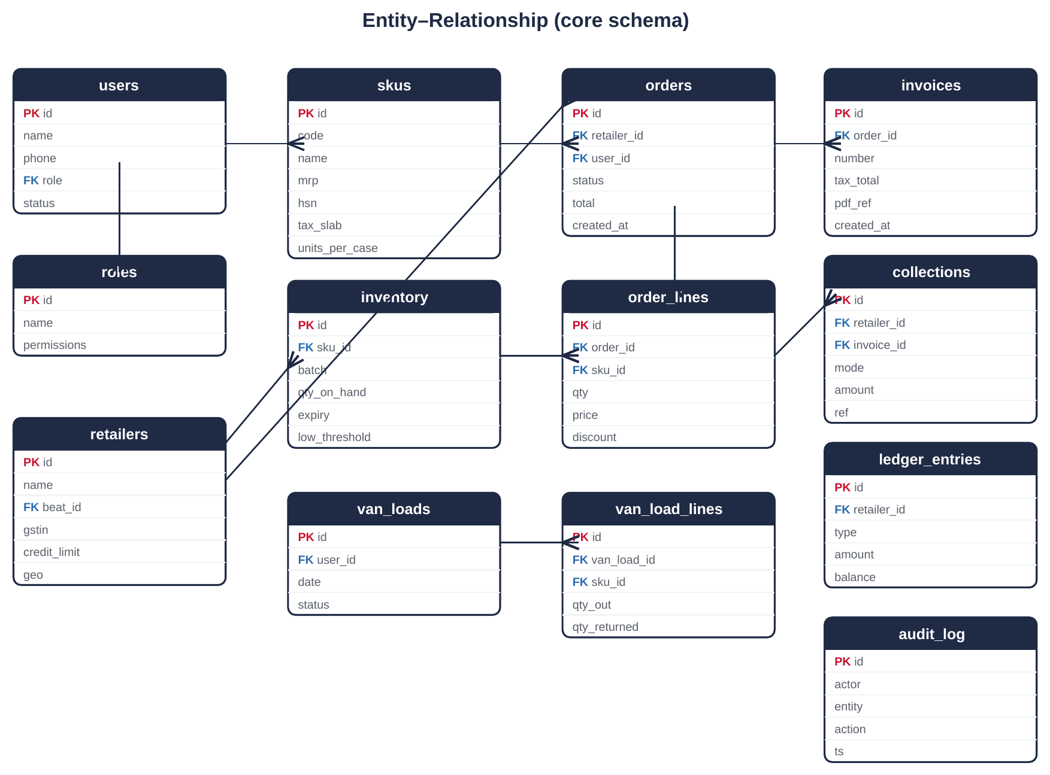
LOW-LEVEL DESIGN
Data model (Postgres)
Integrity rules
qty_on_hand ≥ 0 enforced by constraint
invoice ↔ order is 1:1; number from a configured series
invoice + stock deduct in one transaction
discount ≤ role ceiling
ledger_entries & audit_log are append-only
reconciliation reads van_load_lines vs invoiced qty
RLS on every exposed table — no exceptions
GroundsTruth · DMS System Design · Internal
7

Slide 8
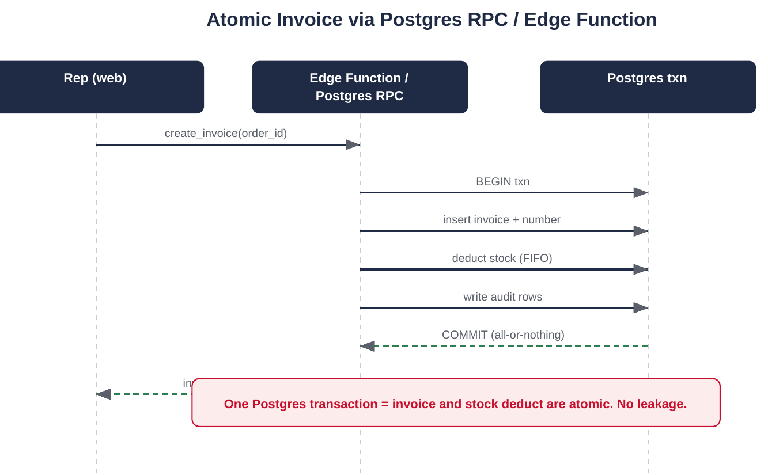
THE MONEY PATH
Order → Invoice → Stock deduct (atomic)
Why atomic matters
Invoice and stock deduction run in a single Postgres transaction — implemented as a database function (RPC) or Supabase Edge Function.
Either both happen or neither does. The system can never invoice without deducting stock, or deduct without invoicing.
This is the foundation the reconciliation depends on: if the books and the stock can drift, leakage hides. Here they cannot.
GroundsTruth · DMS System Design · Internal
8

Slide 9
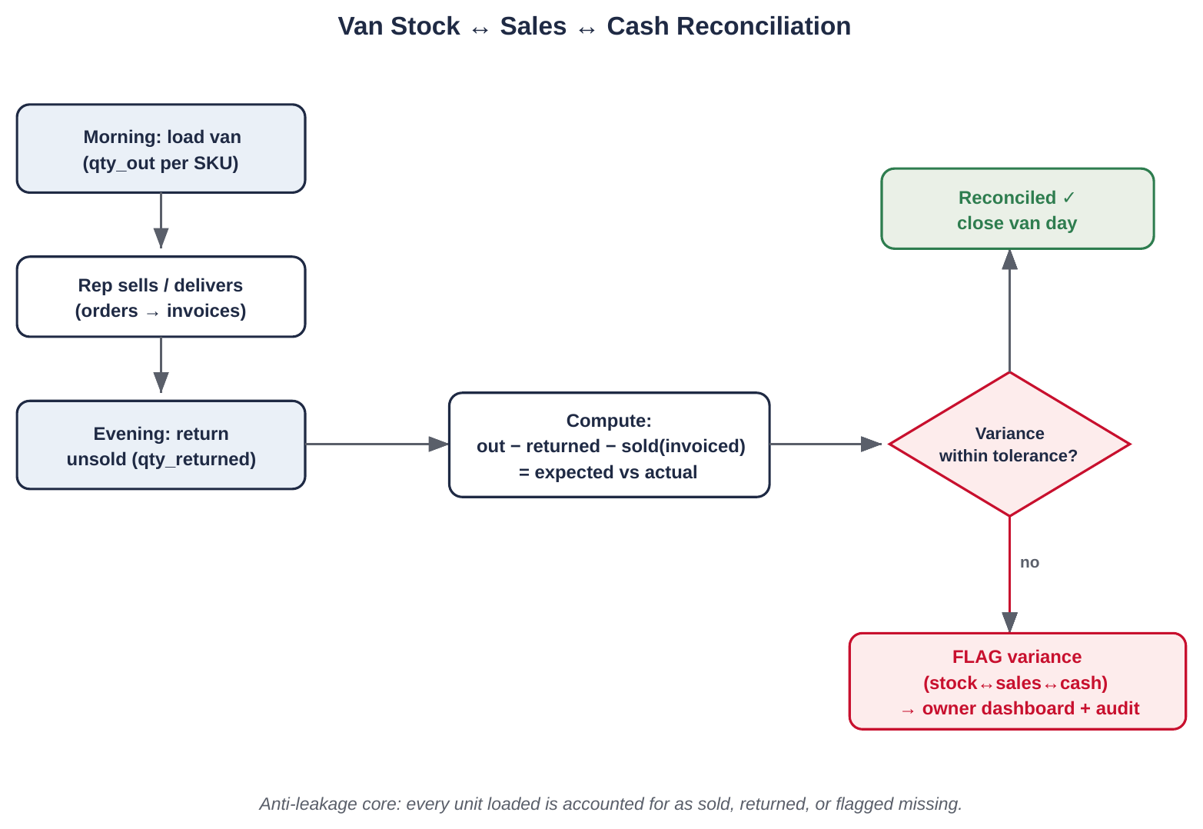
ANTI-LEAKAGE CORE
Van stock ↔ sales ↔ cash reconciliation
The variance identity
expected_returned =
qty_out − qty_sold
variance =
expected_returned − qty_returned
cash_variance =
cash_expected − cash_collected
if |variance| > tolerance
or cash_variance ≠ 0:
→ FLAG to owner + audit
Tolerance is configurable to the client’s “normal”. Built with audit from day one.
GroundsTruth · DMS System Design · Internal
9

Slide 10
LOW-LEVEL DESIGN
API surface
Two layers: Supabase’s auto-generated REST/typed client for straightforward reads & writes (guarded by RLS), and explicit RPC/Edge Functions for multi-step business logic that must be transactional or server-trusted.
Endpoint / call | Purpose | Role | Implemented via
POST /auth/otp · /auth/verify | Request + verify OTP, issue JWT | public | Supabase Auth
GET/POST /skus, /retailers, /inventory | Catalog, retailer, stock CRUD | owner/warehouse | Auto REST + RLS
POST /orders | Create draft order with lines | driver/rep | Auto REST + RLS
RPC create_invoice(order_id) | Invoice + stock deduct + audit (atomic) | driver/rep | RPC / Edge Fn
RPC reconcile_van(load_id) | Compute variance, flag if beyond tolerance | warehouse/owner | RPC / Edge Fn
POST /collections | Record cash/UPI against invoice | driver/rep | Auto REST + RLS
RPC post_ledger(retailer,…) | Ledger entry + credit check (Phase 2) | system | RPC / Edge Fn
Edge Fn notify(target,channel,…) | Send WhatsApp/email/push alert | system | Edge Fn → Meta/Resend
GET /dashboard, /reports/dsr | KPIs, daily sales report | owner | Auto REST + RLS / view
RLS means even the auto-generated endpoints are safe to call from the browser — the database refuses rows the user shouldn’t see.
GroundsTruth · DMS System Design · Internal
10

Slide 11
NON-FUNCTIONAL REQUIREMENTS
NFRs — targets we hold to
Performance
Integrity
Anti-leakage
Core screens < 1.5s p95 on 4G; dashboard < 3s
Invoice+deduct atomic; ledger never silently wrong
Every loaded unit sold/returned/flagged
Indexes; pagination; async PDF
Txn + constraints + audit
Reconciliation routine
Security
Availability
Auditability
Role-scoped; OTP; TLS; least-privilege
~99% business hours (needs connectivity)
Who/what/when on stock, money, discounts
Supabase Auth + RLS
Managed infra, backups
Append-only audit_log
Usability
Maintainability
Backup/DR
Field user completes an order in few taps
New SKU/role/tax without code change
Daily backup + tested restore
Simple role UI, big targets
Config-driven
Supabase backups + runbook
GroundsTruth · DMS System Design · Internal
11

Slide 12
HOLD THESE THROUGHOUT
Considerations & guardrails
Liability hotspots
Data & config
Inventory/van ledger + variance flag — build first, audit from day 1
Invoice/challan/HSN/tax — config-driven, to client CA’s signed-off spec
Manual discount — bounded by approval ceiling
Tax slabs, invoice series, thresholds, ceiling, tolerance — all config
Master data validated on import; gaps flagged before clock-start
Reliability
Security & privacy
Connectivity required — show clear ‘no network’ states
Idempotency on invoice/collection POSTs (avoid double-submit)
Daily backups + tested restore before go-live
RLS on every table; service key only server-side
Driver sees own beat only; margins hidden from field roles
GPS/attendance collected with staff awareness
GroundsTruth · DMS System Design · Internal
12

Slide 13
SECURITY & GOVERNANCE
How we keep it trustworthy
Security is enforced at the data layer, and every consequential action leaves a trail. Governance is built in from day one — not bolted on before go-live.
Access control
Audit logging
Secrets & keys
Supabase Auth (phone OTP) + Row Level Security on every exposed table. A user’s role and id are in the JWT; the database filters rows. Field roles never see margins or other beats.
Append-only audit_log captures who/what/when for every mutation that touches stock, invoices, collections, discounts and variance flags. Never updated or deleted — a tamper-evident history.
Service-role key used server-side only (RPC/Edge Functions); the browser only ever holds the anon key, which RLS makes safe. Secrets in env/Supabase Vault, never in code or the repo.
Least privilege
Data ownership & export
Change & release control
Each role gets only the permissions it needs; admin/bypass operations are server-side and logged. No shared logins for privileged roles.
Client owns its data and its instance; data export available on request. Mutual NDA; client/CA own tax-format correctness, we build to the signed-off spec.
Versioned DB migrations (no manual prod edits), separate dev/staging, reviewed schema changes, daily backups + a tested restore runbook before go-live.
Audit + RLS + atomic writes together are what make the anti-leakage claim real: the books can’t silently drift, and every change is attributable.
GroundsTruth · DMS System Design · Internal
13

Slide 14
BUILD APPROACH
Build the core first, prove it, then layer
1
Foundation
Repo on Vercel, Supabase project, schema + RLS, auth, design system
wk 0–1
2
MVP core
Inventory + atomic invoice + van reconciliation (the anti-leakage spine) + collection + dashboard
wk 1–4
3
Phase 2
Beat/GPS, attendance, ledger/credit, geo-PoD, discounting, alerts router, DSR
wk 4–6
4
Harden
Tests on critical paths, pilot with 2–3 users, backups, go-live
each phase
Detailed step-by-step build is in the Excel Delivery Tracker (70 low-level steps, MVP then Phase 2).

