Slide 1
GROUNDWORK BY JALLA
90-Day Admin Platform Plan
Turning the Groundwork admin into the operational control center required to run hundreds of active construction projects end to end.
90-DAY OKR
Ensure hundreds of existing active projects are fully operational on Groundwork — with project setup, milestone tracking, verification evidence, updates and payment workflows functioning end to end.
Presentation • September 11, 2026

Slide 2
GROUNDWORK • ADMIN PLATFORM
Why the Admin Is Critical to the 90-Day OKR
The goal is operational readiness, not simply a visual redesign.
01
Projects need a complete operational home
Setup, milestones, budgets, evidence, updates, inspections and payments must connect.
02
Communication needs project context
GHL-powered WhatsApp, email and calls need to resolve to the right person and project.
03
Operations needs one action queue
Reviews, approvals, messages, inspections, applications and issues should surface in one place.
04
Existing modules need to work together
Projects, Reviews, Budgets, Applications, Contractors and Support become connected workflows.

Slide 3
GROUNDWORK • ADMIN PLATFORM
Information Architecture
Two central concepts organize the admin: Project Workspace + Unified Inbox.
OVERVIEW
What is happening across Groundwork?
Portfolio metrics • health • pipeline • attention • activity
ACTION CENTER
What needs human action?
Approvals • reviews • messages • inspections • issues • tasks
PROJECT WORKSPACE
What is happening with this project?
Stages • budget • evidence • updates • team • issues • conversations
UNIFIED INBOX
What are people communicating about?
WhatsApp • Jalla • email • calls • project context
SUPPORTING MODULES
Where do specialized workflows live?
People • applications • quote requests • analytics • integrations

Slide 4
GROUNDWORK • ADMIN PLATFORM
Core Data Relationships
The project becomes the center of operational data; communication and activity attach to it.
Person
Client / Contractor / Agent / Team
can participate in projects, conversations and tasks
Project
Client + Contractor(s) + Team
owns stages, budget, updates, inspections, issues and documents
Project Stage
Milestone + Review
tracks status, dates, progress and approval
Site Update
Evidence + Verification
photos, description, timestamp, location and verification
Inspection
Checklist + Result
can create issues or trigger stage review
Conversation
Person + Project
stores WhatsApp/Jalla/email/call messages and internal notes
Activity
Any entity + Project
unified audit/timeline event for important changes

Slide 5
GROUNDWORK • ADMIN PLATFORM
End-to-End Project Workflow
The admin should make the operational lifecycle visible and actionable.
1
Project Setup
2
Milestones
3
Site Evidence
Client • location • plan • team • project configuration
Stages • target dates • progress • approvals
Updates • photos • GPS/time • verification
4
Communication
5
Budget & Payments
6
Resolution
Messages automatically linked to people and projects
Confirmations • commitments • spend • payment milestones
Issues • inspections • tasks • stage completion • handover

Slide 6
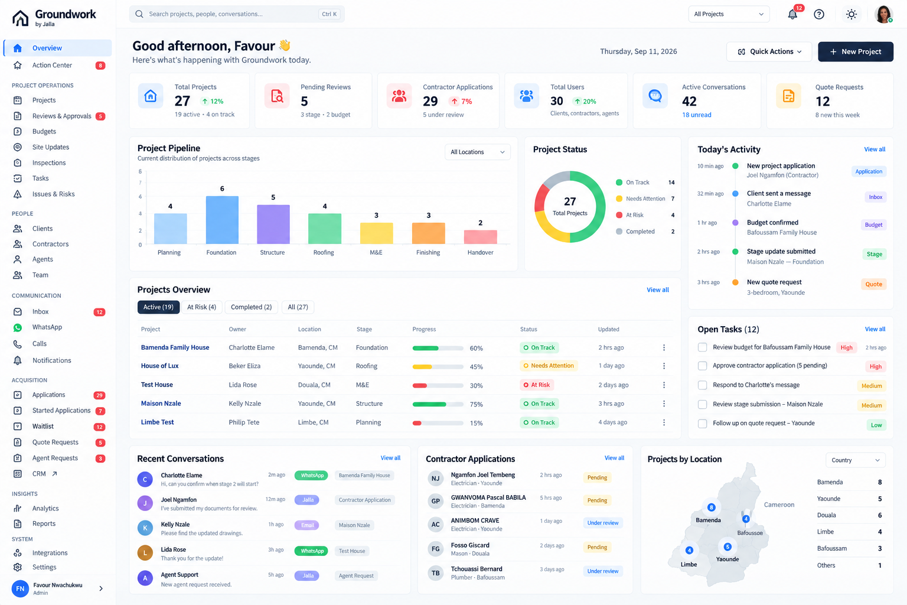
FUTURE-STATE UI • ILLUSTRATIVE
Overview — Operations Control Center
Portfolio health, action queue, project pipeline, active projects and recent activity in one view.
Primary direction: make Overview operational, not just a collection of KPI cards.

Slide 7
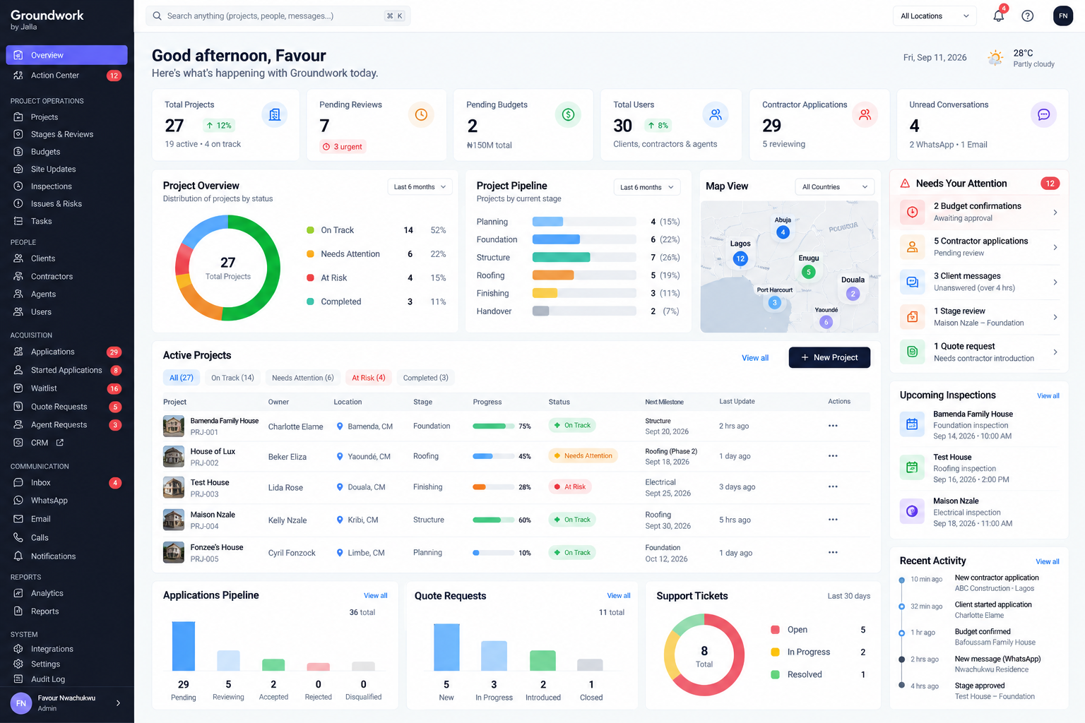
FUTURE-STATE UI • ILLUSTRATIVE
Overview — Detailed Portfolio View
A denser portfolio view for projects, attention items, inspections, applications and location.
Alternative light-mode direction showing how the dashboard can support day-to-day portfolio management.

Slide 8
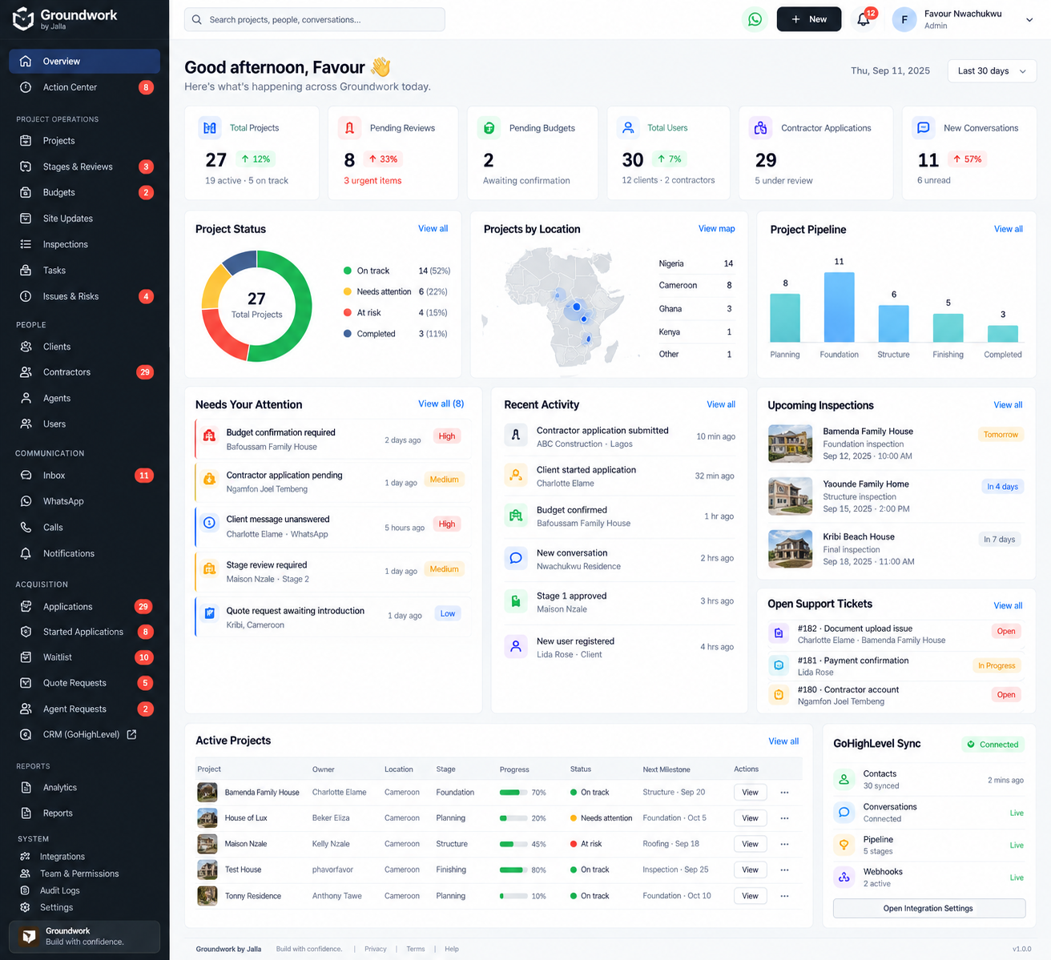
FUTURE-STATE UI • ILLUSTRATIVE
Overview — Executive / Reporting View
A reporting-oriented variation with status, pipeline, recent projects, applications and communications.
Useful for leadership visibility while preserving links back to operational workflows.

Slide 9
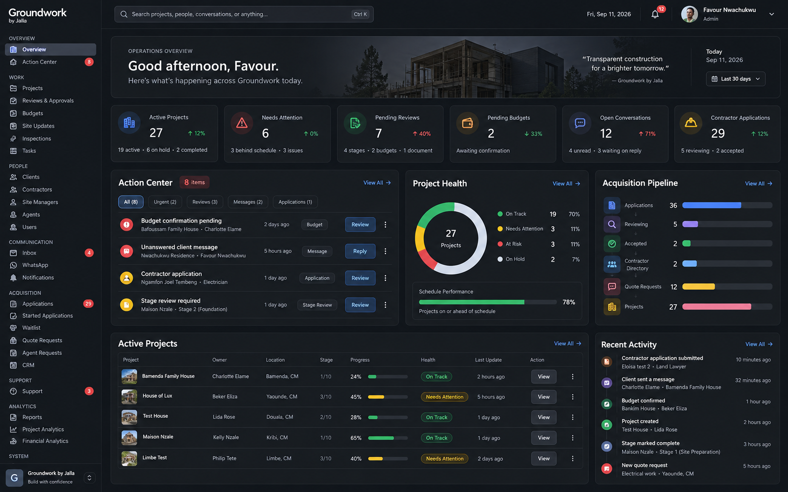
FUTURE-STATE UI • ILLUSTRATIVE
Overview — Dark Operations Mode
A high-density operations console for teams managing a large active project portfolio.
Dark-mode alternative: stronger visual hierarchy for an operations-heavy environment.

Slide 10
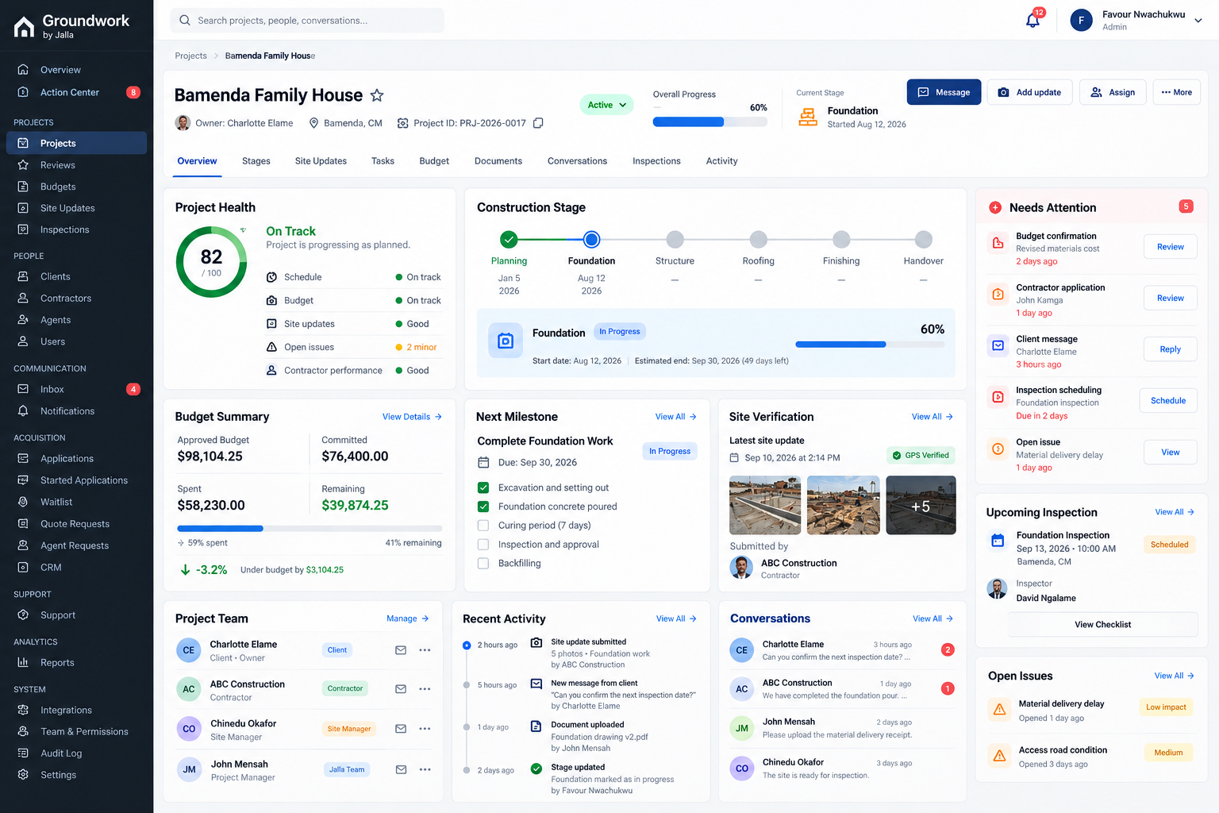
FUTURE-STATE UI • ILLUSTRATIVE
Project Workspace
Every active project gets one operational home for setup, milestones, budget, evidence, team, issues and activity.
Central project record: the key foundation for making hundreds of projects operational.

Slide 11
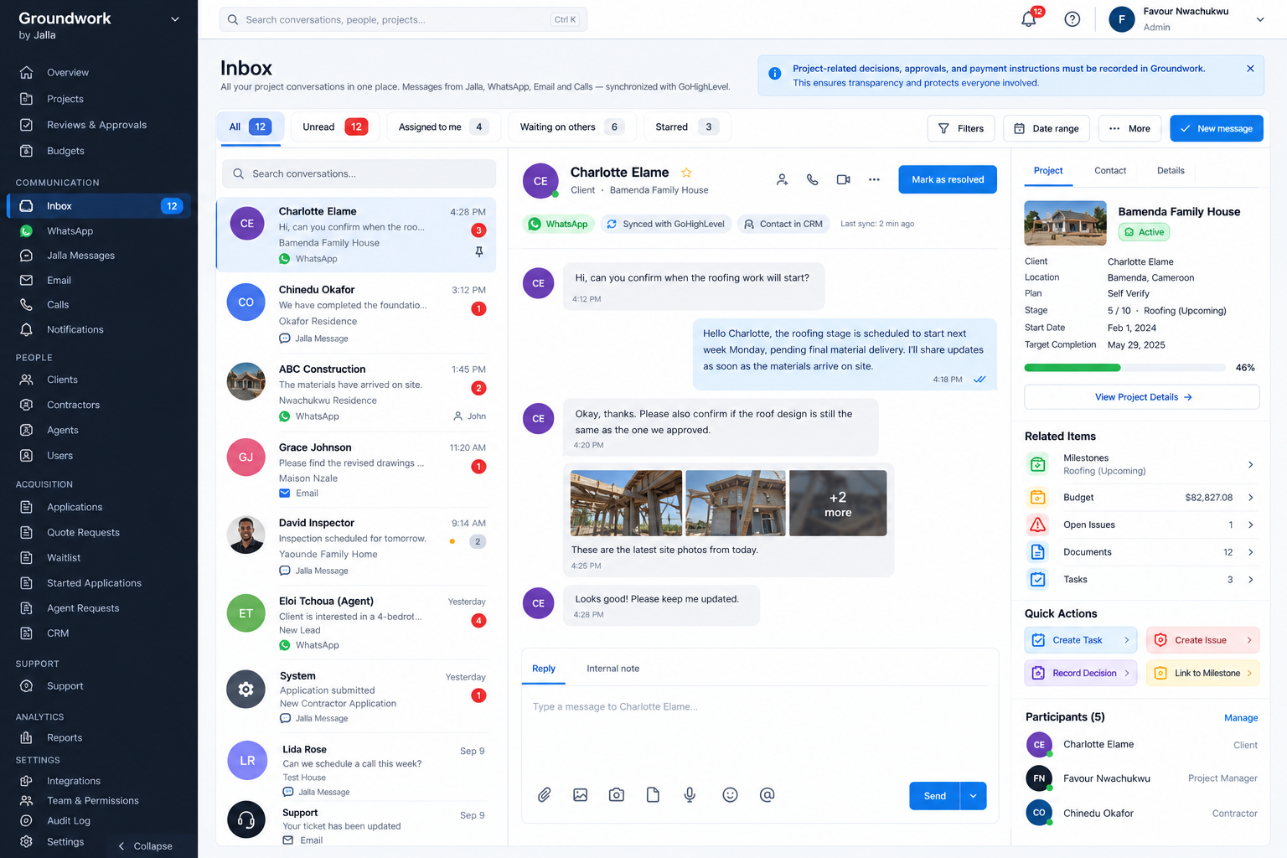
FUTURE-STATE UI • ILLUSTRATIVE
Unified Communication / Inbox
WhatsApp, Jalla, email and calls become one communication workspace with project context.
Communication is tied back to the project so admins can act without switching between systems.

Slide 12
GROUNDWORK • ADMIN PLATFORM
How Existing Modules Will Be Refactored
The modules remain — but they become specialized views around the two central concepts.
Projects
Portfolio + project workspace
Every project opens into the full operational record.
Reviews & Approvals
Global review queue
Click-through to the relevant project stage.
Budgets
Financial queue + project budget
Budget actions connect to project milestones and payment workflows.
Site Updates
Evidence queue + project timeline
Verification becomes visible and auditable.
Inspections
Schedule + results
Inspection outcomes can create issues or trigger reviews.
Contractors
Directory + contractor profile
Contractors connect directly to applications, projects and conversations.
Applications
Acquisition pipeline
Applicant → review → acceptance → contractor profile.
Quote Requests
Matching workflow
Request → contractor introduction → conversation → project.
Support
Support queue
Tickets link to the customer and, where relevant, project.
CRM / GHL
Integration view
GHL remains the communication/CRM layer; Groundwork remains the project operational source of truth.

Slide 13
GROUNDWORK • ADMIN PLATFORM
Groundwork + GoHighLevel
Preserve the existing integration while making synchronization visible and reliable.
GROUNDWORK / SUPABASE
GOHIGHLEVEL
Projects
CRM contacts
Stages & reviews
↔
WhatsApp
Budgets
Email
Site updates
Calls
Inspections
Pipeline / automations
Project relationships
External IDs / sync state
Principle: do not replace GHL or duplicate its conversation system. Build a reliable bridge and attach communication to Groundwork projects.

Slide 14
GROUNDWORK • ADMIN PLATFORM
90-Day Implementation Plan
Sequence the build around the operational outcome.
Days 1–15
Days 16–30
Days 31–50
Audit + architecture
Overview + Action Center
Project Workspace
Repository, database, auth, RLS, GHL, webhooks, existing routes and real data relationships.
Real-data aggregation, portfolio health, queues, activity and attention workflows.
Project setup, stages, milestones, budget, evidence, updates, inspections and activity.
Days 51–65
Days 66–80
Days 81–90
Unified Inbox
Refactor modules
Hardening + rollout
WhatsApp/email/Jalla/calls, project context, assignment, internal notes and decisions.
Reviews, budgets, contractors, applications, quote requests and support around the new core.
Permissions, realtime, GHL sync reliability, QA, performance, migration and team adoption.

Slide 15
GROUNDWORK • ADMIN PLATFORM
Definition of Done
Success is measured by operational workflows functioning on real projects.
✓
Existing active projects can be fully configured and managed in Groundwork.
✓
Milestones and stages have clear status, dates, ownership and review/approval states.
✓
Site updates and verification evidence are captured and traceable to the project.
✓
Budget and payment actions are connected to project context and approvals.
✓
Client / contractor communication is accessible through the admin with project context.
✓
Pending work is surfaced through the Action Center instead of being hidden across modules.
✓
Existing GHL integration and webhooks continue working without duplicate or lost conversations.
✓
No mock datasets or hard-coded operational metrics are used in the final implementation.

Slide 16
THE OUTCOME
A Groundwork admin that can actually run the operation.
The redesign is the operational layer that enables the 90-day OKR: hundreds of active projects moving through setup, milestones, verification, updates and payments — end to end.
Build the system around the work — then let the UI make that work visible.
Groundwork by Jalla • 90-Day Admin Platform Plan

