Slide 1
FOR CONTRACTORS
You're great at what you do.
The system around you is broken.
Unclear scope. Payments 'handled later'. Projects that stall because nobody is coordinating the sequence.

Slide 2
WHAT IT IS
Groundwork is not a job board.
It is controlled infrastructure for executing diaspora building projects properly — with the right professionals, in the right sequence, with the right safeguards.

Slide 3
WHAT CHANGES
Scope is agreed before you start.
Payment is held before you build.
The client funds each stage up front. Jalla verifies the work. The money is released against evidence, not against a phone call.

Slide 4
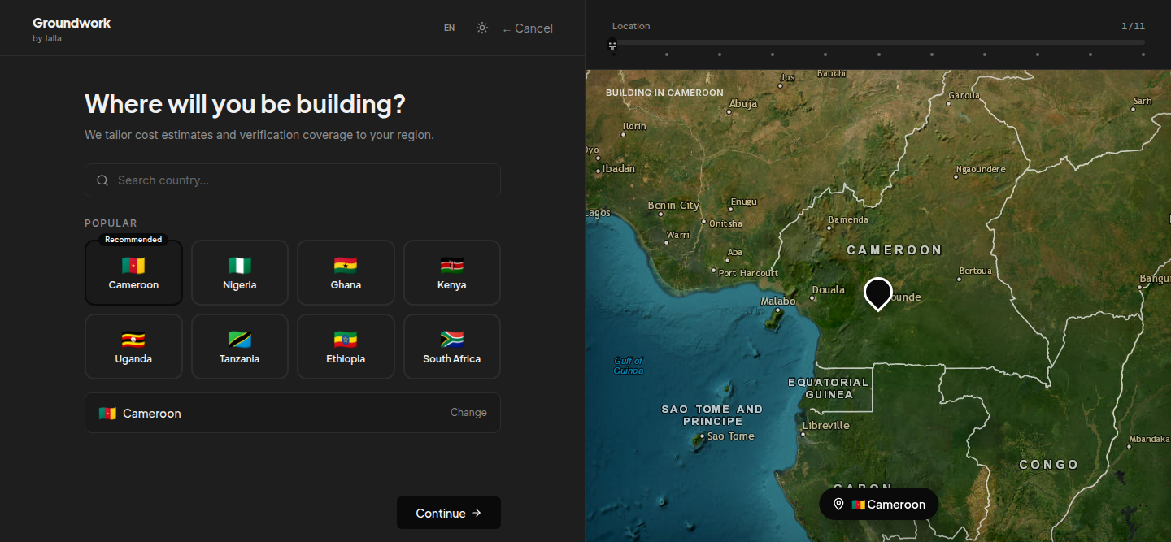
A client scopes the build before you are called
Eleven steps: location, building type, floors, rooms, roof, finish. The budget is measured from quantities at your city's rates — not a guess per square metre.

Slide 5
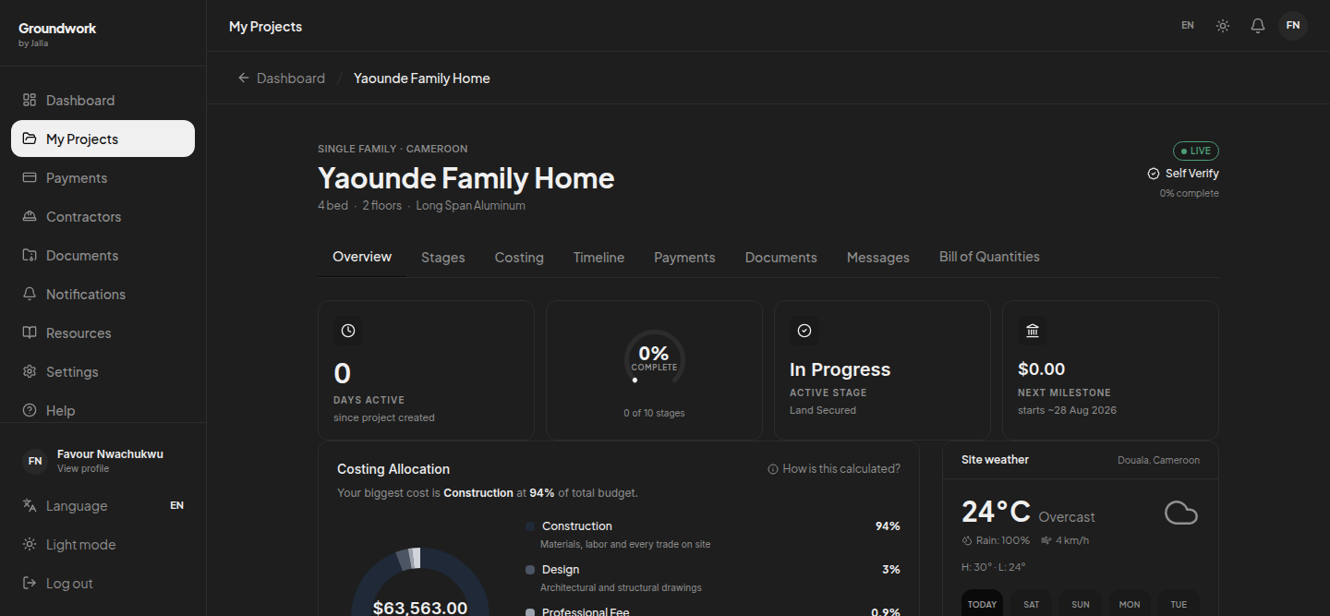
Every project arrives already costed
Construction, design, professional and permit, itemised. You are quoting against a figure the client has already accepted.

Slide 6
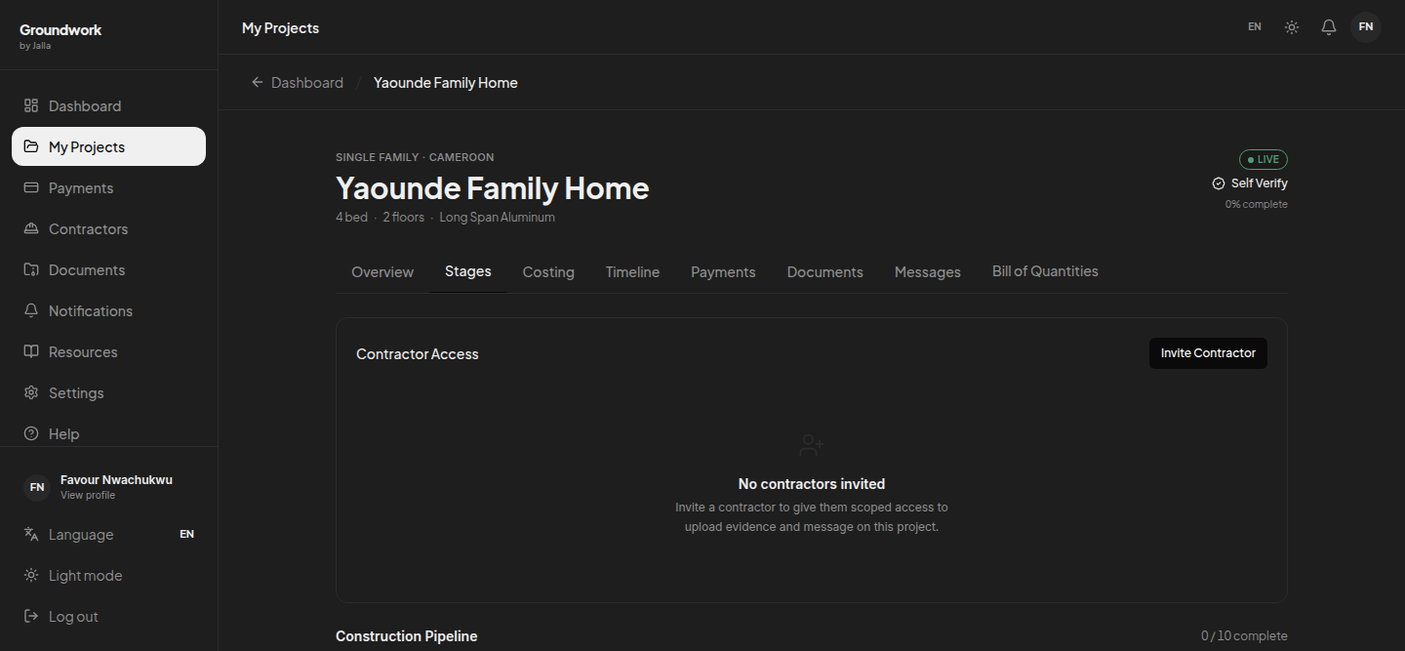
Ten stages, each with its own evidence
Land, design, site prep, foundation, structure, roofing, services, finishing, exterior, handover. Everyone can see where the build actually is.

Slide 7
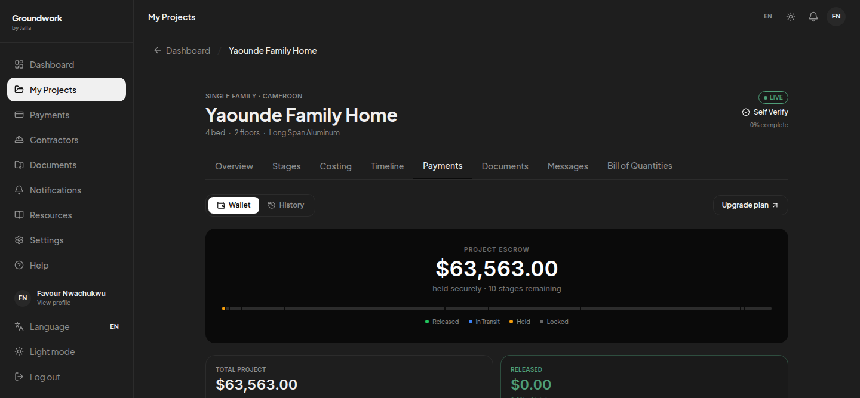
The money is already there
Funds sit in escrow against the stage schedule. Complete the stage, submit the evidence, the payment is released. No chasing.

Slide 8
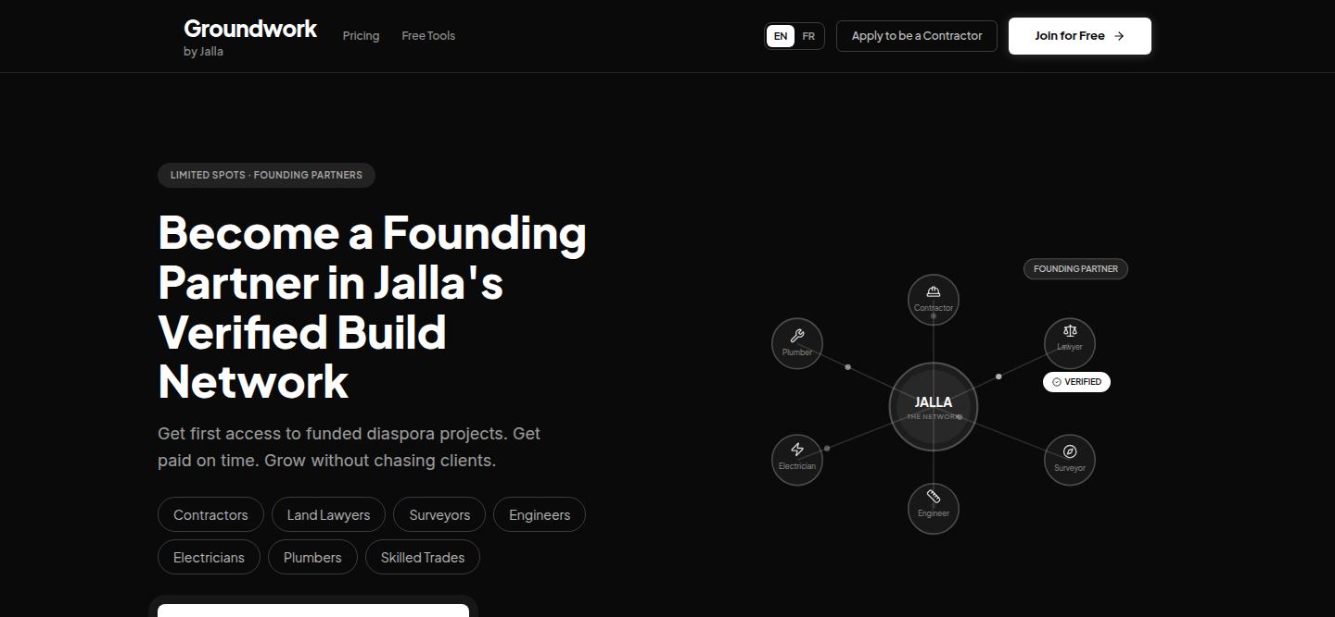
First in gets the best position
We are onboarding a limited number of partners per trade, per region. The application takes about three minutes: your details, your credentials, and three past projects with references.

Slide 9
HOW TO JOIN
Apply to be a founding contractor
tryjalla.com/contractor-apply

