Slide 1

Sprint 1 Presentation
Bachelor in Applied Information Technology
Yinghan LING and Joris LEFONDEUR
27/04/2022

Slide 2
Summary
UML class diagram
Sprint 1 retrospective
UI – Main Menu/Game
Pokédex
Tilemap
Player & NPC
Live demonstration
Sprint 2 planning

Slide 3
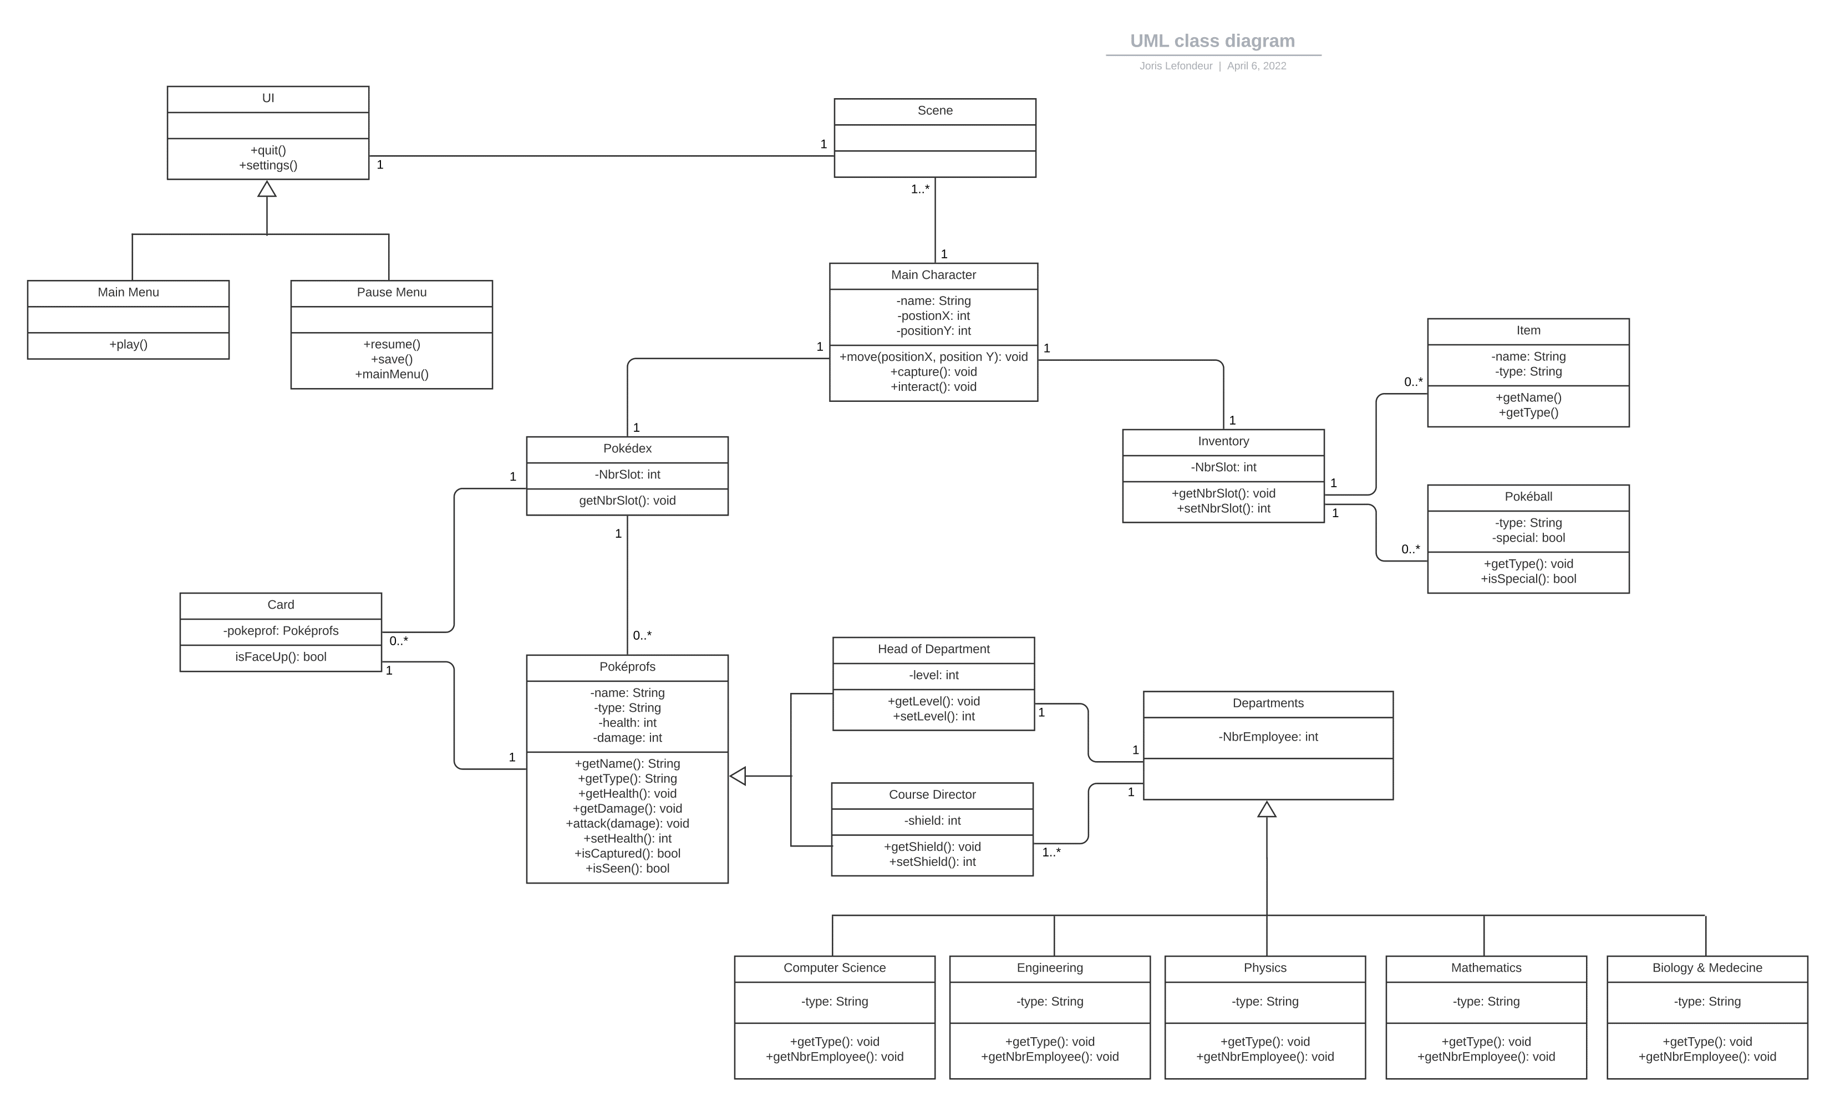
UML class diagram
Goal: represents each member's personal idea of the game

Slide 4




Sprint 1 retrospective
Yinghan:
create the first quest
create the first NPC
Pol:
create the first room
create the player
Joris:
implement the GUI
create the pokédex

Slide 5
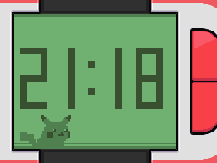
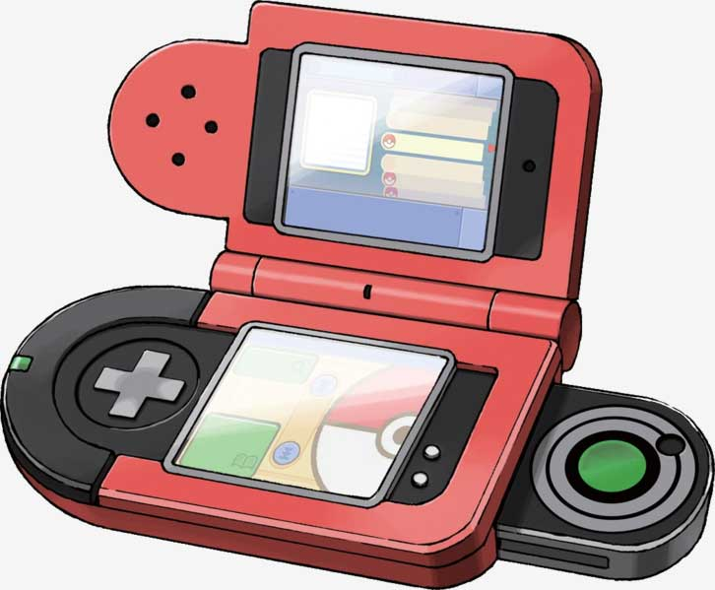
UI – Main Menu/Game
Transition between scenes
Pokétch - UI for the main menu
Pokédex – joystick idea

Slide 6




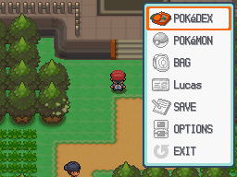


UI – Main Menu/Game
Selector – pokedex/quest/inventory/option
Dialogues text box
Pokéballs

Slide 7

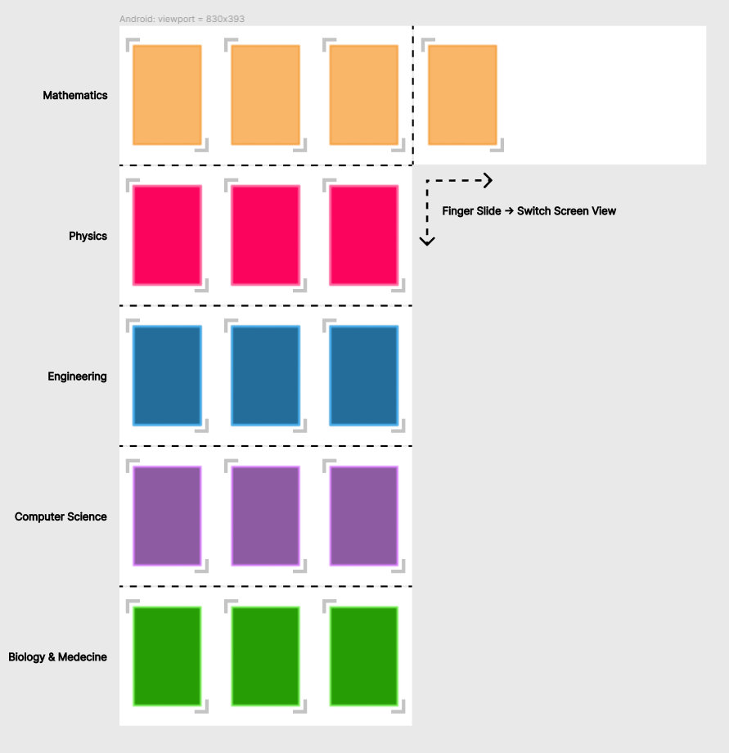


Pokédex

Slide 8
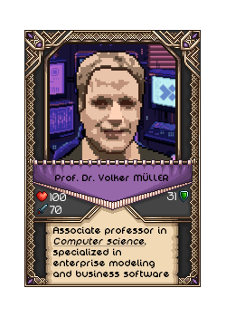

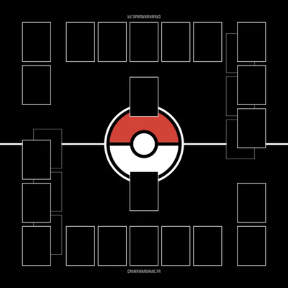
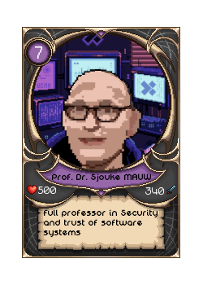

Pokédex
Course director
Head of Departments

Slide 9


Live demonstration

Slide 10
Sprint 2 planning
Joris:
The Capture minigame.
Build the interior rooms.
Yinghan:
Complete the tilemap.
Make all NPCs.
Create simple Pokéballs collecting quest.

Slide 11
THANK YOU!

