Slide 1
Group 2 - SEP
Joris Lefondeur Pol Kihn Yinghan Ling

Slide 2
Overview
Initial Individual Ideas
Nature of the Project
Project Description
Feasibility Study
Conclusion

Slide 3
Initial Individual Ideas
Joris
Pol
Yinghan
Escape room
Explore faculty and find hints and trivia to solve thematic levels
Catch and collect faculty personnel (like Pokémon)
Document progress and individual “stats” in an index or encyclopedia
Fighting Game
Faculty Personnel fights thematic enemies for them respectively

Slide 4
Nature of the Project
Game
Mobile
Incorporate individual ideas into the project

Slide 5
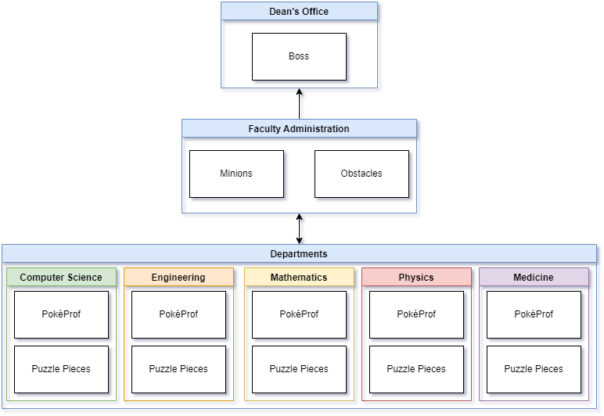
Project description:
2D Top-down Mobile Game
Collect PokéProf of differing types from different departments
Solve puzzles and fight the minions of the villain with your PokéProf
Free the dean and vice-dean

Slide 6
Feasibility Study
What is the scope of the planned project?
Is it technically feasible?
What are the benefits?
What are the expected costs? Timetable?
Are needed resources available?
What are the risks?
2D Top-down Mobile Game
IDE, Phone or Phone Emulator ⇒ Yes
Engaging, accessible
12 weeks
Open-source IDEs, Emulators ⇒ Yes
Underestimation of workload ⇒ Scrum

Slide 7
Conclusion
A feasible and engaging way to present the Faculty of Science Technology and Medicine

