Slide 1


FAKE NEWS CLASSIFIER
Group 3:
DSCI – 6007-03
Midterm Project

Slide 2


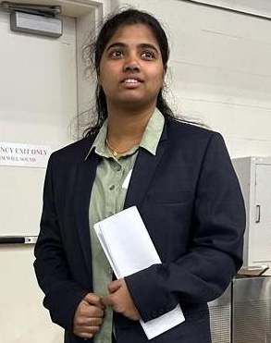

OUR TEAMS
SAI VENKATA AJAY VARMA ALLURI
Storytelling and Research
YASASVI THATI
Data Modeling & Deployment
SRI VISHNU PRIYA SANGARAJU
Methodology Research
SRIVIDYA CHEKURI
Testing & Evaluation

Slide 3

Fake News
Fake news refers to false or misleading information that is presented as if it were true.

Slide 4
THE PROBLEM WITH FAKE NEWS
Misinformation
Amplification

Slide 5
OBJECTIVE
Building a classifier model to distinguish whether the news is real or fake and to check which classifier model gives better accuracy.

Slide 6
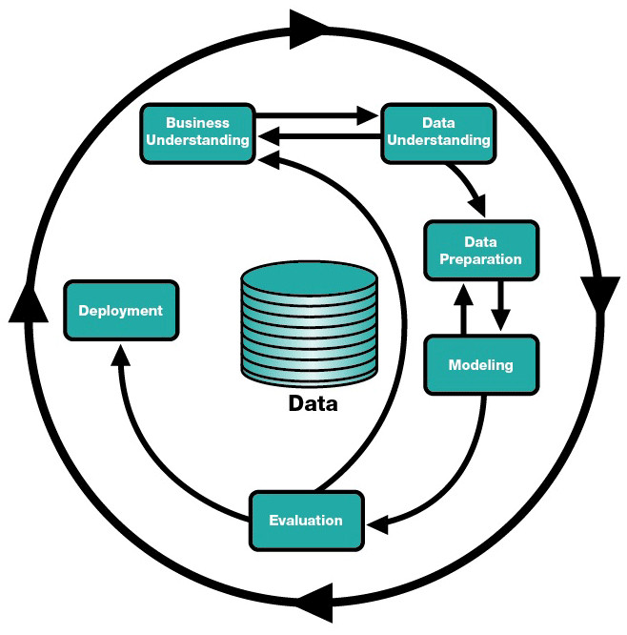
CRISP METHODOLOGY

Slide 7
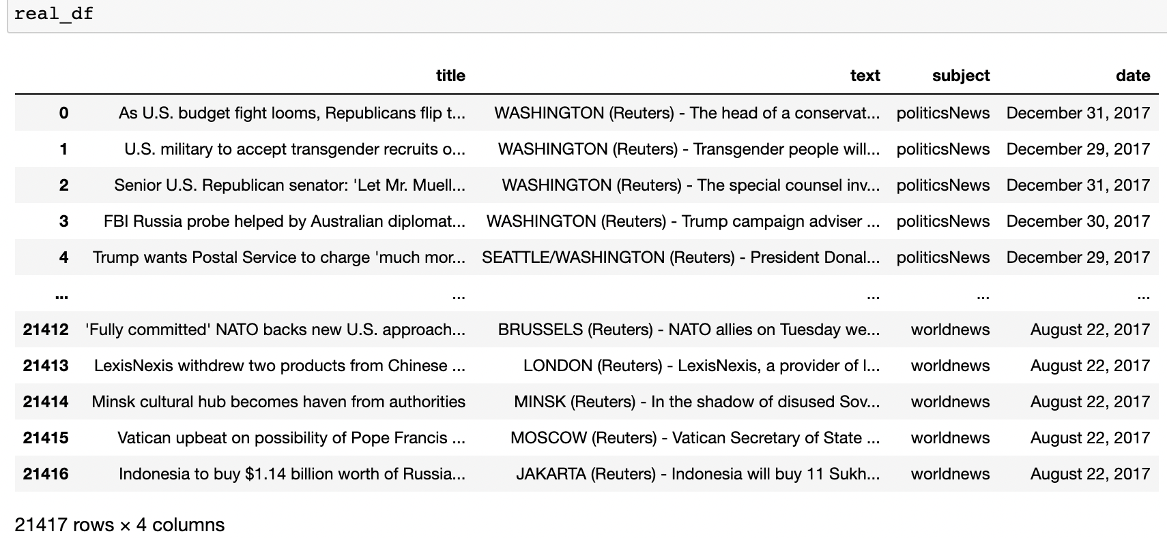
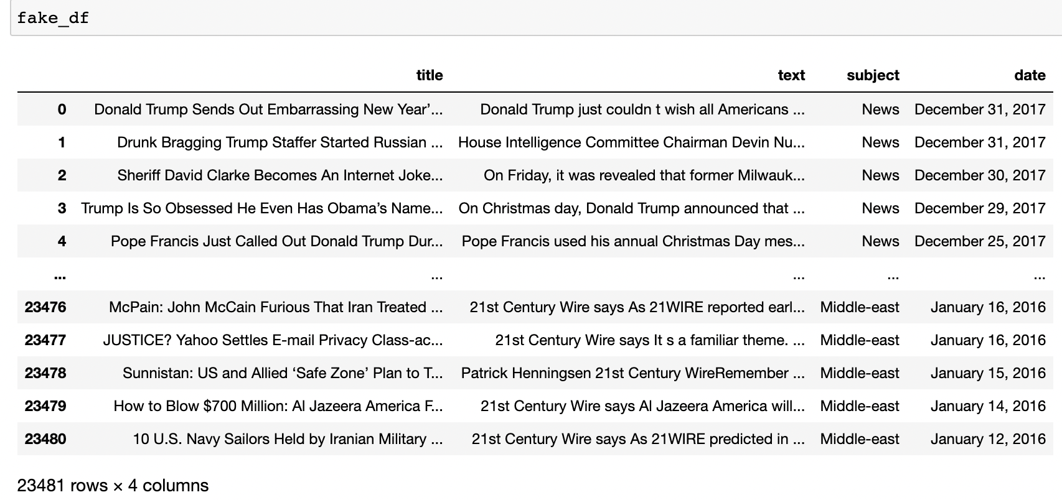
DATASET
REAL NEWS
FAKE NEWS

Slide 8
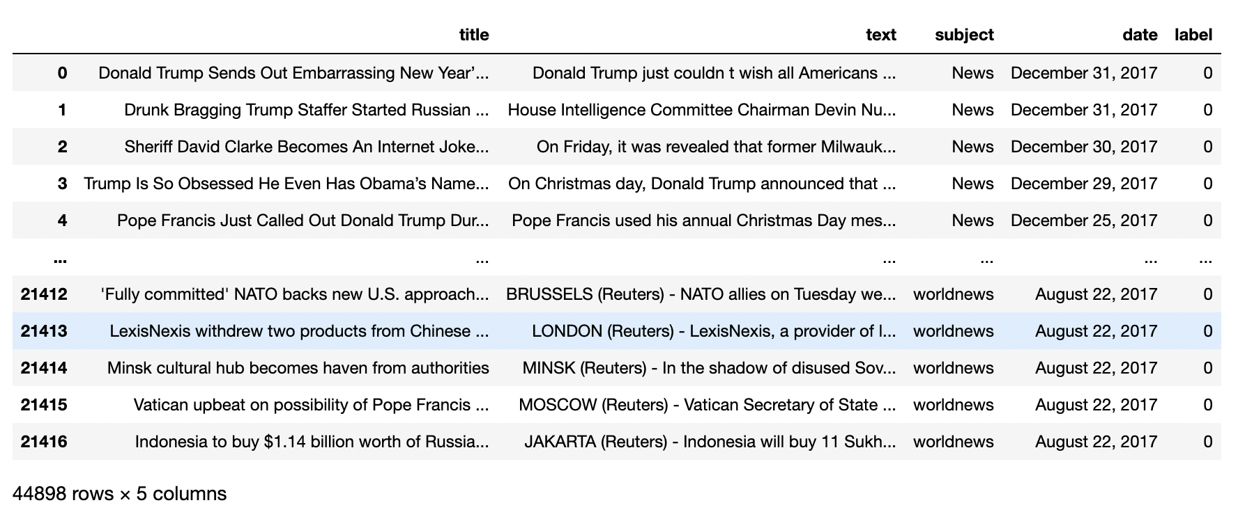
DATASET

Slide 9
ALGORITHMS USED
DECISION TREE
SUPPORT VECTOR MACHINE
82.32%
80.46%

Slide 10

DEPLOYMENT
STREAMLIT
Easy to use
Efficient deployment

Slide 11
THANK YOU

