Slide 1


FAKE NEWS CLASSIFIER
Group 3:
DSCI – 6007-03
Midterm Project

Slide 2




OUR TEAM
Sai Venkata Ajay Varma Alluri
Yasasvi Thati
Srividya Chekuri
Sri Vishnu Priya Sangaraju

Slide 3

Fake News
Fake news refers to false or misleading information that is presented as if it were true.

Slide 4
THE PROBLEM WITH FAKE NEWS
Misinformation
Amplification

Slide 5
OBJECTIVE
Building a classifier model to distinguish whether the news is real or fake and to check which classifier model gives better accuracy.

Slide 6
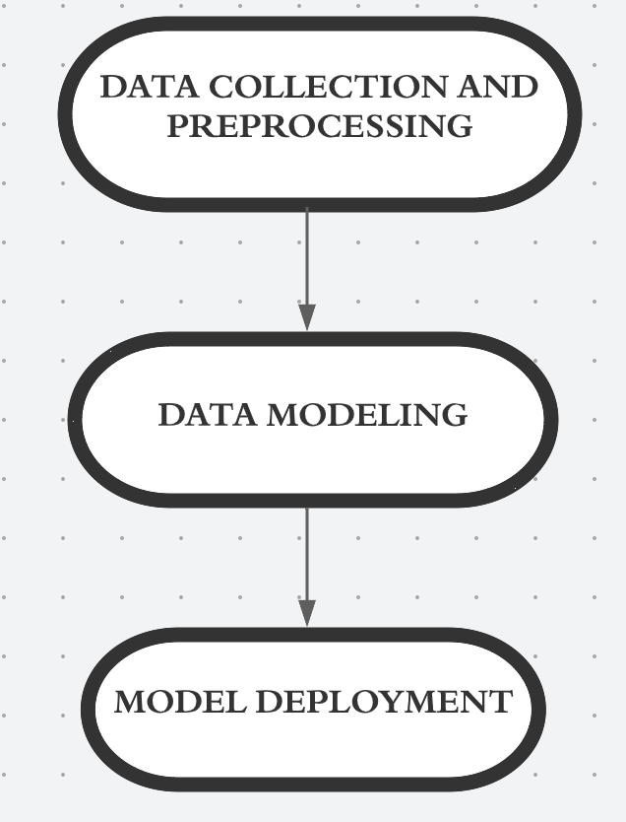
Project plan to build classifier model

Slide 7
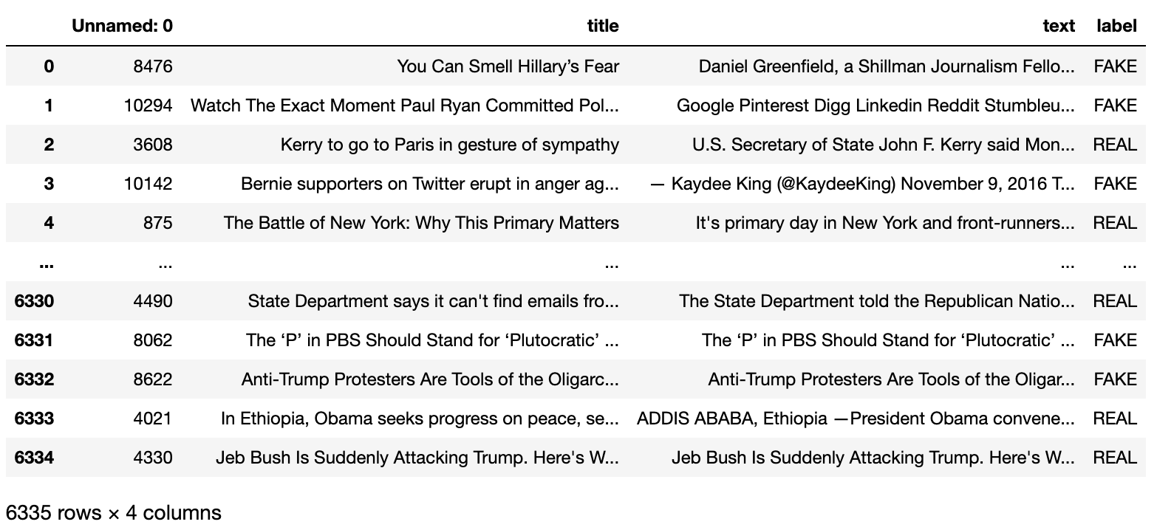
DATASET SAMPLE

Slide 8
NAÏVE BAYES CLASSIFIER
Naive Bayes is a probabilistic algorithm that uses Bayes' theorem to make predictions by assuming independence between the features.

Slide 9
BERNOULLI NAÏVE BAYES CLASSIFIER
Bernoulli Naive Bayes classifier is a probabilistic algorithm used for classification tasks in machine learning as it assumes that the features are binary (0 or 1)

Slide 10
LOGISTIC REGRESSION
Logistic regression is a statistical method used to analyze the relationship between a binary or categorical dependent variable and one or more independent variables, and to estimate the probability of the dependent variable taking a particular value.

Slide 11
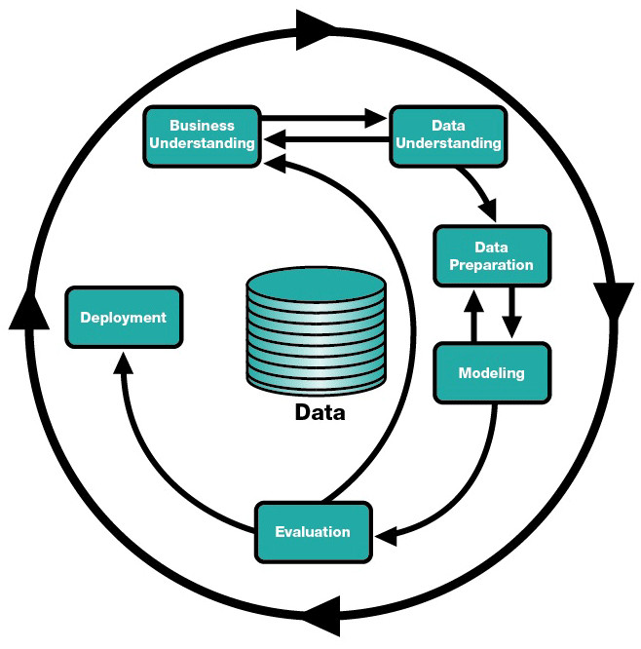
CRISP METHODOLOGY

Slide 12
THANK YOU

