Slide 1


30/10/2026
NTU SINGAPORE
Agentic Threat Hunting on the ELK Stack
Pratyush Joshi
Madhur Choudhary
Madhav Malhotra
Aleksander Sak
Victor Moll Pons
Naren Rithvik

Slide 2










NTU SINGAPORE
Problem Statement
Solution
Threats move at machine speed, but SOC analysts still ingest logs by hand and write one-off queries for every hunt: slow, manual and impossible to scale
Meet Agentic SOC: state a threat hypothesis in plain language, and AI agents hunt through the ELK stack via our MCP server, returning an evidenced verdict at machine speed

Slide 3
















Technologies used
NTU SINGAPORE
VMWARE
UBUNTU
UNSLOTH
WINDOWS VM
TAILSCALE
ELK STACK
Hosts the isolated
lab virtual machines
Desktop + Server being used for VM
Used to train our AI Models
Victim endpoint
that generates
Windows event logs
Private VPN that
connects all team
machines and VMs
Central platform
that stores, parses
and searches all logs
QWEN3.5
ATOMIC RED TEAM
FILEBEAT + WINLOGBEAT
UFW LOGS
OMLX
GEMMA 4
Backup main agent and log-parsing
agent
Runs safe simulated attacks to generate
logs to hunt
Data shippers
Ubuntu Server
firewall logs that
show network activity
Runs the AI models
locally on Apple
Silicon Macs
Main AI agent that runs threat hunts through the
MCP server

Slide 4

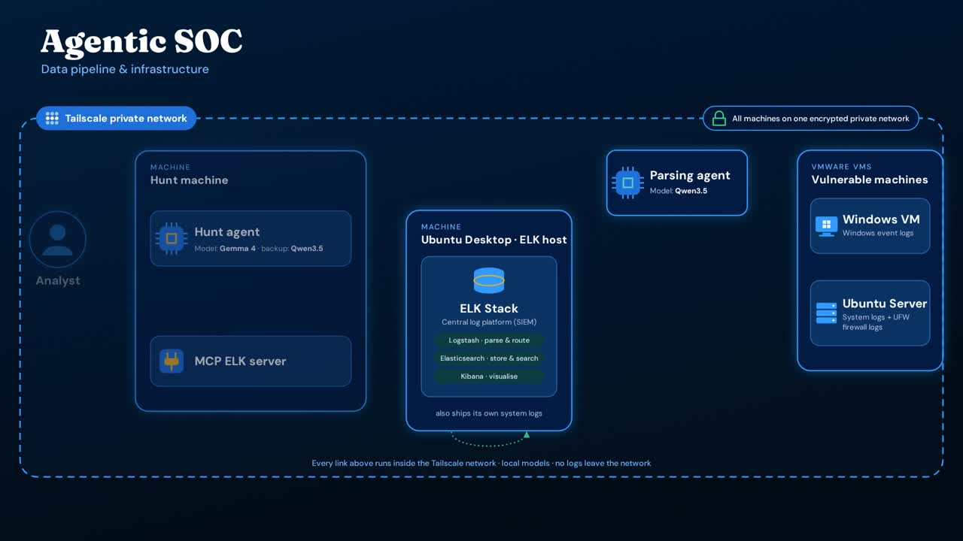

Slide 5
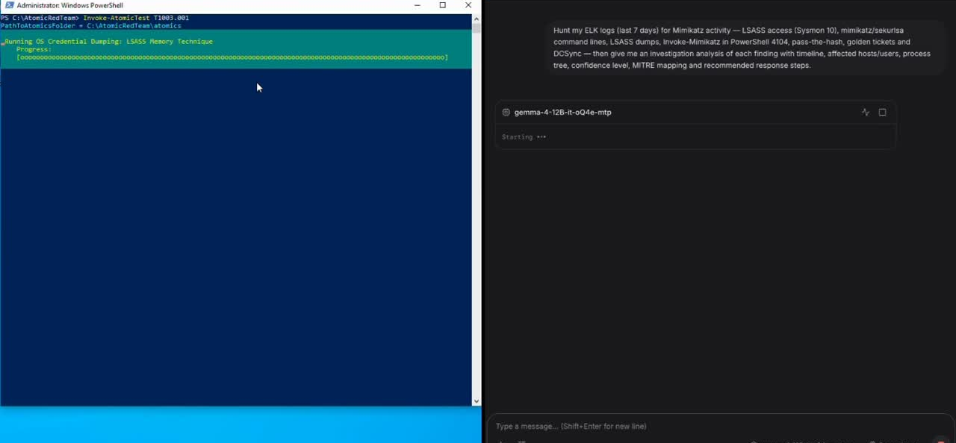

WINDOWS ATTACK RESPONSE
NTU SINGAPORE

Slide 6
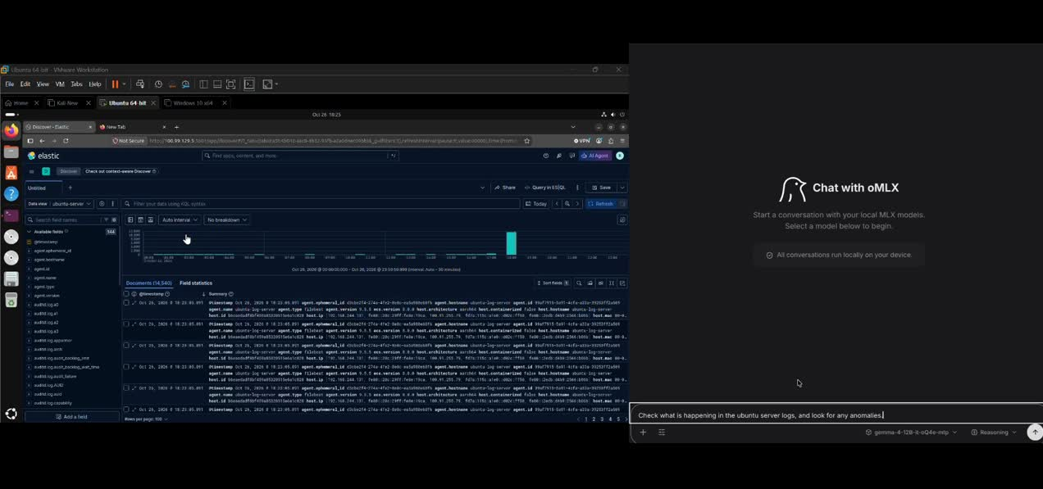
UBUNTU SERVER RESPONSE
NTU SINGAPORE

Slide 7
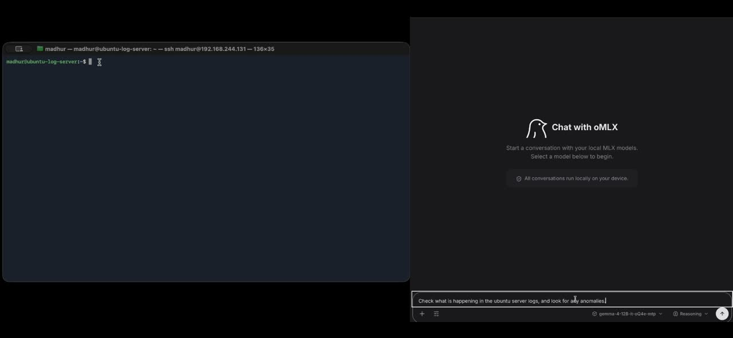
NETWORK LOG RESPONSE
NTU SINGAPORE

Slide 8
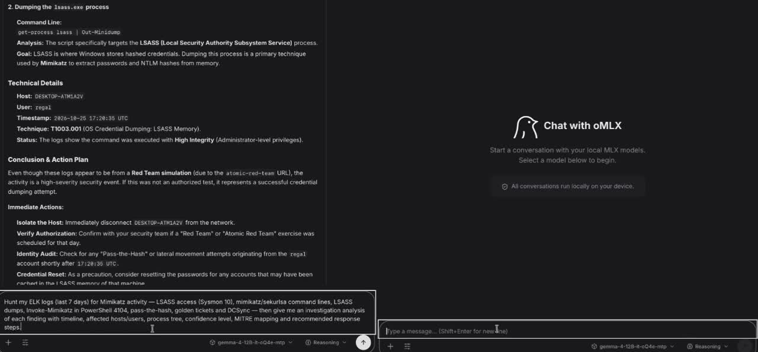
REPORT COMPARISON
NTU SINGAPORE

Slide 9







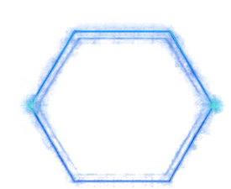

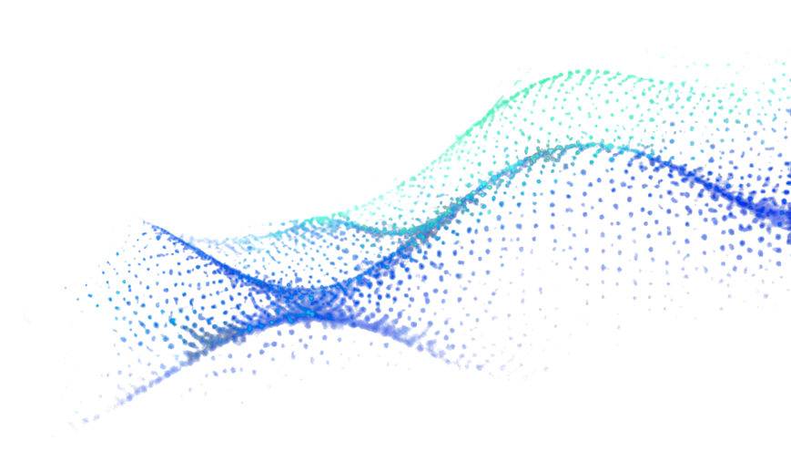
















30/10/2026
Group 3
NTU SINGAPORE
THANKS FOR YOUR ATTENTION!
Q&A
AGENTS
SECURITY
VERDICTS

