Slide 1
Query and Solution Text Mapping using Self Organizing Maps
Monisha Lakshmipathi
Prashant Patel
MENTOR : PROF. Andrew lee

Slide 2

Motivation
Automatic Medical Diagnosis (AMD) for areas with low doctor-inhabitant ratios
Tremendous amounts of data
Particularly useful in developing countries in Africa/Asia.
Traditional clustering based AMD does not support large data-rates
SOM-based AMD is scalable for large data-inputs

Slide 3
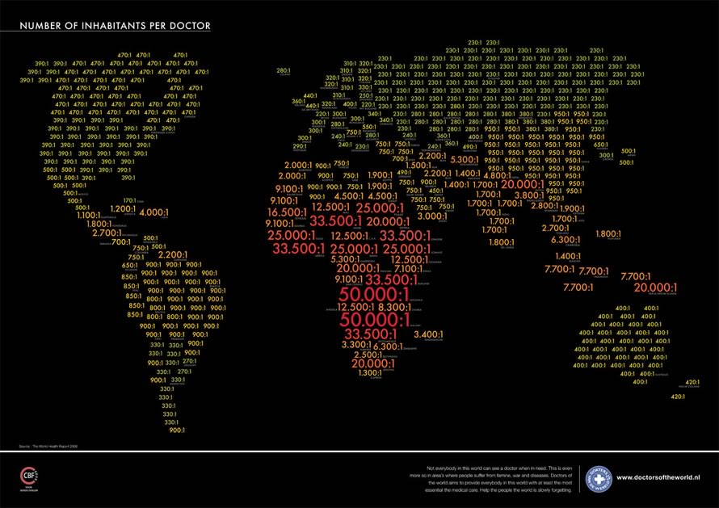

Slide 4
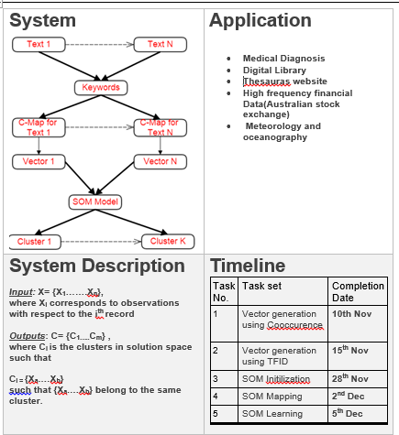
Quad Chart

Slide 5
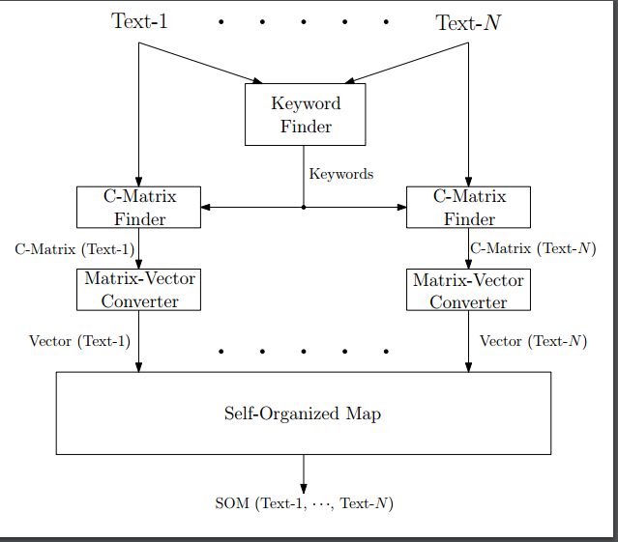
Our Proposed System

Slide 6
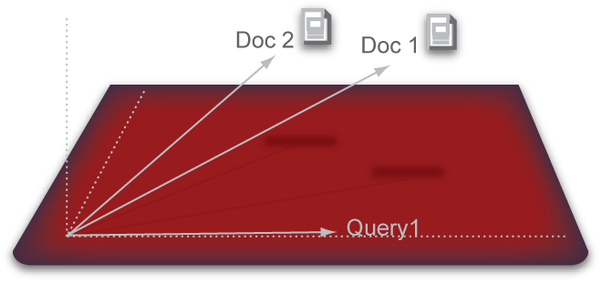
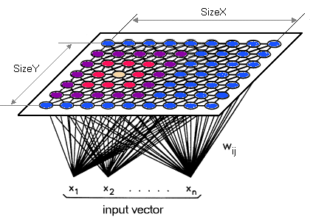
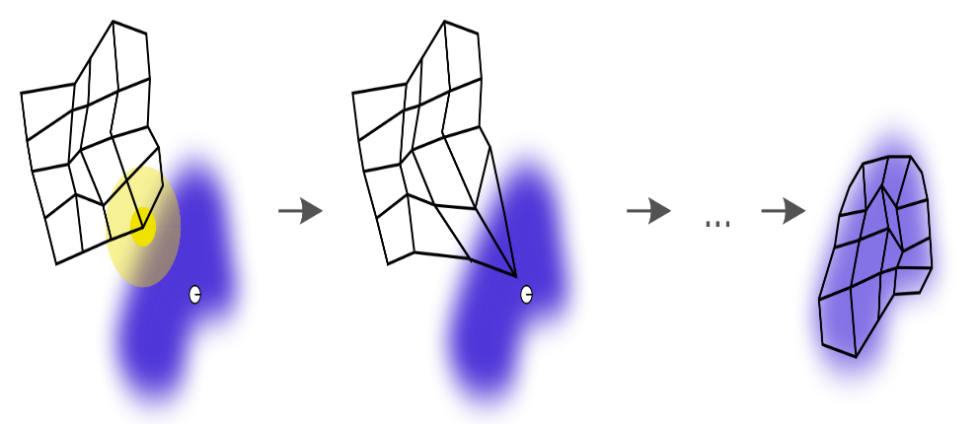
Stages of building Self-Organizing Map
Vector Generation
SOM Initialization
SOM Learning

Slide 7
Vector Generation
Approach 1 : Term frequency and the inverse document frequency
Common Approach.
TF – how frequently a term occurs in the document.
TF(t) : number of occurrences of a term/total number of terms in the document.
IDF – how important a term is.
IDF(t) = log_e(Total number of documents / Number of documents with term t in it).
Approach 2 : Co-occurrence of adjacent terms
Every word provides a meaning to its adjacent words.
TF-IDF do not account for this approach.
Example –
1. “Please cross the road when there a green signal.”
2. “French people love eating green apples”.
These sentence provide different context with same term – “green”.

Slide 8
Vector Generation (Contd)
Approach 3 : Co-occurrence of adjacent terms and individual term frequency Combo
Similar to Co-occurrence approach but considers the term weight individually.
It is a combination of Approach 1 and Approach 2.
Better understanding of term connections and their weights.
Example –
1. “Please cross the road when there a green signal.”
2. “French people love eating green apples”.
The vector dimensions are
sentence 1 : [Please, Please-cross,road,road-when,when,when-green,green,green-signal]
sentence 2 : [French, French-people, people,people-love,eating,eating-green,green,green-apples]

Slide 9
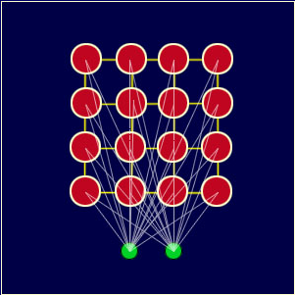
SOM Initialization
SOM creates complex data representation into a simple 2-D representation.
So initialize MXN Matrix.
Each matrix element has a weight vector.
Random weights for each dimension of
Weight vector.
Weight Vector [w1,w2,…]
Random weights for each dimension

Slide 10
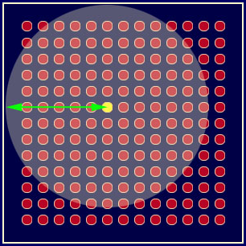


SOM Unsupervised Learning
For every input vector, use distance formula.
Find the BMU (Best Matching Unit).
Find the radius which is a function of time.
Input Vector 1

Slide 11
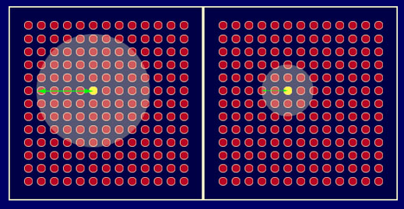

SOM Unsupervised Learning(Contd)
Adjust the weight vector for every neighborhood node within the radius of the BMU.
W(t+1) = W(t) + L(t)( V(t) – W(t))
t = time-step
L = learning rate which
decreases with time
W = weight
V = input vector
Adjusting the weight vector within the radius

Slide 12
SOM Visualization
Smooth Data Histogram
data distribution of the data samples by counting a number of most likely positions.
Activity Histogram :
Displays a colour-coding of the activity of a certain input vector over the whole map.
Component Planes :
Component planes show the values of a single component (attribute, feature) over the whole map.
Neighborhood KNN :
relations between the data are preserved by the projection.

Slide 13
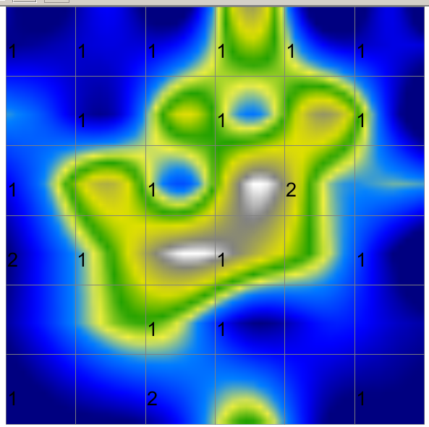
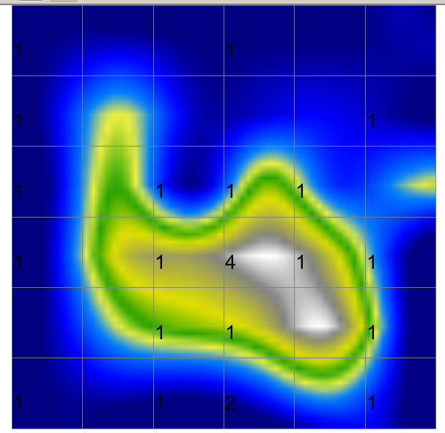
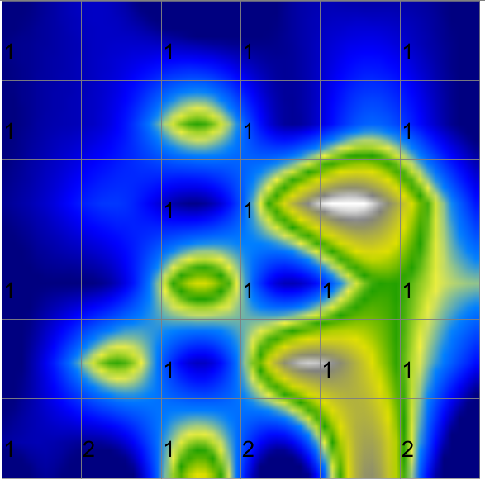
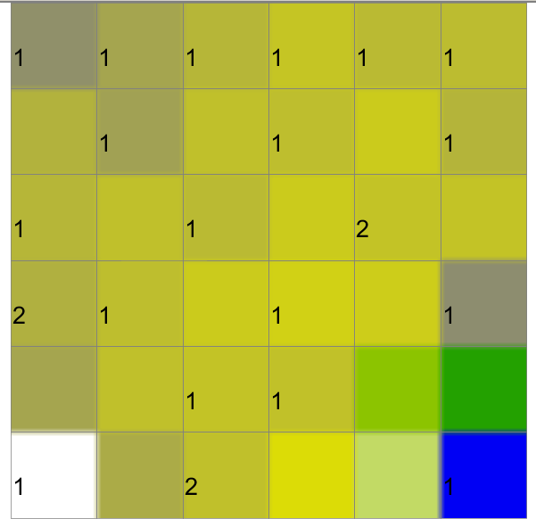
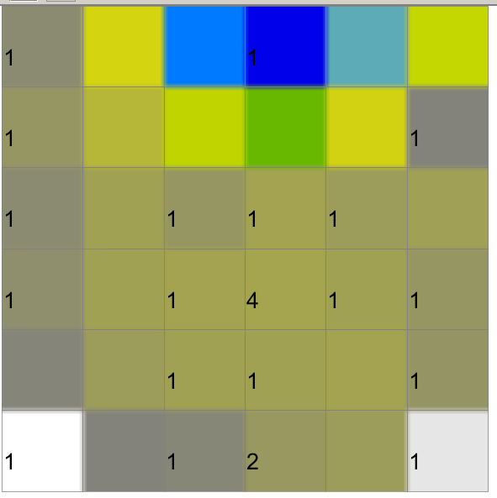
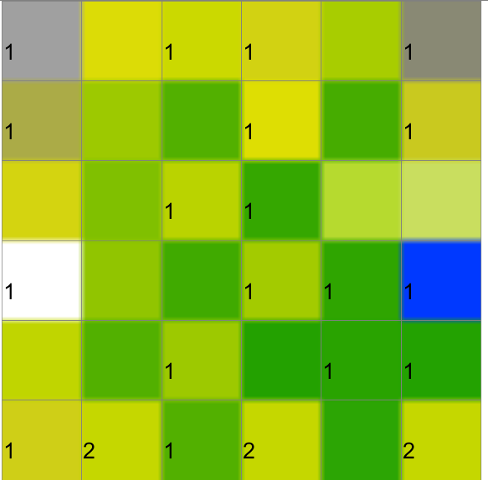
SOM Visualization (Contd)
CO-OCCURRENCE WITH INDIVIDUAL TERMS | CO-OCCURRENCE | TF-IDF
Smooth Data Histogram | Smooth Data Histogram | Smooth Data Histogram
Activity Histogram | Activity Histogram | Activity Histogram

Slide 14
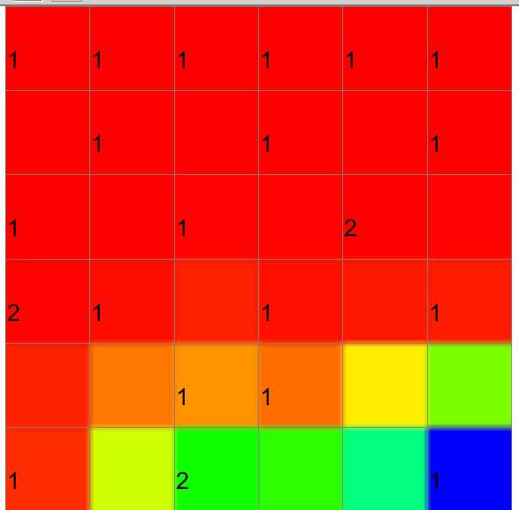
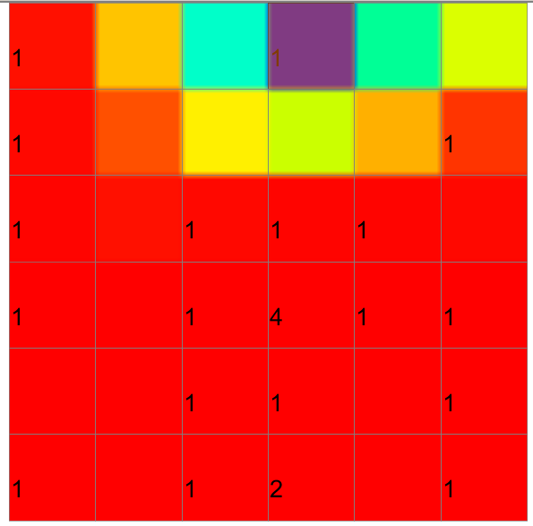
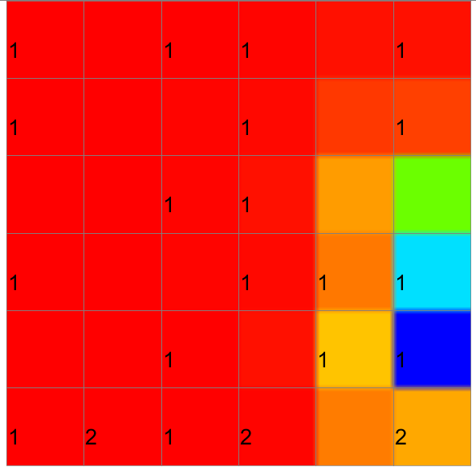
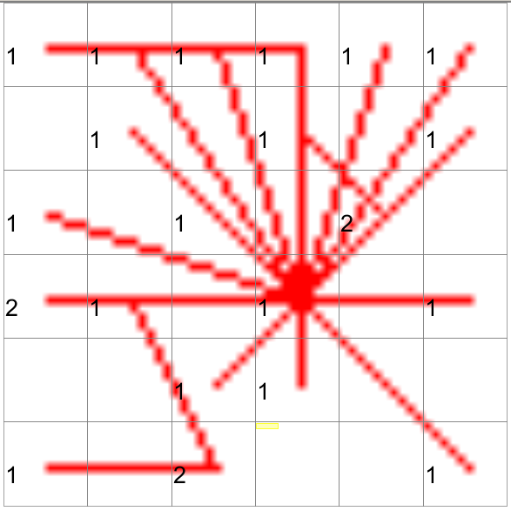
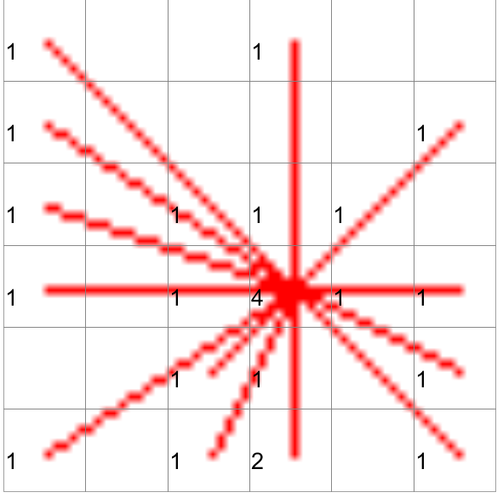
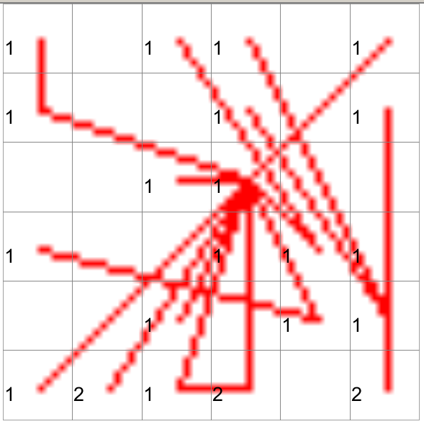
SOM Visualization (Contd)
CO-OCCURRENCE WITH INDIVIDUAL TERMS | CO-OCCURRENCE | TF-IDF
Cluster Component Planes | Cluster Component Planes | Cluster Component Planes
Neighborhood KNN | Neighborhood KNN | Neighborhood KNN

