Slide 1
Smart Home System
Energy Consumption Simulation

Slide 2
Agenda
Requirements
System Architecture
Class Diagram
Component Diagram
State Diagram
Implementation

Slide 3
Analysis & Design
UML Diagrams

Slide 4
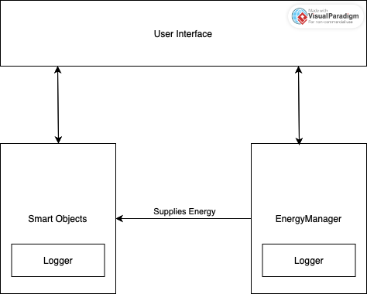
System Architecture

Slide 5
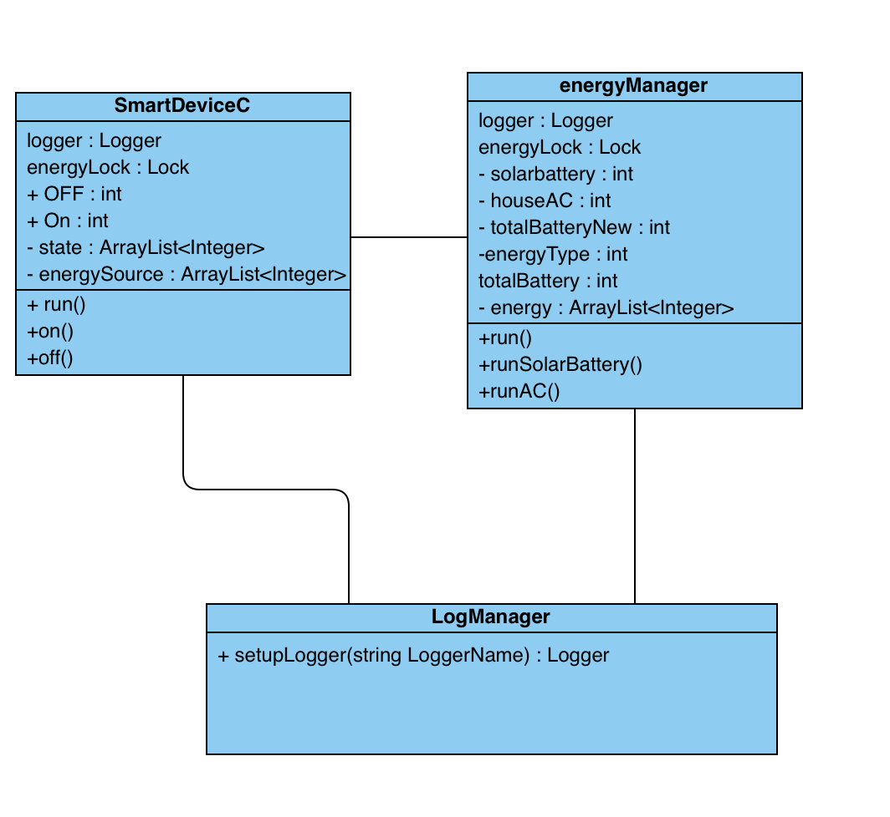
Class Diagram
Consists of 3 Classes:
SmartDeviceC
energyManager
LogManager

Slide 6
Component Diagram

Slide 7
Behavioral Diagrams
State diagram, Activity

Slide 8
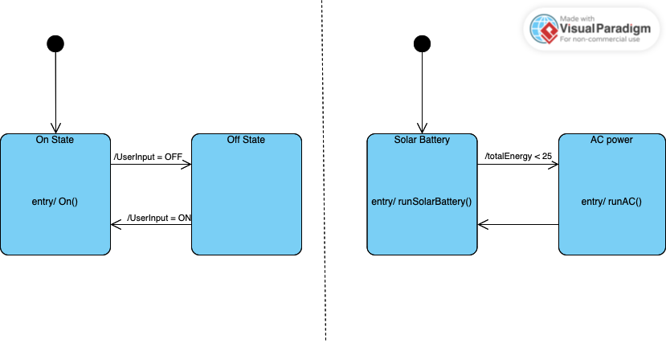
State Diagram
Smart Objects
Energy Manager

Slide 9
Implementation
Mapping to code

Slide 10
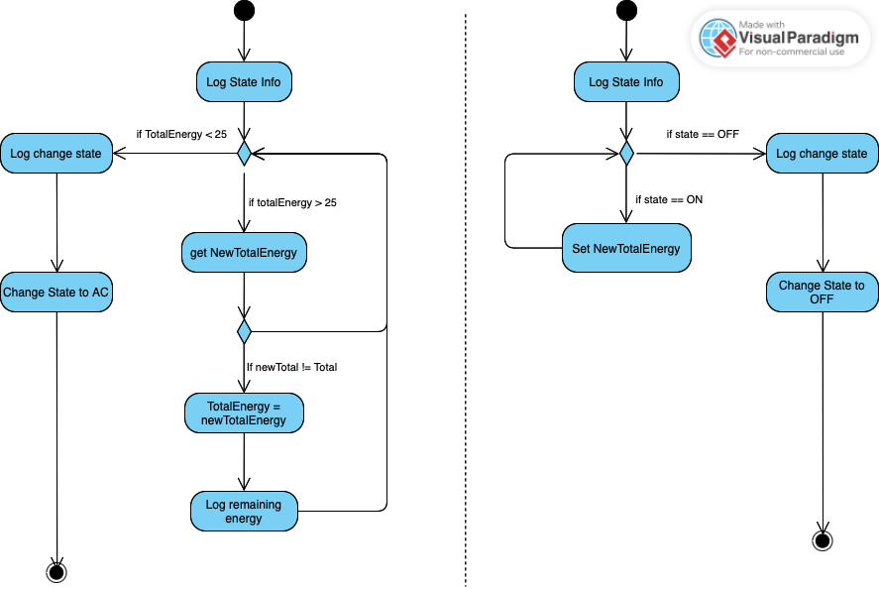
Concurrency part
Energy Manager
Smart Objects

Slide 11
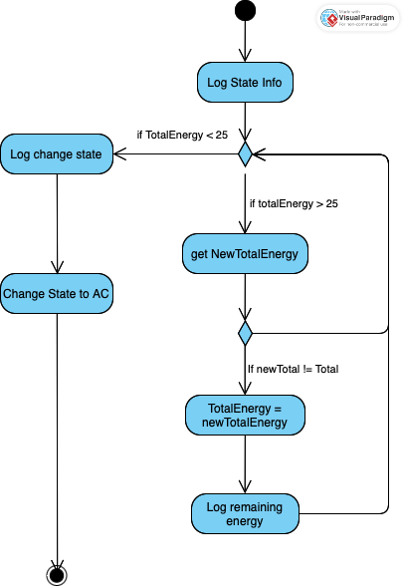
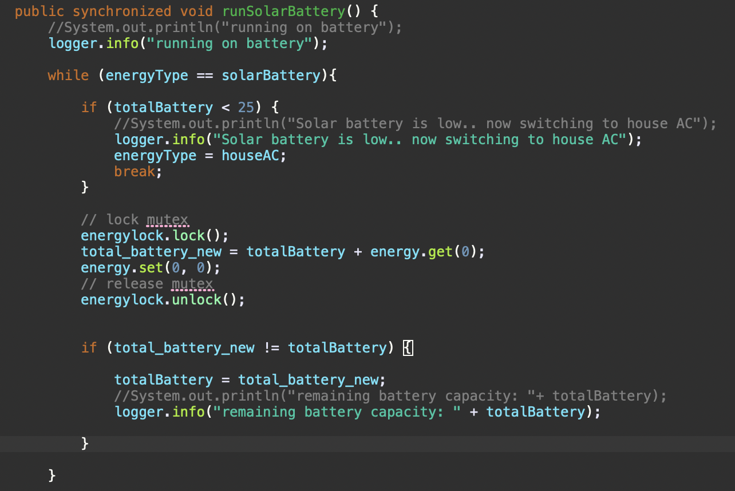
Activity Diagram 1
Energy Manager

Slide 12
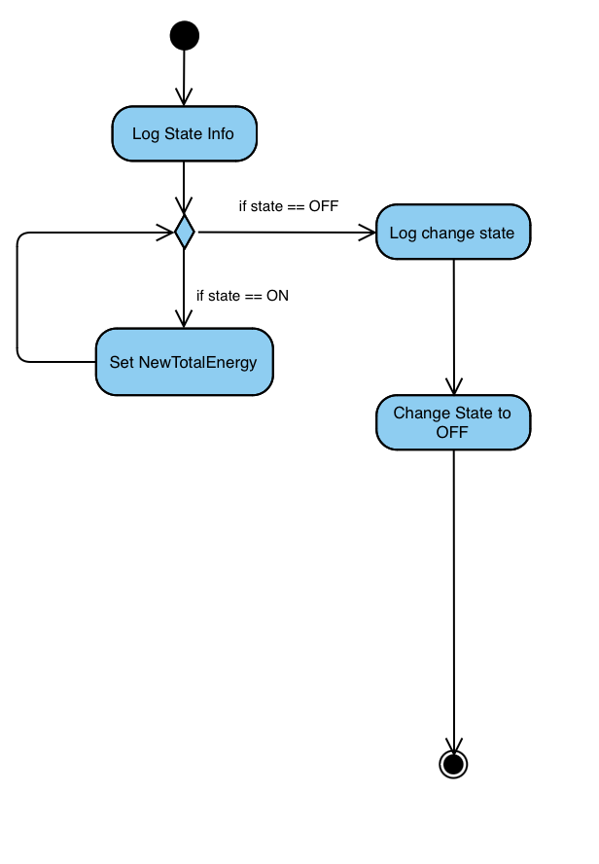
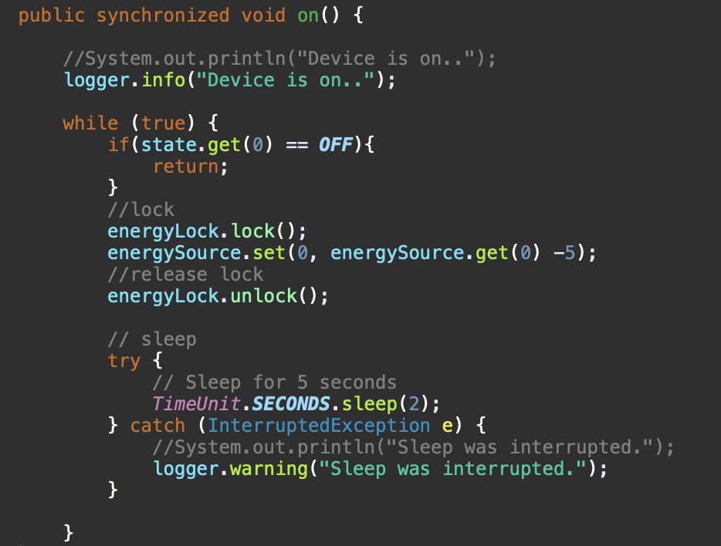
Activity Diagram 2
Smart Objects

Slide 13
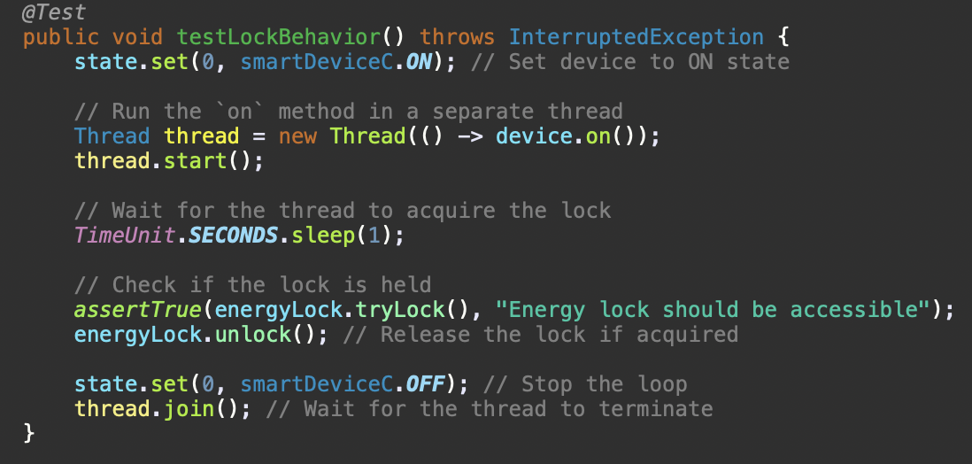
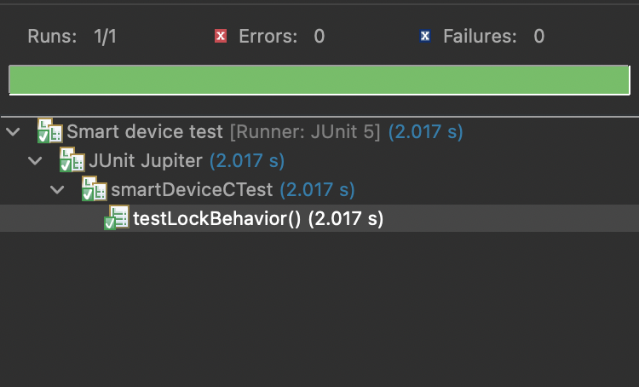
Unit test

Slide 14
Thank you

Slide 15
Backup slides

