Slide 1
DocEasy
By :- Group J

Slide 2
Team Members
Sahil Verma -> Frontend, Backend, Deployment
Ritik Jain -> Backend, Deployment
Mayank Garg -> Frontend, Deployment
Shallum Israel -> Backend, Deployment
Rachna Kumari -> Backend, Deployment
Shivangi -> Frontend, Testing
Ratna Priya Jha -> Frontend, Testing
Santhosh -> Backend, Testing

Slide 3
Project comprises
Home page
Doctor Portal
Patient Portal
Make Appointment
Doctor-portal
Doctor -Login
Doctor-Dashboard
Add-patient
View Appointment
Add-prescription
Patient-portal
View Details
View Latest -Prescription
View All Prescription

Slide 4
Objective
To implement a portal that helps in
Generating Prescriptions
Viewing Prescriptions
Making Appointments
Future Scope :- Pharmacy Feature

Slide 5
Tech Stack
We used
ReactJs
DJango
DJango Rest Framework
EC2
Docker
Selenium

Slide 6
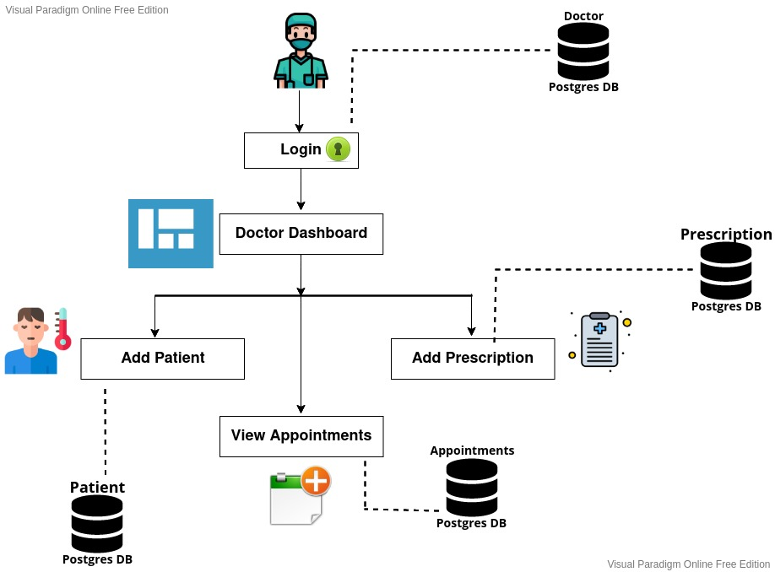
Visual Structure of Doctor Portal

Slide 7
Doctor-Dashboard
Doctor can add new patient.
Doctor can give prescription to registered patient .
Doctor can view his/her appointments .

Slide 8
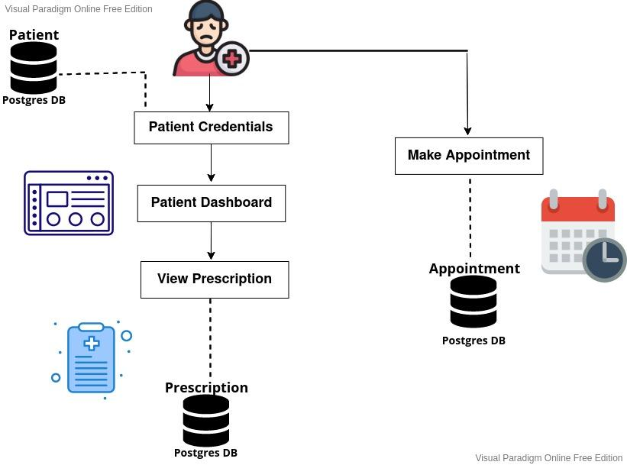
Visual Structure of Patient Portal

Slide 9
Patient Dashboard
Patient can view his/her details.
Patient can view their latest/all prescription that was prescribed to them .
Patient can make their appointment .

Slide 10
Prescription Information
Patient can view his/her prescription which comprises of
Doctor - Details
Patient - Details
Medication Item

Slide 11
Database Model
Database Model comprises of
Doctor Model
Patient Model
E-Prescription Model
Appointment Model

Slide 12
API Structure
There are four major API endpoints :
Doctor => api/doctors/
Patient => api/patient/
ePrescription => api/eprescription/
Appointment => api/appointments/

Slide 13
Docker
We built a CI/CD pipeline on Github Actions that automatically creates a docker image when we push/merge something into the repo.
Github/Action then publishes the docker image in the Docker Hub.
Now, we can pull the image and use it to deploy the image on the EC2 instance.

Slide 14
EC2 ( Elastic Compute Cloud )
Launching EC2 instance :-
Select an Amazon Machine Image (AMI)
Select the Instance Type
Select Configure Security Group
After hitting the Launch button you will see a pop-up page that requires you to select a Key Pair
Save your key file on the system in private mode
Then install docker in EC2 instance on the system
You can run your image.

Slide 15
Testing
Selenium Testing
API Testing

Slide 16
THANK YOU

