Slide 1
Data Analysis of Prevention
Programme for CHD
TEAM Anyway
Zichen Zhou, Kehan Chang, Yalin Xing, Ziyu Wang, Ning Wang

Slide 2
Facts abouts CHD: coronary heart disease
CHD is the leading cause of death in the U.S. , causing one in four deaths.
It’s the third leading cause of death globally.
In Germany and across Europe, CHD account for about 40% of deaths before age 75.
Financially, these diseases take up about 17% of the total healthcare expenditure in the US.
Insurance prevention programs could help reduce the mortality from CHD up to 50%.

Slide 3

Prevention Programme : KardioPro
GOAL: promote early detection, prevention, and guideline-based treatment to reduce the premium of later stage heart disease.
Procedures:
SBK CardioPro Risk Test determines the risk factor of having a heart attack in the next 10 years
Doctors will measure blood pressure and cholesterol equivalents and assess them using scientifically based PROCAM health test.
They will help to reduce personal risk factors - through SBK client phone, and a wide range of courses and counseling services or therapy

Slide 4
Main Audience:
Business Problem:
insurance providers
lessen both financial stress and patient suffering
how much money the prevention programme can save for insurance company?
Build the model to predict the probability of an individual ending up with CHD and determine the potential participants for the programme.
Analyze the cost-effectiveness of prevention strategies to help the company save money and patients’ life from developing into the late stage
Notes:
Having the leading mortality rate, CHD are also one of the most costly medical conditions for insurance providers, such prevention program has significant meaning

Slide 5
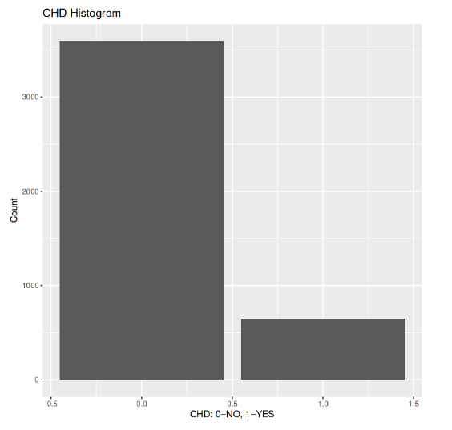
Data
Predictor | Binary | gender, currentsmoker, BPMeds, stroke, hype, diabetes
 | Continuous | age, cigsperday, chol, sysBP, diaBP, BMI, heartrate, glucose
 | Categorical | education
Response | Binary | TenYearCHD
Obs | 4238
3594
644
Notes:
Our data contains 15 potential risk factors and the response to be predicted is the 10-year risk of CHD development. That is, each data point represents an individual who had each risk factor recorded, then the response ("CHD") has a value of 1 if the individual developed CHD in the next 10 years, and a 0 if they did not. We have 4238 observations in total. Particularly, our data is imbalanced - as approximately 85 percent of response are zero. We argue that it makes sense because to some extent the ratio here represents the probability of developing CHD in reality. If we collect random sample around it’s not possible to get a half-to-half sample.

Slide 6
Models
Models | Parameter
Logistic Regression | Threshold = 0.2 (to capture the minority)
KNN | k = 5 (to capture the local structure of the data)
SVM | Threshold = 0.05 (to capture the minority)
Decision Tree | Threshold = 0.2 (to capture the minority)
Random Forest | Threshold = 0.2 (to capture the minority)
ANN | hidden = 5
Notes:
We used the models we discussed in class. Nothing special but note that in order to cope with the imbalance of our data, we set a relatively small number for the threshold in models. For example, in KNN, we choose k to be 5, because we want to capture the very local data structure.

Slide 7
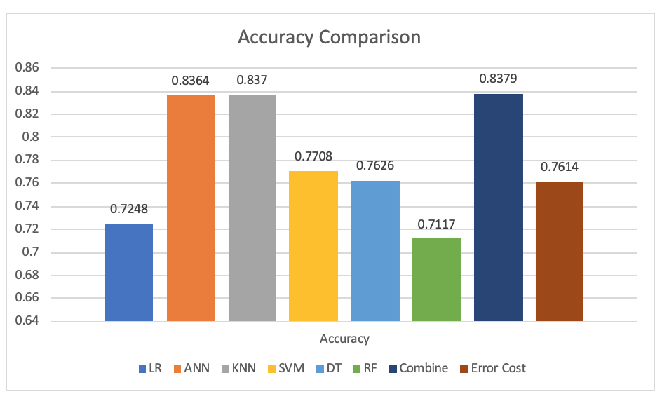
Accuracy Comparison
We choose Combine Model.

Slide 8
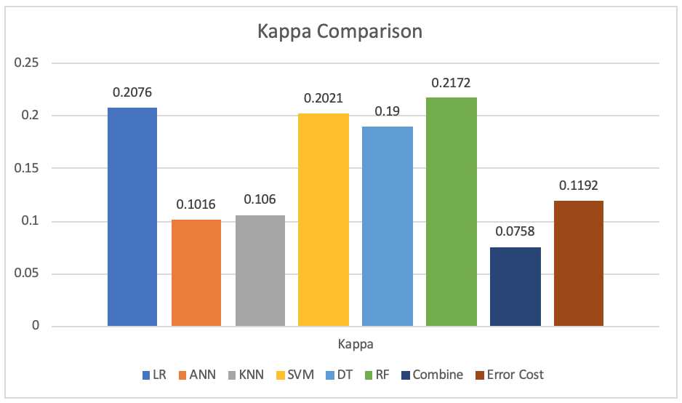
Kappa Comparison
Disease
Low Kappa

Slide 9
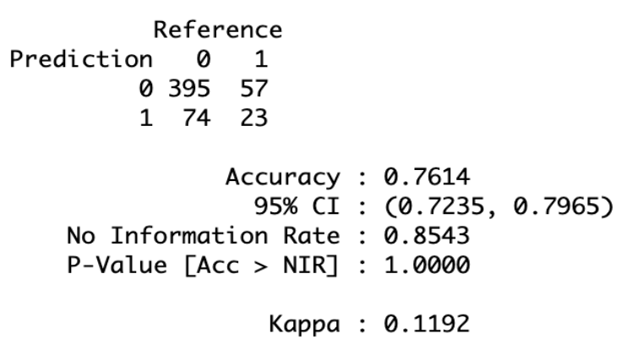
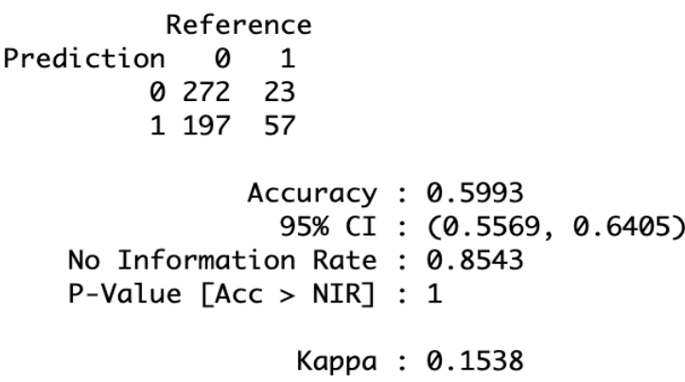

c(0,1,3,0)
c(0,1,4,0)
c(0,1,5,0)
#False Positive (FP): A false positive occurs when the model incorrectly predicts that a person has heart disease when they do not. While this is certainly not ideal—possibly leading to unnecessary stress for the patient, additional tests, and healthcare costs—the consequences are generally not as severe as missing a true positive case.
#False Negative (FN): A false negative in the context of heart disease prediction means that a person who has heart disease is incorrectly predicted by the model as not having the disease. This is potentially dangerous as it may result in the patient not receiving timely treatment, which can lead to serious health complications or even death. Therefore, the cost of false negatives is considered to be high, as it directly impacts patient health and outcomes.

Slide 10
Why considering Kappa’s value takes precedence over Accuracy?
The Kappa statistic takes into account both the accuracy and randomness of model predictions, while accuracy simply measures the proportion of correct predictions made by the model.

Slide 11

Financial considerations
 | Prevention cost $ | Future treatment cost saving ($）
Wellness | 250 | 817.5
Screening | 125.0 | 700.0
Medication | 1,000.0 | 5,000.0
Total | 1,375.0 | 6,517.5
Incident rate of CHD: 15%
Average treatment cost:
$38,051 for first year emergency treatment
$1,051/year for 10 years continuous treatment
Total: $48,561
Average insurance rate: $200/month
For a CHD patient, every $1 invested in prevention plan can save $4.7 future treatment costs.

Slide 12
Financial considerations-before
Before：
For a group of 1000 people:
Assumptions:
The actual incident rate of CHD are 15%
The insurance company do nothing but undertake the total treatment cost after patients having CHD
Revenue from insurance premium:
1000* $200/month*12 months*10 years= $24MM
Total Treatment Costs:
1000*15%*($38,051 + $1,051*10 years）= $7.3MM
Gross Profit=$16.7MM

Slide 13
Financial considerations-after
 | Non CHD | CHD
Non CHD | 272(50%) Healthy people, and the model also predicted them as healthy | 23(5%) CHD patients missed by the model and developing into late stage, company needs to cover all
CHD | 197(36%) Healthy people, but mistakenly predicted as CHD by model and join the prevention → -wasted prevention plan cost | 57(10%) Predicted by the model correctly and join the prevention→ +fee saved from succeed prevention -prevention plan cost
For a group of 1000 people:
Assumptions:
The incident rate of CHD are 15%
We predicted according to confusion matrix percentage, and enroll everyone who are projected CHD [(36%+10%)=46% ,460 out of 1000] into the prevention plan
Gross profit without prevention plan: $16.7MM
- Prevention plan cost: $0.6MM (1000*46%*$1,375)
+ Treatment cost saving for CHD patients: $0.65MM (1000*10%*$6,517)
____________________________________
Gross Profit after prevention plan =$16.7+$0.65MM-$0.6M=$16.75MM
Non CHD correct prediction:92.20% (272/295)
CHD correct prediction: 22.44% (57/254)

Slide 14
Reference
Lozano R, Naghavi M, Foreman K, et al: Global and regional mortality from 235 causes of death for 20 age groups in 1990 and 2010: a systematic analysis for the Global Burden of Disease Study 2010. Lancet 2012, 380(9859):2095–2128.
Aljutaili, M., Becker, C., Witt, S., Holle, R., Leidl, R., Block, M., Brachmann, J., Silber, S., Bestehorn, K., & Stollenwerk, B. (2014a). Should health insurers target prevention of cardiovascular disease?: A cost-effectiveness analysis of an individualised programme in Germany based on routine data. BMC Health Services Research, 14(1). https://doi.org/10.1186/1472-6963-14-263
Rayner M, Allender S, Scarborough P, British Heart Foundation Health Promotion Research G: Cardiovascular disease in Europe. Eur J Cardiovasc Prev Rehabil 2009, 16(Suppl 2):S43–S47

Slide 15
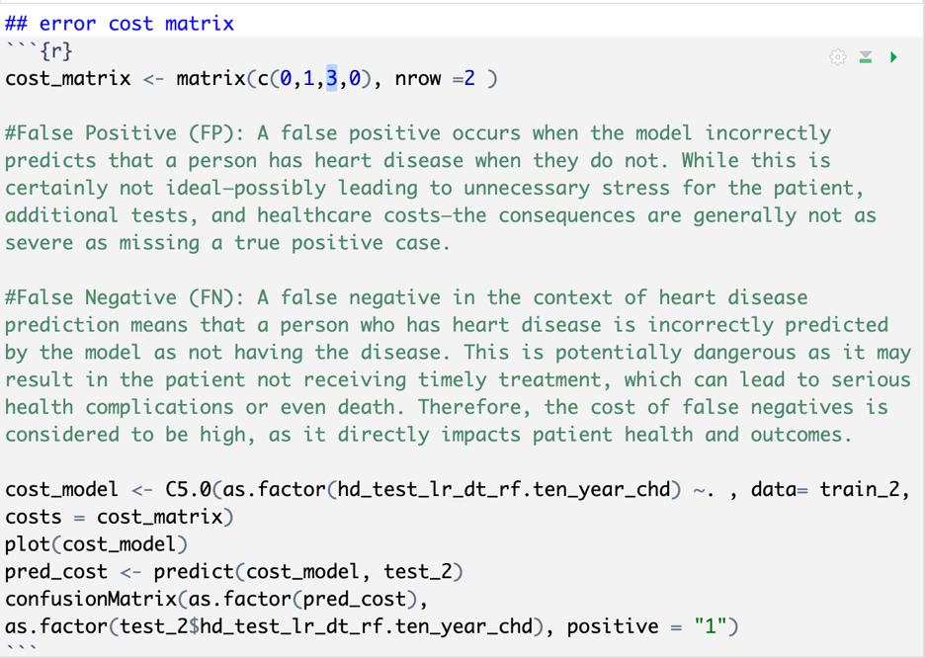
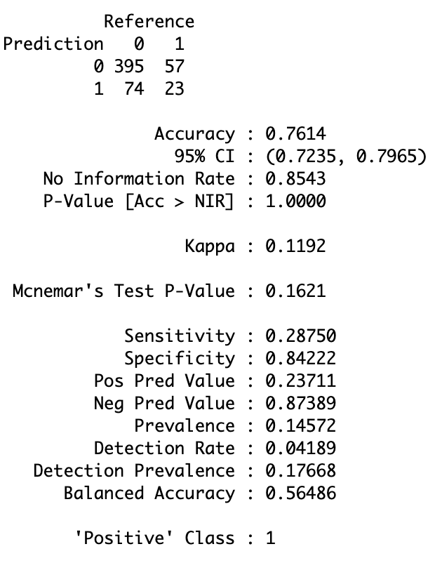

Slide 16
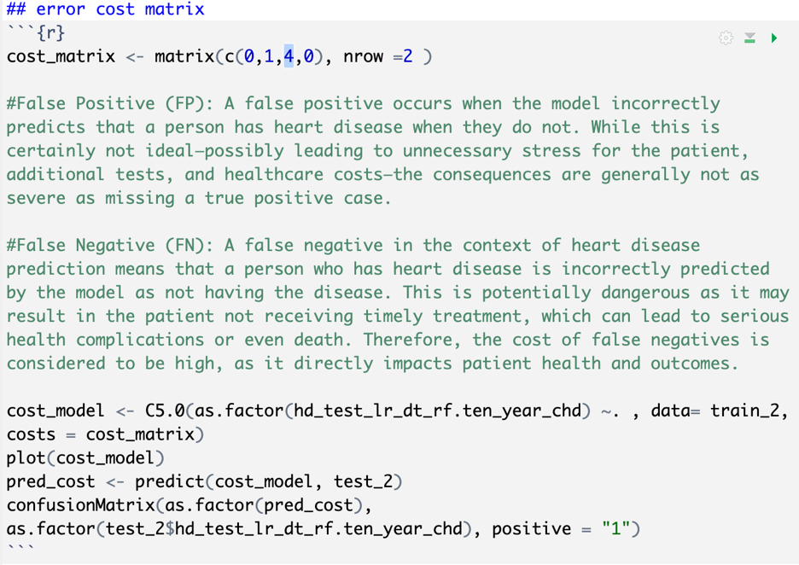
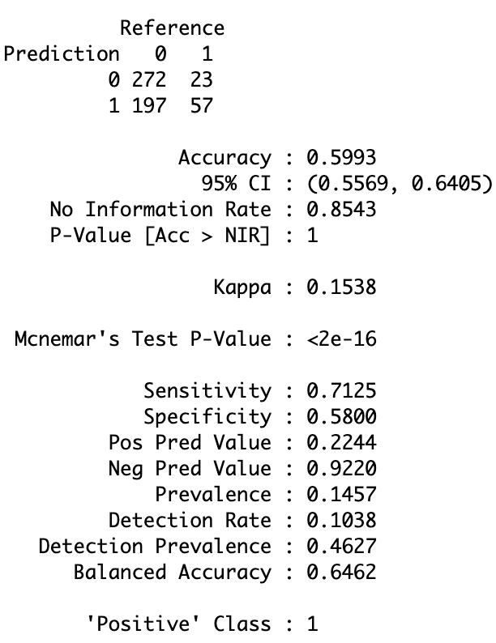

Slide 17
