Slide 1

CONVENIENCE STORE SALE MANAGEMENT
Group 04: 1753087 – Nguyễn Tuấn Phùng
1753089 – Nguyễn Lý Nhật Phương
1753093 – Hồ Bùi Văn Quang
1753132 – Võ Khánh Vy
1753153 – Lý Thanh Long

Slide 2
Project Plan
Vision
Use Case
Software Architecture
UI Prototype
Test Plan
Test Cases & Test Report
Project Demo

Slide 3
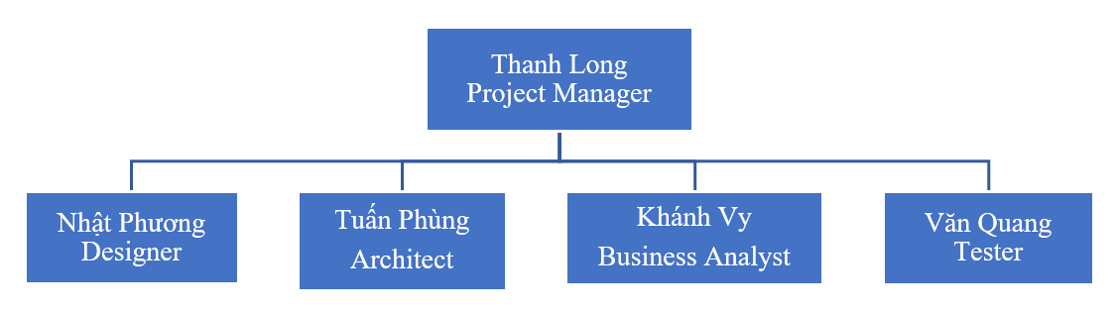
Project plan
Project Overview:
Purpose: Build a system to manage the operation of a convenience store.
Scope: Users including staffs, warehouse staffs and administrator of the store.
Ojectives: Meet the staff's business requirements and be able to do the shop management.
Project Organization:

Slide 4
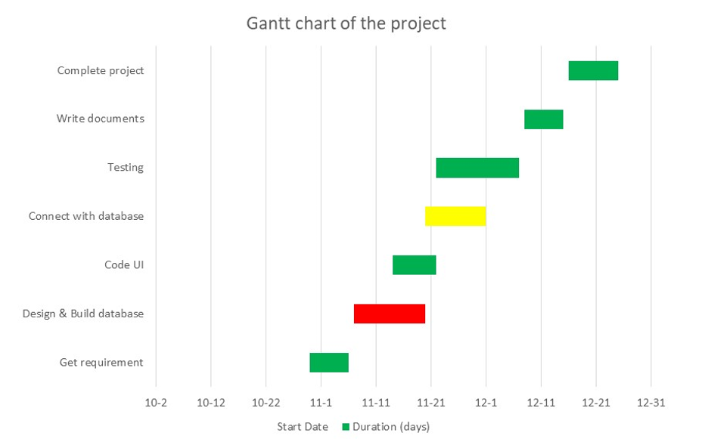
Project Plan
Management Process:

Slide 5
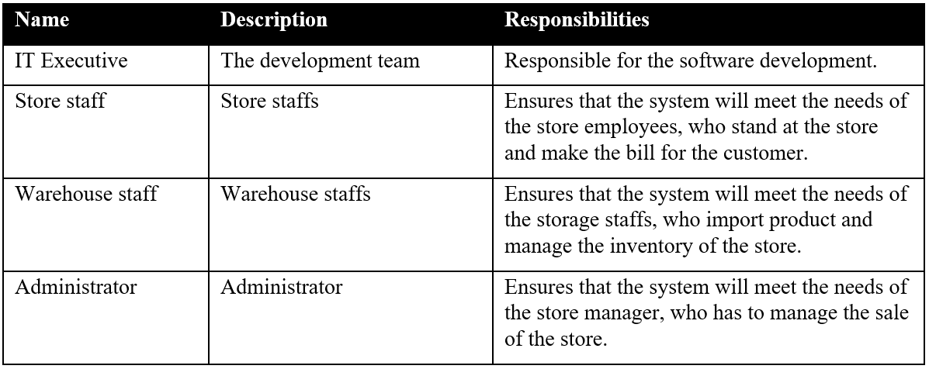
Vision
Stakeholder and User Descriptions:
Stakeholder:

Slide 6
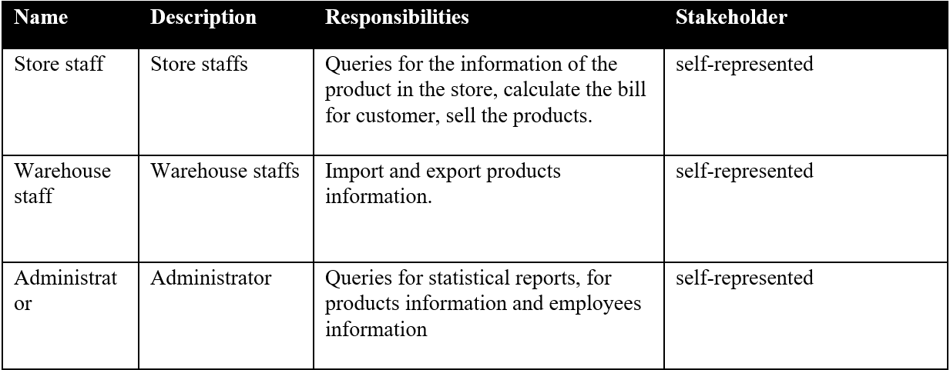
Vision
Stakeholder and User Descriptions:
User:

Slide 7
Vision
Product Features:
Log in, log out
Change/recover password
Register/search member
View product information
Search product
Add/search/export bill
Import/export products from supplier
Add/delete staff
Statistic sales
…
Non-Functional Requirements:
Give back search product results in least than 3 seconds.
Privacy of information, the export of restricted technologies, intellectual property rights, etc. should be audited.
Staff must change the initially assigned login password immediately after the first successful login and the initial should never be reused.
...

Slide 8
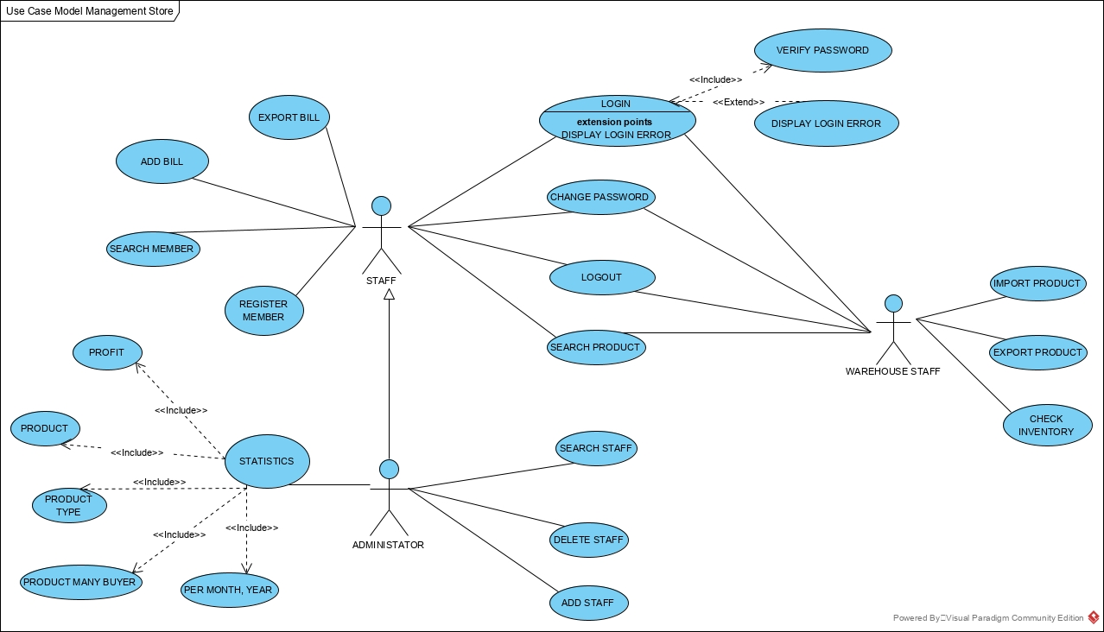
Use case
Use-case Model:

Slide 9
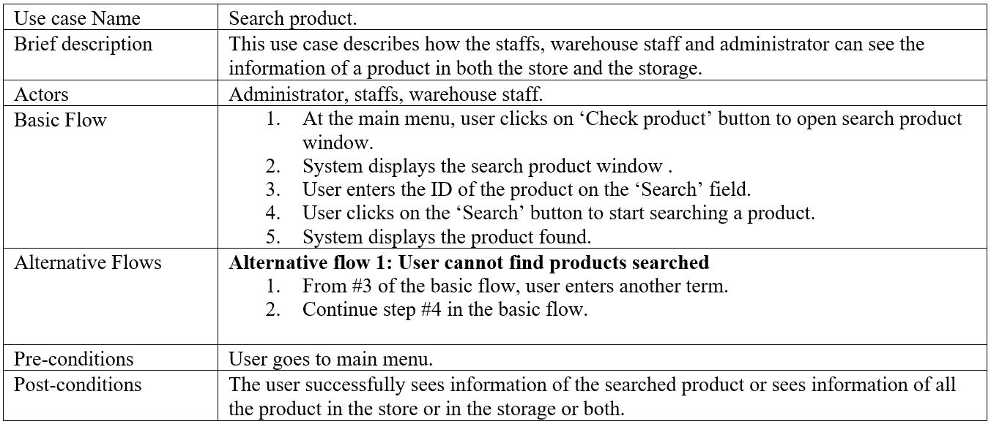
Use case
Use-case Specifications:
Search product:

Slide 10
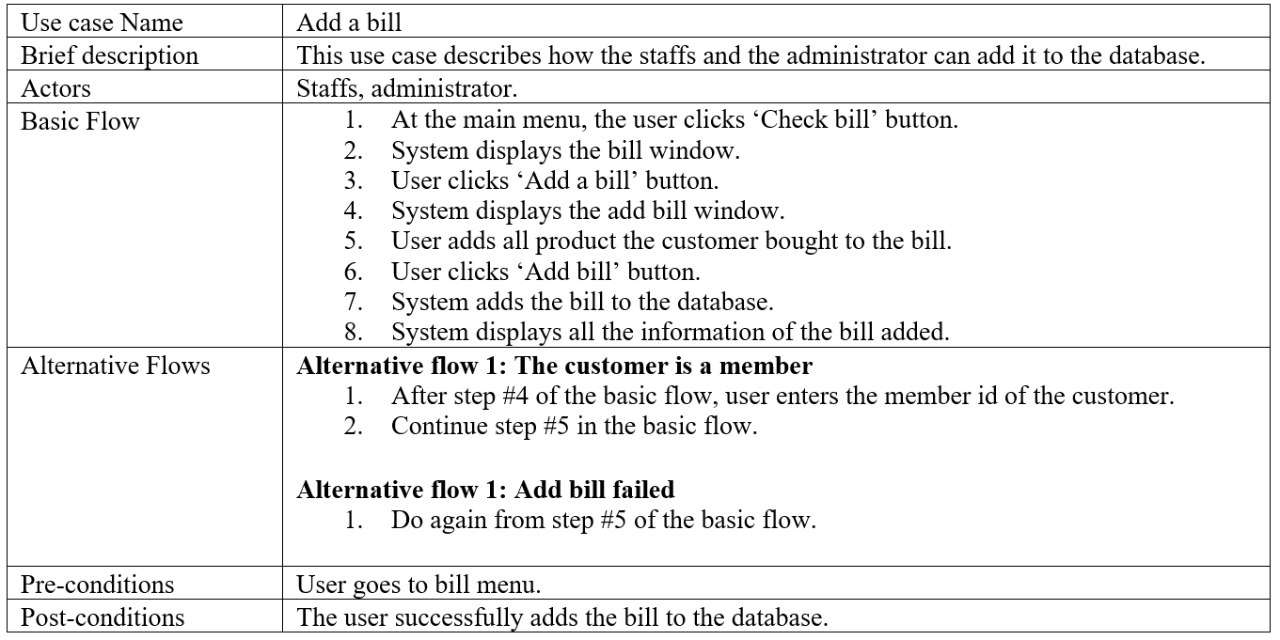
Use case
Use-case Specifications:
Add a bill:

Slide 11
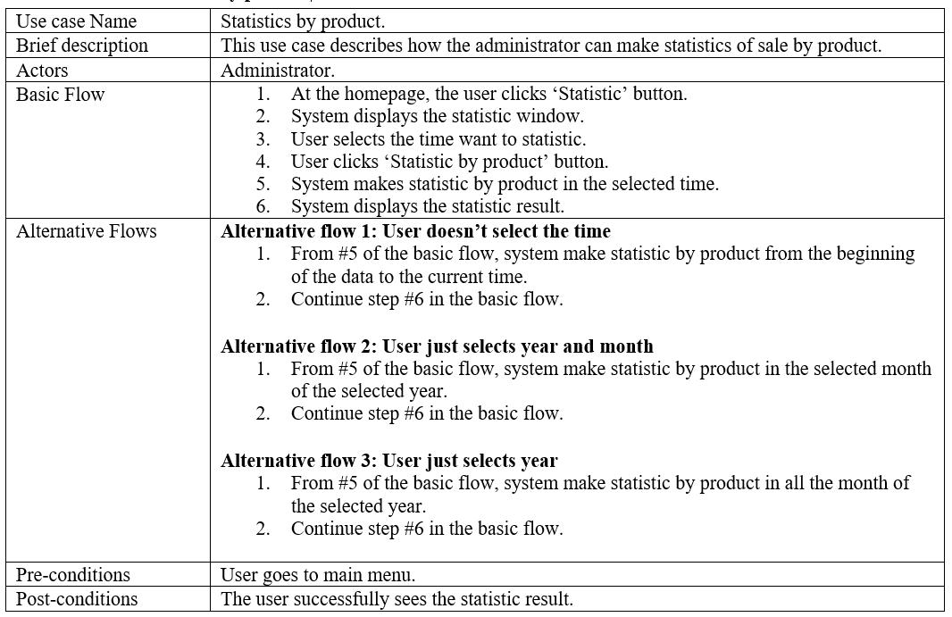
Use case
Use-case Specifications:
Statistic sales (by product):

Slide 12
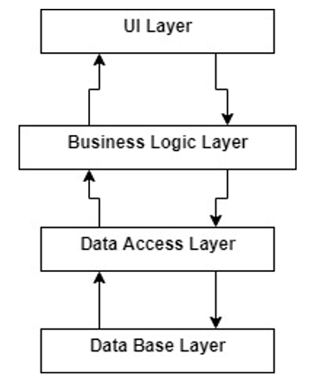
Software architecture
Logical View:

Slide 13
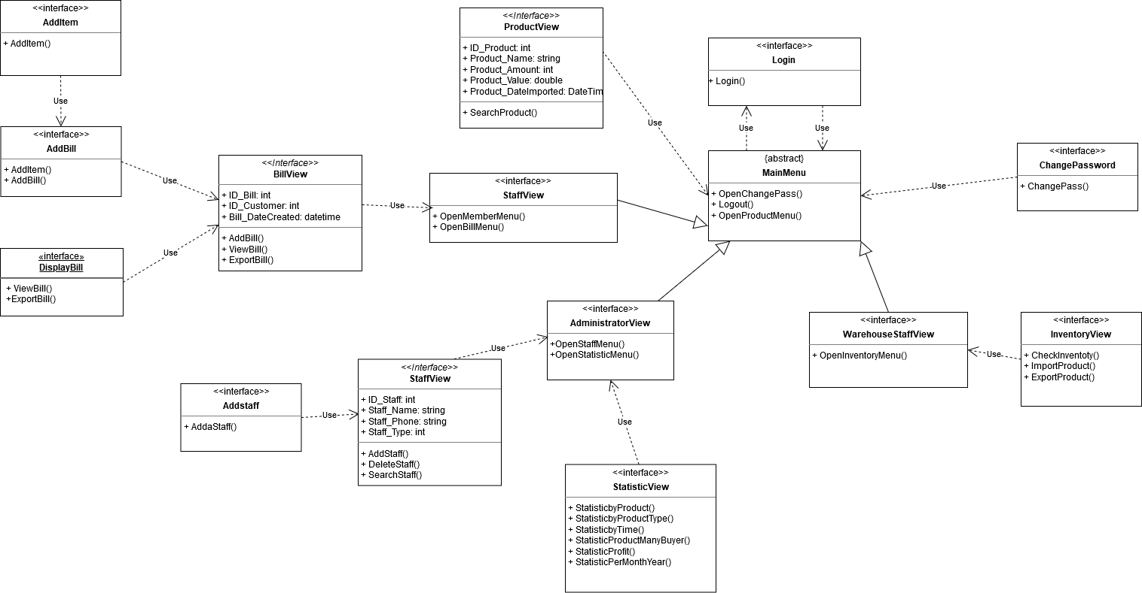
Software architecture
Logical View:
UI Layer:

Slide 14
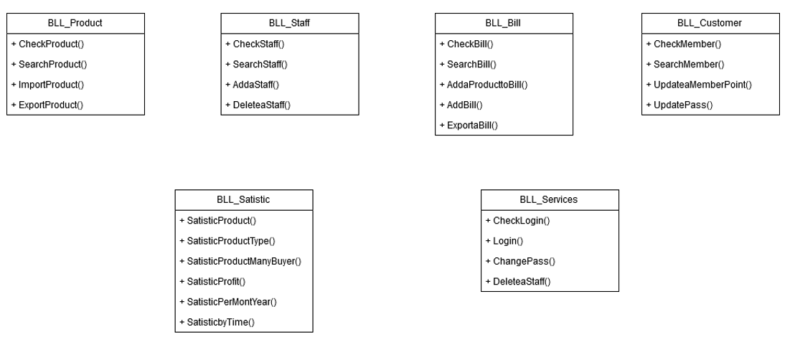
Software architecture
Logical View:
Business Logic Layer:

Slide 15
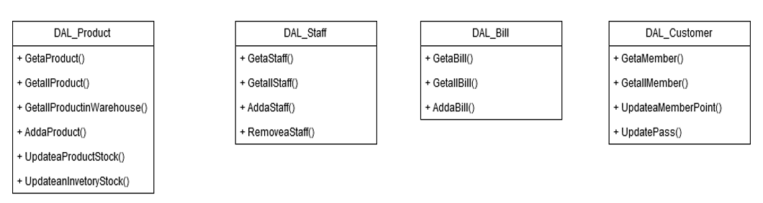
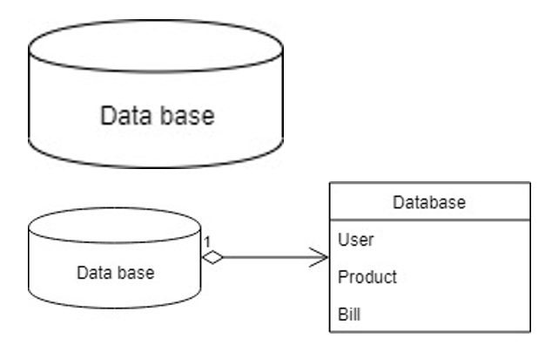
Software architecture
Logical View:
Data Access Layer:
Database Layer:

Slide 16
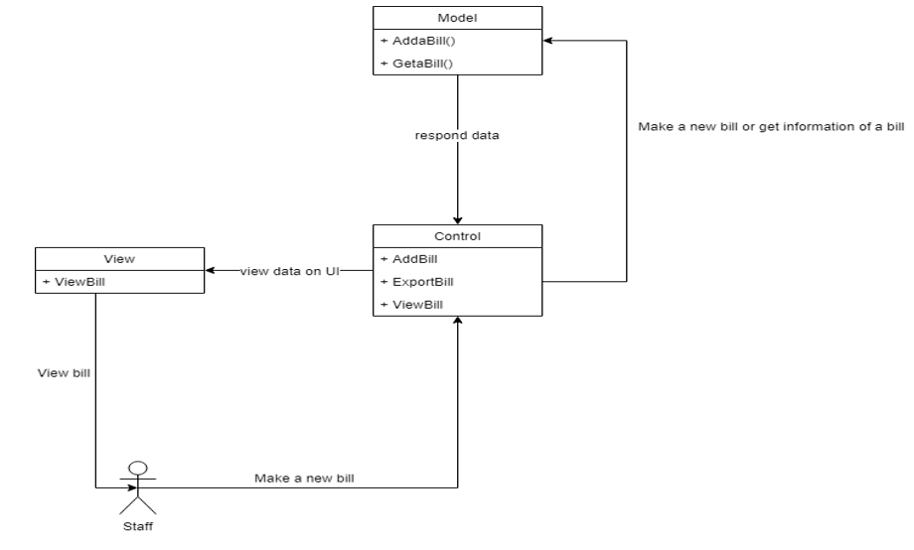
Software architecture
Logical View:
MVC Model: For staff

Slide 17
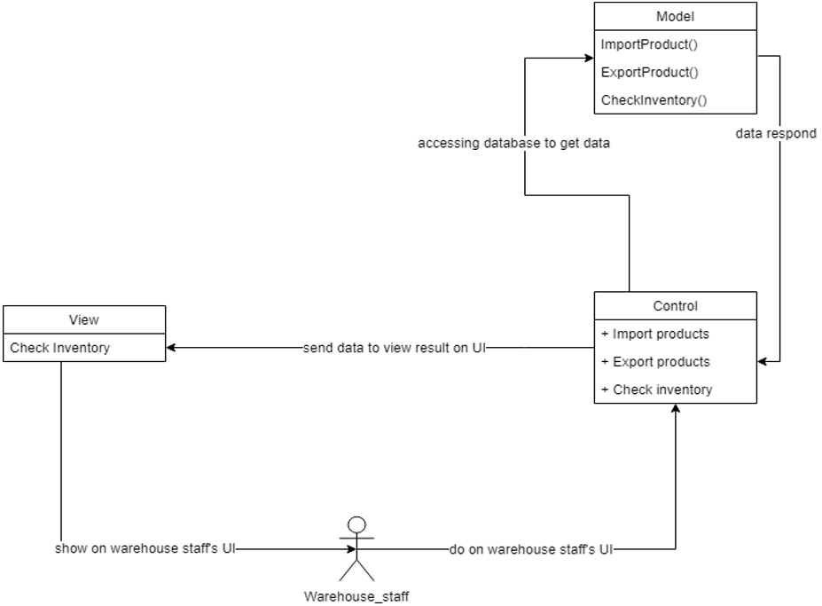
Software architecture
Logical View:
MVC model: For warehouse staff

Slide 18
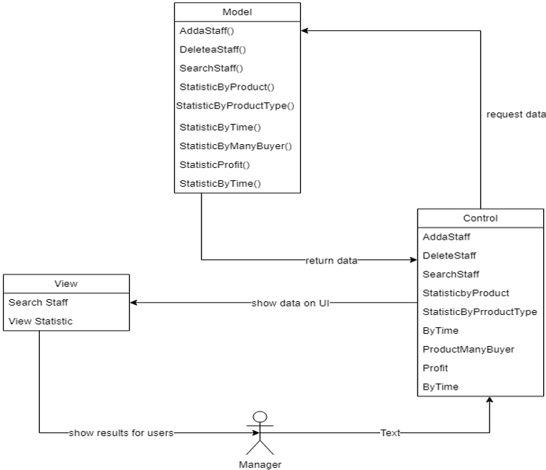
Software architecture
Logical View:
MVC Model: For administrator
Administrator

Slide 19
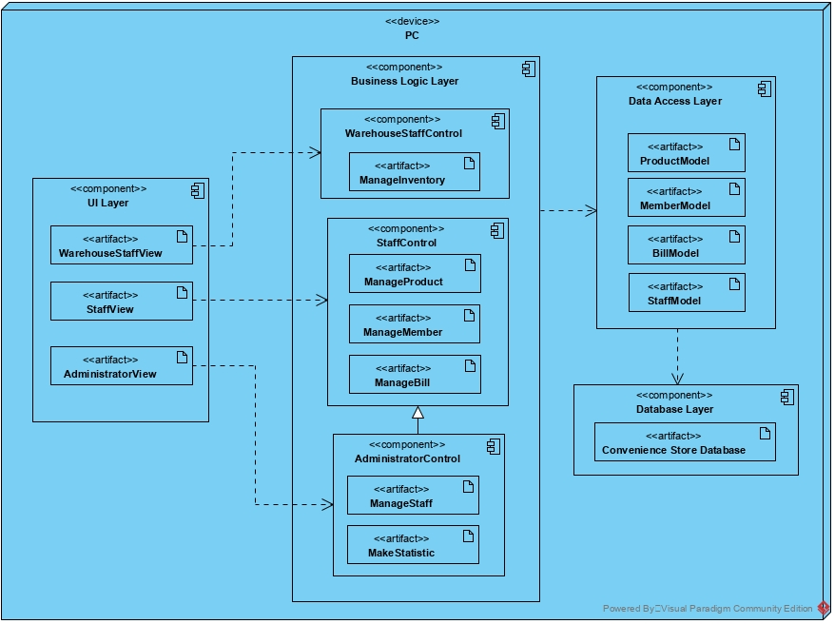
Software architecture
Deployment:

Slide 20
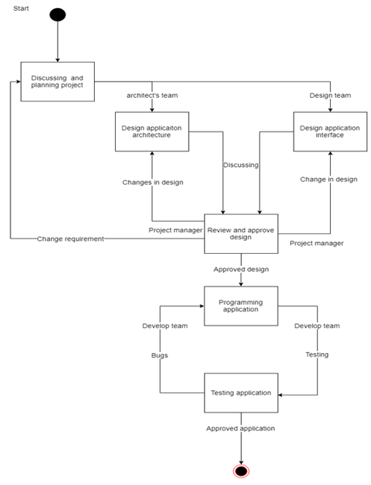
Software architecture
Implementation View:

Slide 21
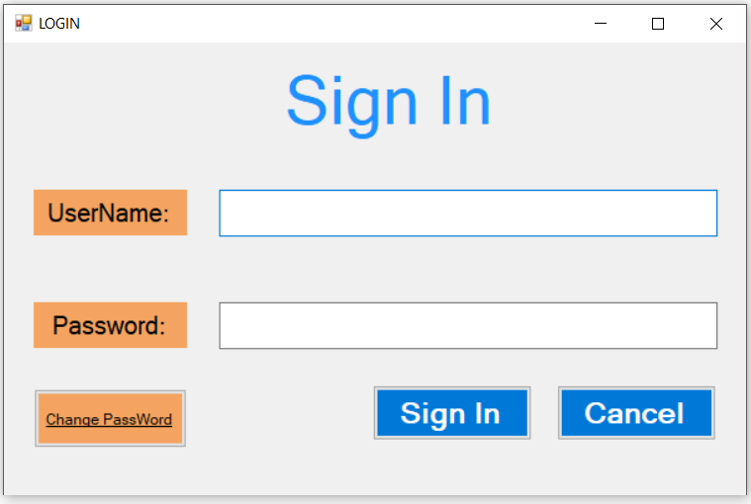
UI prototype

Slide 22
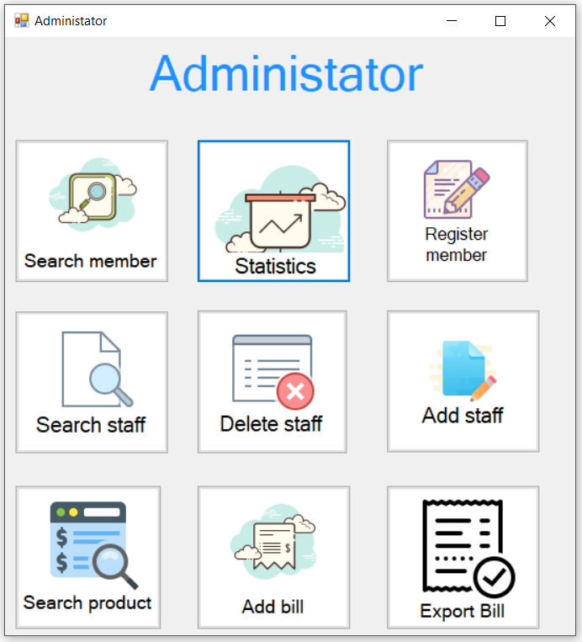

Slide 23
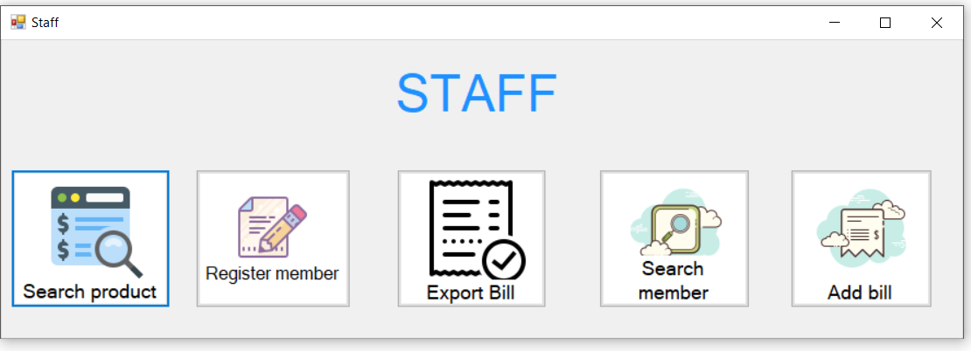

Slide 24
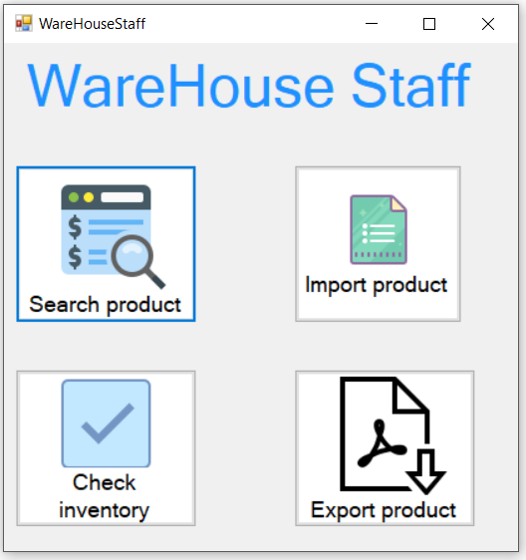

Slide 25
Test plan
Target Test Items:
Database testing.
Functional testing.
UI testing.
Environmental Needs:
Hardware requirements: Minimum hardware
Processor: 1 GHz or faster processer of SoC.
RAM: 1 GB for a 32-bit version, 2 GB for a 64-bit version.
Hard disk space: 16 GB for a 32-bit OS, 20 GB for a 64-bit OS.
Software in the Test Environment:
Window 10, 64 bits.
Microsoft SQL Server.
Productivity and Support Tools: .NET framework 3.5 (or higher).

Slide 26
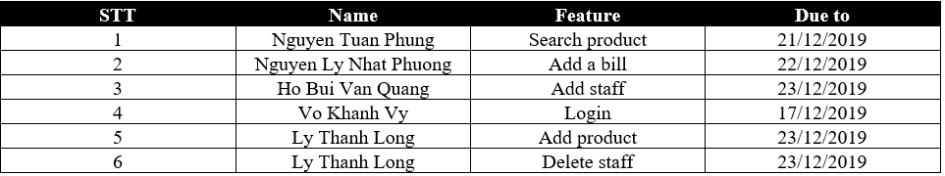
Test plan
Responsibilities, Staffing, and Training Needs:
People and Roles:
Test Manager: 1
Test Designer: 1
Tester: 2
Test System Administrator: 1
List scheduling plan test of team:
Tool auto testing:
TestComplete.
Ranorex Studio.

Slide 27
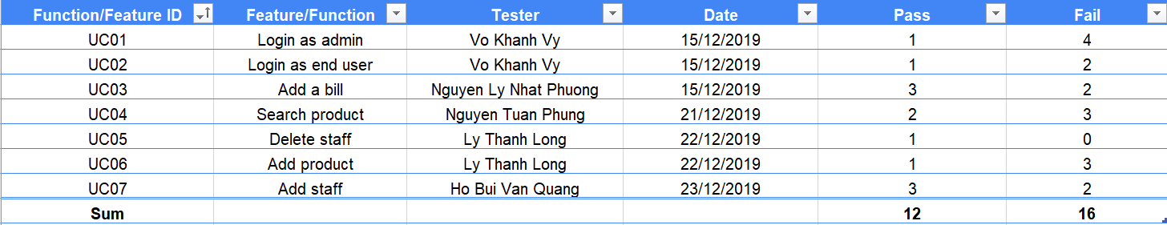
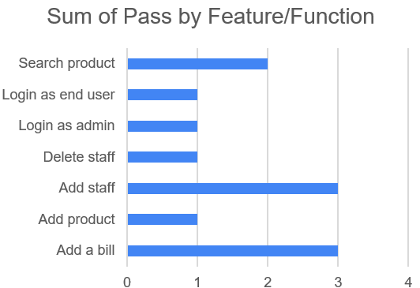
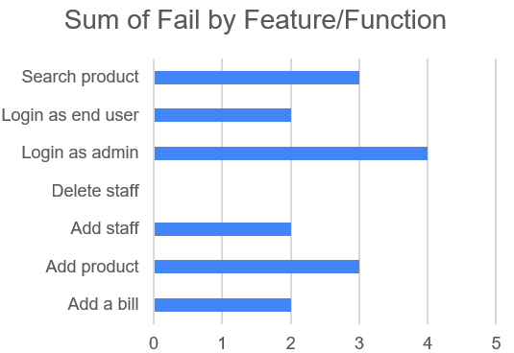
Test cases & Test report
Summary:
Chart:

Slide 28
Project demo

Slide 29

Q & A

Slide 30


