Slide 1
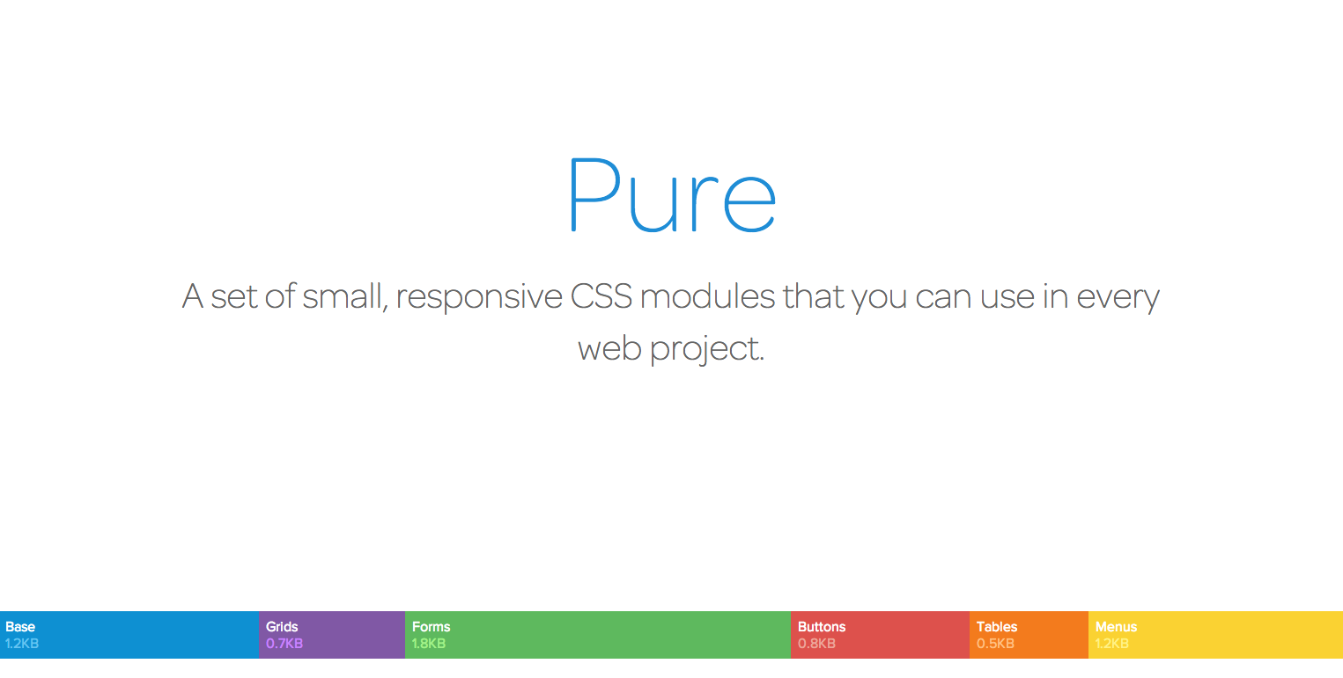

Nhóm 1
Hà Thị An
Hoàng Văn Thắng - Ngô Quang Hải

Slide 2
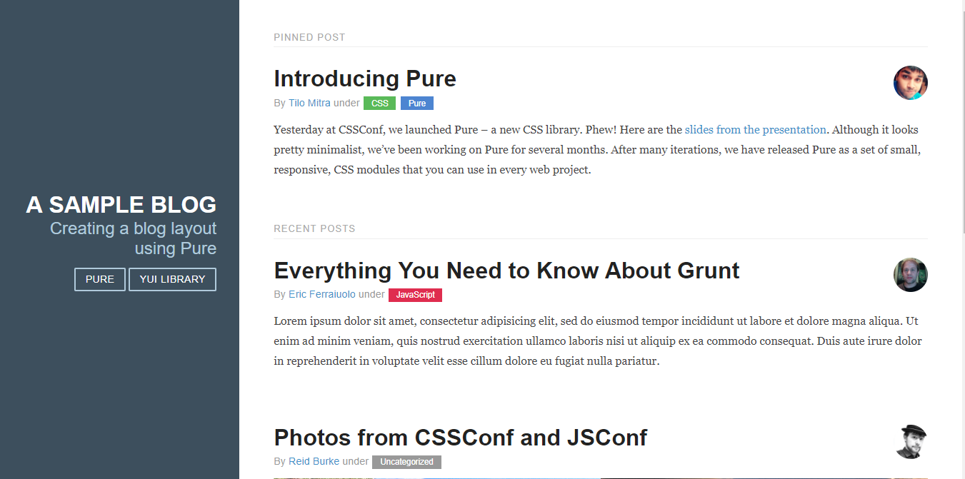
Layout
Blog

Slide 3
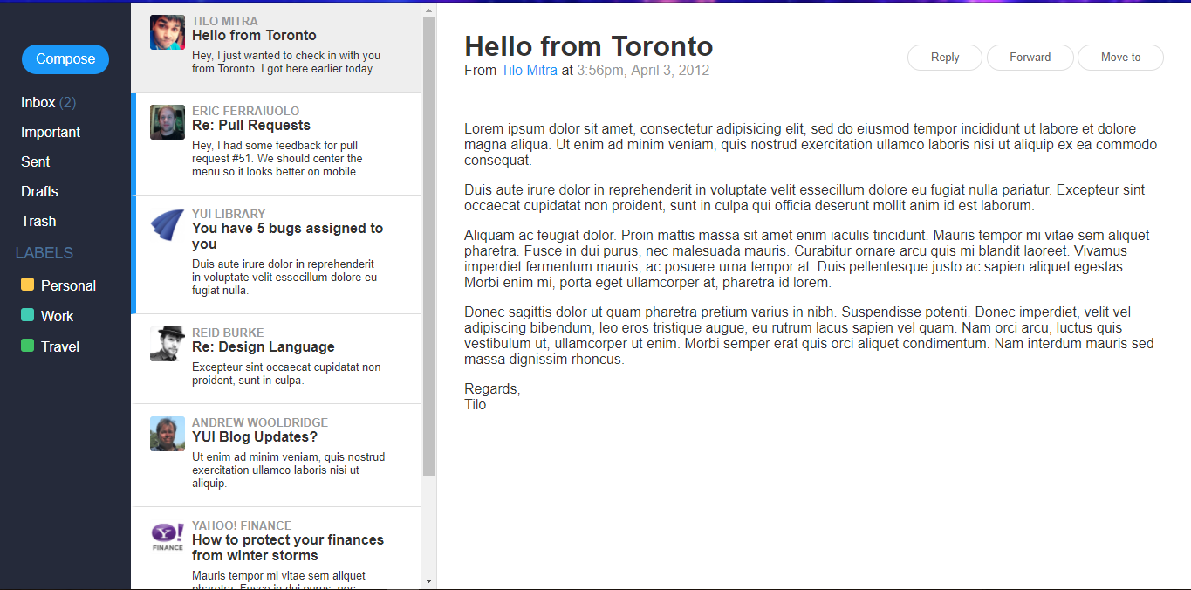
Layout
Email

Slide 4
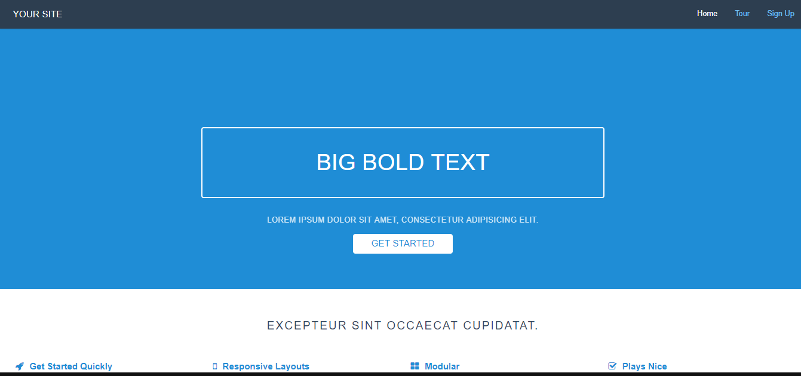
Layout
Landing page

Slide 5
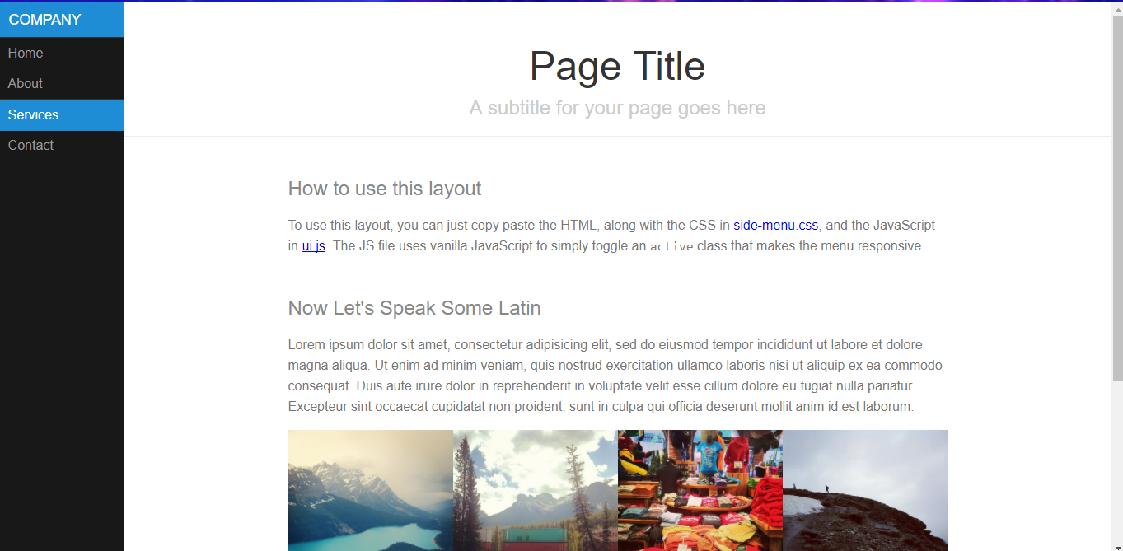
Layout
Responsive

Slide 6
Add Pure to Your Page
add the following <link> element into your page's <head>, before your project's stylesheets
<link rel="stylesheet" href="https://unpkg.com/purecss@1.0.0/build/pure-min.css" integrity="sha384-nn4HPE8lTHyVtfCBi5yW9d20FjT8BJwUXyWZT9InLYax14RDjBj46LmSztkmNP9w" crossorigin="anonymous">

Slide 7
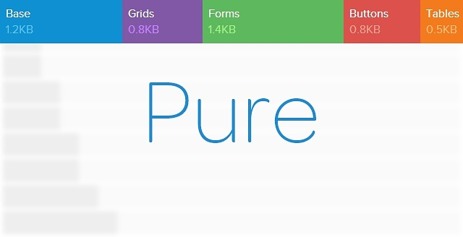
Add the Viewport Meta Element
<meta name="viewport" content="width=device-width, initial-scale=1">

Slide 8
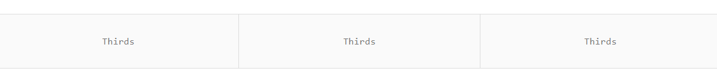
Understand Pure Grids
create a row by using the .pure-g class, and create columns within that row by using the pure-u-* classes.
Here's a grid with three columns:
<div class="pure-g">
<div class="pure-u-1-3"><p>Thirds</p></div>
<div class="pure-u-1-3"><p>Thirds</p></div>
<div class="pure-u-1-3"><p>Thirds</p></div>
</div>

Slide 9
Understand Pure Grids
Grid classes vs. unit classes: Pure Grids consist of two types of classes: the grid class (pure-g) and unit classes (pure-u or pure-u-*)
The widths of the units are fractions:Units have various class names that represent their widths. For example, pure-u-1-2 has a width of 50%, whereas pure-u-1-5 would have a width of 20%.
All child elements of a grid must be units:Child elements contained within an element with a pure-g classname must be a grid unit with a pure-u or pure-u-* classname.
Content goes inside grid units: All content which is visible to people needs to be contained inside a grid unit. This ensures that the content will be rendered properly.

Slide 10
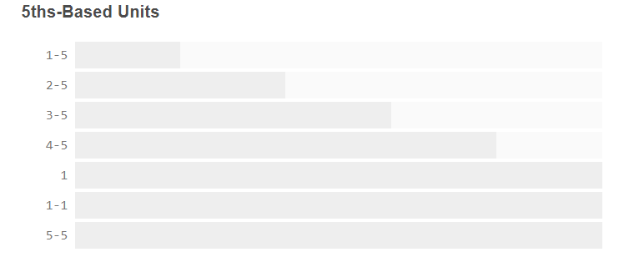
Grids Unit Size

Slide 11
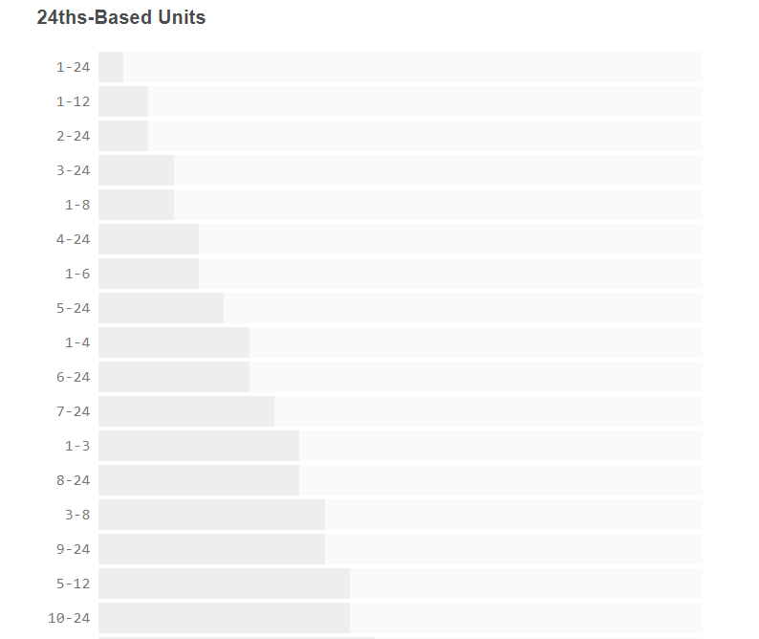
Grids Unit Size

Slide 12
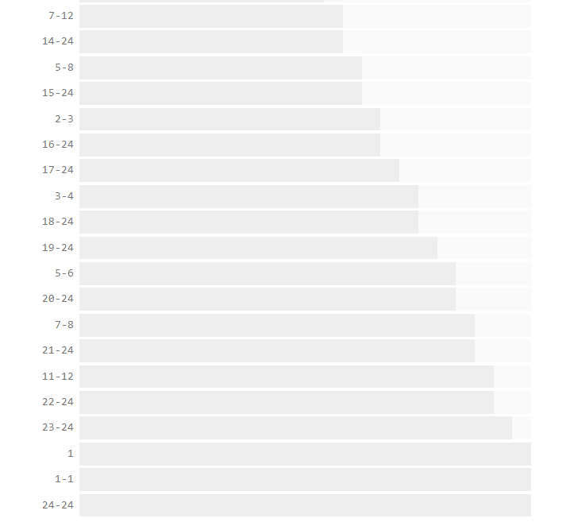
Grids Unit Size
24ths - Based unit

Slide 13

Responsive Grids
Fix trình duyệt IE
<!--[if lte IE 8]>
<link rel="stylesheet" href="https://unpkg.com/purecss@1.0.0/build/grids-responsive-old-ie-min.css">
<![endif]-->
<!--[if gt IE 8]><!-->
<link rel="stylesheet" href="https://unpkg.com/purecss@1.0.0/build/grids-responsive-min.css">
<!--<![endif]-->

Slide 14
Responsive Grids
The default responsive breakpoints included in grids-responsive.css:
Key | CSS Media Query | Applies | Classname
None | None | Always | .pure-u-*
sm | @media screen and (min-width: 35.5em) | ≥ 568px | .pure-u-sm-*
md | @media screen and (min-width: 48em) | ≥ 768px | .pure-u-md-*
lg | @media screen and (min-width: 64em) | ≥ 1024px | .pure-u-lg-*
xl | @media screen and (min-width: 80em) | ≥ 1280px | .pure-u-xl-*

Slide 15

Base
The Foundation:
All modules in Pure build on top of Normalize.css
Normalize.css is an open-source project by Nicolas Gallagher and Jonathan Neal. In their own words.

Slide 16
Base
Hiding Elements:
<input type="text" name="_csrf" hidden>
Responsive Images:
<img class="pure-img" src="...">

Slide 17
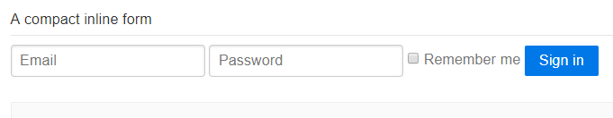
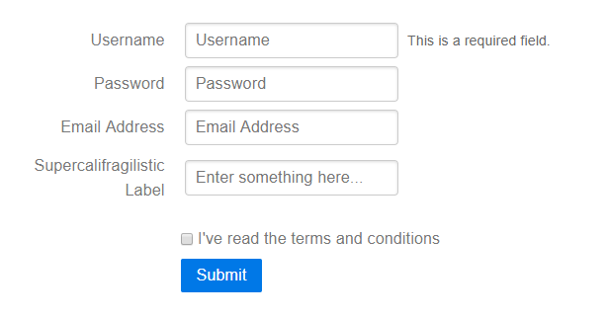
Form
Default Form: <form class="pure-form">
Aligned Form: <form class="pure-form pure-form-stacked">

Slide 18
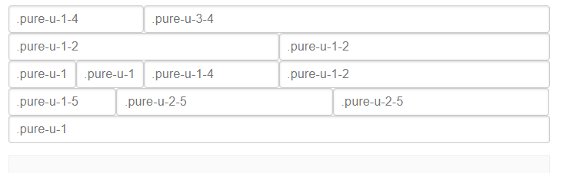
Form
Input Sizing:
<form class="pure-form">
<input class="pure-input-1" type="text" placeholder=".pure-input-1"><br>
<input class="pure-input-2-3" type="text" placeholder=".pure-input-2-3"><br>
<input class="pure-input-1-2" type="text" placeholder=".pure-input-1-2"><br>
<input class="pure-input-1-3" type="text" placeholder=".pure-input-1-3"><br>
<input class="pure-input-1-4" type="text" placeholder=".pure-input-1-4"><br>
</form>

Slide 19


Button
Primary Buttons: <a class="pure-button pure-button-primary" href="#">A Primary Button</a>
Buttons with icons:
<button class="pure-button">
<i class="fa fa-cog"></i>
Settings
</button>

Slide 20
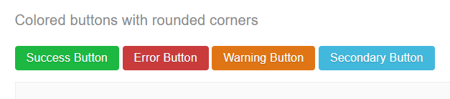
Button
Customizing Buttons
<div>
<style scoped>
.button-success,
.button-error,
.button-warning,
.button-secondary {
color: white;
border-radius: 4px;
text-shadow: 0 1px 1px rgba(0, 0, 0, 0.2);
}
.button-success {
background: Green;}
<button class="button-success pure-button">Success Button</button>

Slide 21
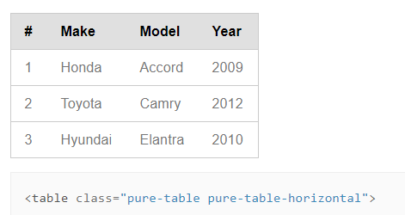
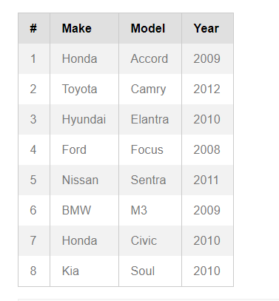
Table
Table with Horizontal Borders
Striped Table
<table class = “pure-table-striped”>

Slide 22
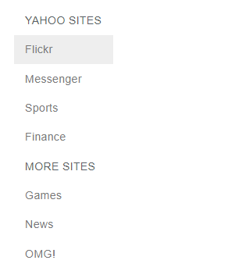
Menu
Vertical Menu
<div class="pure-menu custom-restricted-width">

Slide 23

Menu
Horizontal Menu
div class="pure-menu pure-menu-horizontal">

Slide 24

Menu
Selected and Disabled Items
<ul class="pure-menu-list">
<li class="pure-menu-item pure-menu-selected"><a href="#" class="pure- menu-link">Selected</a></li>
<li class="pure-menu-item pure-menu-disabled">Disabled</li>
</ul>

Slide 25
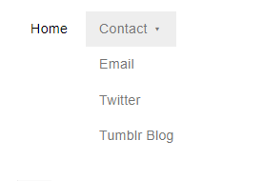
Menu
Dropdowns menu:
<div class="pure-menu pure-menu-horizontal">
<ul class="pure-menu-list">
<li class="pure-menu-item pure-menu-selected"><a href="#" class="pure-menu-link">Home</a></li>
<li class="pure-menu-item pure-menu-has-children pure-menu-allow-hover">
<a href="#" id="menuLink1" class="pure-menu-link">Contact</a>
<ul class="pure-menu-children">
<li class="pure-menu-item"><a href="#" class="pure-menu-link">Email</a>
</ul>
</li>
</ul>
</div>

Slide 26
Thank for your attention !

