Slide 1
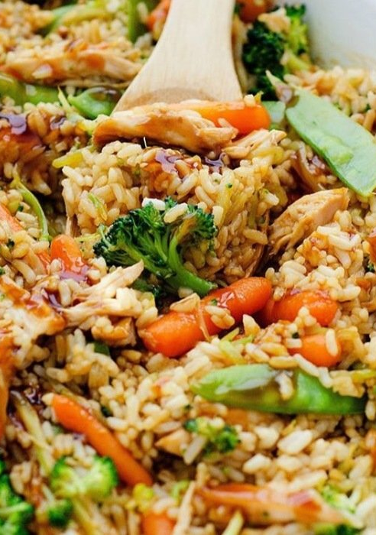
CIS 4004 · MERN STACK PROJECT
PlatePilot
Plan less. Savor more.
Discover recipes. Build your week.
Recipe imagery via TheMealDB

Slide 2
One team owns the complete product story.
01
02
03
04
Product
Experience
Platform
Reliability
Product lead
Scope, story, presentation
React lead
Interface, responsive UX
API lead
Express, OAuth, email
Data & delivery
MongoDB, tests, CI/CD
02

Slide 3
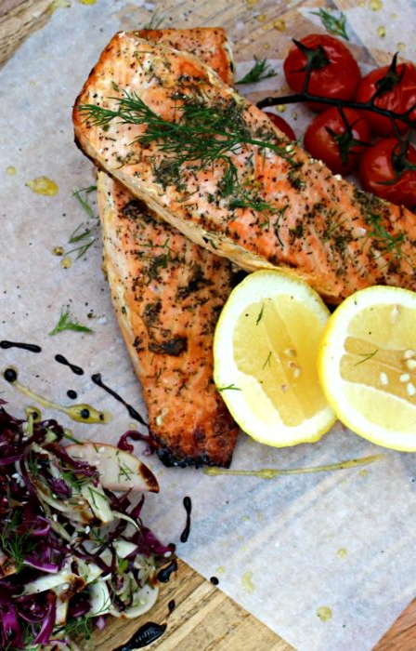
Dinner starts with three disconnected decisions.
Find inspiration
Search scattered recipe sources.
Make it fit
Turn an idea into a realistic week.
Recipe imagery via TheMealDB

Slide 4

THE PRODUCT
PLATEPILOT
One place to discover, choose, and plan.
Live recipes become a useful weekly plan.
Every choice stays attached to the user.
Recipe imagery via TheMealDB

Slide 5
A recipe becomes a plan in four quick moves.
01 · Sign in
Google OAuth or a verified email account.
02 · Discover
Search live recipes by meal or cuisine.
03 · Choose
Inspect ingredients and directions.
04 · Plan
Assign, replace, or remove any weekday.
05

Slide 6
React turns intent into asynchronous JSON requests.
SERVER + DATA
Node + Express
↳ MongoDB stores users and weekly plans
↳ TheMealDB supplies normalized recipes
CLIENT
JSON crosses every boundary.
React + Vite
Responsive AJAX interface
JWT stored for protected requests
Express coordinates identity, recipes, and persistence.
06

Slide 7
Every course requirement maps to a working feature.
MERN is the foundation. Security, quality, and delivery are built around it.
OAuth
Email
Tests
CI/CD
Google credential verification
Expiring, hashed verification token
Jest + Supertest API coverage
Deploy after a passing main push
MONGODB • EXPRESS • REACT • NODE • JSON • THEMEALDB • HTTPS
07

Slide 8

The live demo proves the complete user journey.
Sign in with the demo account
Search “chicken” recipes
Open ingredients and directions
Assign a meal to Wednesday
Replace or remove a planned meal
Show the mobile layout
08
Recipe imagery via TheMealDB

Slide 9
The JSON API is simple to inspect and easy to explain.
Method | Endpoint | Auth | Purpose | Postman
GET | /health | Public | Service health | 1
GET | /recipes?search= | Public | TheMealDB search | 2
GET | /recipes/:id | Public | Recipe detail | —
POST | /auth/google | Public | OAuth sign-in | —
POST | /auth/register | Public | Verification email | —
GET | /meal-plans | JWT | Read the week | 4
PUT | /meal-plans/:day | JWT | Assign a recipe | —
09

Slide 10
Verification keeps the demo fast, safe, and repeatable.
Automated API checks
Health, validation, route protection, recipe fallback, and OpenAPI.
Lighthouse gate
Desktop and mobile performance, accessibility, best practices, and SEO.
Dependency review
Production packages checked against npm security advisories.
JEST + SUPERTEST
FINAL DOMAIN TARGET
KNOWN VULNERABILITIES
6 / 6
≥95
0
passing
required
npm audit
10

Slide 11
Constraints made the product stronger.
What went well and what challenged us share the same root.
The product had to stay presentation-ready while every external dependency remained real.
That pushed us toward clear boundaries and graceful fallbacks.
What went well
What challenged us
Reusable React components kept the experience consistent.
Server-side recipe normalization simplified the client.
Fallback recipes protect the demo from API downtime.
OAuth and email depend on correct production credentials.
HTTPS deployment needs DNS and firewall coordination.
Lighthouse tuning belongs on the final hosted domain.
The result stays polished even when a dependency is slow.
11

Slide 12
PLATEPILOT
MERN · JSON · THEMEALDB
Questions?

