Slide 1
Spectra of the Moon using a Robotic Telescope
E.Almas, T.Christopherson, W.Hogg, E.Stone

Slide 2
Goals: the following steps (1-5) are mandatory in order to complete the project, however you may boost marks, either as a group, or as an individual, with optional goals (5-8).
(1)Demonstrate acquiring calibrated test spectra of different materials .g. tarmac, concrete, rock samples, vegetation, using a hand held spectrometer.
(2)Use N (e.g. 20) identifiable reference areas of the Moon (highland and/or mare) to calibrate measured brightness values in the CCD camera wrt a standard lunar pectrum(find this on-line).
(3)select and measure some target areas that you want to measure the spectrum of wrt the previously derived standard lunar spectra.
(4)Analyse the spectra from (3) to determine –can you see any mineral absorption ands –what might these be? What is/are the most colourful area(s)f the Moon?
(5)How accurately can you measure absorption bands in the spectra of lunar surface features you are studying(use propagation of errors)?
(6)Investigate whether the telescope optics suffer from vignetting, or other non-linear sensitivity effects, across the image. Can you calibrate out/mitigate this effect if present?
(7)Experiment with producing meaningful co-registered colour ratio images of the lunar surface o highlight surface composition differences.
(8)Repeat your spectra measurements at other lunar phases to see if the surface changes colour at different illumination and viewing angles?

Slide 3
Spectra of objects with handheld spectrometer

Slide 4
“Before analysing a sample it is frequently necessary to check the calibration of the spectrometer that is being used. This is performed by analysing known samples and measuring the error between the empirical and known values for the samples. A skew, or bias, can be introduced into the data handling routines of the data analysis equipment of the spectrometer to compensate for these differences.”
Davies, Anthony MC, and Harald A. Martens. "Method and apparatus for calibrating a spectrometer." U.S. Patent No. 5,321,970. 21 Jun. 1994.

Slide 5
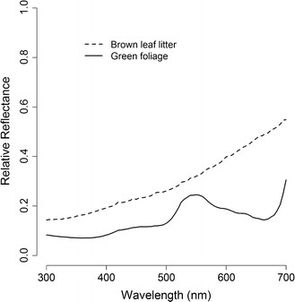
Comparing to Known spectra
Figure 1: Mean reflectance spectra of brown leaf litter (n = 20) and... - Scientific Figure on ResearchGate. Available from: https://www.researchgate.net/figure/276212092_fig6_Figure-1-Mean-reflectance-spectra-of-brown-leaf-litter-n-20-and-green-foliage-n [accessed Feb 19, 2016]

Slide 6
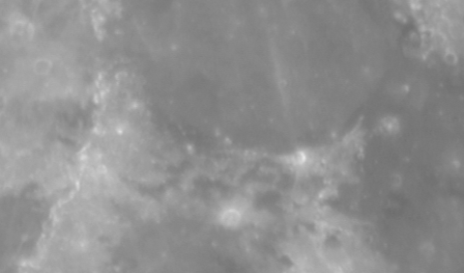
Figure 1- Mare Serenitatis (top middle) and Mare Tranquillitatis (right) in R-Band

Slide 7
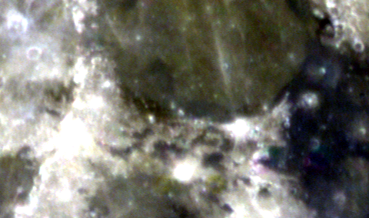
Combining this photo in RGB with Red representing I-band, Green representing R-band and Blue representing B-band yields the following result:

Slide 8
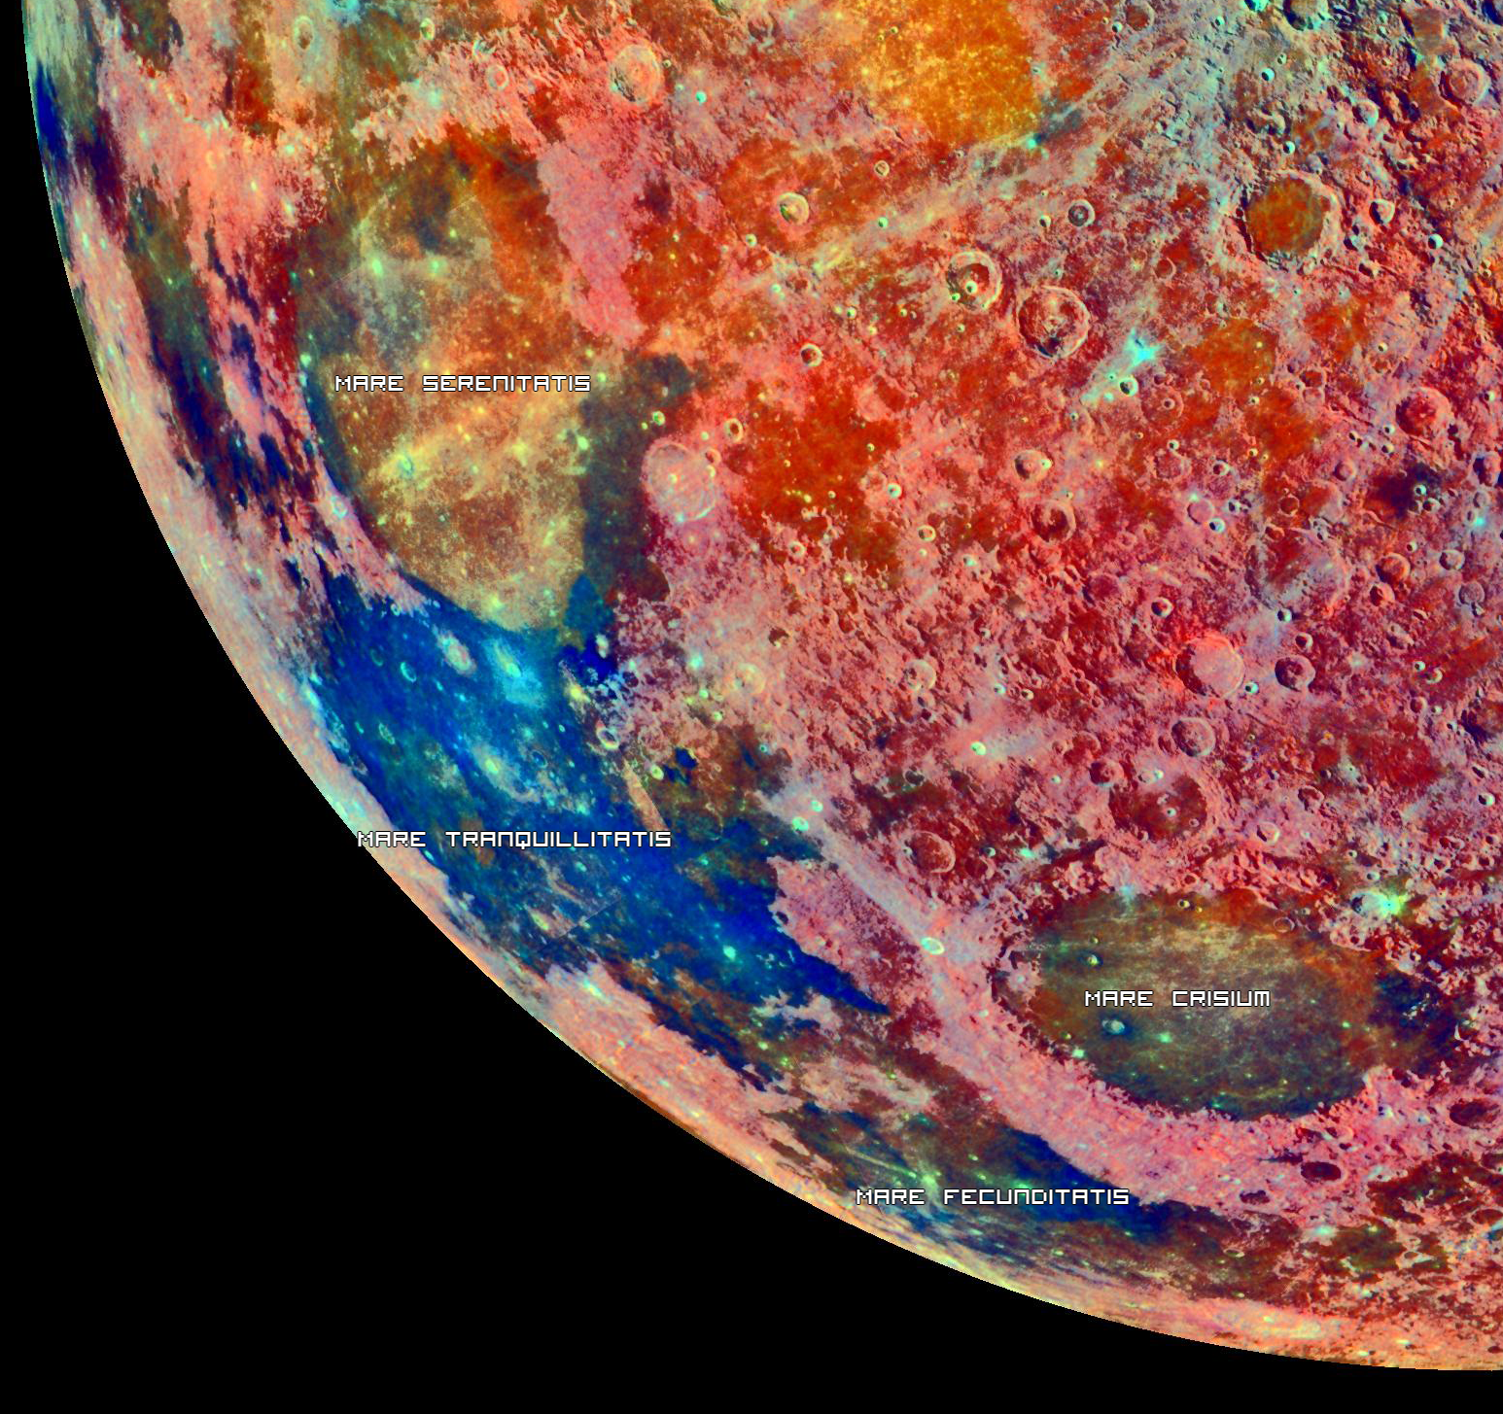
Comparing this to NASAs spectral composition of the moon shows a similar result where Mare Serenitatis is in the green-yellow part of the spectrum and Mare Tranquillitatis is in the blue-purple part.

