Slide 1
Spectra of the Moon using a Robotic Telescope
E.Almas, T.Christopherson, W.Hogg, E.Stone

Slide 2
Spectra of objects with handheld spectrometer

Slide 3
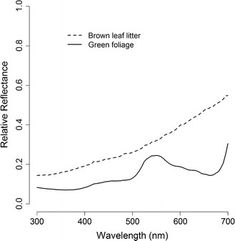
Comparing to Known spectra
Figure 1: Mean reflectance spectra of brown leaf litter (n = 20) and... - Scientific Figure on ResearchGate. Available from: https://www.researchgate.net/figure/276212092_fig6_Figure-1-Mean-reflectance-spectra-of-brown-leaf-litter-n-20-and-green-foliage-n [accessed Feb 19, 2016]

