Slide 1
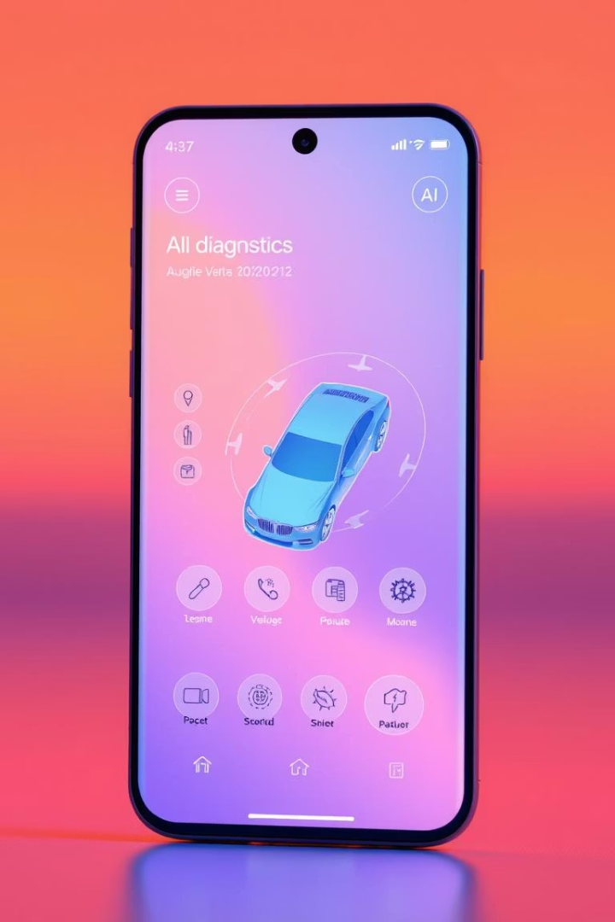

AI-Powered Car Diagnostic App: From Data to Design
This presentation outlines the journey from initial data gathering to the design of an AI-powered car diagnostic mobile application. We'll explore the objectives, techniques, and key findings that shaped our approach. We will also review the brainstorming sessions and reverse engineering insights that led to the development of a mobile-first, AI-powered tool designed to empower users with confidence in car maintenance.
by Chuye Princely

Slide 2
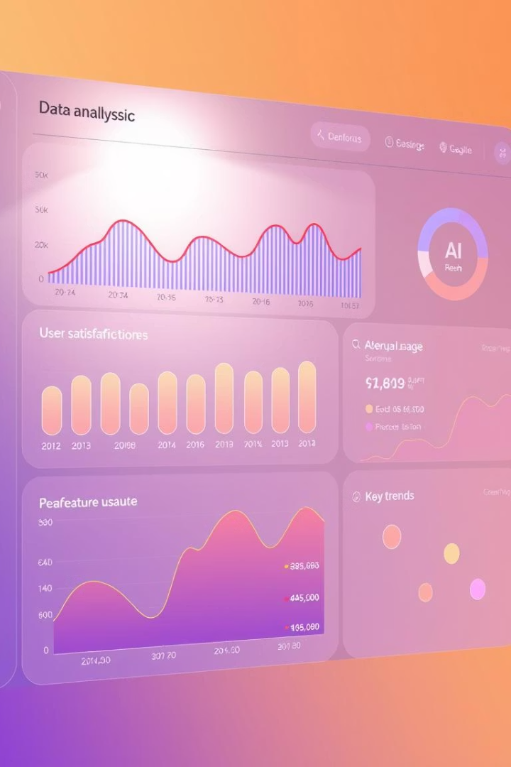



Data Gathering: Understanding User Needs
Online Survey
Interviews
Quantitative insights from car owners, drivers, and mechanics revealed that 68.8% consult a mechanic for dashboard lights, and 80% cannot detect engine faults via sound.
Qualitative context highlighted that most users lack technical knowledge, desire visual guidance, and prefer AI assistance as a second opinion. Offline use is essential.
Brainstorming
Translated user feedback into actionable feature ideas, including YouTube API integration, a mechanic-matching service, and confidence percentage display.

Slide 3
Reverse Engineering: Identifying Gaps
OBD Auto Doctor
Car Scanner ELM OBD2
Sound Analyzer App
AutoMate AI
Real-time diagnostics via Bluetooth OBD. Requires hardware.
Detect frequencies and classify sounds. Not tailored to car issues.
Predict faults via symptoms. Lacks mechanic interaction.
Diagnostic reports, emission tests. Not user-friendly for laypersons.

