Slide 1

Super Store Sales Analysis
By
Hader Karam
Janet Essam Gad
Nadia Amr Atrees
Rokia Ashraf
Fatma Samy Hassan Muhammad
Muhammad Hassan Mahmoud
Disclaimer: The information provided in this text is not factual and is for illustrative purposes only

Slide 2
Report Objective
Period: 2015 – 2018
This report aims to analyze sales performance across different regions, product categories, and time periods, in order to understand market trends, identify strengths and weaknesses, and support strategic decision-making.
The report includes key performance indicators (KPIs), customer behavior analysis, order distribution, and outlier detection — all of which significantly contributed to accurate data understanding and generating actionable insights.
One of the key findings was the reduction of skewness in sales distribution. Initially, the mean sales value was nearly five times greater than the median, indicating a strong right skew. After addressing outliers, the gap between the mean and median narrowed significantly, resulting in a more realistic and reliable interpretation of sales performance.

Slide 3
Super Store Sales Dashboard discuss some KPI
Average Order to ship time
No of customers
Total Orders & Sales
Mean & Median
Also explains some relations
Average Order to Ship time by Ship Mode
Total Sales & Total Orders for every region
Total Sales by Time
Average Order To Ship Time by Segment
Total Sales by Category hierarchy
The map describes the distribution of Sales & Orders on the Country hierarchy

Slide 4
In addition to some slicers
Section (treatment for the effect of outliers)
Category
State
Region
Product Name
Order Date
Is Outlier
Ship Mode
Customer Name

Slide 5
يوجد فى الداتا فى عمود المبيعات تباين كبير جدا فى الاسعار حيث تبلغ اقل قيمة 0.44 واكبر قيمة 22638 مما يؤدى لوجود outliers حيث يبلغ ال median ربع قيمة mean فلذالك قمنا بتقسيم الداتا الى قطاعات وبحسابات STD توجد القيم الشاذة outliers فى قطاعات 5,6,7,8 وبحسابات IQR يوجد 1000 اوردر بقيمة 1.45 مليون فى outliers
وقد اسهم تقسيم الداتا الى قطاعات فى فهم افضل مما يؤدى الى قرارات افضل حيث اقتربت قيم mean & median
ويبلغ عدد الاوردرات فى المنتجات فى القطاع 1 ما بين سعرى (0.44 – 50) 3231 اوردر واجمالى مبيعات94K وبنسبة 4.2% مع ملاحظة ان الاوردر الواحد ربما يكون به عدد منتجات باسعار من قطاعات مختلفة
والقطاع 2 ما بين سعرى (50-100) 1183 اوردر واجمالى مبيعات 98K بنسبة 4.3%
بينما اكبر قطاع من حيث المبيعات 511K بنسبة 23% و 654 اوردر

Slide 6
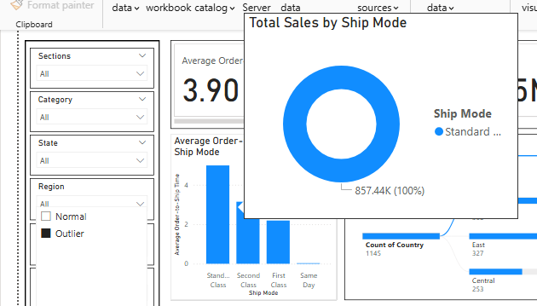
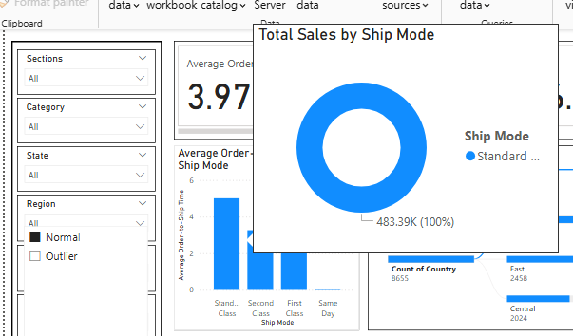
وهنا يظهر تأثير ال outliers على سبيل المثال فى Total sales by ship mode حيث تبلغ قيمة standard ship mode فى حالة outliers ضعف فى حالة الnormal

Slide 7
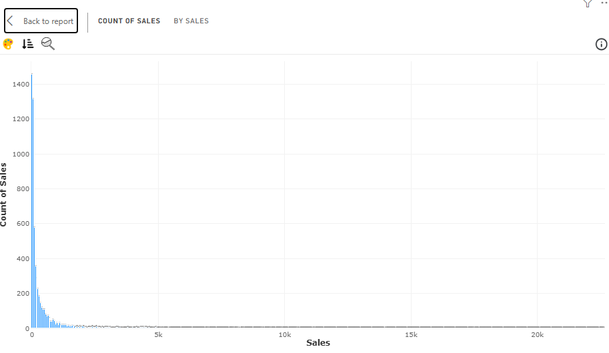
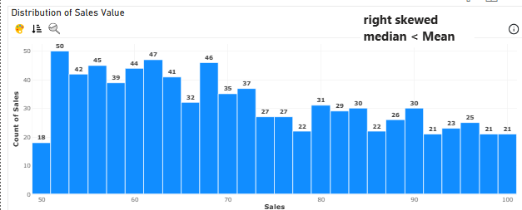
Histogram (right skewed) median<mean
بعد التقسيم الى sections
With outliers

Slide 8
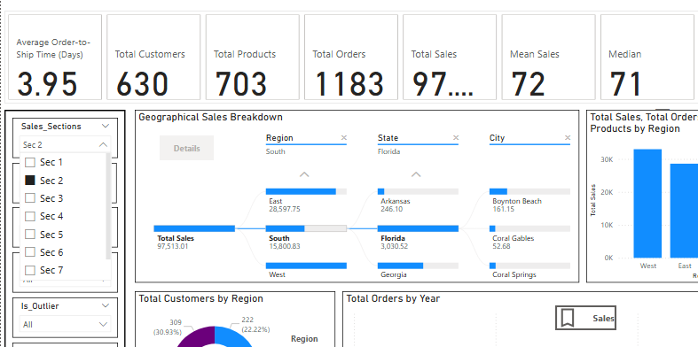
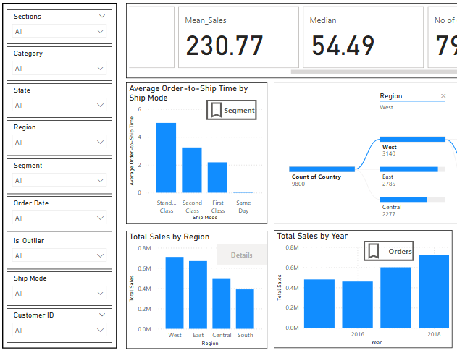
Outliers effect on median & mean

Slide 9

Question
Thank You

