Slide 1
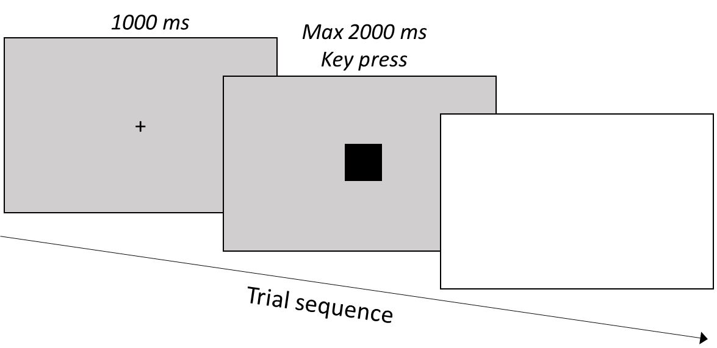
(small stimulus)
(large stimulus)
1000 ms
Max 2000 ms
Key press
+
1500 ms
Trial sequence

Slide 2
