Slide 1
CHAPTER 2
Testing throughout the software life cycle
Group 2

Slide 2
Overview
Software development models
Test levels
Test type: the targets of testing
Maintenance testing
Notes:
Mỗi qui trình phát triển phần mềm khác nhau ảnh hưởng lớn đến cách testing.
Testing không tồn tại độc lập, mà hoạt động testing liên quan đến các hoạt động phát triển phần mềm.
Mỗi phương thức test thì phải được tổ chức phù hợp với mỗi development life cycle nếu không thì việc test này không mang lại lợi ích.

Slide 3
2.1 Software development models 1. V-model
Business Case
User Requirement
System Requirement
Global Design
Detailed Design
Implement
Waterfall Model
Testing
Notes:
Business Case – Tìm hiểu, phân tích những điều mà khách hàng mong muốn ở phần mềm.
User Requirements – Những gì các phần mềm cần phải làm để đạt được mục ở bussiness case.
System Requirement – Dành cho developers, phù hợp với user requirement.
-> System Processes , External Interfaces, Non-functional requirements
Global Design – cách các phần mềm sẽ được cấu trúc thành các thành phần
Detailed Design – làm thế nào một phần sẽ được cấu trúc .
→ This phase concentrates on how the software will be built

Slide 4
Defects were being found too late in the life cycle, as testing was not involved until the end of the project
Difficult to get feed back passed backwards up the waterfall and there are difficulties if we need to carry out for a particular phase.

Slide 5
V-model
The V-model provides guidance that testing needs to begin as early as possible in the life cycle
These activities should be carried out in parallel with development activities,
Testers need to work with developers and business analysts
→ so they can perform these activities and tasks and produce a set of test deliverables.

Slide 6
Common type use 4 test levels
component testing: searches for defects in and verifies the functioning of software components
integration testing: tests interfaces between components.
system testing: The main focus of system testing is verification against specified requirements;
acceptance testing: validation testing with respect to user needs, requirements, and business processes

Slide 7
Business Case
Operational System
User Requirement
Acceptance Test
Verification Traceability
Validation
System Requirement
System Test
Validation
Global Design
Integration Test
Verification Traceability
Validation
Detailed Design
Component Test
Implement

Slide 8
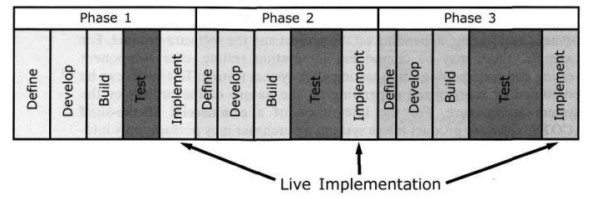
2. Iterative life cycles

Slide 9
a/ Rapid Application Development
Encourages active customer feedback: the customer gets early visibility of the product,
They can provide feedback on the design and can decide, based on the existing functionality, whether to proceed with the development,
→Validation with the RAD development process is thus an early and major activity

Slide 10
b/ Agile development
Extreme Programming (XP) is currently one of the most well-known agile development life cycle models:
With XP there are numerous iterations each requiring testing.
XP developers write every test case they can think of and automate them.

Slide 11
3. Testing within a life cycle model
for every development activity there is a corresponding testing activity
each test level has test objectives specific to that level
the analysis and design of tests for a given test level should begin during the corresponding development activity;
testers should be involved in reviewing documents as soon as drafts are available in the development cycle.

Slide 13
2.3 TEST levels
Content:
- Component testing
- Integration testing
- System testing
- Acceptance testing

Slide 14
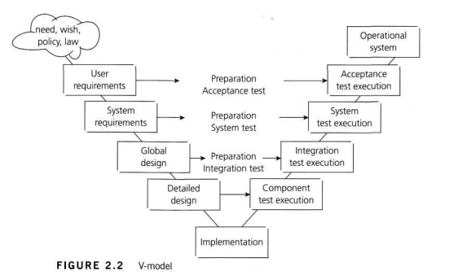
Notes:
Understanding -> prevent/make overlaps, remove gaps -> more effective

Slide 15
2.2.1 Component Testing
Search defects, verify functions
Stubs vs drivers
Test cases: from software design, data model
Access to the code
People
Support
→Fix defects
Types: functional, specific non-functional, structural
Introduce an approach: test-driven development
Notes:
Programmer, different programmer

Slide 16
2.2.2 Integration Testing
Test interfaces, interactions
Levels:
Component integration testing
System integration testing
Extreme approaches: big-bang vs incremental
Incremental integration testing:
Top-down
Bottom-up
Functional
People
Types: functional, structural, specific non-functional
Notes:
Developers, specialist integration testers, developers/integrators including non-functional specialists

Slide 17
2.3.3 System Testing
Test the behavior of the whole system
Tests are based on risks, requirements specification, business processes, use cases…
Test environment
People
Types: functional, non-functional
Functional: specification-based (black-box), structure-based (white-box) techniques
Non-functional: performance, reliability
Notes:
Dedicated specialist testers, sometimes independent test team; third party team or business analysts

Slide 18
2.2.4 Acceptance Testing
Establish confidence in the system, part of the system or specific non-functional characteristics
Not necessarily the final level of testing
Levels
Types of acceptance test:
User acceptance test
Operational acceptance test
Contract acceptance test
Compliance acceptance test
Mass market products: alpha testing & beta testing
Notes:
Validation

Slide 19
2.3 TEST TYPES
The target of testing

Slide 20
Content
Functional testing
Non-functional testing
Structural testing
Testing related to changes

Slide 21
2.3.1 Functional Testing
Focus on (based on ISO 9126):
Suitability
Interoperability
Security
Accuracy
Compliance
2 perspectives:
Requirement-based
Business-process-based
Notes:
All test level.
Often known as “Black-box” testing → not entirely true, “Black-box” also include Non-functional testing.

Slide 22
2.3.1 Functional Testing
Techniques:
Specification-based
Experienced-based
Model:
Process model
State transition
Plain-language specification

Slide 23
2.3.2 Non-functional Testing
6 characteristics (ISO 9126):
Functionality
Reliability
Usability
Efficiency
Maintainability
Portability
Notes:
All test level.

Slide 24
2.3.3 Structural Testing
Is often referred to as “White-box” or “Glass-box”.
Is mostly applied at:
Component level: Code coverage – Percentage of executable elements that have been exercised by a test suite.
Integration level: Based on system architecture.
Notes:
All test level.

Slide 25
2.3.3 Testing related to changes
Include:
Confirmation testing (Re-testing): Ensure that the test is executed exactly the same way as before (same inputs, data, environment).
Regression testing: Verify that the modifications have not caused unintended adverse side effects and that the system still meet its requirements.
Notes:
Regression tests are executed whenever the software changes: result of fixes or new or changed functionality or some aspect of the environment changes (new version of a database management system; a new version of a source code compiler,…)

