Slide 1
Group 3 - Naive Bayes Classification Project
OMP 3009 - Applied Math for Data Science & AI Jordon Abrams, Jonny Tahai, Sam Kippur November 17th, 2025

Slide 2
Introduction
This project explores the Naive Bayes classification algorithm using a small weather dataset. The goal is to predict whether it will rain based on four features: Outlook, Temperature, Humidity, and Windy. By computing the probabilities manually and validating the model using Leave-One-Out Cross-Validation, we connect the mathematical theory directly to executable code. This provides a complete demonstration of how Bayes' theorem powers classification systems.

Slide 3
Why Naive Bayes Still Matters
Even though our project used only 14 days of weather, Naive Bayes secretly has an incredibly busy life in the real world. It works behind the scenes anytime a fast decision is needed with limited information — kind of like a detective who is great at making quick, logical guesses. Here are some places where Naive Bayes is quietly doing the heavy lifting

Slide 4
Email & Text Classification
Whether something is spam, ham, urgent, or probably a scam, Naive Bayes is often the first filter reading the subject line and keywords before you ever see the message.

Slide 5
Medical Diagnostics
If symptoms = {cough, fever, loss of taste}, the algorithm helps decide: “Is this a cold, flu, or something more serious?” — using probability instead of panic

Slide 6
Real-Time Recommendations
Shopping websites estimate what you might love based on simple signals: “You clicked on hiking boots, so you probably like outdoorsy things.”

Slide 7
Sentiment Analysis
Companies use Naive Bayes to check if people on social media are praising their product or calling it “the worst purchase ever.”

Slide 8
Cybersecurity Alerts
When network traffic suddenly looks suspicious, the model doesn’t wait — it raises a red flag based on patterns it has learned.

Slide 9
Even though it assumes all features are independent (which we know is rarely true), Naive Bayes still performs shockingly well — especially when:
datasets are small
predictions need to be extremely fast
interpretability is important
categorical features dominate This simplicity is a superpower. Many modern machine learning systems start with Naive Bayes as a benchmark — proving that sometimes the most “naive” idea is actually the smartest one in the ro

Slide 10
Connecting the Project to the Course Objectives
This project connects mathematical concepts directly to algorithmic implementation.
Bayes' theorem serves as the foundation, showing how theoretical probability translates into code that can make real predictions.
The project uses Bayes' theorem, written as: P(Y|X) = [P(X|Y) × P(Y)] / P(X).
This relationship guided the entire implementation. By calculating priors and likelihoods, the program determines how probable it is that it will rain given observed weather conditions.
Probability is central to the model. Linear algebra principles appear in the way we represent categorical data as discrete, countable values. Laplace smoothing (alpha = 1) prevents zero probabilities and ensures numerical stability. Finally, this work demonstrates how such fundamental math ideas remain in use across modern ML systems.

Slide 11
Mathematical Foundation
Bayes' theorem provides the rule for updating the probability of a hypothesis based on new evidence. In this project, the hypothesis is whether it will rain (Yes or No), and the evidence is a set of observed weather features. Since P(X) is constant across classes, the model focuses on maximizing P(Y) × Π P(xi | Y). The Naive assumption states that all features are conditionally independent given the class: P(x1, x2, ..., xn | Y) = Π P(xi | Y) Although this assumption is rarely true, it dramatically simplifies computation while still performing well.

Slide 12
Implementation Summary
The dataset contains 14 daily weather observations. We calculated prior probabilities: P(Yes) = 9/14 and P(No) = 5/14, then applied smoothing, resulting in 0.625 and 0.375. Conditional probabilities were computed for each feature using: P(xi | Y) = (count(xi, Y) + alpha) / (count(Y) + alpha × k) We predicted new observations and validated the model using Leave-One-Out Cross-Validation. Accuracy of the hand-coded model was 50%, while sklearn’s MultinomialNB reached 64%, largely due to encoding differences

Slide 13
Results and Discussion
The computed priors and likelihoods aligned with the dataset's distribution. Because rainy days occurred more often, the model assigned a higher probability to the “Yes” class. Posterior results were mathematically consistent and interpretable. The sklearn implementation validated correctness, confirming the model behaves as expected even with small datasets.

Slide 14
Independence Assumption
While features like Temperature and Humidity are often related, Naive Bayes assumes independence to simplify computation. Even when the assumption is technically wrong, classification accuracy remains surprisingly strong in many domains.

Slide 15
Conclusion
Naive Bayes remains a widely used classification method because it is both computationally efficient and easy to interpret. Implementing the model from scratch emphasized how mathematical principles such as probability theory directly power AI systems. Even simple models can produce meaningful predictions and support critical real-world applications

Slide 16
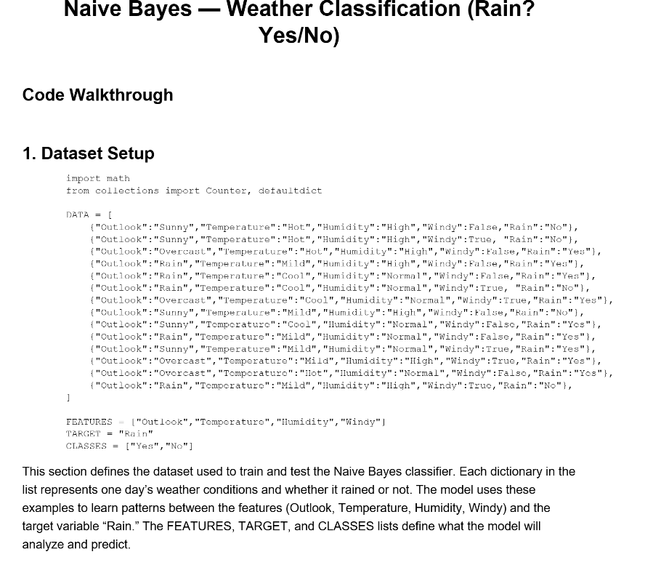

Slide 17
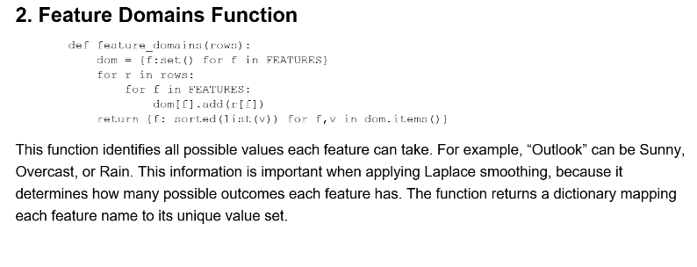

Slide 18
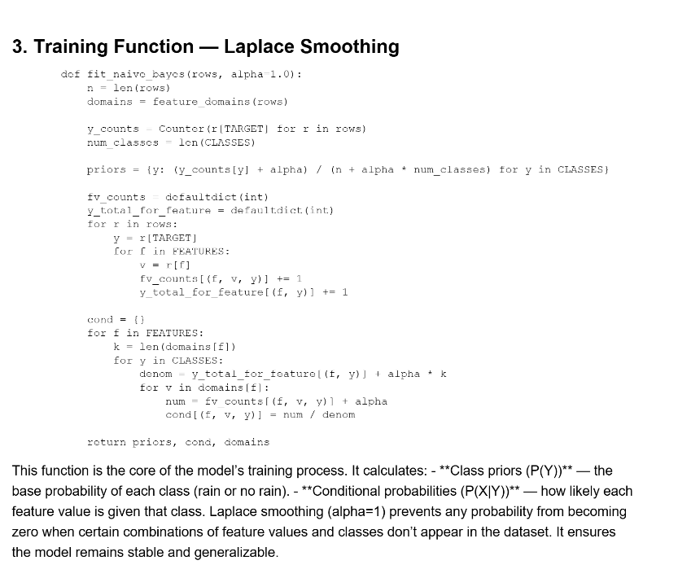

Slide 19
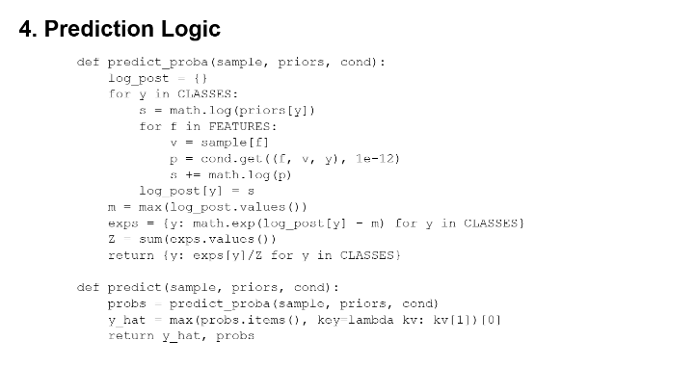
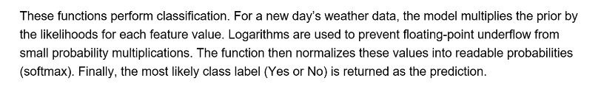

Slide 20
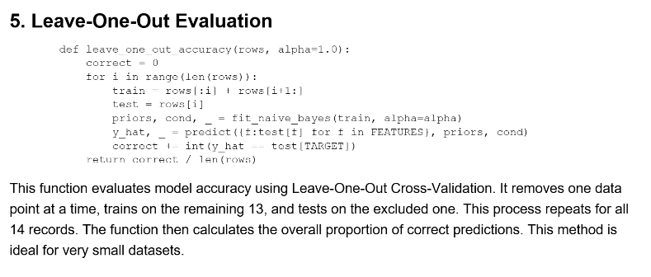

Slide 21
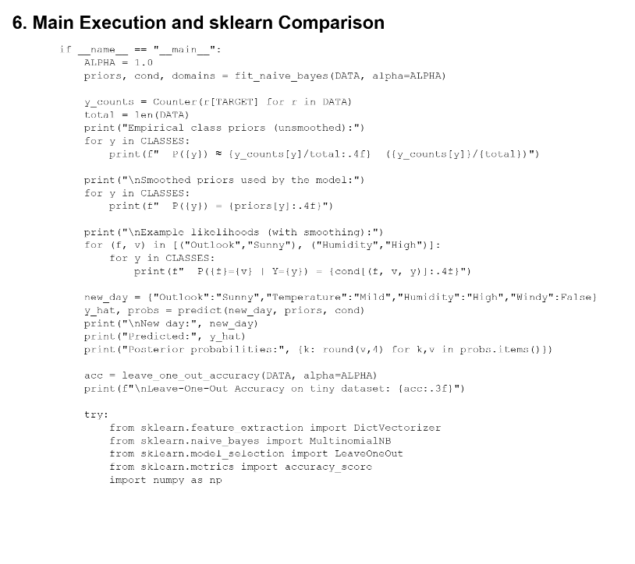

Slide 22
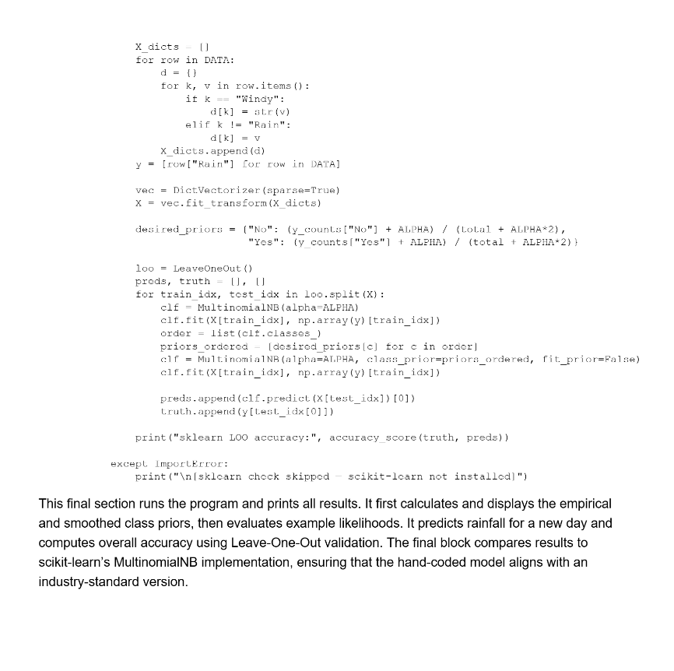

Slide 23
Group 3 - Naive Bayes - Code.py

