Slide 1
Big Data Summer School

Slide 2
Clustering
the process of grouping a set of objects into classes of similar objects
Applications?
Order Prediction

Slide 3
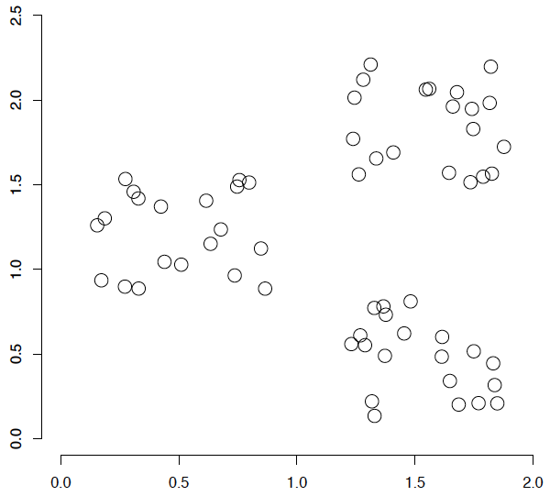
A data set with clear cluster structure
What are some of the issues for clustering?
What clustering algorithms have you seen/used?

Slide 4
Issues for clustering
Representation for clustering
  How do we represent an example
    features, etc.
  Similarity/distance between examples
Number of clusters
  Fixed a priori
  Data driven?

Slide 5
Hard vs. soft clustering
Hard clustering: Each example belongs to exactly one cluster
Soft clustering: An example can belong to more than one cluster (probabilistic)
  Makes more sense for applications like creating browsable hierarchies
  You may want to put a pair of sneakers in two clusters: (i) sports apparel and (ii) shoes

Slide 6
K-means
Most well-known and popular clustering algorithm:
Start with some initial cluster centers
Iterate:
  Assign/cluster each example to closest center
  Recalculate centers as the mean of the points in a cluster

Slide 7
K-means: an example

Slide 8
K-means: Initialize centers randomly

Slide 9
K-means: assign points to nearest center

Slide 10
K-means: readjust centers

Slide 11
K-means: assign points to nearest center

Slide 12
K-means: readjust centers

Slide 13
K-means: assign points to nearest center

Slide 14
K-means: readjust centers

Slide 15
K-means: assign points to nearest center
No changes: Done

Slide 16
K-means
Iterate:
  Assign/cluster each example to closest center
  Recalculate centers as the mean of the points in a cluster
How do we do this?

Slide 17
K-means
Iterate:
  Assign/cluster each example to closest center
  Recalculate centers as the mean of the points in a cluster
iterate over each point:
- get distance to each cluster center
- assign to closest center (hard cluster)

Slide 18
K-means
Iterate:
  Assign/cluster each example to closest center
  Recalculate centers as the mean of the points in a cluster
iterate over each point:
- get distance to each cluster center
- assign to closest center (hard cluster)
What distance measure should we use?

Slide 19
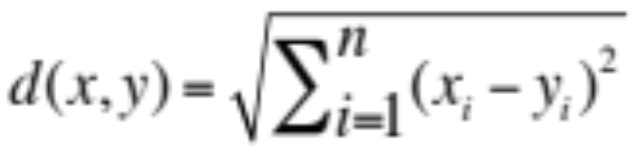
Distance measures
Euclidean:
good for spatial data

Slide 20
K-means
Iterate:
  Assign/cluster each example to closest center
  Recalculate centers as the mean of the points in a cluster
Where are the cluster centers?

Slide 21
K-means
Iterate:
  Assign/cluster each example to closest center
  Recalculate centers as the mean of the points in a cluster
How do we calculate these?

Slide 22
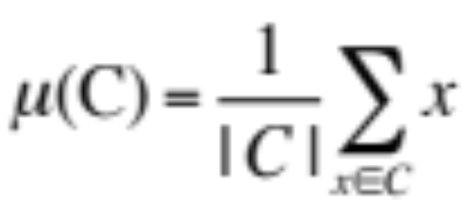
K-means
Iterate:
  Assign/cluster each example to closest center
  Recalculate centers as the mean of the points in a cluster
Mean of the points in the cluster:

Slide 23

K-means loss function
K-means tries to minimize what is called the “k-means” loss function:
S_{i}: class i
u_{i}: center of S_{i}
that is, minimize the sum of the squared distances from each point to the associated cluster center

Slide 24
K-means algorithm
Pick a number (k) of cluster centers
Assign every object to its nearest cluster center
Move each cluster center to the mean of its assigned objects
Repeat 2-3 until convergence

Slide 25
K-means variations/parameters
Start with some initial cluster centers
Iterate:
  Assign/cluster each example to closest center
  Recalculate centers as the mean of the points in a cluster
What are some other variations/parameters we haven’t specified?

Slide 26
K-means variations/parameters
Initial (seed) cluster centers
Convergence
  A fixed number of iterations
  partitions unchanged
  Cluster centers don’t change

Slide 27
K-means: Initialize centers randomly
What would happen here?
Seed selection ideas?

Slide 28
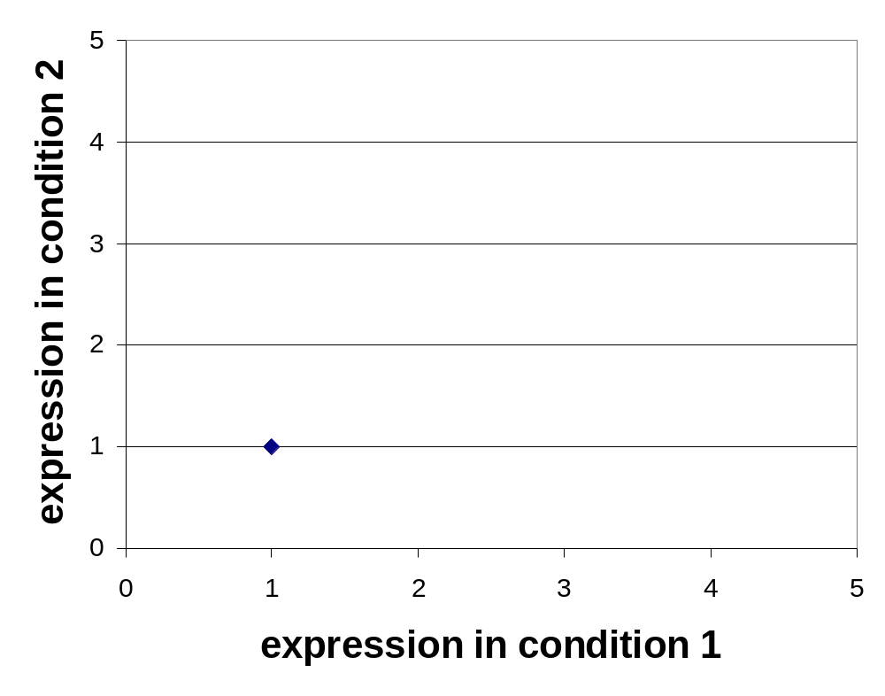
Clustering: Example 2, Step 1
k₁
k₂
k₃

Slide 29
Clustering: Example 2, Step 2
k₁
k₂
k₃

Slide 30
Clustering: Example 2, Step 3
k₁
k₃
k₂

Slide 31
Clustering: Example 2, Step 4
k₁
k₃
k₂

Slide 32

Clustering: Example 2, Step 5
k₁
k₂
k₃

Slide 33
Seed choice
Results can vary drastically based on random seed selection
Some seeds can result in poor convergence rate, or convergence to sub-optimal clusterings
Common heuristics
  Random centers in the space
  Randomly pick examples
  Points least similar to any existing center (furthest centers heuristic)
  Try out multiple starting points
  Initialize with the results of another clustering method

Slide 34
K-means: Initialize furthest from centers
Pick a random point for the first center

Slide 35
K-means: Initialize furthest from centers
What point will be chosen next?

Slide 36
K-means: Initialize furthest from centers
Furthest point from center
What point will be chosen next?

Slide 37
K-means: Initialize furthest from centers
Furthest point from center
What point will be chosen next?

Slide 38
K-means: Initialize furthest from centers
Furthest point from center
Any issues/concerns with this approach?

