Slide 1
Big Data Summer School
Indexing

Slide 2
Outline
Datasets
  Trajectory
    Car 1: (time, location, Busy/Free)
    Car 2: (time, location, Busy/Free)
    … …
  Order
    Passenger: (time, source, destination)
  Road network
    Graphs
      Nodes
      Edges (roads)

Slide 3

Outline
Applications
  Given an order, how to find k nearest cars?
    Euclidean distance
    Road distance (graph distance)
  How to get the best route from source to destination?
    Graph algorithms
  Where to park after finishing an order?
    Clustering
    Approximate query processing

Slide 4
Outline
Techniques to Handel Big Data
  Indexing
    B-tree, R-tree, KD-tree
  Clustering
    K means, DBScan
  Graph
    Dijkstra, G-tree,GraphChi
  Distributed Computing
    Spark SQL
  Approximate Query Processing
    Sampling

Slide 5

The Concept of Index
Searching a Book…
Index
  A data structure that helps us find data quickly
Note
  Can be a separate structure (we may call it the index file) or in the records themselves.
  Usually sorted on some attribute
Where are books by Wen?
Index by
Author
Database
by Guoliang
Database
by Wen
Data Mining
by Jie
Index by
Title
Where is “Database” ?
Catalogs
Books

Slide 6
Query, Key and Search Key
Queries
  Exact match (point query)
    Q1: Find me the book with the name “Database”
  Range query
    Q2: Find me the books published between year 2003-2005
Searching methods
  Sequential scan － too expensive
  Through index – if records are sorted on some attribute, we may do a binary search
    If sorted on “book name”, then we can do binary search for Q1
    If sorted on “year published”, then we can do binary search for Q2
Key vs. Search key
  Key: the indexed attribute
  Search key: the attribute queried on

Slide 7
Simple Index File (Clustered, Dense)
Dense index
Sorted records
10
10
20
20
30
30
40
40
50
60
50
70
60
80
70
90
80
100
90
110
100
120

Slide 8
Simple Index File (Clustered, Sparse)
Sparse index
Sorted records
10
10
30
20
50
30
70
40
90
110
50
130
60
150
70
170
80
190
90
210
100
230

Slide 9
Simple Index File (Clustered, Multi-level)
Sparse 2nd level
Sorted records
10
10
10
90
30
20
170
50
30
250
70
40
90
330
50
110
410
60
130
490
150
570
70
170
80
190
90
210
100
230

Slide 10
Simple Index File (Unclustered, Dense)
Unsorted records
Dense index
10
30
20
50
10
30
40
20
50
70
90
...
50
80
60
sparse
high
level
40
70
...
100
10
90
60

Slide 11
Simple Index File (Unclustered, Sparse ?)
Unsorted records
Sparse index
30
30
50
20
80
20
100
70
90
80
...
40
100
10
does not make sense!
90
60

Slide 12
Indexes on Composite Keys
Q3: age=20 & sal=10
Index on two or more attributes: entries are sorted first on the first attribute, then on the second attribute, the third …
Q4: age=20 & sal>10
Q5: sal=10 & age>20
Note
  Different indexes are useful for different queries
Examples of composite key
indexes using lexicographic order.
11,80
11
12,10
12
12,20
name
age
sal
12
13,75
bob
12
10
13
<age, sal>
cal
11
80
<age>
joe
12
20
10,12
sue
13
75
10
20,12
Data records
sorted by name
20
75,13
75
80,11
80
<sal, age>
<sal>

Slide 13
Indexed sequential access method (ISAM)
Tree structured index
Support queries
  Point queries
  Range queries
Problems
  Static: inefficient for insertions and deletions
Data pages
Overflow page

Slide 14
The B⁺-Tree: A Dynamic Index Structure
Grows and shrinks dynamically
Minimum 50% occupancy (except for root).
  Each node contains d <= m <= 2d entries. The parameter d is called the order of the tree.
Height-balanced
  Insert/delete at log_{f} N cost (f = fanout, N = No. leaf pages)
Pointers to sibling pages
  Non-leaf pages (internal pages)
  Leaf pages
    If directory page, same as non-leaf pages; pointers point to data page addresses
    If data page
P₀ K₁
P₁ K₂
P₂ K₃
…
K_{m} P_{m}
K₀ D₀
K₁ D₁
K₂ D₂
…
K_{m} D_{m}

Slide 15
Searching in a B⁺-Tree
Search begins at root, and key comparisons direct it to a leaf (as in ISAM)
Search for 5, 15, all data entries >= 24 ...
What about all entries <= 24 ?
Root
13
17
24
30
2
3
5
14
16
19
20
22
24
27
29
33
34
38
39

Slide 16
Insertion in a B⁺-Tree
Find correct leaf L
Put data entry onto L
  If L has enough space, done!
  Else, must split L (into L and a new node L2)
    Redistribute entries evenly, copy up middle key.
    Insert index entry pointing to L2 into parent of L.
This can happen recursively
  To split index node, redistribute entries evenly, but push up middle key. (Contrast with leaf splits.)
Splits “grow” tree; root split increases height.
  Tree growth: gets wider or one level taller at top.

Slide 17
Inserting 7 & 8 into the B⁺-Tree
Root
13
17
24
30
2
3
5
7
14
16
19
20
22
24
27
29
33
34
38
39
(Note that 5 is copied up and continues to appear in the leaf.)
Observe how minimum occupancy is guaranteed in both leaf and index pg splits
5
13
17
24
30
2
3
5
7
8

Slide 18
Inserting 8 into the B⁺-Tree (continued)
(17 is pushed up and only appears once in the index. Contrast this with a leaf split.)
Note the difference between copy up
and
push up
17
5
13
24
30
5
13
17
24
30
2
3
5
7
8

Slide 19
The B⁺-Tree After Inserting 8
Root
17
5
13
24
30
2
3
5
7
8
14
16
19
20
22
24
27
29
33
34
38
39
Note that root was split, leading to increase in height
We can avoid splitting by re-distributing entries. However, this is usually not done in practice. Why?

Slide 20
Deletion in a B⁺-Tree
Start at root, find leaf L where the entry belongs.
Remove the entry.
  If L is at least half-full, done!
  If L has only d-1 entries,
    Try to redistribute, borrowing from sibling (adjacent node with same parent as L).
    If redistribution fails, merge L and sibling.
If merge occurred, must delete entry (pointing to L or sibling) from parent of L.
Merge could propagate to root, decreasing height.

Slide 21
Deleting 19 & 20 from the B⁺-Tree
Root
17
5
13
24
30
2
3
5
7
8
14
16
19
20
22
24
27
29
33
34
38
39
Root
17
5
13
27
30
2
3
5
7
8
14
16
22
24
27
29
33
34
38
39
Deleting 20 is done with re-distribution. Note how the middle key is copied up

Slide 22
Deleting 24 from the B⁺-Tree
Merge happens
Observe ‘toss’ of index entry (on right), and ‘pull down’ of index entry (below).
Note the decrease in height
30
22
27
29
33
34
38
39
Root
5
13
17
30
2
3
5
7
8
14
16
22
27
29
33
34
38
39

Slide 23
How to set b?

Slide 24
The Memory Hierarchy
CPU Die
iMac
Quad-core Intel i7
CPU: 3.4GHz
Memory: 32GB
CPU
Registers
4 clock cycles 0.4 ns
L1 Cache
10 clock cycles 1ns
L2 Cache
40 clock cycles 4ns
L3 Cache
100 ns
Main Memory
10 ms
Cost is affected significantly by disk accesses !
Hard Disk

Slide 25
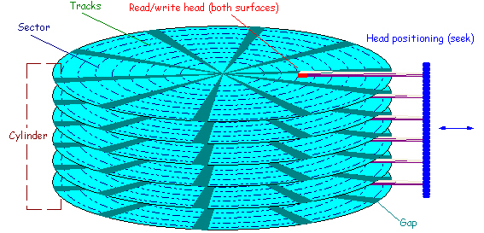
The Hard (Magnetic) disk
The time for a disk block access, or disk page access or disk I/O
  access time = seek time + rotational delay + transfer time
Segate Desktop HDD.15: 4TB
  Seek time: 8.5 msec
  Rotational delay: 5.1 msec
  Transfer rate: 146MB/sec, that is, 0.027msec/4KB

Slide 26
The Cost Model
Cost measure: number of page accesses
Objective
  A simple way to estimate the cost (in terms of execution time) of database operations
Reason
  Page access cost is usually the dominant cost of database operations
  An accurate model is too complex for analyzing algorithms
Note
  This cost model is for disk based databases; NOT applicable to main memory databases
  Blocked access: sequential access

Slide 27
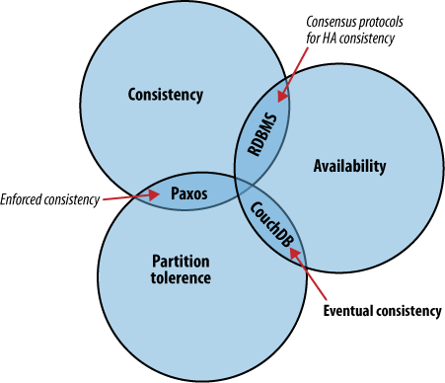
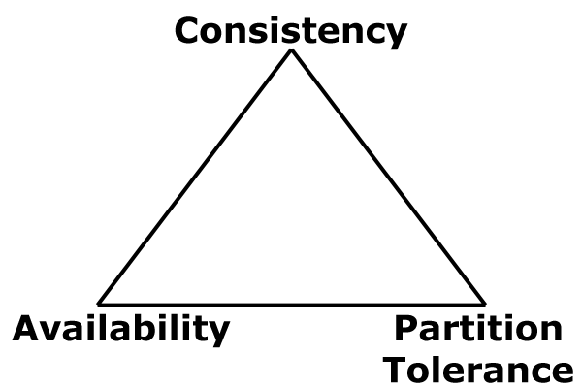
Summary of the B⁺-Tree
A dynamic structure – height balanced – robustness
Scalability
  Typical order: 100. Typical fill-factor: 67%.
    average fanout = 133
  Typical capacities (root at Level 1, and has 133 entries)
    Level 5: 133⁴ = 312,900,700 records
    Level 4: 133³ = 2,352,637 records
  Can often hold top levels in buffer pool:
    Level 1 = 1 page = 8 Kbytes
    Level 2 = 133 pages = 1 Mbyte
    Level 3 = 17,689 pages = 133 Mbytes
Efficient point and range queries – performance
Concurrency
  CAP
Essential properties of a DBMS

Slide 28
Other Basic Indexes: Hash Tables
Static hashing: static table size, with overflow chains
Extendible hashing: dynamic table size, with no overflows
Efficient point query, but inefficient range query
  0
...
M-1

Slide 29
Other Basic Indexes: Bitmap
Bitmap with bit position to indicate the presence of a value
Advantages
  Efficient bit-wise operations
  Efficient for aggregation queries: counting bits with 1’s
  More compact than trees-- amenable to the use of compression techniques
Limitations
  Only good for domain of small cardinality
gender
rating
M | F
1 | 0
1 | 0
0 | 1
1 | 0
cusid | name | gender | rating
112 | Joe | M | 3
115 | Ram | M | 5
119 | Sue | F | 5
120 | Woo | M | 4
1 | 2 | 3 | 4 | 5
0 | 0 | 1 | 0 | 0
0 | 0 | 0 | 0 | 1
0 | 0 | 0 | 0 | 1
0 | 0 | 0 | 1 | 0

Slide 30
B⁺-Tree For All and Forever?
Can the B+-tree being a single-dimensional
index be used for emerging applications such as:
  Spatial databases
  High-dimensional databases
  Temporal databases
  Main memory databases
  String databases
  Genomic/sequence databases
  ...
Coming next … Indexing Multidimensional Data

Slide 31
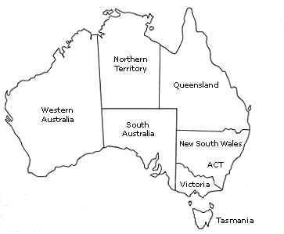
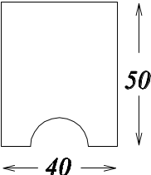



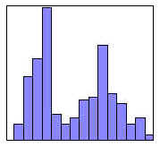


Multidimensional Data
(low-dimensionality)
Spatial data
  Geographic Information: Melbourne (37, 145)
  Which city is at (30, 140)?
  Computer Aided Design: width and height (40, 50)
  Any part that has a width of 40 and height of 50?
Records with multiple attributes
  Employee (ID, age, score, salary, …)
  Is there any employee whose
  age is under 25 and
  performance score is greater than 80 and
  salary is between 3000 and 5000
Multimedia data
  Color histograms of images
  Give me the most similar
  image to
  Multimedia Features: color, shape, texture
(medium-dimensionality)
ID | Age | Score | Salary | …
…
(high-dimensionality)

Slide 32
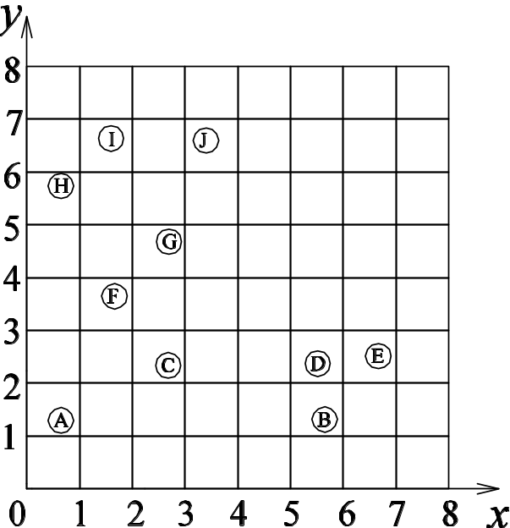
Multidimensional Queries
Point query
  Return the objects located at Q(x₁, x₂, …, x_{d}).
  E.g. Q=(3.4, 6.6).
Window query
  Return all the objects enclosed or intersected by the hyper-rectangle
  W{[L₁, U₁], [L₂, U₂], …, [L_{d}, U_{d}]}.
  E.g. W={[0,2],[4,5]}
K-Nearest Neighbor Query (KNN Query)
  Return k objects whose distances to Q are no larger than any other object’ distance to Q.
  E.g. 3NN of Q=(4,1)

Slide 33
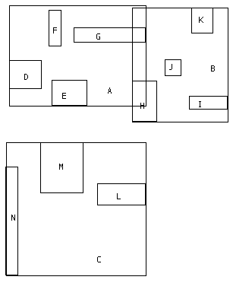
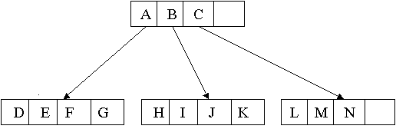
R-tree
A balanced tree similar to a B⁺-tree;
Each tuple has a unique identifier which can be used to retrieve it
(I, child-pointer)
(I, tuple-identifier)

Slide 34
Minimum Bounding Rectangle (MBR)

Slide 35
R-Trees: The Structure.
Internal nodes : ( MBR, child pointer)
  MBR is minimum bounding rectangle
  Pointer to all rectangles contained by the MBR.
Leaf Nodes : (MBR , tuple-identifier)
  MBR is minimum bounding rectangle
  Tuple-identifier is a pointer to the data object.

Slide 36
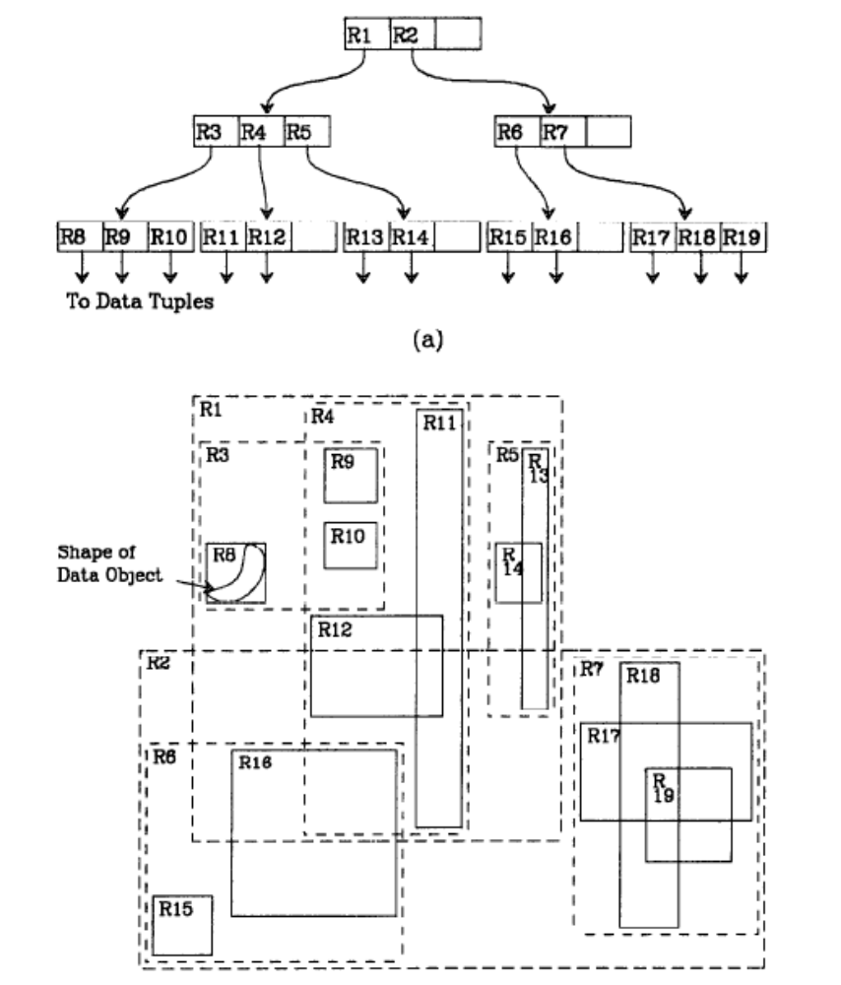
Example
3 levels
m=2, M=4

Slide 37
Properties of R-trees
An R-tree satisfies the following properties
The root has at least two children unless it is a leaf
Every non-leaf node has between m and M children unless it is the root
Every leaf node contains between m and M entries unless it is the root
All leaves appear on the same level
M: the maximum number of entries in a node
m: the minimum number of entries in a node

Slide 38
R-Trees: Operations
Insertion
Deletion
Update ( delete and re-insert)
Queries/Searches
  Give me all rectangles that are contained in the input rectangle.
  Give me all rectangles intersecting this rectangle.
  Give me k nearest neighbors to a given location

Slide 39
Insertion
Similar to insertion into B+-tree but may insert into any leaf; leaf splits in case capacity exceeded.
  Which leaf to insert into? (Choose Leaf)
    Find the mbr whose rectangle needs least enlargement to include the record
  How to split a node? (Node Split)
    Similar to B-trees, new index records are added to the leaves
    Nodes that overflow are split
    Splits propagate up the tree

Slide 40
Insertion: Choose Leaf
n
m
o
p
Notes:
Rationale: MBR with larger area has higher probability of intersecting random query. Want to minimize this probability so as to minimize number of intersected MBRs (and hence subtrees that need to be searched).

Slide 41
Insertion: Choose Leaf
m

Slide 42
Insertion: Choose Leaf
n

Slide 43
Insertion: Choose Leaf
o

Slide 44
Insertion: Choose leaf
p

Slide 45
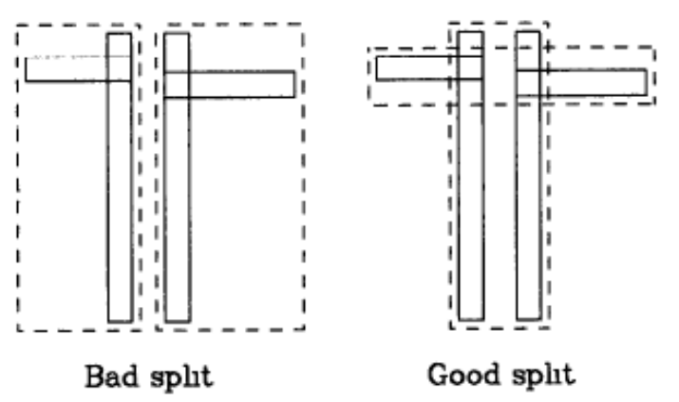
Node Splitting
A full node contains M entries.
Divide the collection of M+1 entries to 2 nodes.
Objective: Make it as unlikely as possible for the resulting two new nodes to be examined on subsequent searches.
Heuristic: The total area of two covering rectangles after a split should be minimized.
Total area is larger!

Slide 46
Node Splitting
Divide M+1 objects to 2 groups
Exhaustive algorithm
  Generate all possible cases and choose the best case with minimum total area.
Quadratic method
  A heuristic to find a small-area split.
  Cost is quadratic in M and linear in the number of dimensions.
Linear method
  A heuristic to find a small-area split.
  Cost is linear in M and linear in the number of dimensions.

Slide 47
Quadratic method
Initialize: Pick two of the M+1 entries to be the first elements of the two new groups, such that
  O_{i} in Group 1
  O_{j} in Group 2
  O_{i,j} – O_{i} – O_{j} is maximized
Pick Next
  d₁ = O_{l,1} – O_{l} –G₁
  d₂ = O_{l,2} – O_{l} –G₂
  Find O_{l} to maximize |d₁-d₂|
  Add O_{l} to Group 1 if d₁<d₂; otherwise Group 2

Slide 48
Linear method
Initialize: Choose two objects that are furthest apart.
Pick Next
  simply chooses any of the remaining entries and insert it into the group to minimize the total area

Slide 49
Delete
Straightforward.
The only complication is under-flows:
An under-full node can be merged with whichever sibling will have its area increased least.

Slide 50
R-tree: range query
P3
P1
P2
P3
P4
A
P1
C
F
I
G
H
B
P2
P4
J
A
B
C
H
I
J
E
D
D
E
F
G

Slide 51
R-tree: range query – pseudo code
Range-search(RtreeNode R; query rectangle Q) {
For each entry of R:
If its MBR intersects the query rectangle Q
Apply range-search on the child node of the entry;
or print out, if this is a leaf entry;
}
MBR: {r_{x1},r_{x2},r_{y1},r_{y2}}

Slide 52
R-tree: NN query
Depth-first search
  Find a near object
  (circular) range query
  Refine the query range (circle)
P3
A
P1
C
F
I
G
H
B
P2
P4
J
q
E
D

Slide 53
R-tree: NN query
Best-first search
  priority queue, with promising MBRs, and their best and worst-case distance
Main idea: Every face of any MBR contains at least one point of an actual spatial object
P3
Consider
P2 and P4
A
P1
C
F
G
I
H
B
P2
J
q
E
P4
D

Slide 54
R-tree: NN query
I
H
best of P2
E
P4
J
q
P2
D
best of P4
P2 is more promising for 1-nn

Slide 55
MINDIST Function
MINDIST (q, R) is the minimum distance between a point q and a rectangle R.
  If the point is inside the rectangle, MINDIST = 0;
  If the point is outside the rectangle, MINDIST is the minimal possible distance from the point to any object in or on the perimeter of the rectangle.
q
q
t
q
R
q

Slide 56
Search
Dist(q, o): distance between query q and object o
MinDist(q, R) function: minimal distance from q to R
  q: location
  R: MBR
NN Search
  If Dist(q, o_{best})<MinDist(q, R) , prune R
KNN Search
  k best objects

Slide 57
NN Search Algorithm
Maintain a priority queue Q
Insert the root into Q
While Q is not empty
  Dequeue the element e with minimal MinDist(q, e)
  If e is an object
    return e
  Else
    For each child C of e, Add C into Q

Slide 58
KNN Search Algorithm
Maintain a priority queue Q and a result set A
Insert <root, 0> into Q
While Q is not empty and |A|<k
  Dequeue the element e with minimal MinDist(q, e)
  If e is an object
    add e into A
  Else if e is a non-leaf MBR,
    For each child C of the MBR, Add <C, MinDist(q, C)> into Q
  Else if e is a leaf MBR
    For each object O in the MBR, Add <O, Dist(q, O)> into Q

Slide 59
Quadtree
Space-based hierarchical structures
A recursive subdivision of the space into 4 quadrants
The subdivision can be into either equal sized or unequal sized quadtrants
Each leaf node has at most m objects
A
B
C
D
F
E
[D,E,J]
[G,H,I,L]
[H,J,K]
J
G
H
I
[A,B,F]
[B,C,F]
[F,G]
[F]
K
L

Slide 60
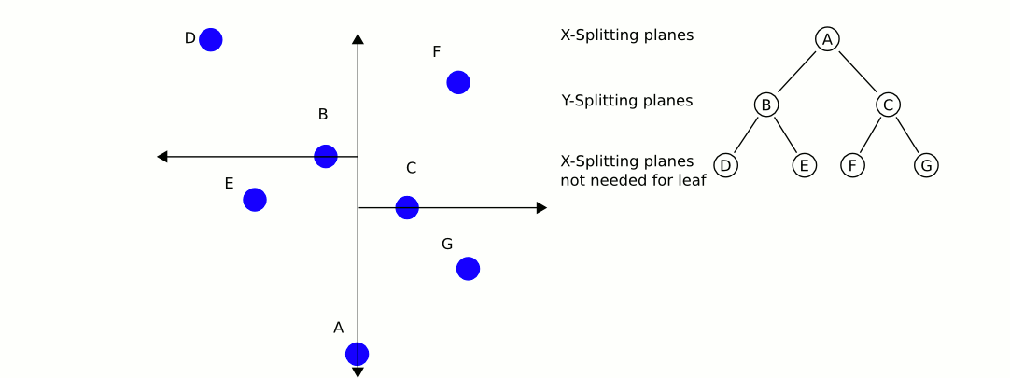
KD-tree
A recursive space partitioning tree.
  Partition along x and y axis in an alternating fashion.
  Each internal node stores the splitting node along x (or y).

Slide 61
Hierarchical Tree Structures
R-tree
  Minimum bounding rectangle (MBR)
  Incomplete and overlapping partitioning
  Disk-based; Balanced
K-d-tree
  Space division recursively
  Complete and disjoint partitioning
  In-memory; Unbalanced
  There are algorithms to page
  and balance the tree, but with
  more complex manipulations
N₁
N₃
N₃
N₃
N₃
N₁
N₁
N₁
A
N₄
N₁
N₁
B
N₂
C
D
A
A
B
0.5
A
D
C
D
D
N₁
N₂
N₁
N₅
N₂
C
F
F
G
F
A
D
B
C
0.3
A
C
D
B
E
F
G
N₅
E
G
E
N₂
B
E
C
B
N₁
N₂
N₂
N₄
B
C
E
F
G
A
A
D
D
F
Problem: Overlap
G
Problem: Empty space
C
F
G
E
B
E
C
B

Slide 62
Hierarchical Tree Structures (continued)
Quad-tree
  Space divided into 4 rectangles
  recursively.
  Complete and disjoint partitioning
  In-memory; Unbalanced
  There are algorithms to page
  and balance the tree, but with
  more complex manipulations
The point quad-tree
A
NW
NE
NW
NE
SW
SE
D
A
F
D
C
B
C
B
G
E
SW
SE
G
E
F

Slide 63
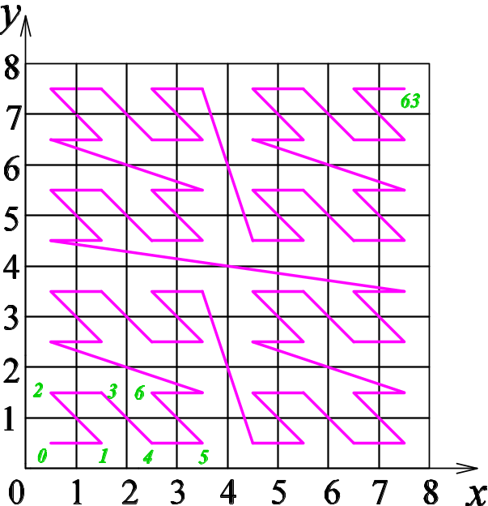
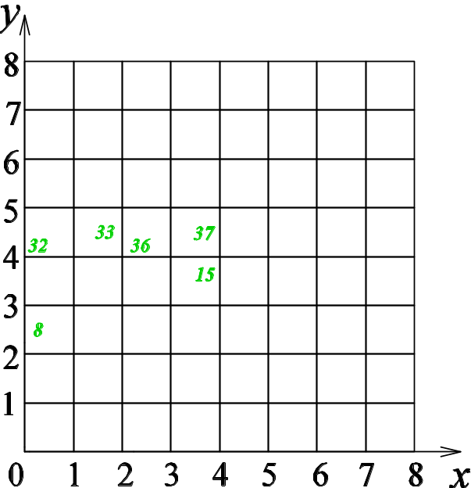
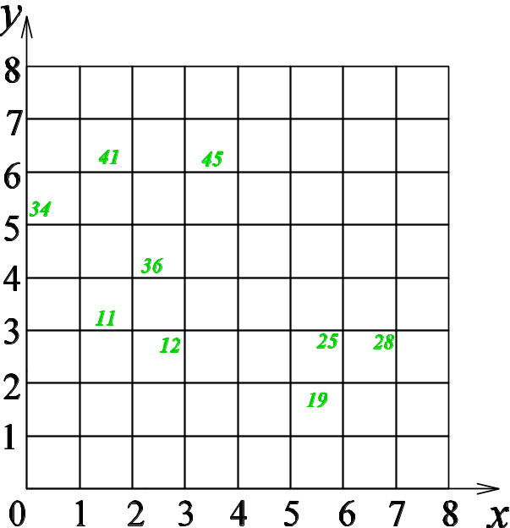
Mapping Based Multidimensional Indexing
Sort
Name | x | y | Block | Height
A | 0.7 | 1.2 | 2 | 100
B | 5.8 | 1.2 | 19 | 50
C | 2.7 | 2.3 | 12 | 80
D | 5.5 | 2.4 | 25 | 90
E | 6.6 | 2.5 | 28 | 40
F | 1.7 | 3.8 | 11 | 120
G | 2.8 | 4.7 | 36 | 100
H | 0.6 | 5.8 | 34 | 50
I | 1.6 | 6.7 | 41 | 60
J | 3.4 | 6.6 | 45 | 40
Name | x | y | Block | Height
A | 0.7 | 1.2 | 2 | 100
F | 1.7 | 3.8 | 11 | 120
C | 2.7 | 2.3 | 12 | 80
B | 5.8 | 1.2 | 19 | 50
D | 5.5 | 2.4 | 25 | 90
E | 6.6 | 2.5 | 28 | 40
H | 0.6 | 5.8 | 34 | 50
G | 2.8 | 4.7 | 36 | 100
I | 1.6 | 6.7 | 41 | 60
J | 3.4 | 6.6 | 45 | 40
Story
  The CBD: [0,2][4,5]
  Blocks in the CBD are: [8,15], [32,33] and [36,37]
General strategy: three steps
  Data mapping and indexing
  Query mapping and data retrieval
  Filtering out false positive

Slide 64
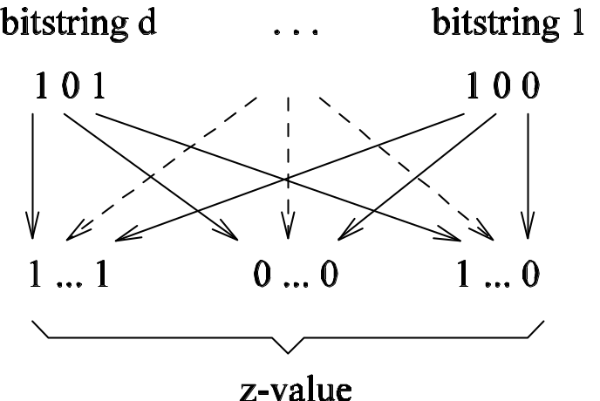
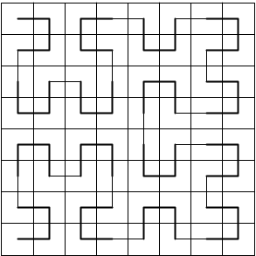
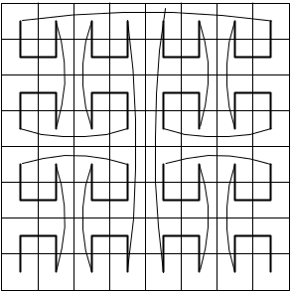
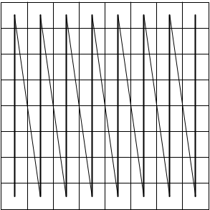
The Z-curve and Other Space-Filling Curves
The Z-curve
  Z-value calculation: bit-interleaving
  Support efficient window queries
  Disadvantage
    Jumps
Other space-filling curves
  Hilbert-curves
  Gray-code
  Column-wise scan

Slide 65
Summary of the Indexing Techniques
Index | Disk-based / In-memory | Balanced | Efficient query type | Dimensionality | Comments
R-tree | Disk-based | Yes | Point, window, kNN | Low | Disadvantage is overlap
K-d-tree | In-memory | No | Point, window, kNN(?) | Low | Inefficient for skewed data
Quad-tree | In-memory | No | Point, window, kNN(?) | Low | Inefficient for skewed data
Z-curve + B⁺-tree | Disk-based | Yes | Point, window | Low | Order of the Z-curve affects performance

Slide 66
Index Implementations in major DBMS
SQL Server
  B+-Tree data structure
  Clustered indexes are sparse
  Indexes maintained as updates/insertions/deletes are performed
Oracle
  B+-tree, hash, bitmap, spatial extender for R-Tree
  Clustered index
  Index organized table (unique/clustered)
  Clusters used when creating tables
DB2
  B+-Tree data structure, spatial extender for R-tree
  Clustered indexes are dense
  Explicit command for index reorganization

