Slide 1
Big Data Summer School
Graph Algorithms

Slide 2
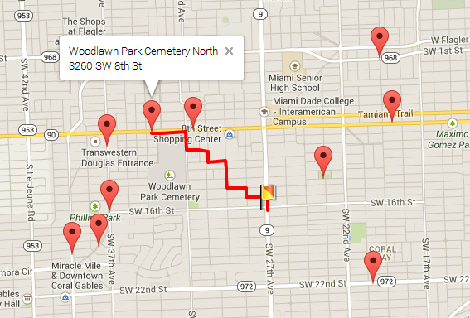
KNN Search on Road Network
Given [a query location], [a set of candidate objects], KNN query returns the [K]-nearest objects ranked by shortest path distance.

Slide 3

Single-Source Shortest Path Problem
Single-Source Shortest Path Problem - The problem of finding shortest paths from a source vertex v to all other vertices in the graph.

Slide 4
Dijkstra's algorithm
Dijkstra's algorithm - is a solution to the single-source shortest path problem in graph theory.
Approach: Greedy
Input: Weighted graph G={E,V} and source vertex v∈V, such that all edge weights are nonnegative
Output: Lengths of shortest paths (or the shortest paths themselves) from a given source vertex v∈V to all other vertices

Slide 5
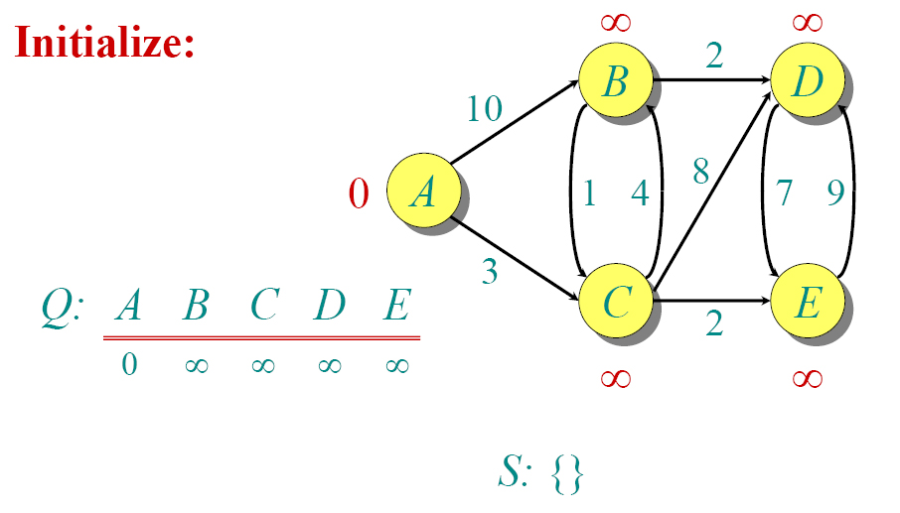
Dijkstra Animated Example

Slide 6

Dijkstra Animated Example

Slide 7

Dijkstra Animated Example

Slide 8

Dijkstra Animated Example

Slide 9

Dijkstra Animated Example

Slide 10

Dijkstra Animated Example

Slide 11

Dijkstra Animated Example

Slide 12

Dijkstra Animated Example

Slide 13

Dijkstra Animated Example

Slide 14

Dijkstra Animated Example

Slide 15
Dijkstra's algorithm - Pseudocode
dist[s] ←0 (distance to source vertex is zero)
for all v ∈ V–{s}
do dist[v] ←∞ (set all other distances to infinity)
S←∅ (S, the set of visited vertices is initially empty)
Q←V (Q, the queue initially contains all vertices)
while Q ≠∅ (while the queue is not empty)
do u ← mindistance(Q,dist) (select the element of Q with the min. distance)
S←S∪{u} (add u to list of visited vertices)
for all v ∈ neighbors[u]
do if dist[v] > dist[u] + w(u, v) (if new shortest path found)
then d[v] ←d[u] + w(u, v) (set new value of shortest path)
(if desired, add traceback code)
return dist

Slide 16
Implementations and Running Times
The simplest implementation is to store vertices in an array or linked list. This will produce a running time of O(|V|^2 + |E|).
For sparse graphs, or graphs with very few edges and many nodes, it can be implemented more efficiently storing the graph in an adjacency list using a binary heap or priority queue. This will produce a running time of O((|E|+|V|) log |V|)

Slide 17
Dijkstra - Why It Works
Lemma 1: Triangle inequality
If δ(u,v) is the shortest path length between u and v,
δ(u,v) ≤ δ(u,x) + δ(x,v)
Lemma 2:
The subpath of any shortest path is itself a shortest path.
The key is to understand why we can claim that anytime we put a new vertex in S, we can say that we already know the shortest path to it.

Slide 18


Applications of Dijkstra's Algorithm
- Traffic Information Systems are most prominent use
- Mapping (Map Quest, Google Maps)
- Routing Systems

Slide 19
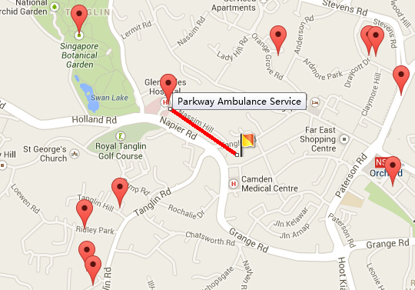
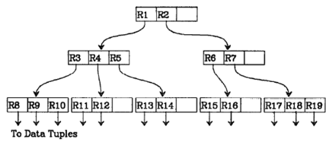
KNN Search on Metric Space
As known, on metric space, R-tree is elegant and efficient in finding top-k answers.

Slide 20
Challenge
However, it is not easy to extend KNN search on metric space to road networks.
Bottleneck 1: Calculating distance between two nodes
  On metric space: O(1) time, O(1) space
  On road network(graph):
 | Time | Space
Pre-compute all pairs | O(1) | O(n²)
Improved Dijkstra | O(nlogn) | O(1)

Slide 21
Challenge
Bottleneck 2: Pruning algorithm
  On metric space:
    By exploiting minimal bounding rectangle(MBR), R-tree can efficiently support top-k pruning with the help of best-first-search algorithm.
  On road network:
    However, NO SUCH index exists.
    Best-first-search algorithm cannot be used.

Slide 22
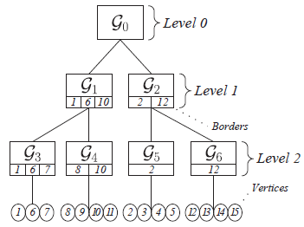
G-tree
What we want?
  An elegant index similar to R-tree on road network.
    1. Balance tree structure;
    2. Exploit best-first-search to find top-k answers;
    3. Good extensibility (keyword search, etc.).
R-tree
G-tree

Slide 23
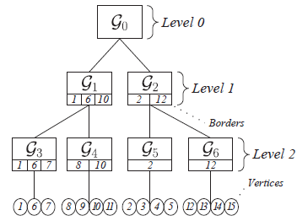
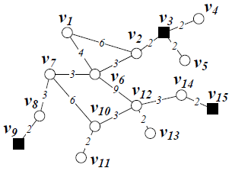
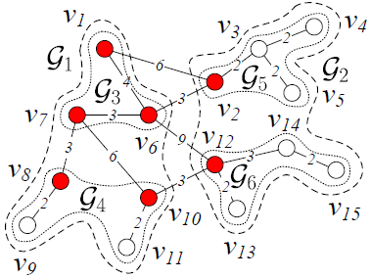
G-tree
The G-tree is constructed by recursively partitioning the road network into sub-networks and each G-tree node corresponds to a sub-network.
Each leaf node contains no more than τ nodes.
We employ METIS to produce balancing partition and minimize the cross-edge between sub-graphs.

Slide 24
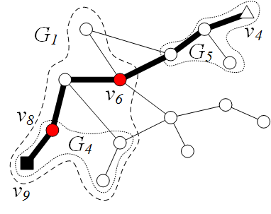
Border
One type of nodes is important: BORDER.
Border is the entry or exit of one sub-network, i.e. any path enters or exits one sub-network MUST bypass at least one border of such sub-network.

Slide 25
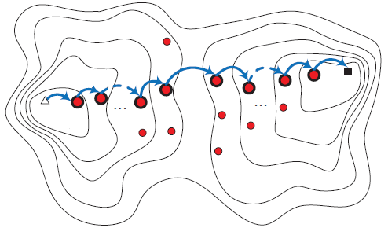
Border
On a hierarchy graph, one path will bypass a series of borders which respectively belongs to one tree node on the G-tree.

Slide 26
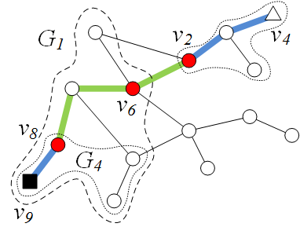
Distance Matrix
A path on graph can be assembled segment by segment with only TWO types of distances:
  1. Distances between two borders(within the same level or adjacent level of G-tree)
  v₂↔v₆, v₆ ↔ v₈
  2. Distances between leaves’ nodes and borders(within leaf nodes)
  v₄↔v₂, v₈ ↔ v₉

Slide 27
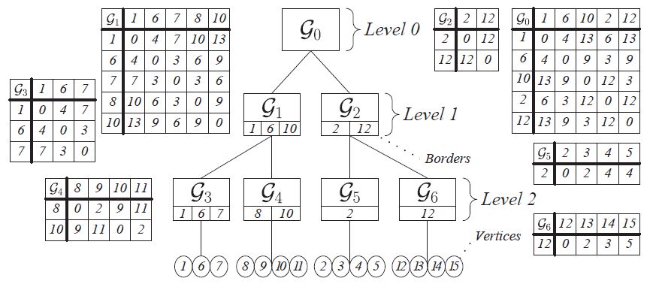
Distance Matrix
Thus, we store a distance matrix on each node of G-tree.
  1. For non-leaf node:
    The rows/columns are all borders in its children
    The value of each entry is the shortest-path distance between the two borders.
  2. For leaf node:
    The rows/columns are all borders/vertices in the node
    The value of each entry is the shortest-path distance between the border and the vertex.

Slide 28
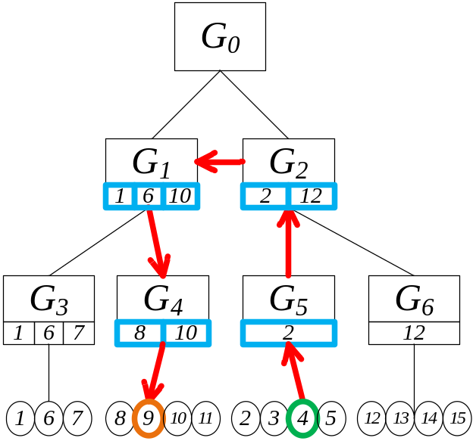
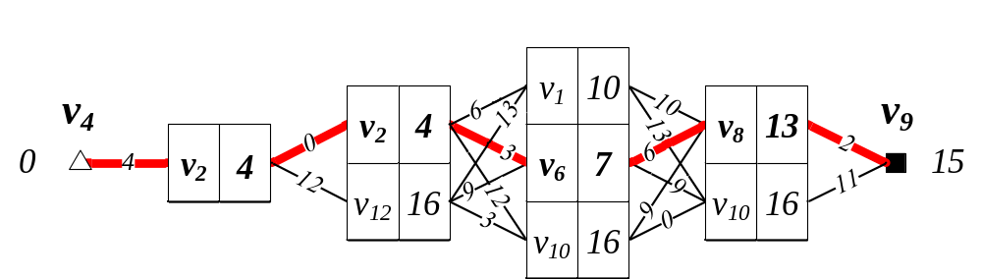
Single Pair Shortest Path
Given two nodes s & t, the graph distance, denoted by Mind(s,t), is calculated as follows:
  1. Find the path from s’ to t’ leaf node on G-tree.
  2. Use dynamic programming algorithm to find the shortest path distance.

Slide 29
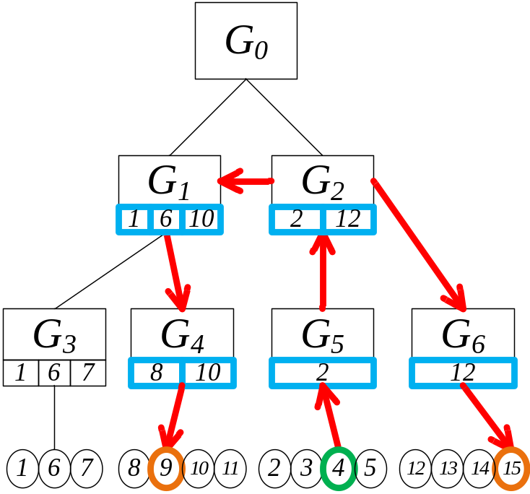
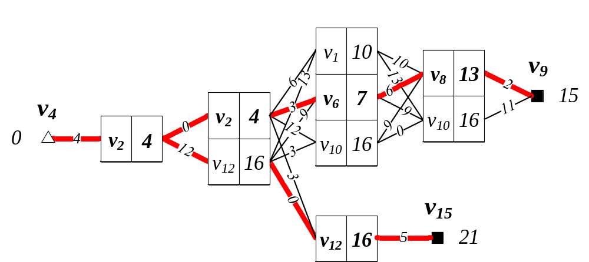
Single Source Shortest Path
Given two paths started from one node, e.g. v₄ to v₉/v₁₅, they might share a section of intermediate paths. Dynamic programming is applied as well.

Slide 30
KNN Search
We enable best-first-search algorithm on G-tree to retrieve top-k answers.
[Best-First-Search]
  Organize the promising nodes/objects in a priority-queue Q ranked by the minimal distance from query location to such node/object.
  Iteratively dequeue the head element e of the priority-queue:
    If e is a tree node, add e’s children into Q;
    If e is an object, thus, e is the nearest object so far, then we add e to the result list.
It’s Proven Good

Slide 31
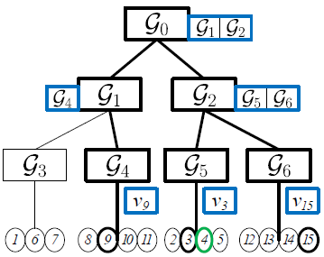
KNN Search: Occurrence List
Occurrence list (on each node) is an indicator for quickly locating promising nodes/objects:
  For non-leaf node: composed of child nodes’ ID of which descendants contain candidate objects;
  For leaf node: composed of objects’ ID.
O={v₃,v₉,v₁₅}

Slide 32
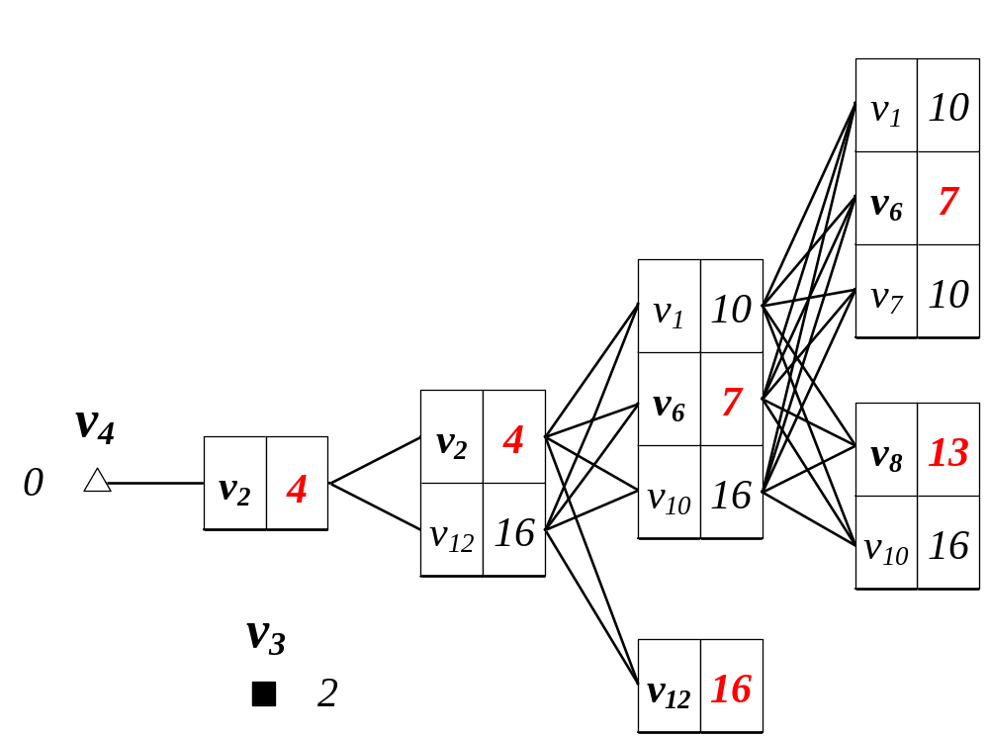
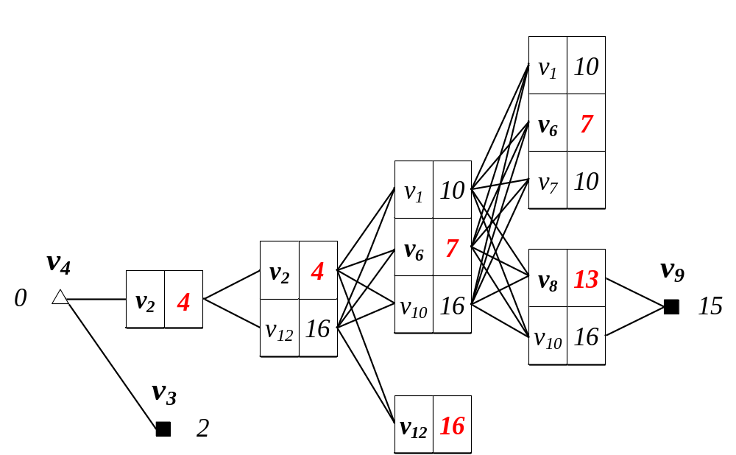








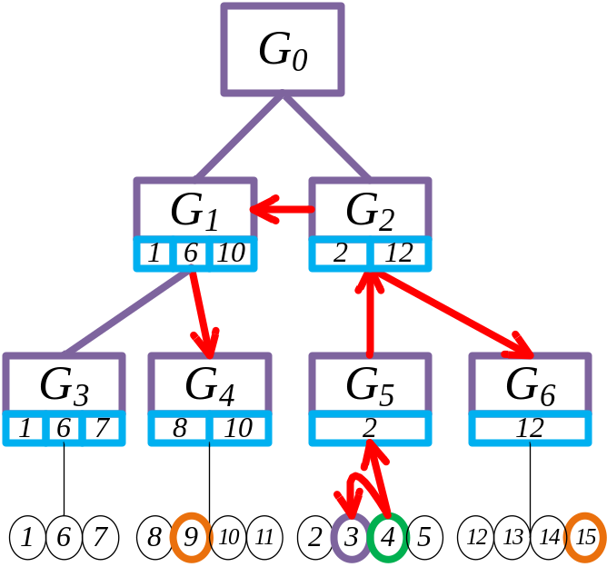
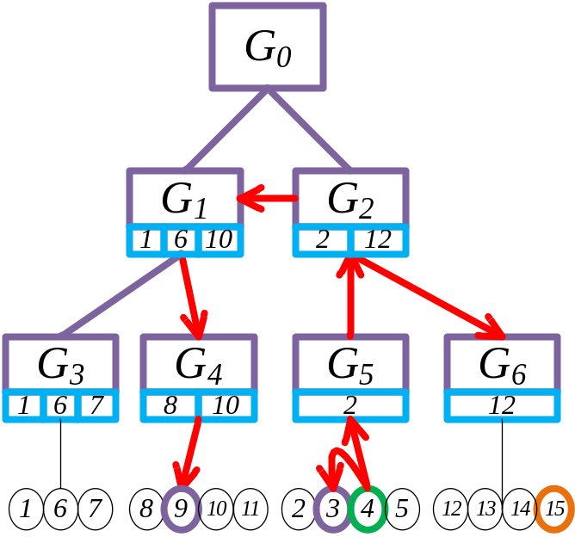
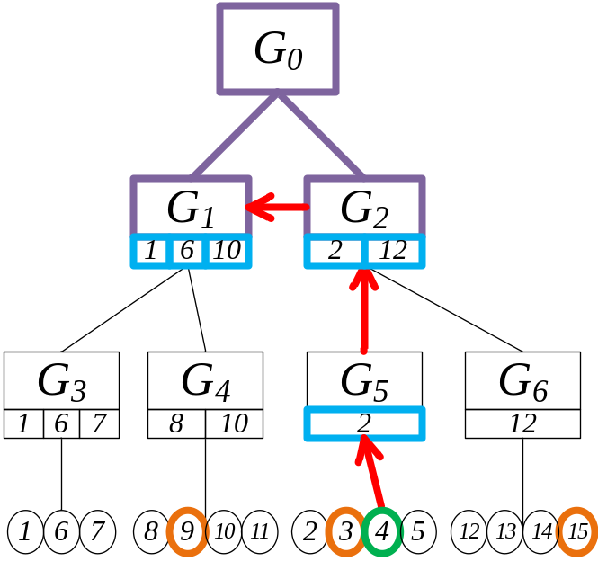
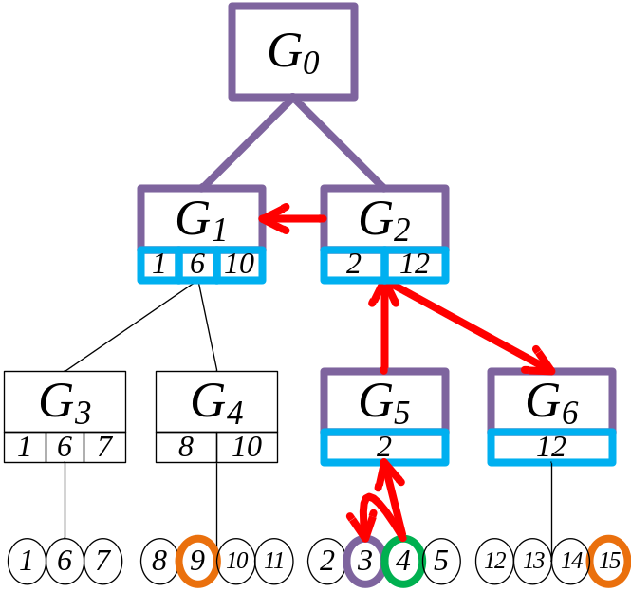
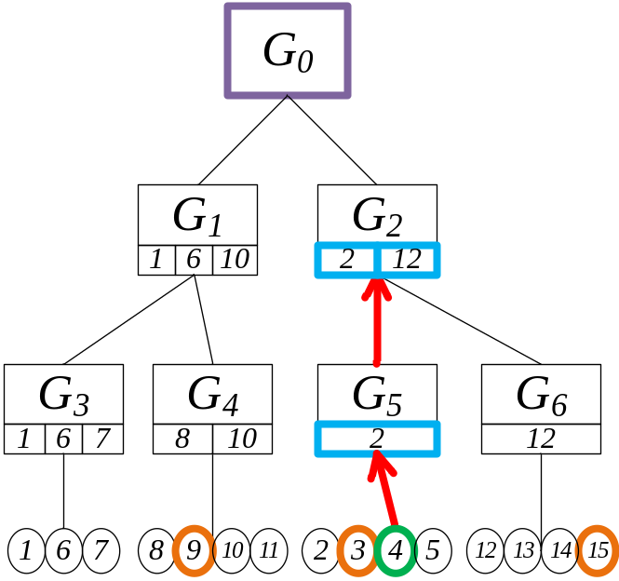
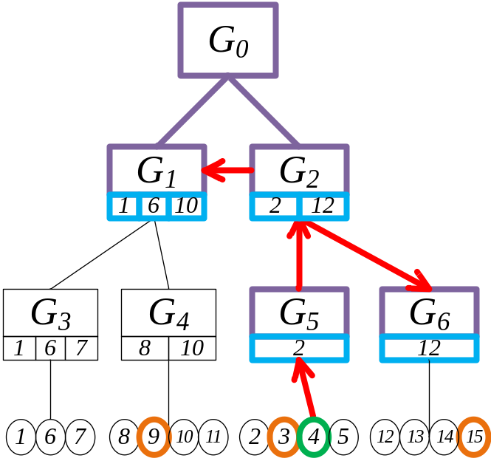
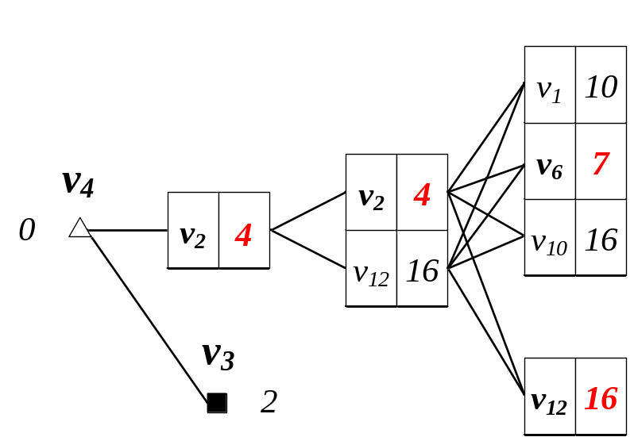
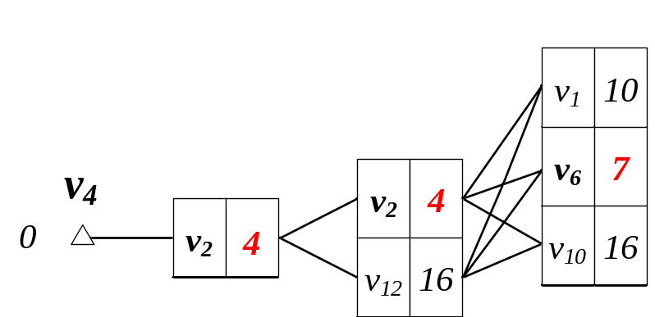
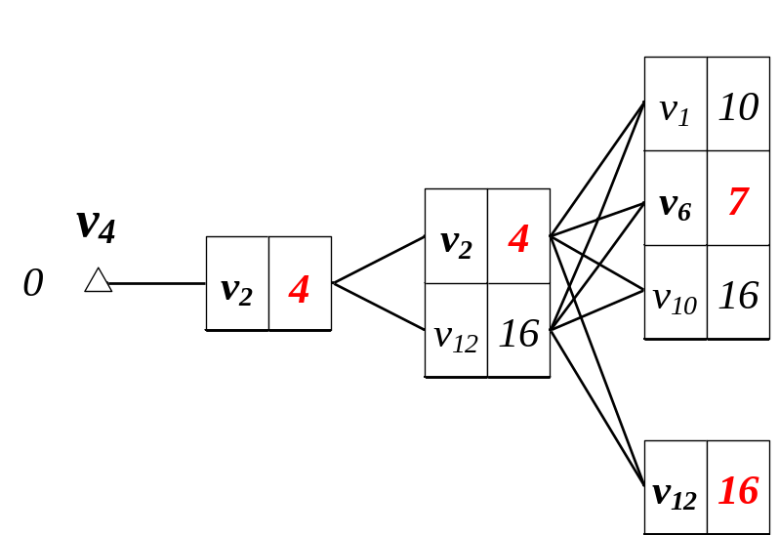
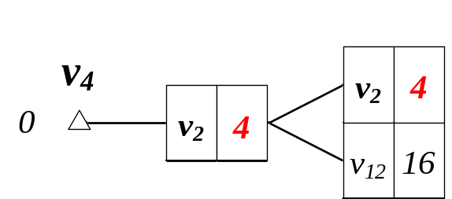


KNN Search— An Example
An example: qloc=v₄, O={v₃,v₉,v₁₅}, K=2
Queue:
Top-2 Result:

Slide 33
Superiority of G-tree
We maintain the intermediate result Mind(qloc,border_{i}) on each node of G-tree, hence, each tree node is accessed only once.
Our method significantly reduces the overhead for calculating minimal boundary, as we can obtain the minimal boundary from the intermediate result incidentally.
By the use of best-first-search algorithm, G-tree has significant pruning power.

