Slide 1
Big Data Summer School
Graph Systems

Slide 2
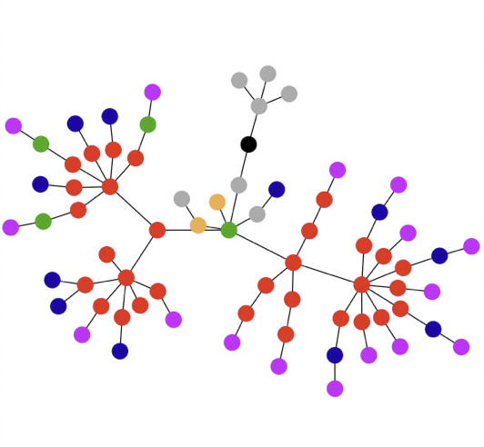
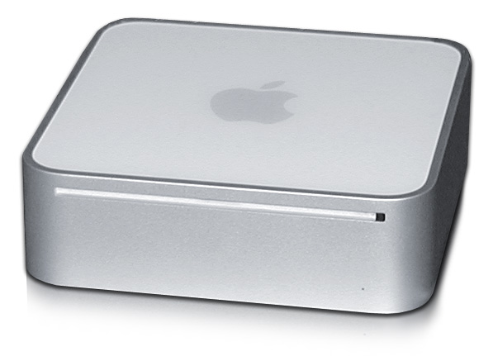
Research Goal
  Compute on graphs with billions of edges, in a reasonable time, on a single PC.
  Reasonable = close to numbers previously reported for distributed systems in the literature.
Experiment PC: Mac Mini (2012)
Notes:
Now we can state the goal of this research, or the research problem we stated for us when we started this project. The goal has some vagueness in it, so let me briefly explain. With reasonable time, I mean that if there have been papers reporting some numbers for other systems, I assume at least the authors were happy with the performance, and our system can do the same in the same ballpark, it is likely reasonable, given the lowe costs here. Now, as a consumer PC we used a Mac Mini. Not the cheapest computer there is, especially with the SSD, but still quite a small package. Now, we have since also run GraphChi with cheaper hardware, on hard drive instead of SSD, and can say it provides good performance on the lower end as well. But for this work, we used this computer.
One outcome of this research is to come up with a single computer comparison point for computing on very large graphs. Now researchers who develop large scale graph computation platforms can compare their performance to this, and analyze the relative gain achieved by distributing the computation. Before, there has not been really understanding of whether many proposed distributed frameworks are efficient or not.

Slide 3
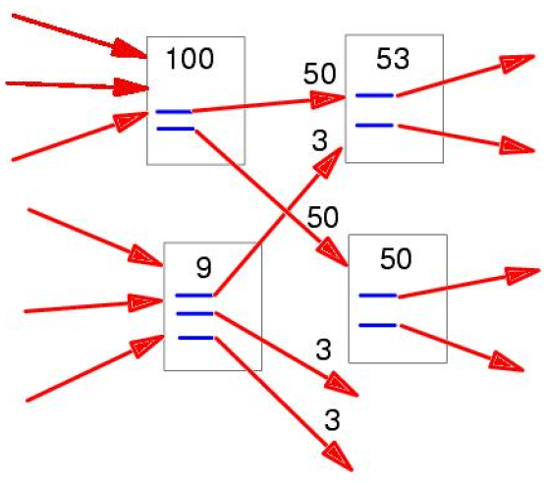
Pagerank
Link-based analysis

Slide 4
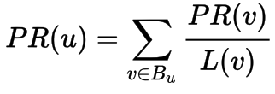
Pagerank
Link-based analysis
B_{u} : the set containing all pages linking to page u
L(v) : the number of links from page v.

Slide 5
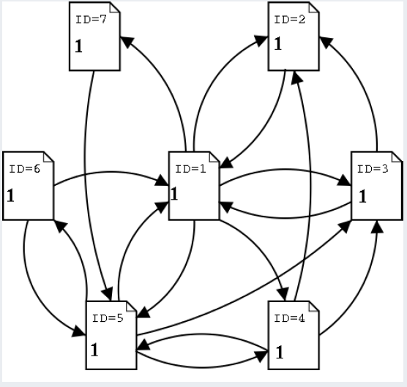

Pagerank

Slide 6
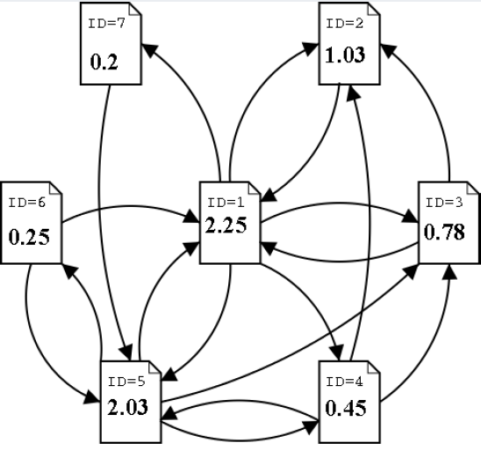
Pagerank

Slide 7
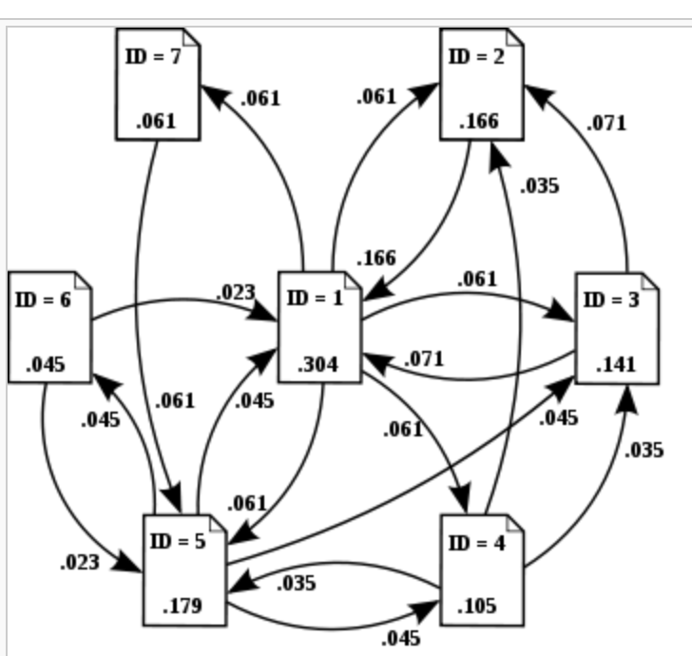
Pagerank

Slide 8
PageRank
Iterations
  Gather
  Apply
  Scatter

Slide 9
Example: SSSP – Dijkstra’s Algorithm
∞
∞
1
10
0
2
3
9
4
6
5
7
∞
∞
2

Slide 10
Example: SSSP – Dijkstra’s Algorithm
10
∞
1
10
0
2
3
9
4
6
5
7
5
∞
2

Slide 11
Example: SSSP – Dijkstra’s Algorithm
8
14
1
10
0
2
3
9
4
6
5
7
5
7
2

Slide 12
Example: SSSP – Dijkstra’s Algorithm
8
13
1
10
0
2
3
9
4
6
5
7
5
7
2

Slide 13
Example: SSSP – Dijkstra’s Algorithm
8
9
1
10
0
2
3
9
4
6
5
7
5
7
2

Slide 14
Example: SSSP – Dijkstra’s Algorithm
8
9
1
10
0
2
3
9
4
6
5
7
5
7
2

Slide 15
Computational Model
Graph G = (V, E)
  directed edges: e = (source, destination)
  each edge and vertex associated with a value (user-defined type)
  vertex and edge values can be modified
    (structure modification also supported)
A
e
B
Terms: e is an out-edge of A, and in-edge of B.
Data
Data
Data
Data
Data
Data
Data
Data
Data
Data
Notes:
Let’s now discuss what is the computational setting of this work. Let’s first introduce the basic computational model.

Slide 16
Vertex-centric Programming
“Think like a vertex”
Popularized by the Pregel and GraphLab projects
  Historically, systolic computation and the Connection Machine
Data
Data
Data
Data
Data
Data
Data
Data
MyFunc(vertex)
{ // modify neighborhood }
Data
Data
Data
Data
Data
Data
Data
Notes:
Think like a vertex was used by the Google Pregel paper, and also adopted by GraphLab. Historical similar idea was used in the systolic computation or connection machine architectures, but with regular networks. Now, we had the data model where we associate a value with every vertex and edge, shown in the picture. As the primary computation model, user defines an update-function that operates on a vertex, and can access the values of the neighboring edges (shown in red). That is, we modify the data directly in the graph, one vertex a time. Of course, we can parallelize this, and take into account that neighboring vertices that share an edge should not be updated simultaneously (in general).

Slide 17
The Main Challenge of Disk-based Graph Computation:
Random Access
Notes:
I will now briefly demonstrate why disk-based graph computation was not a trivial problem. Perhaps we can assume it wasn’t, because no such system as stated in the goals clearly existed. But it makes sense to analyze why solving the problem required a small innovation, worthy of an OSDI publication. The main problem has been stated on the slide: random access, i.e when you need to read many times from many different locations on disk, is slow. This is especially true with hard drives: seek times are several milliseconds. On SSD, random access is much faster, but still far a far cry from the performance of RAM. Let’s now study this a bit.

Slide 18




Random Access Problem
19
5
Symmetrized adjacency file with values,
vertex | in-neighbors | out-neighbors
5 | 3:2.3, 19: 1.3, 49: 0.65,... | 781: 2.3, 881: 4.2..
....
19 | 3: 1.4, 9: 12.1, ... | 5: 1.3, 28: 2.2, ...
Random write
synchronize
For sufficient performance, millions of random accesses / second would be needed. Even for SSD, this is too much.
... or with file index pointers
vertex | in-neighbor-ptr | out-neighbors
5 | 3: 881, 19: 10092, 49: 20763,... | 781: 2.3, 881: 4.2..
....
19 | 3: 882, 9: 2872, ... | 5: 1.3, 28: 2.2, ...
Random read
read
Notes:
Here in the table I have snippet of a simple straightforward storage of a graph as adjacency sets. For each vertex, we have a list of its in-neighbors, and out-neighbors, with associated values. Now let’s say when update vertex 5, we change the value of its in-edge from vertex 19. As vertex 19 has the out-edge, we need to update its value in 19’s list. This incurs a random write.
Now, perhaps we can solve this as following: each vertex only stores its out-neighbors directly, but in-neighbors are stored as file pointers to their primary storage at the neighbors out-edge list. In this case, when we load vertex 5, we need to do a random read to fetch the value of the in-edge. Random read is better, much better, than random write – but, in our experiments, even on SSD, it is way too slow. One additional reason is the overhead of a system call. Perhaps a direct access to the SSD would help, but as we came up with a simpler solution that works even on a rotational hard drive, we abandonded this approach.

Slide 19
Parallel Sliding Windows: Phases
PSW processes the graph one sub-graph a time:
In one iteration, the whole graph is processed.
  And typically, next iteration is started.
1. Load
2. Compute
3. Write
Notes:
The basic approach is that PSW loads one sub-graph of the graph a time, computes the update-functions for it, and saves the modifications back to disk. We will show soon how the sub-graphs are defined, and how we do this without doing almost no random access. Now, we usually use this for ITERATIVE computation. That is, we process all graph in sequence, to finish a full iteration, and then move to a next one.

Slide 20
PSW: Shards and Intervals
1. Load
2. Compute
3. Write
Vertices are numbered from 1 to n
  P intervals, each associated with a shard on disk.
  sub-graph = interval of vertices
interval(1)
interval(2)
interval(P)
shard(1)
Shard(2)
shard(P)
Notes:
How are the sub-graphs defined?

Slide 21
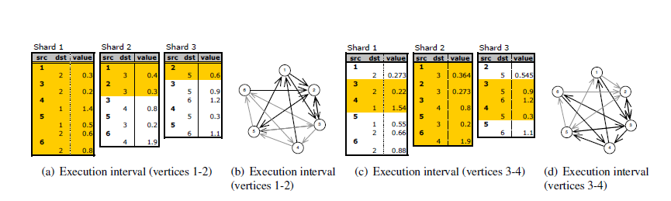
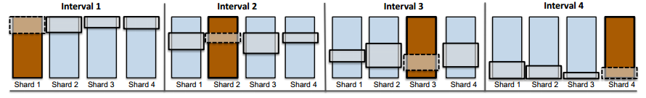
Example

Slide 22


PSW: Layout
1. Load
2. Compute
3. Write
Shard: in-edges for interval of vertices; sorted by source-id
Vertices
1..100
Vertices
101..700
Vertices
701..1000
Vertices
1001..10000
Shard 1
Shard 2
Shard 3
Shard 4
Shard 1
in-edges for vertices 1..100
sorted by source_id
Shards small enough to fit in memory; balance size of shards
Notes:
Let us show an example

Slide 23
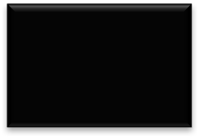





PSW: Loading Sub-graph
1. Load
2. Compute
3. Write
Load subgraph for vertices 1..100
Vertices
1..100
Vertices
101..700
Vertices
701..1000
Vertices
1001..10000
Shard 1
Shard 2
Shard 3
Shard 4
in-edges for vertices 1..100
sorted by source_id
Load all in-edges in memory
What about out-edges?
Arranged in sequence in other shards

Slide 24

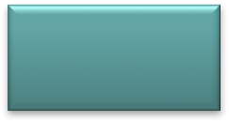
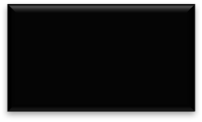
PSW: Loading Sub-graph
1. Load
2. Compute
3. Write
Load subgraph for vertices 101..700
Vertices
1..100
Vertices
101..700
Vertices
701..1000
Vertices
1001..10000
Shard 1
Shard 2
Shard 3
Shard 4
in-edges for vertices 1..100
sorted by source_id
Load all in-edges
in memory
Out-edge blocks
in memory

Slide 25
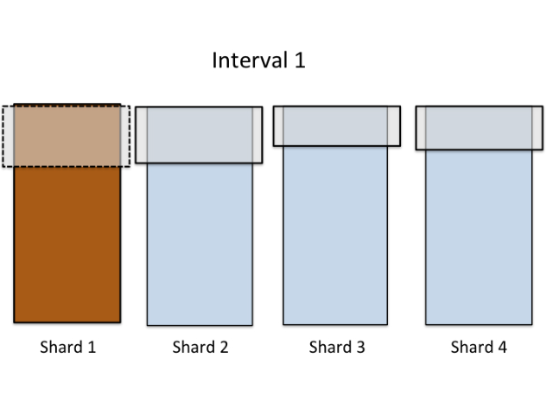
PSW Load-Phase
1. Load
2. Compute
3. Write
Only P large reads for each interval.
P² reads on one full pass.

Slide 26

PSW: Execute updates
1. Load
2. Compute
3. Write
Update-function is executed on interval’s vertices
Edges have pointers to the loaded data blocks
  Changes take effect immediately → asynchronous.
Block X
&Data
&Data
&Data
&Data
&Data
Deterministic scheduling prevents races between neighboring vertices.
&Data
Block Y
&Data
&Data
&Data
&Data
Notes:
Now, when we have the sub-graph in memory, i.e for all vertices in the sub-graph we have all their in- and out-edges, we can execute the update-functions. Now comes important thing to understand: as we loaded the edges from disk, these large blocks are stored in memory. When we then create the graph objects – vertices and edges – the edge object will have a pointer to the data block. I have changed the figure to show that actually all data blocks are represented by pointers, pointing in to the blocks loaded from disk. Now: if two vertices share an edge, they will immediatelly observe change made by the other one since their edge pointers point to the same address.

Slide 27
PSW: Commit to Disk
1. Load
2. Compute
3. Write
In write phase, the blocks are written back to disk
  Next load-phase sees the preceding writes → asynchronous.
In total:
P² reads and writes / full pass on the graph.
→ Performs well on both SSD and hard drive.
Block X
&Data
&Data
&Data
&Data
&Data
&Data
Block Y
&Data
&Data
&Data
&Data

Slide 28
Programming
virtual void before_iteration(int iteration, graphchi_context &gcontext)
virtual void after_iteration(int iteration, graphchi_context &gcontext)
virtual bool repeat_updates(graphchi_context &gcontext)
virtual void before_exec_interval(vid_t window_st, vid_t window_en, graphchi_context &gcontext)
virtual void after_exec_interval(vid_t window_st, vid_t window_en, graphchi_context &gcontext)
virtual void update(vertex_t &v, graphchi_context &gcontext)=0

Slide 29
Evolving Graphs
Graphs whose structure changes over time
Notes:
Just one more thing

Slide 30
Evolving Graphs: Introduction
Most interesting networks grow continuously:
  New connections made, some ‘unfriended’.
Desired functionality:
  Ability to add and remove edges in streaming fashion;
  ... while continuing computation.
Related work:
  Kineograph (EuroSys ‘12), distributed system for computation on a changing graph.
Notes:
.... however, kineograph is not available

Slide 31
PSW and Evolving Graphs
Adding edges
  Each (shard, interval) has an associated edge-buffer.
Removing edges: Edge flagged as “removed”.
edge-buffer(j, 1)
interval(1)
edge-buffer(j, 2)
(for example)
Twitter “firehose”
interval(2)
New edges
edge-buffer(j, P)
interval(P)
shard(j)

Slide 32
Recreating Shards on Disk
When buffers fill up, shards a recreated on disk
  Too big shards are split.
During recreation, deleted edges are permanently removed.
interval(1)
interval(1)
interval(1)
interval(2)
interval(2)
interval(2)
Re-create & Split
interval(P+1)
interval(P+1)
interval(P)
shard(j)
shard(j+1)
shard(j)

Slide 33
Distributed Graph Systems
Pregel
GraphLab
GraphX

