Slide 1
Big Data Summer School
Lecture 1. Introduction and Parallel Computing
Wenguang CHEN
Tsinghua University

Slide 2





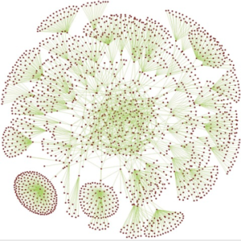
What is big data?
Big data is a broad term for data sets so large or complex that traditional data processing applications are inadequate.
3Vs: Volume，Variety，Velocity
Challenges include analysis, capture, curation, search, sharing, storage, transfer, visualization, and information privacy.

Slide 3
What is big data?
From the computer system perspective
The volume of data and the performance expectation of data analysis become key factors of data processing system design, we call it’s a big data problem
No fixed size
Simple keyword query, TB – PB
Data mining, GB – TB
Consider a shortest path algorithm on a 100 million node gragh

Slide 4

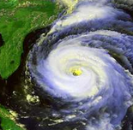
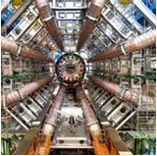





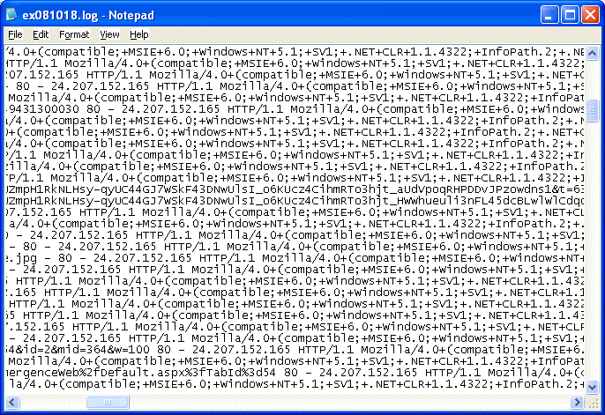


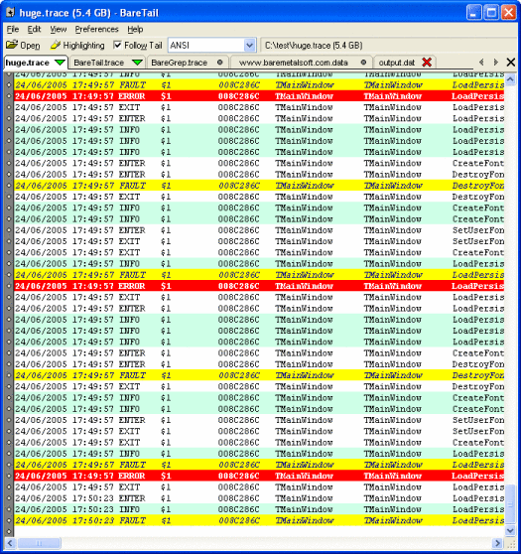

Big data examples
网络大数据?
Astronomy
Weather
Genetics
Health
Economy
Physics
Others
UGC
Deep Web
Multi-modal

Slide 5
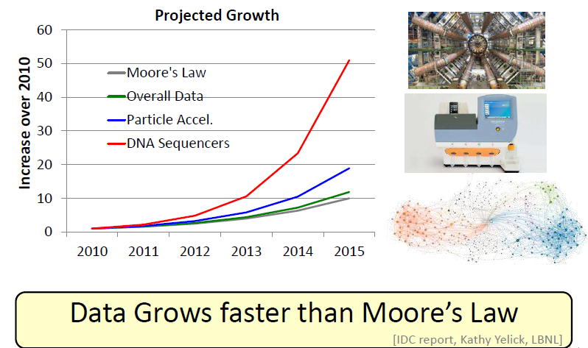
Data growth

Slide 6
Social network data-Volume
Tweets of Sina weibo 10million users
At most 1000 tweets per user – 5TB
300 million users ~ 100TB
Comments, images and video are
User Profile
100GB
Connections between users
100 million users, 10billion connections, ~100GB
Several billion users, ~ several terabytes

Slide 7
Social network data-Velocity
Several hundred million tweets generated by Weibo
512 * 10⁸ Byte ~= 50GB / day
Evolution of connections
More users
40 K new users / day
New connections and removed connections

Slide 8

Social network data-Variety
Tweets – Natural language
Profile / Tags
Connections – Graph
Unstructured data
Retweets and comments
Graph and natural language

Slide 9
Essentials for Big Data
Programming
Data
Algorithm

Slide 10
Paralellism

Slide 11


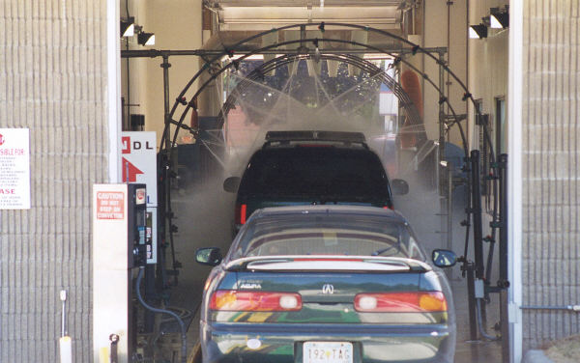
Parallelism
Sequential
Parallel
Pipelined
Parallelism is employed to provide higher performance with more cost
Why this is beneficial?

Slide 12
Motivations for Parallellism
Require more resources to achieve the performance
CPU
Memory
I/O

Slide 13
Fundamentals of Parallelism
Task parallelism
Data parallelism
Pipeline parallelism
dir_x
dir_y
dir_z
calculate_direction_x(m);
calculate_direction_y(m);
calculate_direction_z(m);
for ( i=0; i<N; i++)
a[i] = b[i];
a[1:N] = b[1:N]
dir_x
dir_x
dir_y
x = calculate_direction_x(m);
y = calculate_direction_y(x);
z = calculate_direction_z(y);
dir_y
dir_z
dir_z

Slide 14
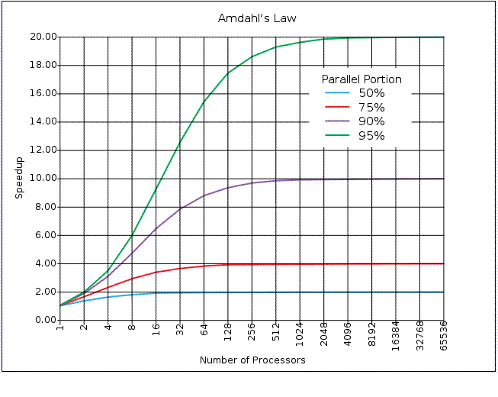
Two laws in parallel computing(1)
Amdahl’s law
If P is the proportion of a program that can be made parallel, the limit of speedup of whole program is bounded at 1/(1-P)
Notes:
14
What are the serial parts in applications?

Slide 15
Two laws in parallel computing(2)
Gustafson’s law
Amdahl’s law assume the fixed problem size
If problem size can increase as the compute power increases, the speedup that can be achieved is much larger, which is
S = a(n) + p(1-a(n))
n, problem size
p, number of processors
a(n), serial portion at problem size n
S → p when a(n) → 0
Reevaluating Amdahl's Law ,Communications of the ACM 31(5),1988. pp. 532-533
Notes:
15
Give an example that parallel part of applications increase faster than serial part

Slide 16
In the real world
Gustafson’s law rescues parallel computing
Larger machines are still useful
Many small chips can deliver good performance when the problem size is big
Blue Gene/L
However, some applications do not have bigger data set
Genome alignment, social network
What happens when fixed problem size meet Moore’s law?
Real world are mix of Amdahl’s law and Gustafson’s law
Notes:
16

Slide 17
Challenges of Parallel Programming
Parallelism identification
Rely on developers to specify
May need incremental parallelization to achieve the performance target
Load balance
The completion time of a parallel program is its last thread’s completion time
Proper synchronization
Make sure the programs are parallelized correctly
Data race and deadlock free
Respect dependence of original program

Slide 18
So what is the rule behind correct parallelism?
Let’s examine it by examples.
Can following loops be parallelized?
//Loop 1
for(int i=0; i<N; i++)
{
a[i] = a[i]+1.0;
}
//Loop 2
for(int i=1; i<N; i++)
{
a[i] = a[i]+a[i-1];
}
Notes:
18

Slide 19
How Loop 2 are executed in parallel?
for(int i=1; i<=4; i++)
{
a[i] = a[i]+a[i-1];
}
A possible parallel execution of the loop:
Thread 1
a[1]=a[1]+a[0];
a[2]=a[2]+a[1];
Thread 2
a[3]=a[3]+a[2];
a[4]=a[4]+a[3];
Thread 2 may use the old a[2], before the right a[2] is calculated
19
Notes:
CS267 Lecture 2
19

Slide 20
Dependence blocks parallelization
Can not parallelize a loop unless we know there’re no cross-iteration data dependence
But aliasing and procedure boundary prevent compiler from accurate and efficient dependence test
An optimization technique called speculative parallelization, which could get the 30% of performance improvement with 4 cores
Is this a good research direction? Why?
Notes:
20

Slide 21
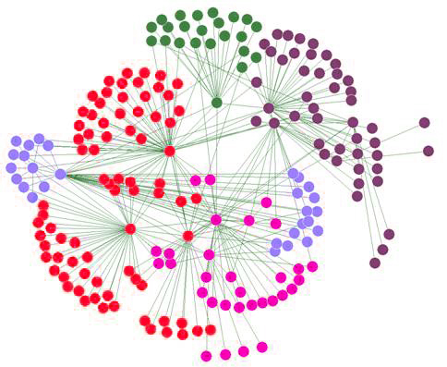
Load Balance
Both Amdahl and Gustafson’s law assume perfect parallelization.
Load imbalance is one of the most significant performance bottleneck
Speedup is damaged seriously
Scheduling loops to processors
Solutions?
T1
T2
T3
T4
IDLE
IDLE
IDLE
Notes:
21

Slide 22
How and Why Parallelism
Avoid parallelism if possible
Check single threaded solution first
Keep the power issues in mind
Difficult to get parallelism correctly and efficiently
Dependences
Load balancing
Data races and deadlocks
Uncertainty
OK, Let’s see how to do parallelism

Slide 23
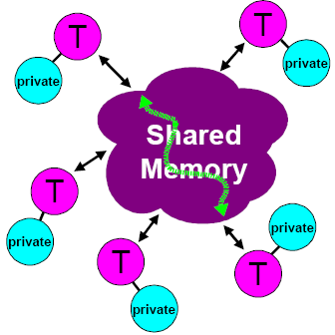
Shared Memeory Programming Model
Shared Memory
Thread still may have private data
Communications are implicitly done
Synchorinization is required to makes sure that S2 should execute AFTER s3
Thread 1
s1:a = b + c
S2:g = a + f
Thread 2
S3:f = e + d
OpenMP, Pthreads
Windows Threads
Notes:
23

Slide 24
Examples: Measure memory bandwidth with threads
Single threaded version
void test(int elems, int stride) {
int i, result = 0;
volatile int sink;
for (i = 0; i < elems; i += stride)
result += data[i];
sink = result;
}

Slide 25
Main threads
void *sum_thread(void *);
volatile long global_sum = 0; /* global */
main()
{
…
for (int i = 0; i < N; i++)
pthread_create(&tid[i], NULL, sum_thread, (void*)i);
for (int i = 0; i < N; i++)
pthread_join(tid[i], NULL);
}

Slide 26
Thread
void *sum_thread(void *vargp)
{
long sum;
int myid = (long) vargp;
int start = myid * sample_num / 4;
int end = (myid+1) * sample_num / 4 - 1;
sum = 0;
for (int i=start; i<=end; i++)
global_sum += x[i];
return NULL;
}
Notes:
Problem with this code?

Slide 27
Thread
void *sum_thread(void *vargp)
{
long sum;
int myid = (long) vargp;
int start = myid * sample_num / 4;
int end = (myid+1) * sample_num / 4 - 1;
sum = 0;
for (int i=start; i<=end; i++)
sum += x[i];
sem_wait(&num_mutex);
global_sum += sum;
sem_post(&num_mutex);
return NULL;
}

Slide 28
Issues with Pthreads
Flexible and powerful
Useful not only in data processing, but also in a wide range of systems
Network server etc.
Complex for data processing
Pthread is not always portable( e.g. Windows )
Code to calculate addresses and loop bounds
May not be easy to specify scheduling schemes

Slide 29
Introduction to OpenMP
What is OpenMP?
Open specification for Multi-Processing [Short Version]
“Standard” API for defining multi-threaded shared-memory programs
openmp.org – Talks, examples, forums, etc.
computing.llnl.gov/tutorials/openMP/
See parlab.eecs.berkeley.edu/2012bootcampagenda
2 OpenMP lectures (slides and video) by Tim Mattson
portal.xsede.org/online-training
www.nersc.gov/assets/Uploads/XE62011OpenMP.pdf
High-level API
Preprocessor (compiler) directives ( ~ 80% )
Library Calls ( ~ 19% )
Environment Variables ( ~ 1% )
Notes:
Motivated by simplifying pThreads
Latest version 4.0, July 2013
Won’t do all details, lots of on-line material,
Homework will give you working code to modify
Directives: hints to compiler (look like comments) about what to parallelize
Can run sequentially, comments “parallelize following loop” are ignored
Some library calls to do specific functions in parallel
get, set #threads, get thread#,
Environment variables: hints like how many processors do I have.

Slide 30
并行结构：Work-sharing Construct(1) - loop
Threads are assigned an independent set of iterations
Threads must wait at the end of work-sharing construct
#pragma omp parallel
#pragma omp for
i = 1
i = 2
i = 3
i = 4
i = 5
i = 6
i = 7
i = 8
i = 9
i = 10
i = 11
i = 12
#pragma omp parallel
#pragma omp for
for(i = 1, i < 13, i++)
c[i] = a[i] + b[i]
Implicit barrier

Slide 31
Combining pragmas
These two code segments are equivalent
#pragma omp parallel
{
#pragma omp for
for (i=0;i< MAX; i++) res[i] = huge();
}
#pragma omp parallel for
for (i=0;i< MAX; i++) {
res[i] = huge();
}

Slide 32
Assigning Iterations
The schedule clause affects how loop iterations are mapped onto threads
schedule(static [,chunk])
Blocks of iterations of size “chunk” to threads
Round robin distribution
Default=N/t
schedule(dynamic[,chunk])
Threads grab “chunk” iterations
When done with iterations, thread requests next set
Default=1
schedule(guided[,chunk])
Dynamic schedule starting with large block
Size of the blocks shrink; no smaller than “chunk”
Default=1
schedule(runtime)
OMP_SCHEDULE

Slide 33
Schedule Clause Example
#pragma omp parallel for schedule (static)
for( int i = 1; i <= 128; i ++ )
{
if ( TestForPrime(i) ) gPrimesFound++;
}
#pragma omp parallel for schedule (static, 8)
for( int i = 1; i <= 128; i ++ )
{
if ( TestForPrime(i) ) gPrimesFound++;
}
#pragma omp parallel for schedule (dynamic)
for( int i = 1; i <= 128; i ++ )
{
if ( TestForPrime(i) ) gPrimesFound++;
}
Notes:
For Fortran example TestForPrime is a LOGICAL function. This example has an increasing amount of work as the iteration counter gets larger. That is because testing numbers for primality with a brute force method takes longer to work since there are more numbers to test.
C example uses STATIC scheduling. Set of iterations is divided up into chunks of size 8 and distributed to threads in round robin fashion.
Fortran example uses DYNAMIC scheduling. Chunks of 8 iterations are scheduled to threads when more work is needed by a thread.

Slide 34
Static Scheduling
For N_{i} iterations and N_{t} threads, each thread gets one chunk of N_{i}/N_{t} loop iterations:
T0 T1 T2 T3 T4 T5
Thread #0: iterations 0 through N_{i}/N_{t}-1
Thread #1: iterations N_{i}/N_{t} through 2N_{i}/N_{t}-1
Thread #2: iterations 2N_{i}/N_{t} through 3N_{i}/N_{t}-1
…
Thread #N_{t}-1: iterations (N_{t}-1)N_{i}/N_{t} through N_{i}-1

Slide 35
Dynamic Scheduling
For N_{i} iterations and N_{t} threads, each thread gets a fixed-size chunk of k loop iterations:
T0 T1 T2 T3 T4 T5 T2 T3 T4 T0 T1 T5 T3 T2
When a particular thread finishes its chunk of iterations, it gets assigned a new chunk. So, the relationship between iterations and threads is nondeterministic.
Advantage: very flexible
Disadvantage: high overhead – lots of decision making about which thread gets each chunk

Slide 36
Guided Scheduling
For N_{i} iterations and N_{t} threads, initially each thread gets a fixed-size chunk of k < N_{i}/N_{t} loop iterations:
T0 T1 T2 T3 T4 T5 2 3 4 1 0 2 5 4 2 3 1
After each thread finishes its chunk of k iterations, it gets a chunk of k/2 iterations, then k/4, etc. Chunks are assigned dynamically, as threads finish their previous chunks.
Advantage over static: can handle imbalanced load
Advantage over dynamic: fewer decisions, so less overhead

Slide 37
Scheduling in OpenMP
Schedule Clause | When To Use
STATIC | Predictable and similar work per iteration
DYNAMIC | Unpredictable, highly variable work per iteration
GUIDED | Special case of dynamic to reduce scheduling overhead

Slide 38
Example: Dot Product
float dot_prod(float* a, float* b, int N)
{
float sum = 0.0;
#pragma omp parallel for shared(sum)
for(int i=0; i<N; i++) {
sum += a[i] * b[i];
}
return sum;
}
What is Wrong?
Notes:
详细解释原因
Multiple threads modifying sum with no protection

Slide 39
Protect Shared Data
Must protect access to shared, modifiable data
float dot_prod(float* a, float* b, int N)
{
float sum = 0.0;
#pragma omp parallel for shared(sum)
for(int i=0; i<N; i++) {
#pragma omp critical
sum += a[i] * b[i];
}
return sum;
}

Slide 40
OpenMP Critical Construct
#pragma omp critical [(lock_name)]
Defines a critical region on a structured block
float RES;
#pragma omp parallel
{ float B;
#pragma omp for privte(B) for(int i=0; i<niters; i++){
B = big_job(i);
#pragma omp critical
{
consum (B, RES);
}
} }
Threads wait their turn –at a time, only one calls consum() thereby protecting RES from race conditions

Slide 41
Do we have something similar to this in OpenMP?
void *sum_thread(void *vargp)
{
long sum;
int myid = (long) vargp;
int start = myid * sample_num / 4;
int end = (myid+1) * sample_num / 4 - 1;
sum = 0;
for (int i=start; i<=end; i++)
sum += x[i];
sem_wait(&num_mutex);
global_sum += sum;
sem_post(&num_mutex);
return NULL;
}

Slide 42
OpenMP Reduction Clause
reduction (op : list)
The variables in “list” must be shared in the enclosing parallel region
Inside parallel or work-sharing construct:
A PRIVATE copy of each list variable is created and initialized depending on the “op”
These copies are updated locally by threads
At end of construct, local copies are combined through “op” into a single value and combined with the value in the original SHARED variable
Notes:
机理和优势

Slide 43
C/C++ Reduction Operations
A range of associative operands can be used with reduction
Initial values are the ones that make sense mathematically
Operand | Initial Value
+ | 0
* | 1
- | 0
^ | 0
Operand | Initial Value
& | ~0
| | 0
&& | 1
|| | 0

Slide 44
Protect Shared Data
Must protect access to shared, modifiable data
float dot_prod(float* a, float* b, int N)
{
float sum = 0.0;
#pragma omp parallel for shared(sum)
for(int i=0; i<N; i++) {
#pragma omp critical
sum += a[i] * b[i];
}
return sum;
}
reduction(+:sum)

Slide 45
We have talked a lot on single machine
OpenMP (or other threading ) is good for a single machine
Shared memory space
Incremental parallelization
RAID can be used to speedup I/O
We still have more to optimize for a single machine, will discuss later
NUMA for task allocation
Mmap for I/O
Let’s try to use multiple machines now

Slide 46
Task/Channel Model
Parallel computation = set of tasks
Task
Program
Local memory
Collection of I/O ports
Tasks interact by sending messages through channels

Slide 47
The message passing paradigm
Parallel PROCESSES
Separate memory spaces
Communication through explicit message send/recv
Need rewrite code, incremental annotation is not sufficient
Private memory
s: 12
s: 14
s: 11
receive Pn,s
y = ..s ...
i: 2
i: 3
i: 1
P0
P1
send P1,s
Pn
Network

Slide 48
A Minimal MPI Program (C)
#include "mpi.h"
#include <stdio.h>
int main( int argc, char *argv[] )
{
MPI_Init( &argc, &argv );
printf( "Hello, world!\n" );
MPI_Finalize();
return 0;
}

Slide 49
Better Hello (C)
#include "mpi.h"
#include <stdio.h>
int main( int argc, char *argv[] )
{
int rank, size;
MPI_Init( &argc, &argv );
MPI_Comm_rank( MPI_COMM_WORLD, &rank );
MPI_Comm_size( MPI_COMM_WORLD, &size );
printf( "I am %d of %d\n", rank, size );
MPI_Finalize();
return 0;
}
Notes:
Run the code and show the results

Slide 50
Send_recv samples
MPI_Init(&argc,&argv);
MPI_Comm_size(MPI_COMM_WORLD,&numprocs);
MPI_Comm_rank(MPI_COMM_WORLD,&myid);
tag=1234;source=0;destination=1;count=1;
if(myid == source){
buffer=5678;
MPI_Send(&buffer,count,MPI_INT,destination,tag,MPI_COMM_WORLD);
printf("processor %d sent %d\n",myid,buffer);
}
if(myid == destination){ MPI_Recv(&buffer,count,MPI_INT,source,tag,MPI_COMM_WORLD,&status);
printf("processor %d got %d\n",myid,buffer);
}
MPI_Finalize();
Notes:
Conditional statement is used to distinguish the operations on different processes, this is called SPMD model

Slide 51
MPI is Simple
Many parallel programs can be written using just these six functions, only two of which are non-trivial:
MPI_INIT
MPI_FINALIZE
MPI_COMM_SIZE
MPI_COMM_RANK
MPI_SEND
MPI_RECV
Point-to-point (send/recv) isn’t the only way...

Slide 52
The pi example
4.0
1
∫
4.0
dx = π
(1+x²)
0
2.0
static long num_steps = 100000;
double step;
void main ()
{int I;
double x, pi, sum = 0.0;
step = 1.0/(double) num_steps;
for (i=0; i< num_steps; i++){
x = (i+0.5)*step;
sum = sum + 4.0/(1.0+x*x);
}
pi = step * sum;
}
F(x) = 4.0/(1+x²)
0.0
1.0
X

Slide 53
The OpenMP version
x=0;
sum = 0.0;
step = 1.0/(double) num_steps;
#pragma omp for reduction(+:sum) private(x)
for (i=0; i < num_steps; i=i+1){
x=(i+0.5)*step;
sum = sum + 4.0/(1.0+x*x);
}
pi=step*sum;
What are needed in MPI if we wish each process do part of the calculation?
Notes:
First, each process need to know num_steps, also there should be support of reduction.

Slide 54
Introduction to Collective Operations in MPI
Collective operations are called by all processes in a communicator.
MPI_BCAST distributes data from one process (the root) to all others in a communicator.
MPI_REDUCE combines data from all processes in communicator and returns it to one process.
In many numerical algorithms, SEND/RECEIVE can be replaced by BCAST/REDUCE, improving both simplicity and efficiency.

Slide 55
Example: PI in C -1
#include "mpi.h"
#include <math.h>
int main(int argc, char *argv[])
{ int done = 0, n, myid, numprocs, i, rc; double PI25DT = 3.141592653589793238462643; double mypi, pi, h, sum, x, a; MPI_Init(&argc,&argv); MPI_Comm_size(MPI_COMM_WORLD,&numprocs); MPI_Comm_rank(MPI_COMM_WORLD,&myid); while (!done) { if (myid == 0) { printf("Enter the number of intervals: (0 quits) "); scanf("%d",&n); } MPI_Bcast(&n, 1, MPI_INT, 0, MPI_COMM_WORLD); if (n == 0) break;

Slide 56
Example: PI in C - 2
h = 1.0 / (double) n; sum = 0.0; for (i = myid + 1; i <= n; i += numprocs) { x = h * ((double)i - 0.5); sum += 4.0 / (1.0 + x*x); } mypi = h * sum; MPI_Reduce(&mypi, &pi, 1, MPI_DOUBLE, MPI_SUM, 0, MPI_COMM_WORLD); if (myid == 0) printf("pi is approximately %.16f, Error is %.16f\n", pi, fabs(pi - PI25DT)); } MPI_Finalize();
return 0;
}

Slide 57
Alternative set of 6 Functions for Simplified MPI
MPI_INIT
MPI_FINALIZE
MPI_COMM_SIZE
MPI_COMM_RANK
MPI_BCAST
MPI_REDUCE
What else is needed (and why)?

Slide 58
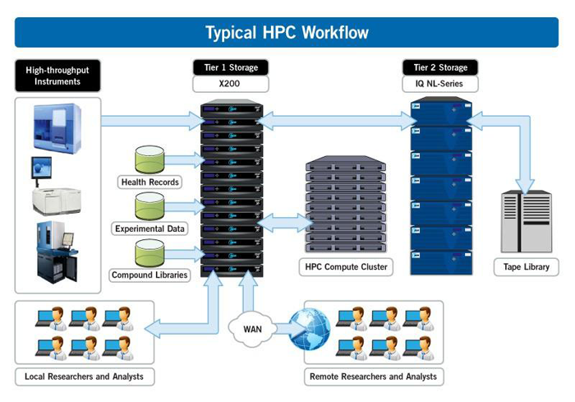
MPI and HPC cluster architecture
Notes:
-Separated compute and storage
-Homogeneous machines

Slide 59
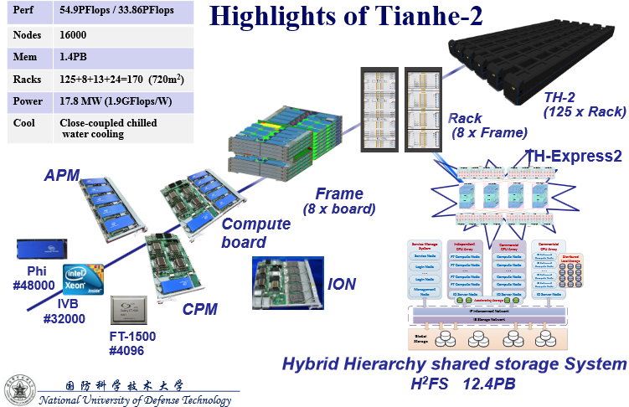
Tianhe - 2

Slide 60
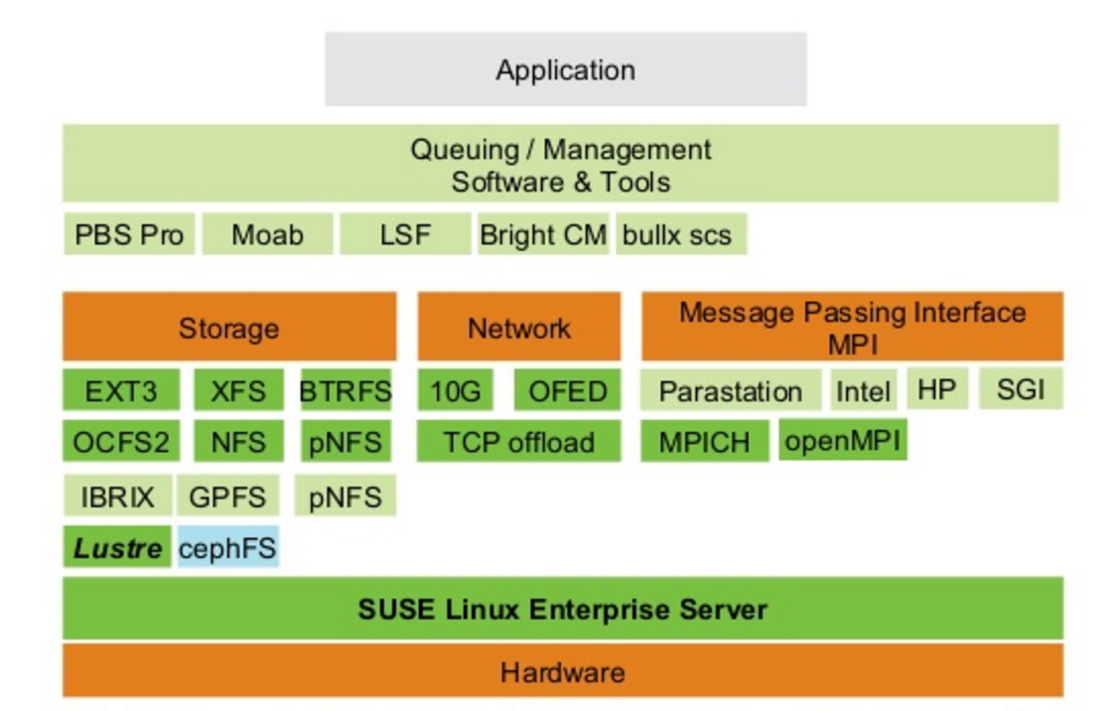
Typical Software Stack of HPC
Notes:
Hardware
Hundreds to thousands cores, homogeneous
Connected with high speed network, such as Infiniband
Software
MPI applications
MPI Libraries( Intel MPI, OpenMPI etc. )
OpenPBS or LSF as scheduler
NFS or Lustre
TotalView, gdb, or printf…
Fastest machine today
5Pflops ( 10¹⁵)

Slide 61
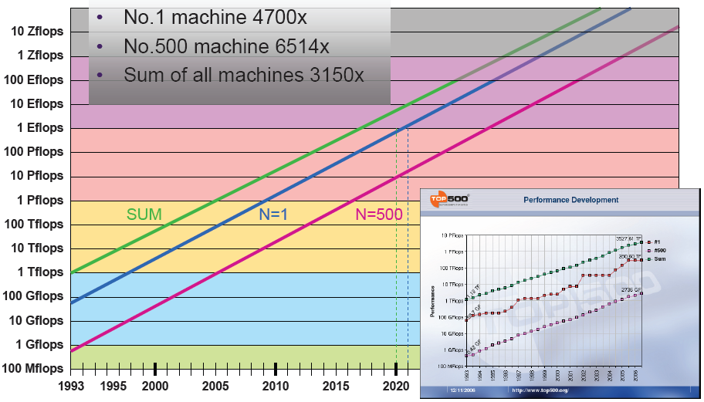
10 Year for 1000X Performance
1998(Tflops) →2008(Pflops) →2018(Eflops)
What are the challenges to build Eflops computers and beyond?

Slide 62
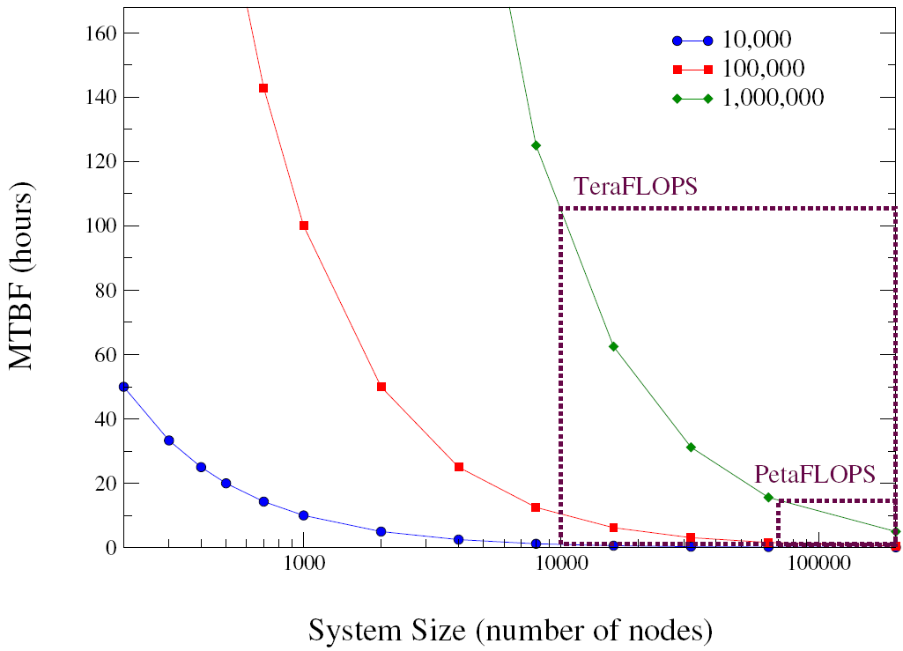
Availability
MTBF of Petaflops machine is likely just a few hours*
What if an application runs 20 days or even longer?
Restart from the beginning does not help
Classic fault tolerance mechanisms do not fit well
Lockstep, n-version programming…
Checkpoint and Restart
* Fabrizio Petrini and Kei Davis and José Carlos Sancho. System-Level Fault-Tolerance in Large-Scale Parallel Machines with Buffered Coscheduling. FTPDS04, 2004.
Notes:
Source: Fabrizio Petrini and Kei Davis and José Carlos Sancho. System-Level Fault-Tolerance in Large-Scale Parallel Machines with Buffered Coscheduling. In In 9th IEEE Workshop on Fault-Tolerant Parallel, Distributed and Network-Centric Systems (FTPDS04), Santa Fe, NM, April 2004.
显示当节点数增加后整个系统MTBF的下降。不同的曲线表示节点不同的MTBF。
04年的预测数据可能比较老，尤其是对系统规模。

Slide 63
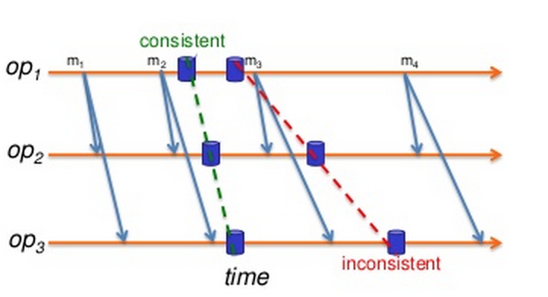
Checkpoint and Restart
Applications can write its own checkpoint
Compact, only save necessary state variables
Not trivial, especially when multiple people are involved

Slide 64
Automatic checkpoint and rollback recovery
Good in concept, not in production system yet
Heavy I/O overhead on checkpointing
Difficult to fit arbitrary program
complex process boundary
File and Virtual Memory are not consistent

Slide 65
I/O overhead of Checkpointing
The amount of time doing useful work
Bandwidth, memory ∝compute power
checkpoint stays constant
Checkpoint interval:
* Schroeder, B., Gibson, G.A., “Understanding failure in petascale computers.” SciDAC 2007
Notes:
Schroeder, B., Gibson, G.A., "Understanding failure in petascale computers." SciDAC 2007.
The effective application utilization of a system is the amount of time it is doing useful work, i.e. executing user code, rather than writing checkpoints or redoing work that has been lost after a node failure.
For future projections, we assume a balanced system model, where bandwidth and memory both grow in proportion to compute power, and hence the time t to write a checkpoint will stay constant over time.
Optimial checkpoint invterval: sqrt(2*MTTF*t). From:
J. W. Young. A first order approximation to the optimum checkpoint interval. Commun. ACM, 17(9):530–531, 1974
in the case where the number of cores per chip doubles every 30 months, the utilization drops to zero by
2013, meaning the system would spend 100% of its time writing checkpoints or recovering lost work, a
situation that is clearly unacceptable. In the remainder of this section we consider different strategies to stave off this predicted drop in utilization.

Slide 66
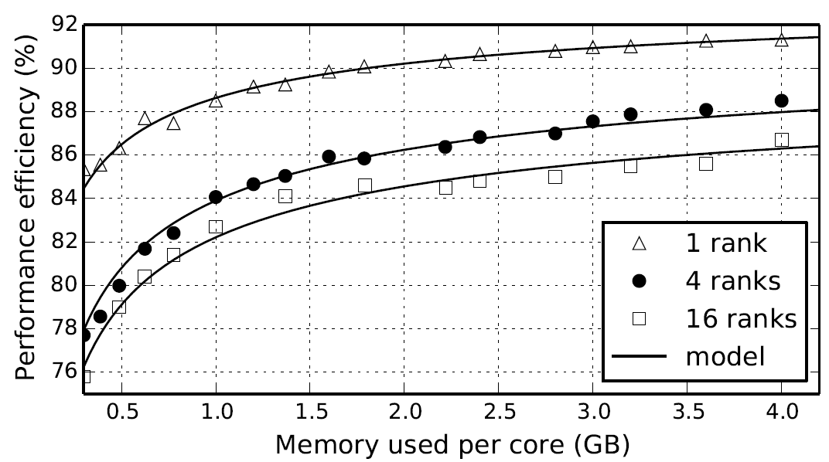
In-Memory Checkpoint and Redundant Execution

Slide 67
File Checkpointing
We propose a way to solve the file system consistency problem by leveraging a user-level file system*
Buffer file changes until the next checkpoint
CKPT
crash
read(buf, “foo”)
File Not Found!
unlink(“foo”)
*Ruini Xue, Wenguang Chen, Weimin Zheng: CprFS: A User-Level File System to Support Consistent File States for Checkpoint and Restart. ICS 2008: 114-123

Slide 68
Revisit HPC cluster architecture
Separated storage and compute nodes
Homogeneous compute nodes
Batch scheduler
All or none scheduling policy
Difficult fault-tolerance
Notes:
-Separated compute and storage
-Homogeneous machines

Slide 69
Challenges to Big data systems
More cost sensitive
Tend to use cheap computers whose MTBF may not as high as in HPC systems
Fault tolerance becomes more important
Elastic demand
Can not fix the number of computers used
Adding/updating new machines all years long, heterogeneous nodes

Slide 70
Challenges to Big data systems(cont’d)
Production workload and analysis workload co-exist in the same cluster for better utilization
The required resources may not be fully available
May kill some tasks for jobs with higher priority
Strong demands on fault tolerance and the support of heterogeneous nodes

Slide 71



Google Cloud Infrastructure
Scheduler
GFS master
Google Cloud Infrastructure
Chubby
Node
Application
BigTable
Server
User
Node
…
MapReduce
Job
Node
Node
Scheduler
slave
GFS
chunkserver
Linux
MapReduce: Simplified Data Processing on Large Clusters ，Jeffrey Dean and Sanjay Ghemawat， OSDI 2004
The Google file system, Sanjay Ghemawat, Howard Gobioff, Shun-Tak Leung，SOSP 2003

Slide 72
A representative big data system infrastructure
Merge compute and storage nodes
For better performance and more cost-effective
Use GFS to support fault-tolerance for data
Use MapReduce programming model
Support heterogeneous nodes
Support scheduling flexibility
Fault-tolerance on computing
Notes:
Locality and bottleneck

Slide 73
Open source big data infrastructure Hadoop
GFS → HDFS
MapReduce → A Java implementation
Scheduler(Borg) → Yarn
Chubby → ZooKeeper
BigTable → HBase

Slide 74

HDFS Architecture

Slide 75
HDFS
Use data replica to achieve high availability
Usually 3 copies are used (why?)
Cost, performance and availability
Cost : -
Performance: +
Availability: +
Notes:
New suggestions?
1 replica : 5000 hours MTBF
Fix time : 200 hour
What is the chance of 2 replica failure? 25 years
What is of the chance of 3 failure?

Slide 76
Computational Science
Application Level
Mahout, R, and Applications
Applications and Community Codes
FORTRAN,C,C++: languages
PAPI: performance and debugging tool
MPI/OpenMP: multi-core parallel model
SLURM: batch scheduler
Lustre: parallel file system
Application Level
Hive
Pig
Sqoop
Flume
FORTRAN, C, C++, and IDEs
Domain-specific Libraries
Map-Reduce
Storm
Numerical Libraries
Performance and Debugging
Data Analytic
Middleware and Management
MPI/OpenMP + Accelerator Tools
Mahout: machine learning tool
Hive: data warehouse software
Pig: provide high level language for big data
Sqoop: exchange data with traditional database
Flume: log management
Zookeeper: maintaining consistency
Storm: real-time computation system.
Hbase: a distributed, scalable big data store.
AVRO: data serialization system.
Zookeeper (coordination)
AVRO
System Monitoring Tools
Hbase Big Table (key-value store)
Cloud Services (e.g. AWS
Lustre (Parallel File System)
Batch Scheduler (such as SLURM)
HDFS (Hadoop File System)
Virtual Machines and Cloud Services (optional)
System Software
Linux OS variant
Linux OS variant
NOTE: The Divergence of
Big Data and HPC
Eco-Systems!
Cluster Software
Ethernet Switches
Local Node Storage
Commodity X86 Racks
Infiniband + Ethernet Switches
SAN + Local Node Storage
X86 Racks + GPUs or Accelerators
Data Analytics Ecosystem
Computational Science Ecosystem
Data analytics and computing ecosystem compared
Inspired by “Exscale Computing and Big Data”, DANIEL A. REED AND JACK DONGARRA , CACM July 2015

Slide 77
Why MPI is hard to schedule flexibly and tolerant fault?
MPI_Init(&argc,&argv);
MPI_Comm_size(MPI_COMM_WORLD,&numprocs);
MPI_Comm_rank(MPI_COMM_WORLD,&myid);
tag=1234;source=0;destination=1;count=1;
if(myid == source){
buffer=5678;
MPI_Send(&buffer,count,MPI_INT,destination,tag,MPI_COMM_WORLD);
printf("processor %d sent %d\n",myid,buffer);
}
if(myid == destination){ MPI_Recv(&buffer,count,MPI_INT,source,tag,MPI_COMM_WORLD,&status);
printf("processor %d got %d\n",myid,buffer);
}
MPI_Finalize();
Notes:
Conditional statement is used to distinguish the operations on different processes, this is called SPMD model

Slide 78
Alternative set of 6 Functions for Simplified MPI
MPI_INIT
MPI_FINALIZE
MPI_COMM_SIZE
MPI_COMM_RANK
MPI_BCAST
MPI_REDUCE

Slide 79
Revisit the MPI with collective communications
#include "mpi.h"
#include <math.h>
int main(int argc, char *argv[])
{ int done = 0, n, myid, numprocs, i, rc; double PI25DT = 3.141592653589793238462643; double mypi, pi, h, sum, x, a; MPI_Init(&argc,&argv); MPI_Comm_size(MPI_COMM_WORLD,&numprocs); MPI_Comm_rank(MPI_COMM_WORLD,&myid); while (!done) { if (myid == 0) { printf("Enter the number of intervals: (0 quits) "); scanf("%d",&n); } MPI_Bcast(&n, 1, MPI_INT, 0, MPI_COMM_WORLD); if (n == 0) break;

Slide 80
h = 1.0 / (double) n; sum = 0.0; for (i = myid + 1; i <= n; i += numprocs) { x = h * ((double)i - 0.5); sum += 4.0 / (1.0 + x*x); } mypi = h * sum; MPI_Reduce(&mypi, &pi, 1, MPI_DOUBLE, MPI_SUM, 0, MPI_COMM_WORLD); if (myid == 0) printf("pi is approximately %.16f, Error is %.16f\n", pi, fabs(pi - PI25DT)); } MPI_Finalize();
return 0;
}

Slide 81
MPI model
What are the obstacles of supporting heterogeneous node and fault tolerance
Knowing N at the beginning
Static partition of the workload
Any idea to solve the problem?

Slide 82
The OpenMP version
x=0;
sum = 0.0;
step = 1.0/(double) num_steps;
#pragma omp for reduction(+:sum) private(x)
for (i=0; i < num_steps; i=i+1){
x=(i+0.5)*step;
sum = sum + 4.0/(1.0+x*x);
}
pi=step*sum;
This is similar to the MPI version we have
Notes:
First, each process need to know num_steps, also there should be support of reduction.

Slide 83
Revisit Static Scheduling
For N_{i} iterations and N_{t} threads, each thread gets one chunk of N_{i}/N_{t} loop iterations:
T0 T1 T2 T3 T4 T5
Thread #0: iterations 0 through N_{i}/N_{t}-1
Thread #1: iterations N_{i}/N_{t} through 2N_{i}/N_{t}-1
Thread #2: iterations 2N_{i}/N_{t} through 3N_{i}/N_{t}-1
…
Thread #N_{t}-1: iterations (N_{t}-1)N_{i}/N_{t} through N_{i}-1

Slide 84
The OpenMP version - Dynamic
x=0;
sum = 0.0;
step = 1.0/(double) num_steps;
#pragma omp for reduction(+:sum) private(x) schedule(dynamic,1)
for (i=0; i < num_steps; i=i+1){
x=(i+0.5)*step;
sum = sum + 4.0/(1.0+x*x);
}
pi=step*sum;
What are needed in MPI if we wish each process do part of the calculation?
Notes:
First, each process need to know num_steps, also there should be support of reduction.

Slide 85
Revisit Dynamic Scheduling
For N_{i} iterations and N_{t} threads, each thread gets a fixed-size chunk of k loop iterations:
T0 T1 T2 T3 T4 T5 T2 T3 T4 T0 T1 T5 T3 T2
When a particular thread finishes its chunk of iterations, it gets assigned a new chunk. So, the relationship between iterations and threads is nondeterministic.
Advantage: very flexible
Disadvantage: high overhead – lots of decision making about which thread gets each chunk

Slide 86
Dynamic scheduling on distributed systems
Doing a small piece of work, complete it and get the next piece
Input from the global file system, similar to the MPI_Bcast
No N is required to know at the beginning
Need a reduce support similar to MPI_Reduce

Slide 87
The MapReduce Programming Model
Borrows from functional programming
Users implement interface of two functions
map (in_key, in_value) ->
(out_key, intermediate_value) list
reduce (out_key, intermediate_value list) ->
out_value list
87

Slide 88
Map
Records from the data source (lines out of files, rows of a database, etc) are fed into the map function as key*value pairs: e.g., (filename, line).
map() produces one or more intermediate values along with an output key from the input.
88

Slide 89
The concept of Key-value pair
Name – Value
int c = 5 ; c is the key, value is 5
<c,5>,<b,0>, <a,2>,<c,6>,<c,7>
What is the average of c?
Use c to retrieve data from the list

Slide 90
Reduce
After the map phase is over, all the intermediate values for a given output key are combined together into a list
reduce() combines those intermediate values into one or more final values for that same output key
(in practice, usually only one final value per key)
90

Slide 91
Architecture
91

Slide 92
Parallelism
map() functions run in parallel, creating different intermediate values from different input data sets
reduce() functions also run in parallel, each working on a different output key
All values are processed independently
Bottleneck: reduce phase can’t start until map phase is completely finished.
92

Slide 93
Example: Count word occurrences
map(String input_key, String input_value):
// input_key: document name
// input_value: document contents
for each word w in input_value:
EmitIntermediate(w, "1");
reduce(String output_key, Iterator intermediate_values):
// output_key: a word
// output_values: a list of counts
int result = 0;
for each v in intermediate_values:
result += ParseInt(v);
Emit(AsString(result));
93

Slide 94
Example vs. Actual Source Code
Example is written in pseudo-code
Actual implementation is in C++ or Java, using a MapReduce library
True code is somewhat more involved (defines how the input key/values are divided up and accessed, etc.)
94

Slide 95
Example
Page 1: the weather is good
Page 2: today is good
Page 3: good weather is good.
95

Slide 96
Map output
Worker 1:
(the 1), (weather 1), (is 1), (good 1).
Worker 2:
(today 1), (is 1), (good 1).
Worker 3:
(good 1), (weather 1), (is 1), (good 1).
96

Slide 97
Reduce Input
Worker 1:
(the 1)
Worker 2:
(is 1), (is 1), (is 1)
Worker 3:
(weather 1), (weather 1)
Worker 4:
(today 1)
Worker 5:
(good 1), (good 1), (good 1), (good 1)
97

Slide 98
Reduce Output
Worker 1:
(the 1)
Worker 2:
(is 3)
Worker 3:
(weather 2)
Worker 4:
(today 1)
Worker 5:
(good 4)
98

Slide 99
Map-Reduce Examples

Slide 100
Problem 1 Distributed Grep
Input
A key word and documents to be searched
Output
The line contains the keyword, with file name
[cwg@HPC-AMD phoenix_scheduler]$ grep main *
MapReduceScheduler.h:/* The main MapReduce engine. This is the function called by the application.
MapReduceScheduler.h: * also organizes and maintains the data which is passed from application to

Slide 101
MR Grep
Map
Emits the result of local grep
Reduce
Output what it get from Map

Slide 102
Problem 2 Inverted Index
Input
A few text documents
Output
(word, docIDList)

Slide 103
MR-II
Map
Parse document and emit (word, DocID)
Reduce
Emit ( word, DocIDList )

Slide 104
Iterative MapReduce: K-Means as an Example
Notes:
104

Slide 105
K-Means Algorithm
Input:
a set of P points in N-dimension space
Output:
distribute them into K clusters, so that points closer to each other is in the same cluster
This is an NP-hard problem
Even when K=2 or D=2
Notes:
105

Slide 106
K-Means Algorithm (cont.)
randomly generate K points as the means
do
for each point in the point set
find the closest mean I, assign the point to cluster I, forming K clusters
calculate new means for each cluster
until no changes are made to the clusters
Notes:
106

Slide 107
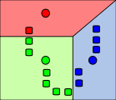
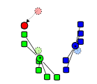
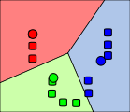
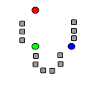
1) k initial "means" (in this case k=3) are randomly selected from the data set (shown in color).
2) k clusters are created by associating every observation with the nearest mean. The partitions here represent the Voronoi diagram generated by the means.
3) The centroid of each of the k clusters becomes the new means.
4) Steps 2 and 3 are repeated until convergence has been reached.

Slide 108
Expressing an Iteration in MapReduce
for each point in the point set
find the closest mean I, assign the point to cluster I, forming new K clusters
calculate new means for each cluster
can be done as a map task
reduce task
map(point p):
for each mean in K means
find the closet mean M to this point
emit_intermediate (index of M, p)
reduce(index of cluster i, list of points lp):
calculate the new mean M’ for points in lp
emit(M’)
Notes:
108

Slide 109
But it only completes one iteration
Can we express the whole K-Means algorithms with Map-Reduce
Yes, but we have to extend the basic Map-Reduce model
Connect output of a Map-Reduce iteration to the input of the next iteration
That what we called Iterative Map-Reduce

Slide 110
MapReduce Conclusions
MapReduce has proven to be a useful abstraction
Greatly simplifies large-scale computations at Google
Functional programming paradigm can be applied to large-scale applications
Fun to use: focus on problem, let library deal w/ messy details
Automatic fault tolerance and load balancing
110

Slide 111
Thanks
111
Notes:
CS267 Lecture 2
111

