Slide 1
Big Data Summer School
Lecture 3. In Memory Computing
Wenguang CHEN
Tsinghua University

Slide 2
Why MapReduce is successful?
Programmers only need to write serial code
Shared/private code in OpenMP
message orders in MPI
Automatically parallel and distributed computing
Automatic load-balancing and fault-tolerance

Slide 3
Users require more
More complex multi-stage applications
Iterative graph algorithms and machine learning, such as K-Means
Interactive query
Both multi-stage and interactive apps require faster data sharing across parallel jobs

Slide 4
Examples of interactive Query
>>> import graph
>>> weibo = graph.Graph('weibo')
Time: 1371.97
>>> import degree
>>> degree.count_degree_dist(weibo, graph.UNION)
Time: 5.68
((0, 128856),
(1, 33929926),
(2, 13015367),
(3, 8519516),
(4, 4755099),
(5, 3841489),
(6, 3296567),
(7, 3007741),
(8, 3328721),
(9, 3090643),
(10, 3306905),
...)
>>> import traversal
>>> traversal.count_bfs_length_dist(0, weibo, graph.UNION)
Time: 39.79
((1, 4),
(2, 3528554),
(3, 159265485),
(4, 112063152),
(5, 7272939),
(6, 286339),
(7, 53462),
(8, 15310),
(9, 3445),
(10, 1195),
(11, 520),
(12, 204),
(13, 126))

Slide 5
Limitations of MapReduce
Only Map and Reduce
Iterative MapReduce
Intermediate result on disk
Many I/O operations , poor performance
Unable to support interactive query efficiently
No mechanism to share data in memory between MapReduce jobs

Slide 6
Read/Write data from/to disks
Not only slowdown the system with poor bandwidth of disks/SSDs
But also suffers the serialization overhead
Transform data into some standard, self-described format
Consider if there’s a pointer…
Parsed by readers which do reserve work of serializer
Comparable but more heavy than MPI message packaging
Notes:
Cost a lot of CPU time

Slide 7
MapReduce Use File to Transfer data
HDFS read
HDFS write
HDFS read
HDFS write
iter. 1
iter. 2
. . .
Input
HDFS read
query 1
result 1
query 2
result 2
query 3
result 3
Input
. . .
The copy, serialization and disk I/O makes it slow
Notes:
Each iteration is, for example, a MapReduce job

Slide 8
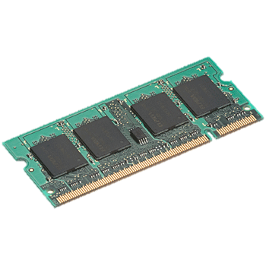
Use memory to store data
iter. 1
iter. 2
. . .
Input
query 1
one-time processing
query 2
query 3
Input
Distributed memory
. . .
10-100 times faster than the disk approach

Slide 9
Is memory computing feasible?

Slide 10
Issues
Is memory large enough to contain all the data?
How about the cost comparing to disks?
Fault-tolerance with memory?
How to represent the data in memory efficiently?
iter. 1
iter. 2
. . .
Input

Slide 11
Many big data problems has its upper bound
Number of human beings
10G, the size of the social network is around 10TB
Features of a user
1M
Number of products
~1M
Yesterday’s big data problems may be just today’s small data problem

Slide 12
Moore’s law and memory cost
1980: Memory $10,000/MB
A single machine with TB memory is common
Memory Cost / Speed
2000: Memory $1/MB
2013: Memory $0.004/MB
Time
Source: Cao et al. In-Memory Database Platform for Big Data
Notes:
DRAM costs are dropping about 32% every 12 months. Things are getting bigger, and costs are getting lower. If you looked at the price of a Dell server with a terabyte of memory three years ago, it was almost $100,000 on their internet site. Today, a server with more cores — sixteen instead of twelve — and a terabyte of DRAM, costs less than $40,000

Slide 13
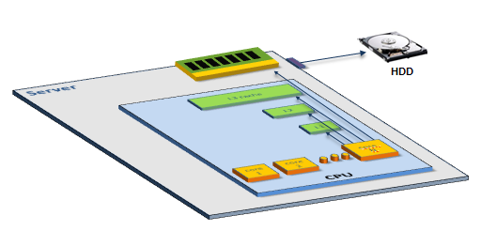
Memory latency
CPU
Core
Core
L1 Cache
L1 Cache
0.5 NS
L2 Cache
L2 Cache
7.0 NS
DRAM is 100,000 faster than disks， but still is 6-200 times slower than on-chip caches
L3 Cache
15.0 NS
Main Memory
100 NS
Disk
SSD: 150K NS HD: 10M NS
Source: SAP

Slide 14
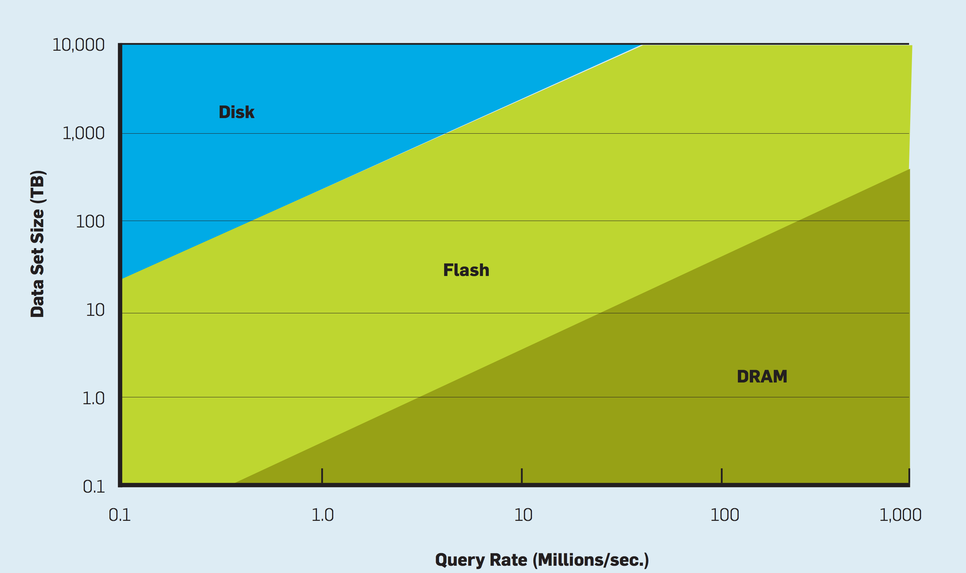
Performance/cost ratio with the data size and query rate
Notes:
3年TCO

Slide 15

Tape is Dead Disk is Tape Flash is Disk RAM Locality is King
Jim Gray
Microsoft
December 2006
In memory of Jim Gray
Notes:
lost at sea January 28, 2007

Slide 16
Issues
Is memory large enough to contain all the data?
How about the cost comparing to disks?
Fault-tolerance with memory?
How to represent the data in memory efficiently?
iter. 1
iter. 2
. . .
Input

Slide 17
AN Example of in-memory computing Spark

Slide 18
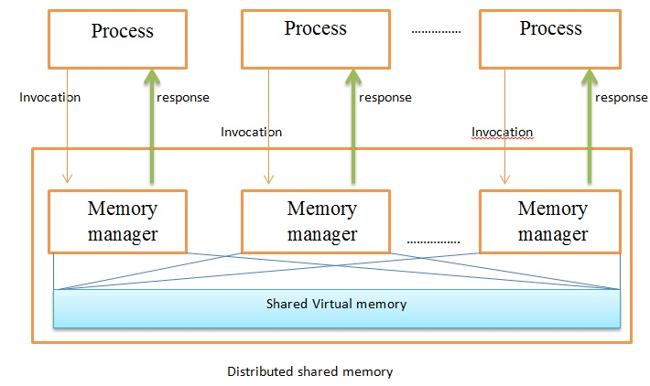
Abstractions on memory of multiple machines
Distributed Shared Memory
Unified memory space
Difficult for fault tolerance

Slide 19
Abstractions on memory of multiple machines
Distributed Key-Value store（Piccolo，RAMCloud, Redis）
Allow fine-grain accesses, mutable
Big fault-tolerance overhead
Replica in memory
Erasure code
Backup in persistent storage for each write
Notes:
What are the problem of each way?

Slide 20
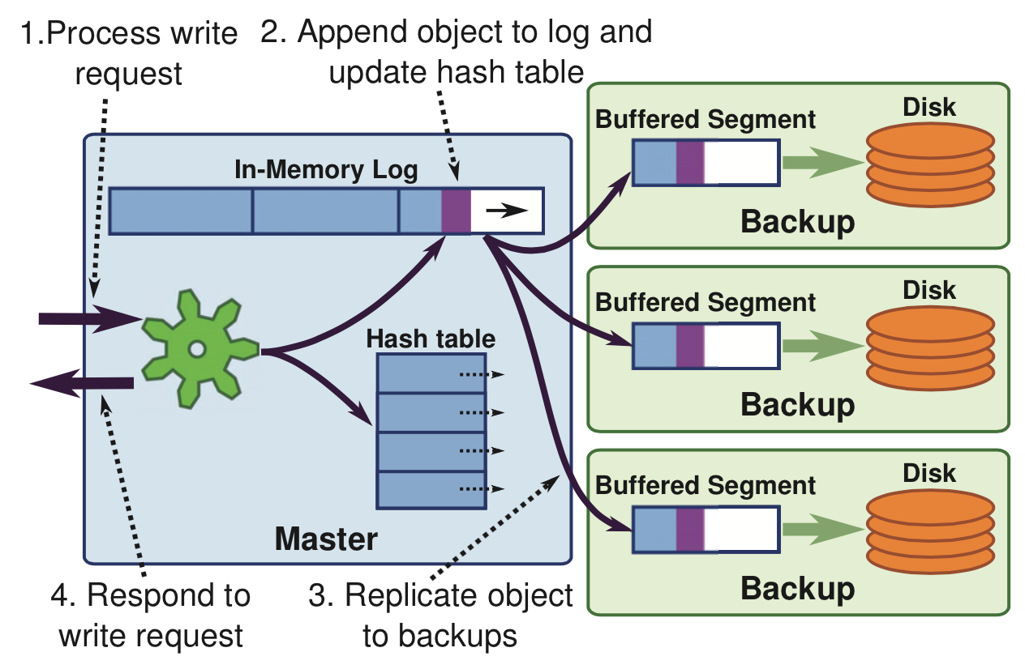
RAMCloud Approach: Buffered Logging
Optimization: Log truncate and memory sharding

Slide 21
Fault tolerance mechanism of DSM or Key-value stores
Replica or Log
Big overhead for data intensive applications
10-100 times slower than local memory accesses

Slide 22
Solution
RDD（Resilient Distributed Datasets ）
Based on data sets, instead of single data
Generated with deterministic coarse grained operations（map，filter，join etc.）
Immutable
To modify data, create new datasets by transformation

Slide 23
Efficient Fault Tolerance
Once the data is generated deterministically, and immutable
Recover the data from “recompute”
Only need to log the sequences to generate rdd. small cost if there’s no fault happens
messages = textFile(...).filter(_.contains(“error”))
.map(_.split(‘\t’)(2))
HadoopRDD
path = hdfs://…
FilteredRDD
func = _.contains(...)
MappedRDD
func = _.split(…)
Notes:
只要记住rdd的生成过程就可以了，这样一次log可以用于很多数据，在不出错的时候几乎没有开销
2 means get the second column

Slide 24
Big data systems
Programming
Model
Fault
Tolerance
Performance/
Cost

Slide 25
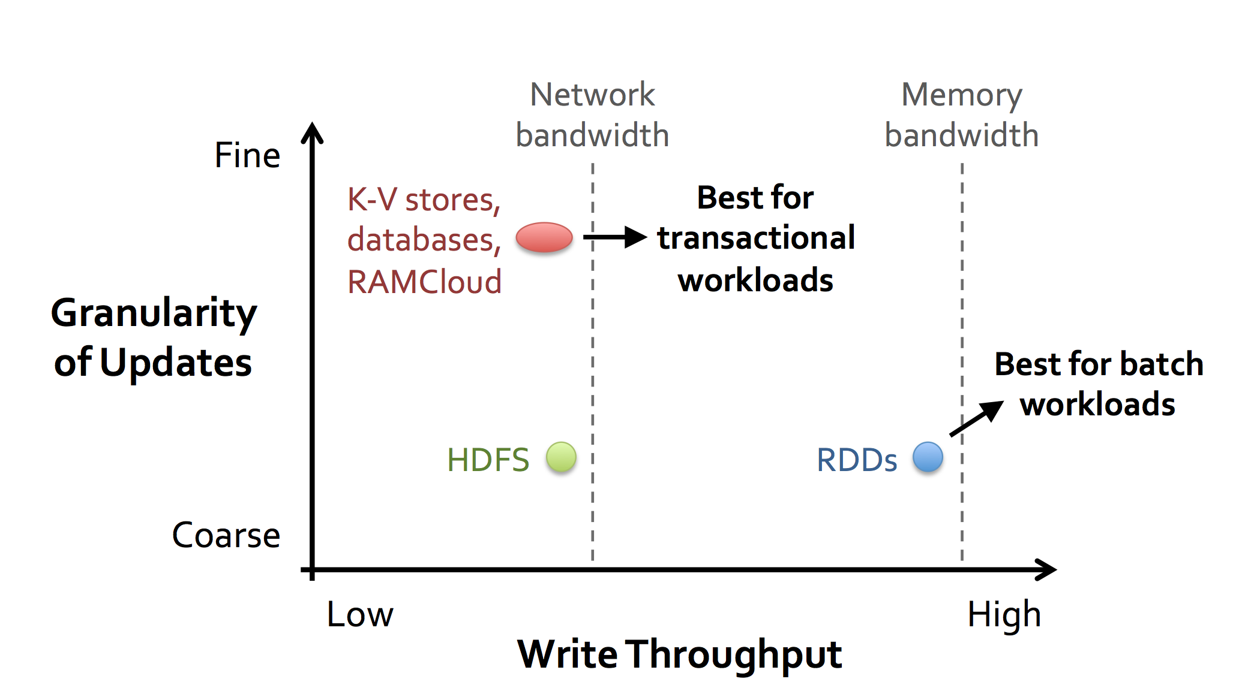
Spark Design Philosophy

Slide 26
Spark programming interface

Slide 27
Programming API
Based on Scala
A Java-like functional language
Can use spark in the Scala concole
Now support Java and Python
RDD operations
Transformation：generate new RDDs from existing RDDs
map, filter, groupBy, sort,distinct, sample…
Action: return a value from RDD
reduce，count, collect, first, foreach…，,

Slide 28
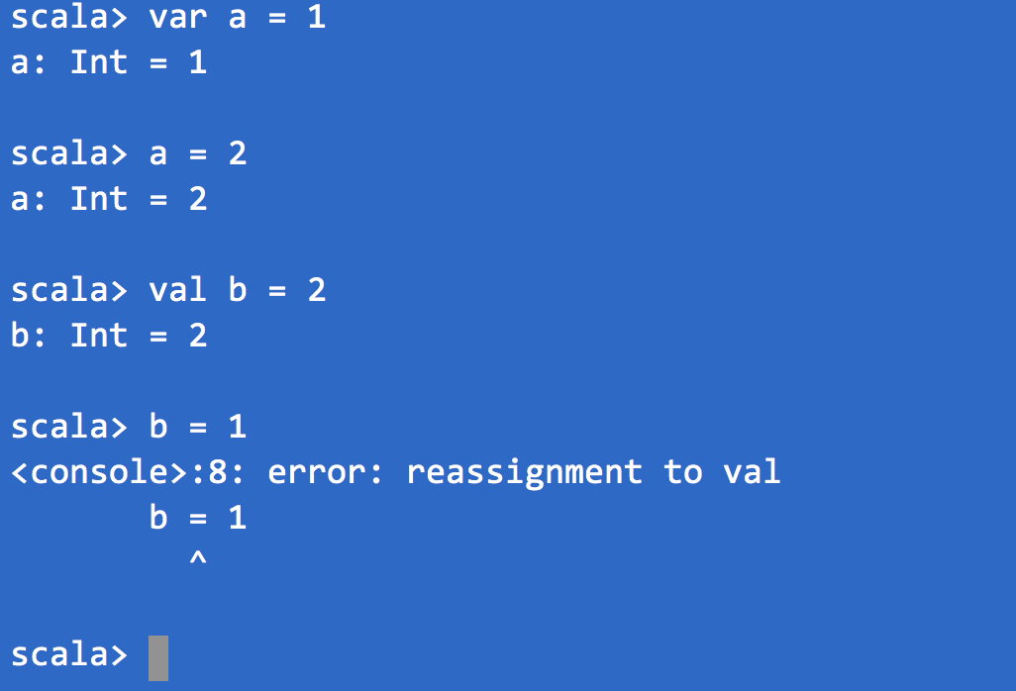
Scala Expressions
Expressions and values
var a = 1 //Mutable
val b = 2 // Immutable

Slide 29
Scala - Functions
def helloWord()={ println(“Hello World”)}
def addOne(x:Int) = {
x+1
}
def addOne(x:Int) = x+1
val addOne = (x:Int) => x + 1

Slide 30
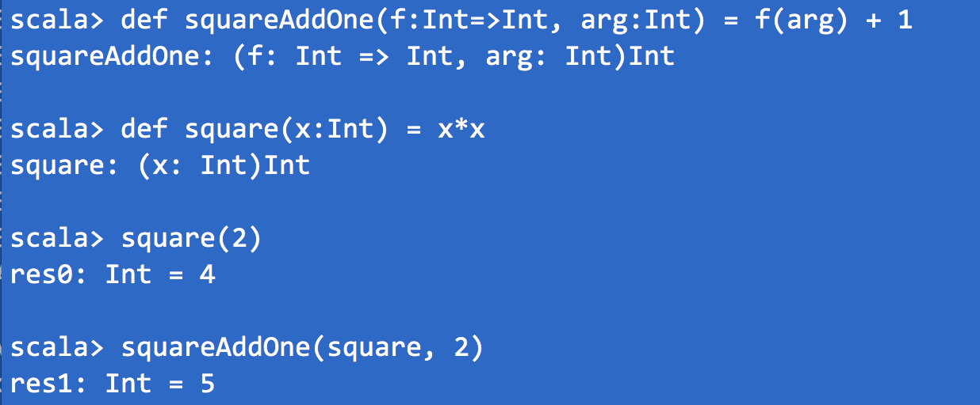
Scala Functions
Pass a function as a parameter

Slide 31
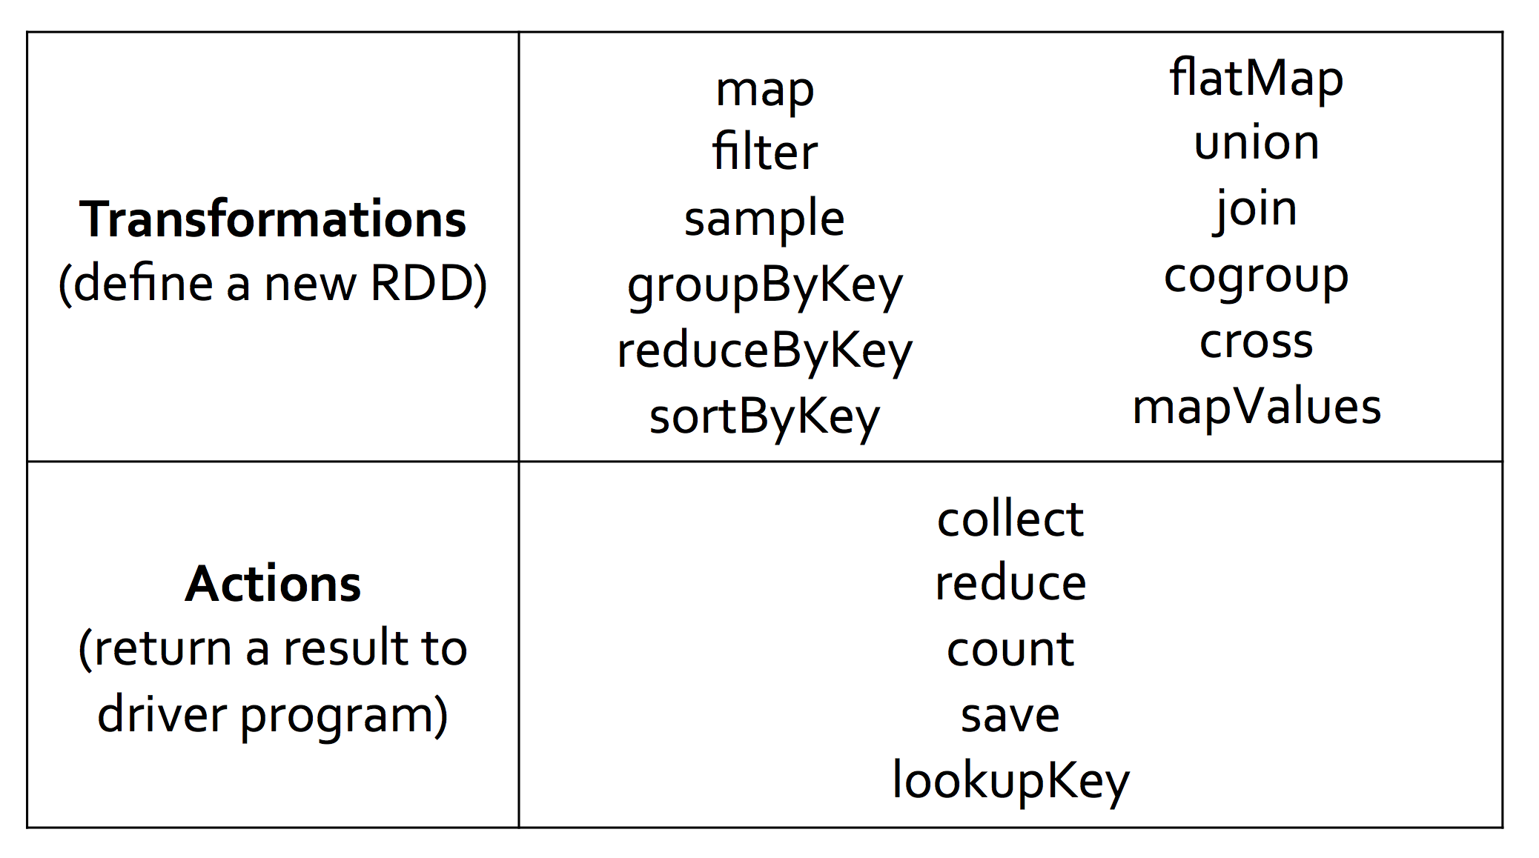
Spark Operators
http://spark.apache.org/docs/latest/programming-guide.html#rdd-operations
Notes:
FlatMap 即每一项可能返回多个同一类型的值

Slide 32
How to create RDDs
From Collection
val a = sc.parallelize(1 to 9, 3)
from File val b = sc.textFile(“/path/to/file”)
from other RDDs val c = b.map(line => line.split(“,”))
Notes:
Parallelize is a spark method to form a distributed dataset , 3 is the number of partitions

Slide 33
Map
Map each element in source RDD to ONE element in destination RDD
scala> val a = sc.parallelize(1 to 9, 3)
^{scala> val b = a.map(x => x*2)}
^{scala> a.collect}
res10: Array[Int] = Array(1, 2, 3, 4, 5, 6, 7, 8, 9)
^{scala> b.collect}
res11: Array[Int] = Array(2, 4, 6, 8, 10, 12, 14, 16, 18)

Slide 34
flatMap
One element in source rdd will be transformed to multiple elements(0..n) in destination rdd
scala> val a = sc.parallelize(1 to 4, 2)
scala> val b = a.flatMap(x => 1 to x)
^{scala> b.collect}
res0: Array[Int] = Array(1, 1, 2, 1, 2, 3, 1, 2, 3, 4)

Slide 35
reduce
Defines a function to combine two elements in a collection to one elements, and keep on applying it to elements in the collection
scala> val c = sc.parallelize(1 to 10) scala> c.reduce((x, y) => x + y)
^{res4: Int = 55}

Slide 36
reduceByKey
Reduce for key-value list
Values with the same keys are reduced, and form a new key-value
scala> val a = sc.parallelize(List((1,2),(3,4),(3,6))) scala> a.reduceByKey((x,y) => x + y).collect
res7: Array[(Int, Int)] = Array((1,2), (3,10))

Slide 37
Output
saveAsTextFile/saveAsSequenceFile/saveAsObjectFile
scala> val a = sc.parallelize(List((1,2),(3,4),(3,6)))
scala> a.reduceByKey((x,y) => x + y).saveAsTextFile(“test”)

Slide 38
Join
(k,v1) join (k, v2) ➔ (k, (v1, v2))
scala> val kv1=sc.parallelize(List((“A”,1),(“B”,2),(“C”,3)))
scala> val kv3=sc.parallelize(List((“A”,4), (“A”,5),(“B”,3),(”D”,30)))
^{scala> kv1.join(kv3).collect}
^{scala> kv1.union(kv3).collect}
Array[(String, (Int, Int))] = Array((A,(1,4)), (A,(1,5)),(B,(2,3)))
Array((A,1), (B,2), (C,3), (A,4), (A,5), (B,3), (D,30))

Slide 39
Use of _
^{val a = ( 1 to 9 )}
^{Val b = a.map( x => x*2 )}
is the same as val b = a.map( _ * 2)
val a = sc.parallelize(List((1,2),(3,4),(3,6))) a.reduceByKey((x,y) => x + y).collect is the same as a.reduceByKey(_+_).collect

Slide 40

Log Mining
Loading data from memory, than query the data interactively
Base RDD
Cache 1
lines = spark.textFile(“hdfs://...”)
errors = lines.filter(_.startsWith(“ERROR”))
messages = errors.map(_.split(‘\t’)(2))
cachedMsgs = messages.cache()
Transformed RDD
Worker
results
tasks
Block 1
Driver
Action
cachedMsgs.filter(_.contains(“foo”)).count
cachedMsgs.filter(_.contains(“bar”)).count
Cache 2
Worker
. . .
Cache 3
Performance: 1TB data with in 5-7 seconds
Disks: 170s
Worker
Block 2
Block 3
Notes:
Add “variables” to the “functions” in functional programming

Slide 41
Logistic Regression
val data = spark.textFile(...).map(readPoint).cache()
var w = Vector.random(D)
for (i <- 1 to ITERATIONS) {
val gradient = data.map(p =>
(1 / (1 + exp(-p.y*(w dot p.x))) - 1) * p.y * p.x
).reduce(_ + _)
w -= gradient
}
println("Final w: " + w)
Load data in memory once
Initial parameter vector
Repeated MapReduce steps to do gradient descent
Notes:
Key idea: add “variables” to the “functions” in functional programming

Slide 42
Logistic Regression Performance
127 s / iteration
first iteration 174 s
further iterations 6 s
Notes:
This is for a 29 GB dataset on 20 EC2 m1.xlarge machines (4 cores each)

Slide 43
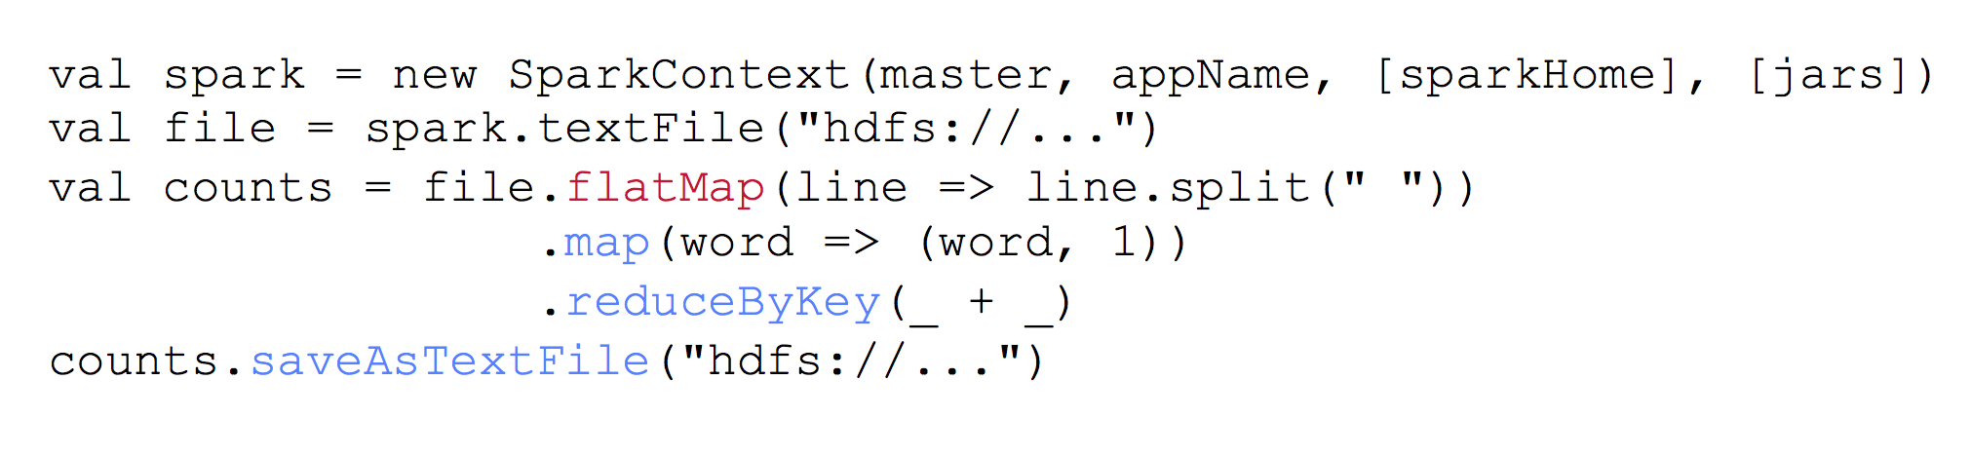
Example：WordCount
Notes:
flatMap，将一个成员映射为0个到多个成员
（word,1)是个键值对

Slide 44
Spark Implementation

Slide 45
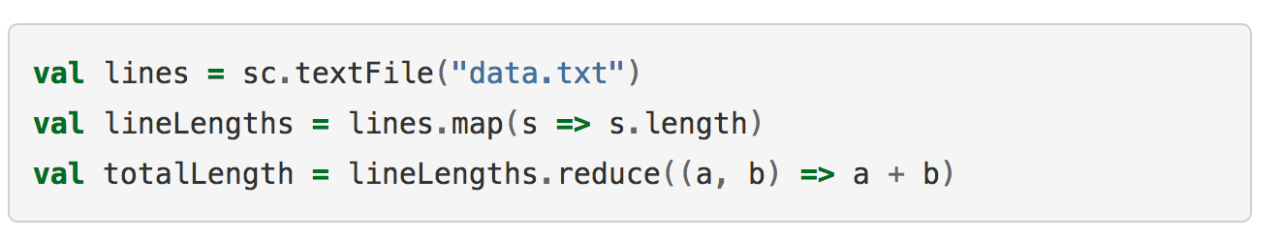
Lazy Evaluation
lines
data.txt
map
lineLengths
func = _.contains(...)
reduce
totalLength
Transformations do not trigger computation
The last reduce will trigger computation and generate the DAG

Slide 46
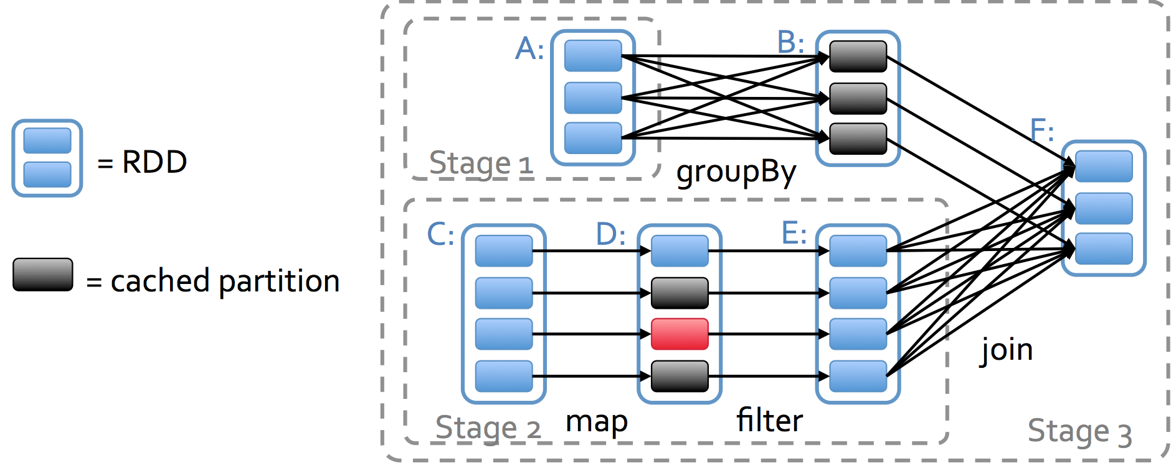
Complex DAGs

Slide 47
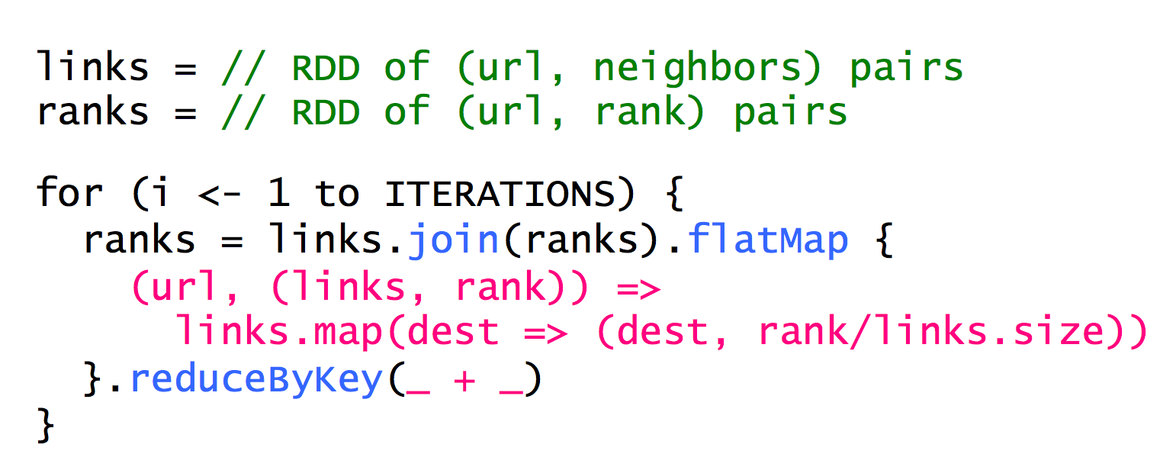
Data Partition

Slide 48
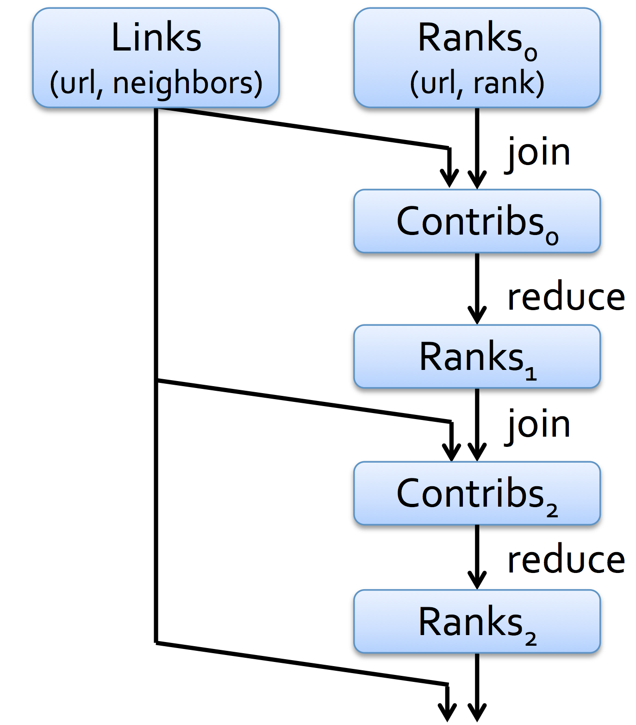
Optimization on Data Partition
Links and Ranks joins multiple times
Partition the links and ranks with sample url together would avoid unnecessary communications
partitionBy() are used to define how to partition data

Slide 49
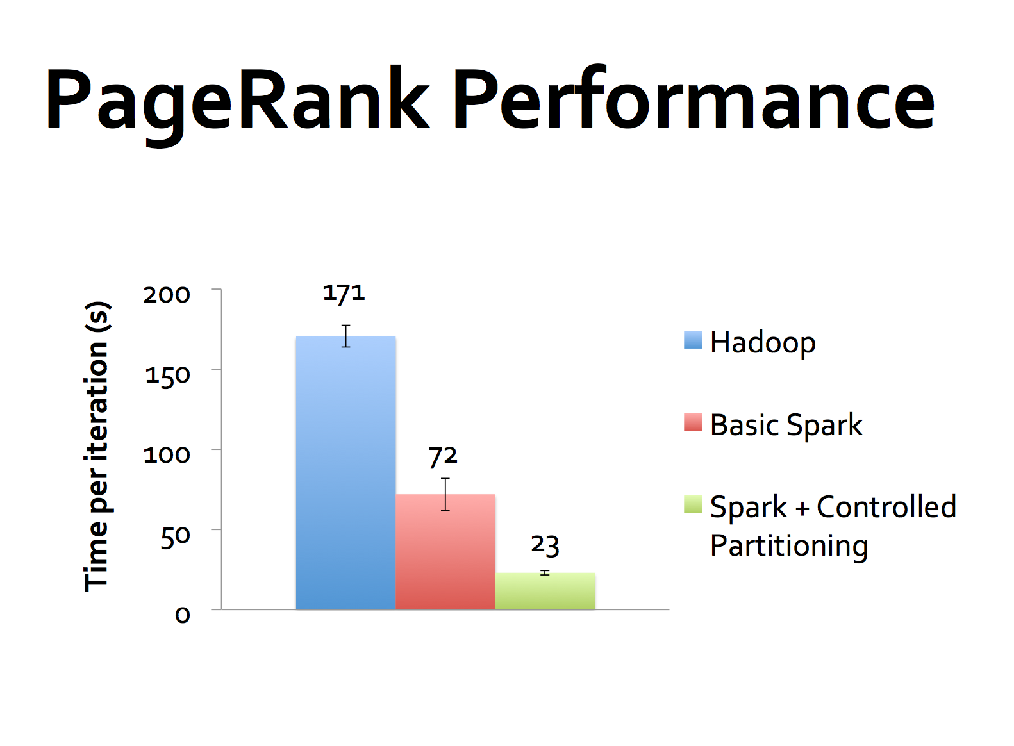

Slide 50
Persist and Cache
Cache the message, means the data would be reused in the future and try to maintain it in the memory
Avoid recalculation
Cache is a special case for Persist
lines = spark.textFile(“hdfs://...”)
errors = lines.filter(_.startsWith(“ERROR”))
messages = errors.map(_.split(‘\t’)(2))
cachedMsgs = messages.cache()
cachedMsgs.filter(_.contains(“bar”)).count

Slide 51
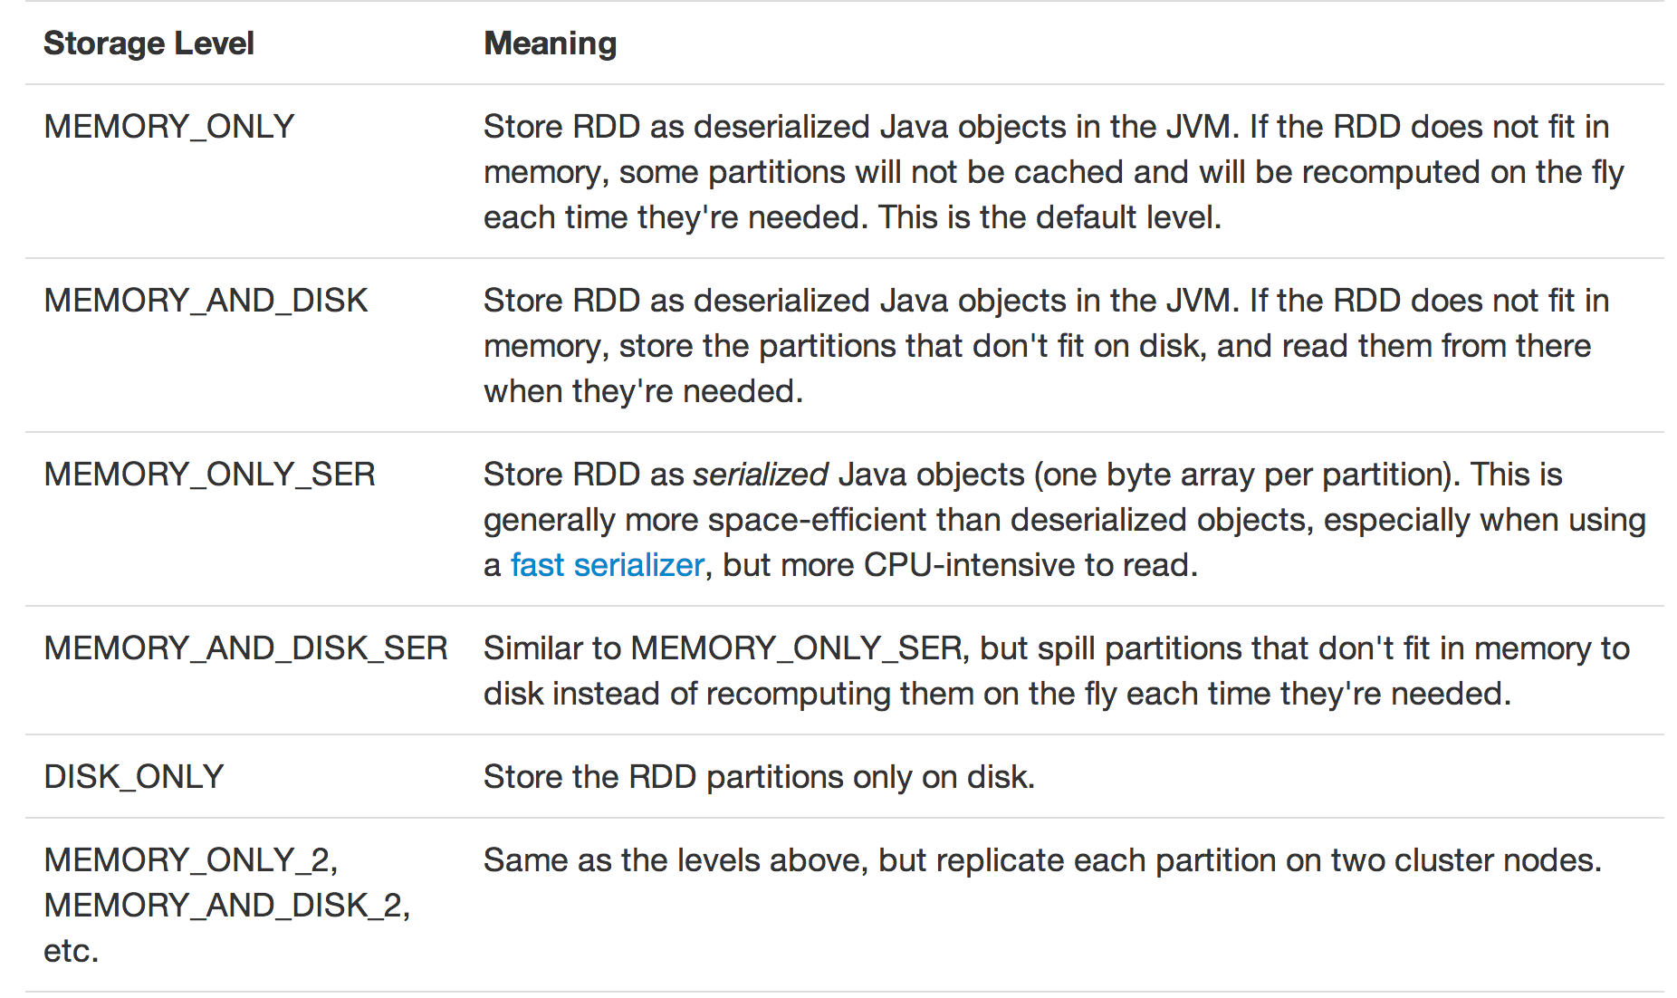

Slide 52
Spark ecosystem

Slide 53
Existing Big data system
Giraph
Pregel
Dremel
Drill
Tez
MapReduce
Impala
GraphLab
Storm
…
S4
General systems for
Batch processing
Special system
(Iterative, interactive and streaming)

Slide 54
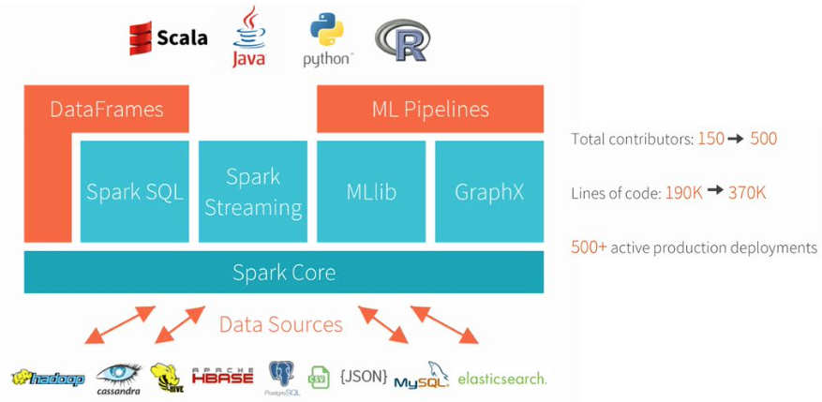
The methodology of Spark
Generalized MapReduce
Sharing the data and task DAGs
Unified Programming Framework

Slide 55



Benefit of Using Spark
With different platforms
HDFS read
ETL
HDFS write
HDFS read
train
HDFS write
HDFS read
query
HDFS write
…
Spark:
Interactive analysis
HDFS read
ETL
train
query
HDFS

Slide 56
Limitations of Spark
Spark：RDD
BFS
Vertex Visited
.
.
.
RDD
Notes:
一个例子是图遍历，另一个是基于实时数据流的热词统计。右边这是Spark编程模型，这个方块代表数据集RDD，圆圈代表具体数据，对图遍历就是记录点的遍历进度的数据结构，对热词统计就是记录词频计数。
以图遍历为例，这个RDD保存着这些点遍历进度的数据结构，初始是0，遍历开始这个点变为1，需要更新，然后这两个点为2，这3个点为3，最后为4。
可以看到每次细粒度的数据更新，对于这种数据集读写的需求，由于spark基于粗粒度RDD只读的数据对象模型，需要RDD变换，即有大量数据的复制，导致处理效率不高。

