Slide 1
SPACE IMPACT
DEMO – PRESENTATION
GROUP 3L

Slide 2
State of Development
Main Menu View
Start Game option in menu
Level Selection (4 levels for now)
Game initiation (game starts, the view with the components shows up)
Player spaceship implemented (bullet amount, health, movement, shooting)
Shooting implemented
Enemy spaceships implemented (for now they only move downwards, if the player destroys the enemy spaceship, it disappears from the screen)
Collision detection implemented

Slide 3
Development Process
The ​ ​implementation ​ ​of ​ ​the ​ ​user​ ​interface ​ ​is changed ​ ​from​ ​canvas-only​ ​to ​ canvas​ ​with ​ ​activities. ​ ​This​ ​change ​ ​allows​ ​the ​ ​game ​ ​to be ​ ​smoother​ ​in ​ ​menu ​ ​transitions​ ​and ​ ​not ​ ​to ​ ​drain ​ ​battery​ ​by​ ​running ​ ​a ​ ​thread ​ ​at ​ ​every stage ​ ​of ​ ​the ​ ​game
We ​ ​canceled ​ ​the ​ ​implementation ​ ​with ​ ​a ​ ​separate ​ ​collision detection ​ ​object, ​ ​instead, ​ ​every​ ​object ​ ​interprets​ ​its​ ​own ​ ​collision ​ ​inside ​ ​their​ classes

Slide 4
Teamwork
The team work has not been the best that our group members individually can achieve, however this skill is relatively new to all of us and our team work will grow exponentially after this first iteration
Everyone has its own strengths in programming and from now on it is best for us to have a division in respect to skills of everyone.
Even when someone is not able to do what is assigned, searching for help from other members of the group helped our progress a lot
However, when certain members of the group show unwillingness to continue working, it is the other members of the group who take over the work so the project will be fully completed.

Slide 5
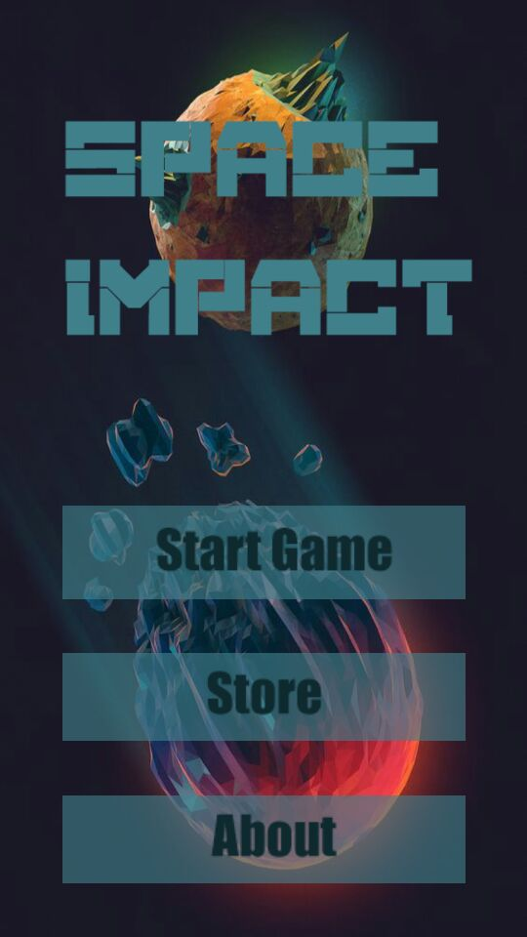
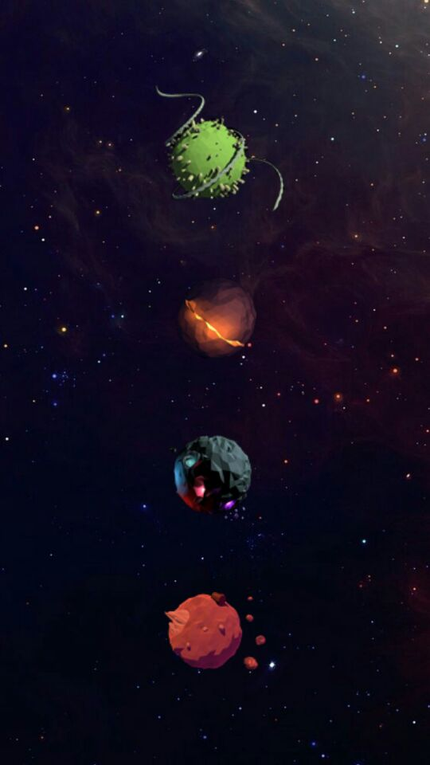
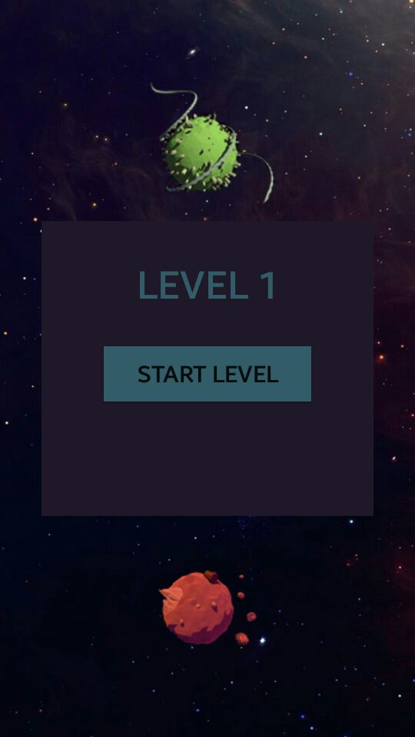
Screenshots (from actual game)
Main Menu
Levels screen
Level Selection

Slide 6
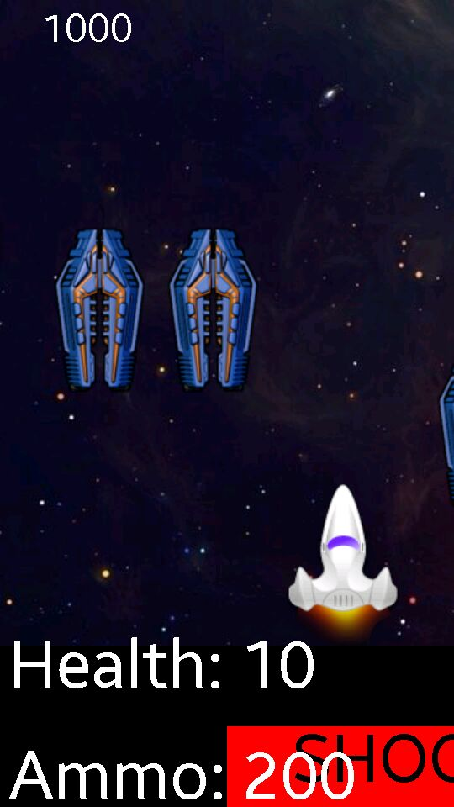
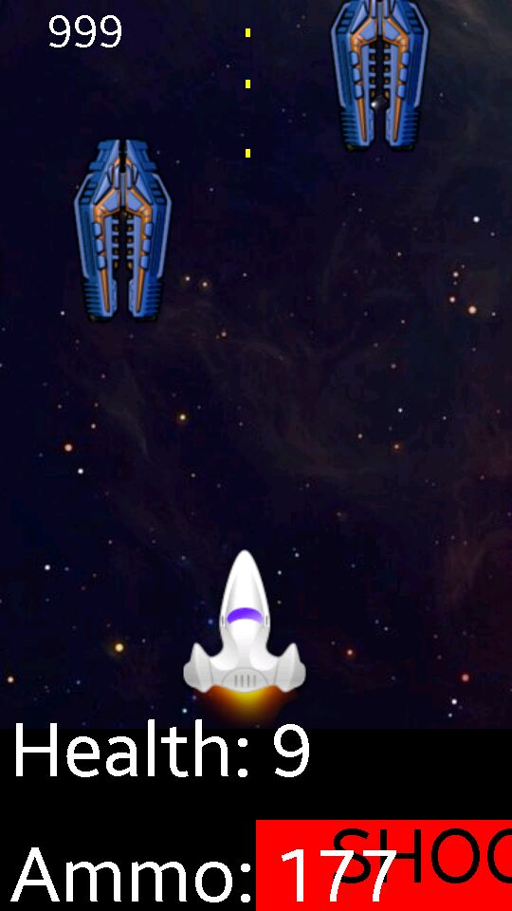
Gameplay
Player Shooting

Slide 7
Project Members (Group 3L)
Büşra ​ ​Arabacı ​ ​
Büşra ​ ​Oğuzoğlu
​Deniz​ ​Şen​ ​
Alperen ​ ​Kaya ​
​Gerard ​ ​Hysa

Slide 8
THANK YOU

