Slide 1
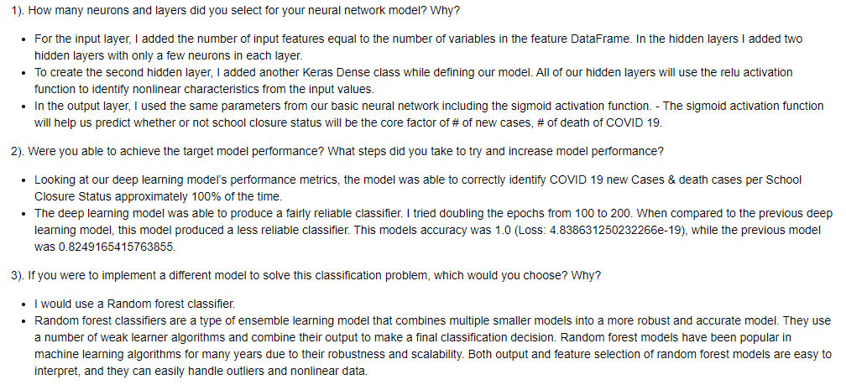
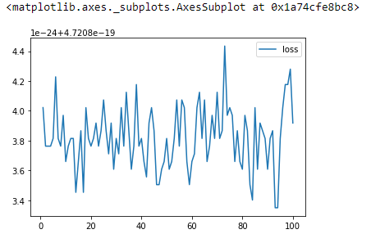



Machine Learning(Neural Networks and Deep Learning) Summary: School Closure & Covid 19

