Slide 1
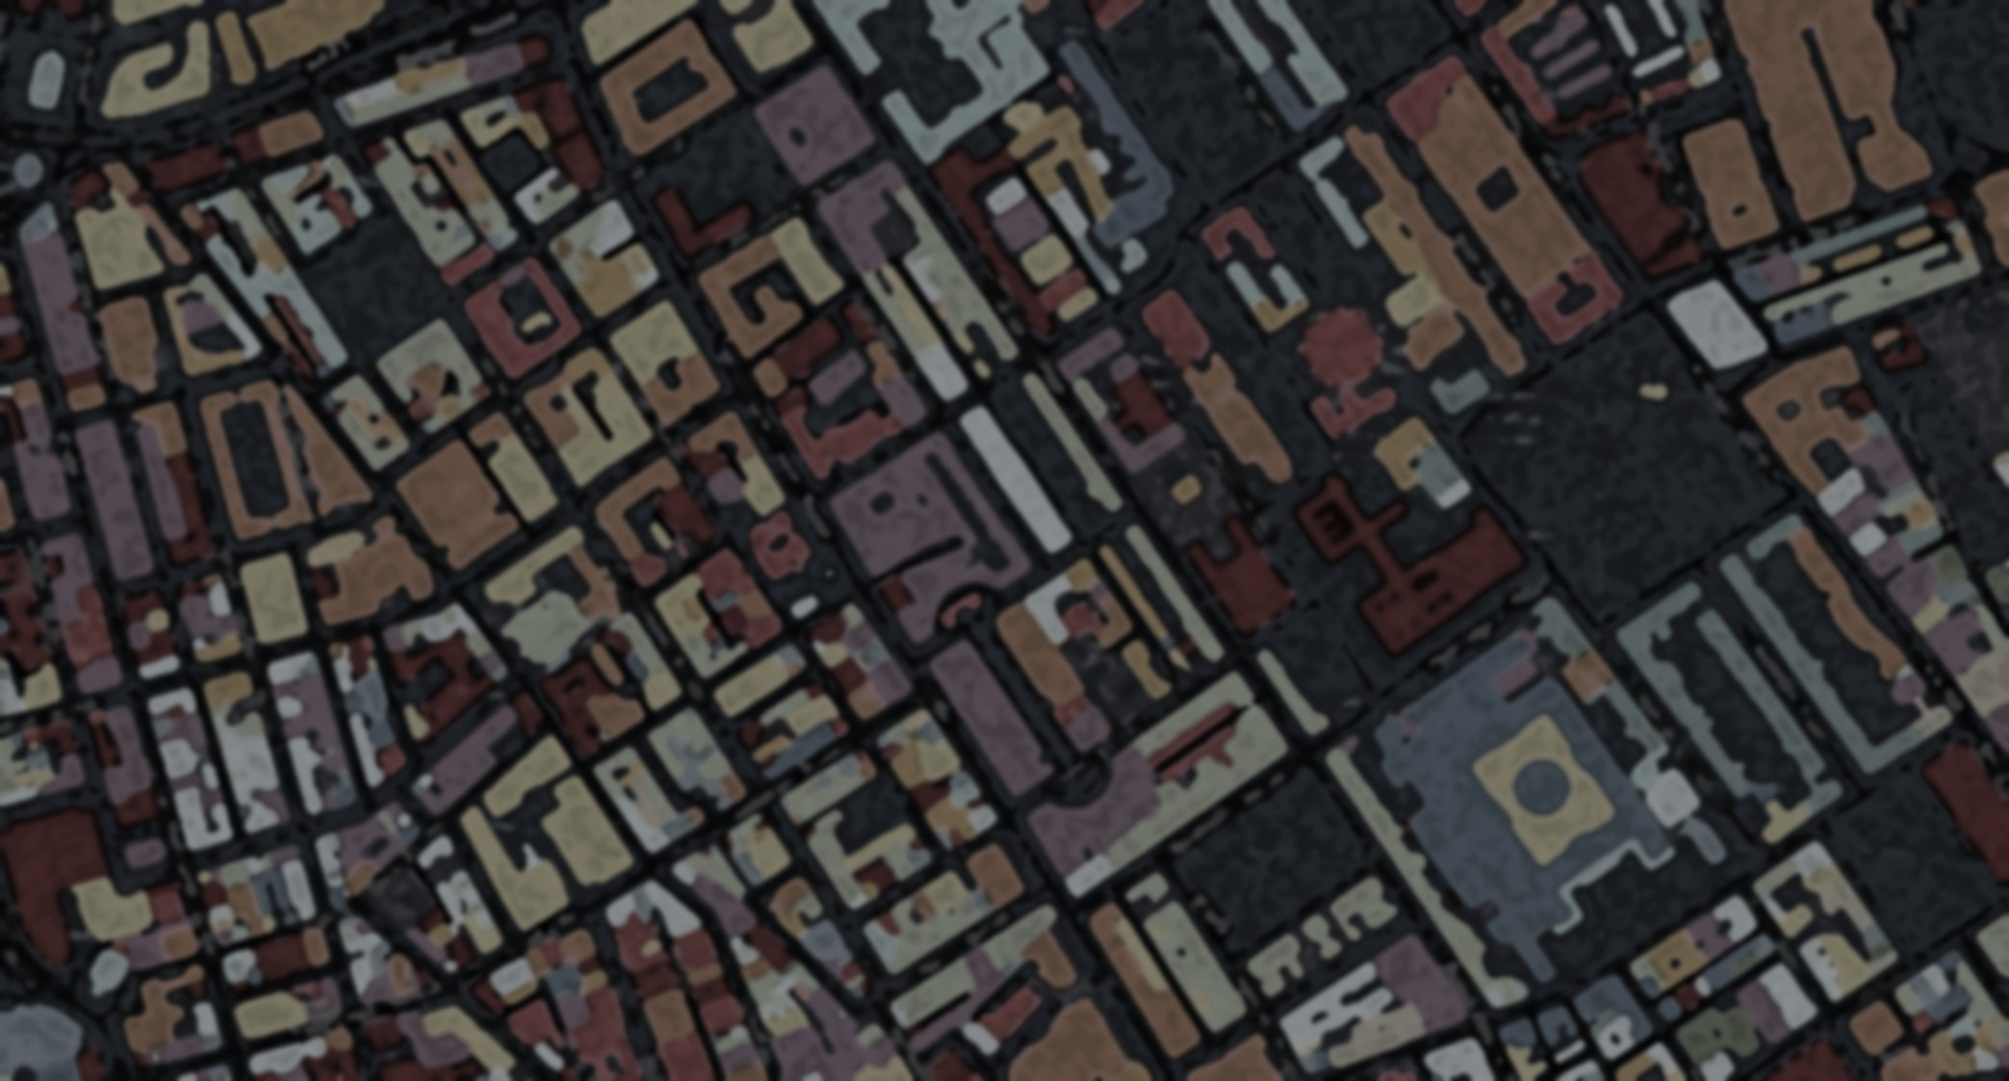
The Living City
Catalogue Globalization Overall Diversity Business Religion Summary
Diverse London
Visualize the urban diversity
“Urban Diversity”, as an important urban issue, is always discussed in different contexts, such as ethnic diversity and mixed land use. To some extent, the diversity of cities also reflects the inclusiveness of different groups or cultures. London has long been known for its diversity, and the government has also been committed to it. Do you want to know what a diverse city London really is?
Creators: Zunhao ZHANG, Yi ZHOU, Yuwei GU, Shengming WANG @Group 4, CASA0003, Bartlett, University College London 27th May
Map Engine: Mapbox GL JS Github: @Group4LondonDiversity Image is from the screen shot of Colouring London @ CASA

Slide 2






Catalogue
Globalization Background:
Migration flows from different parts of the world to UK
Overall Diversity:
The Simpson’s Diversity Index Scores on 6 socio-economic categories based on all LOSAs across London.
Business Diversity:
The business diversity on the employment of different economic sectors and the land use of the business floor space
Religious Diversity:
The geographical distribution of different religious buildings
Summary:
A comprehensive ranking of all aspects of diversity involved in this research

Slide 3


右边导航栏ICON顺序

